Slide 1
IACLE’s Resources
– An Overview –
Hyderabad, 2017
Lewis WILLIAMS & Nilesh THITE
(Optometrist, PhD Optometrist, MOptom)
The IACLE Secretariat’s EDUCATION Team

Slide 3
IACLE Offers…
As well as helping contact lens (CL) educators expand their knowledge and skills, IACLE also provides them with useful
resources.....
Notes:
12
12

Slide 4
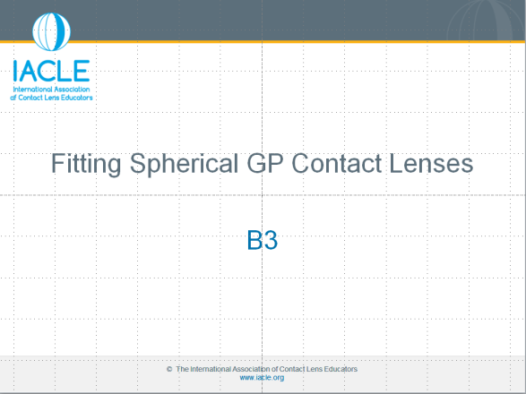
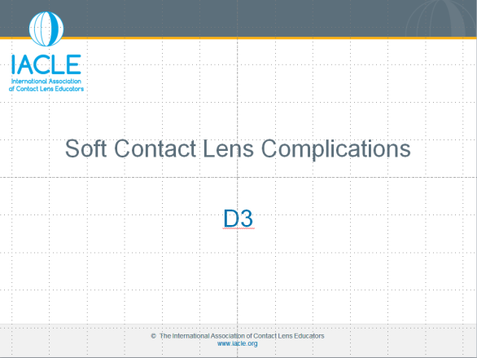
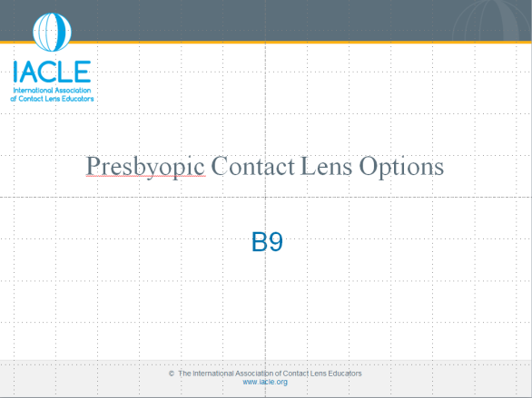
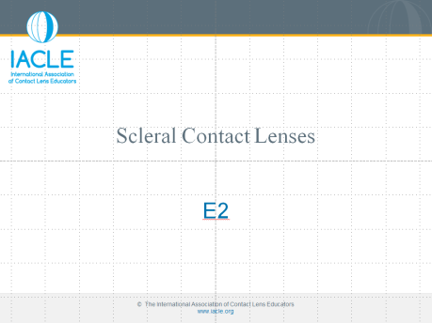
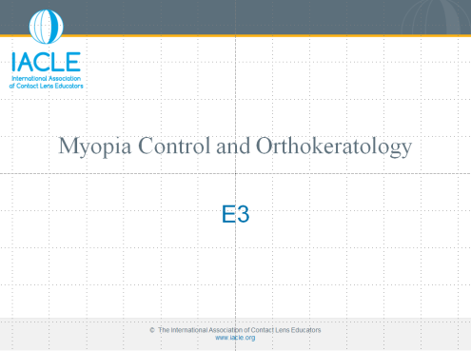
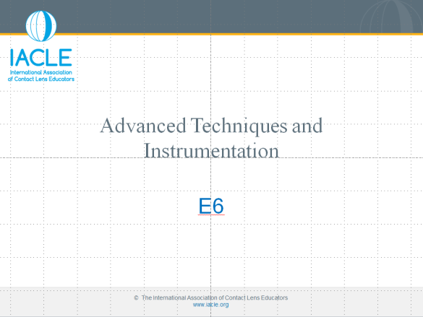
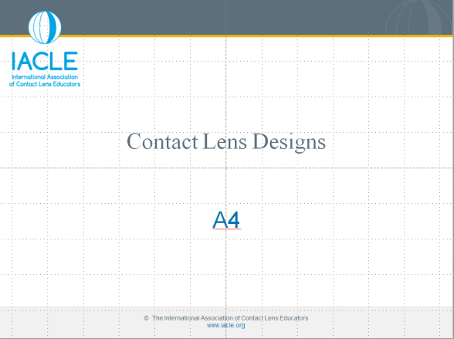
The IACLE Contact Lens Course (ICLC)
Version 2
(29/30 completed)
(PPT only, full colour)
(member-downloadable)
Notes:
12
12

Slide 5
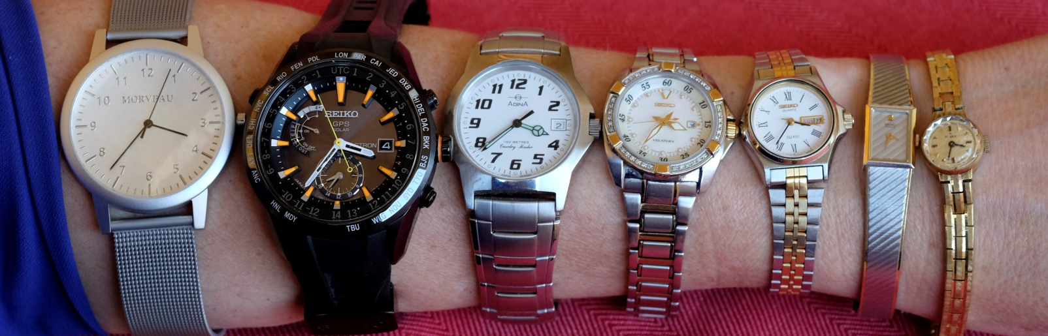

Presbyopes: Female Presbyopes
37 33 29 23 20 9 x 13 11
Dial diameters (mm):
Is female presbyopic vision superior?
The watch industry
seems to think so but…
Other ‘uses’:
Status symbol ($$$?)
Useful bangle/bracelet
Bling/decoration
Other
…are watches for
telling time anymore?
Visual ergonomics
are also important
Notes:
Morgan P. Sight over Forty. A study & publication sponsored by Bausch & Lomb

Slide 6



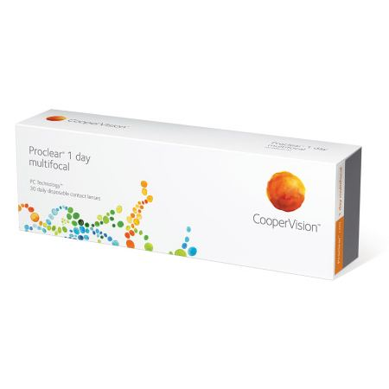

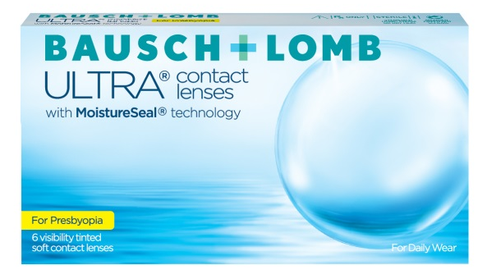
Daily Disposable PPLs
Convenient
Part-time wear
No CL care products
Targeted materials for ‘dry eye’
Easy to fit / assess?
  centred YES / NO
Limited parameters (currently)
    all ‘Universal Fit’
    single ‘effective add’
      exception clariti 1 day

Slide 7
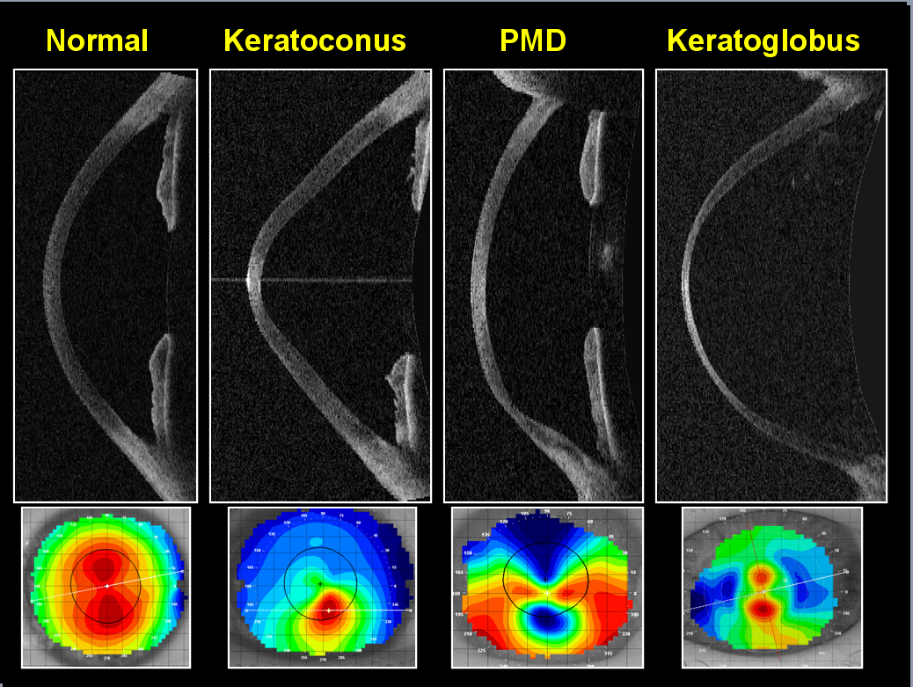
Corneal Topography vs Corneal OCT
Notes:
Credit: Caroline P, André M, 2010. Piggybacking Keratoglobus. CL Spectrum. 24: Dec Issue, back page.
Four characteristic corneal types are presented with their respective OCT & topographical maps.

Slide 8
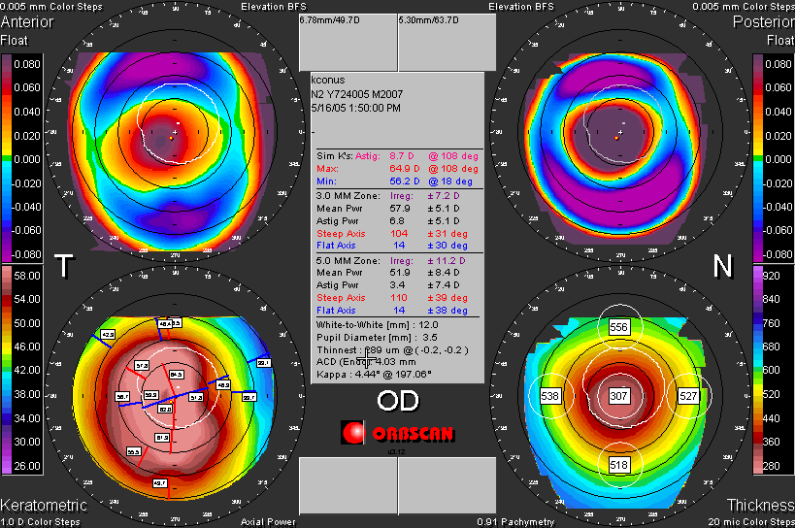
Post-Corneal Surgery CL Fitting
Failed LASIK: Post-Surgical Corneal Topography
(Secondary Ectasia)
Notes:
These maps emphasize the aggressive nature of secondary ectasia.
The onset of the corneal degenerative changes can be soon after the refractive surgery or can occur years down the road.
In order to attempt to prevent this from happening, Lasik surgeons attempt to leave a stromal bed of at least 400 microns. Note in the lower left map of the image (thickness) only 307 remains at the corneal apex.

Slide 9
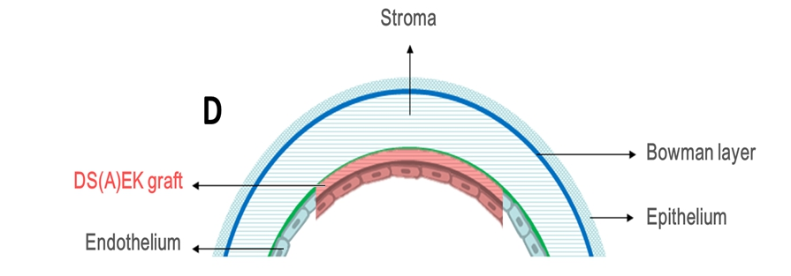
DSAEK (DSEK): Schematic
Notes:
A thin layer of posterior stroma, the DM, & the corneal endothelium are transplanted.

Slide 10
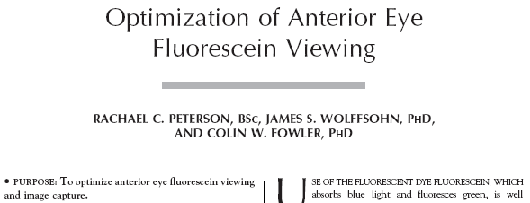
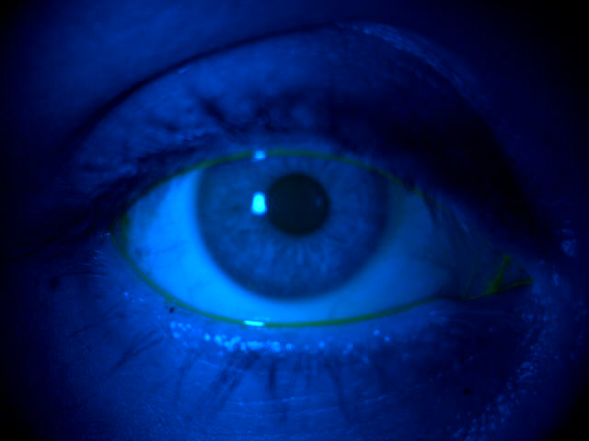
Digital Imaging: Fluorescein Excitation
Ideal spectral radiance (blue) to excite fluorescein is 495 nm, but most slit-lamps have a cobalt blue filter that peaks @ around 450nm
The raw result
Images courtesy of Optometry, Aston University
Notes:
Peterson RC et al., 2006. Optimization of Anterior Eye Fluorescein Viewing. Amer J Ophthalmol. 142(4): 572 – 575.

Slide 11
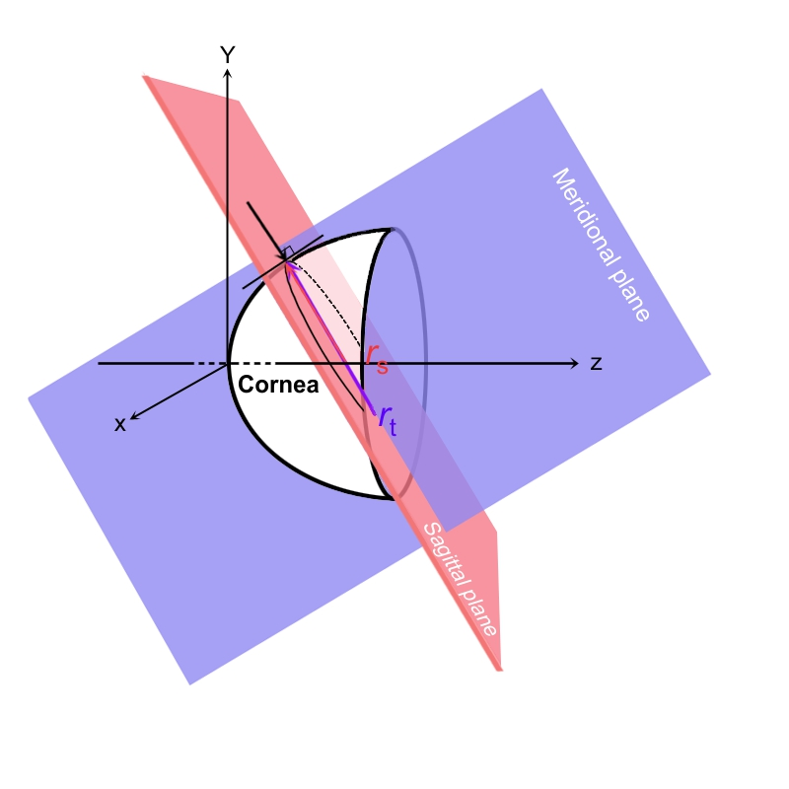
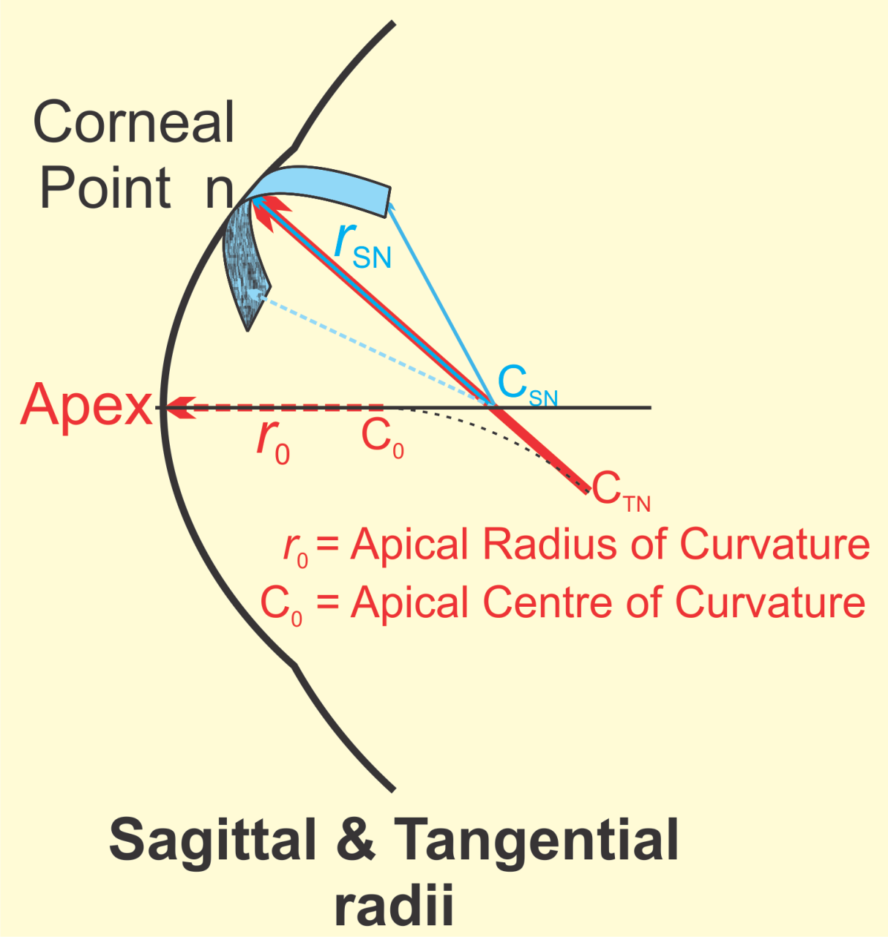
Corneal Maps: Concept of Sagittal & Tangential Radii
Diagram courtesy of:
Dr Vinod Maseedupally
ROK Group, SOVS, UNSW
(see next slide)

Slide 12
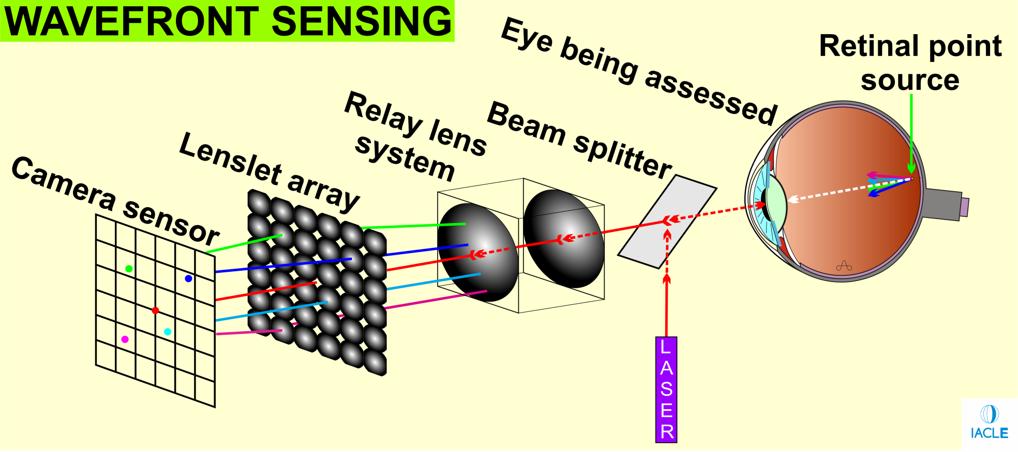
Aberrometry: Principles of Wavefront Sensing
Hartmann-Shack wavefront sensor
Point source created in the retina, light exiting the eye is captured by a camera after passing through an array of lenslets. The camera image is analyzed for pattern regularity

Slide 13
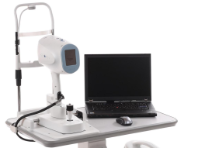
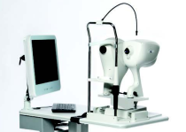
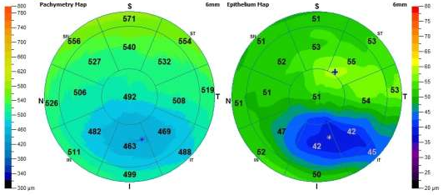
Retinal OCT: Mapping the Epithelium
In 2017 (August ), Optovue got FDA (USA) approval for their Cornea Advance module for their iVue and iFusion OCTs. Cornea Advance offers corneal, stromal, & epithelial thickness mapping (epi-mapping). While optical pachymetry was able to ‘estimate’ epithelial thickness, it required great expertise and was error-prone. The ability to measure corneal epithelial thickness objectively will be welcomed by those working in corneal pathology and ocular surface disease
Optovue iFusion OCT
Optovue iVue OCT
Images courtesy of
BOC Instruments, Australia

Slide 14
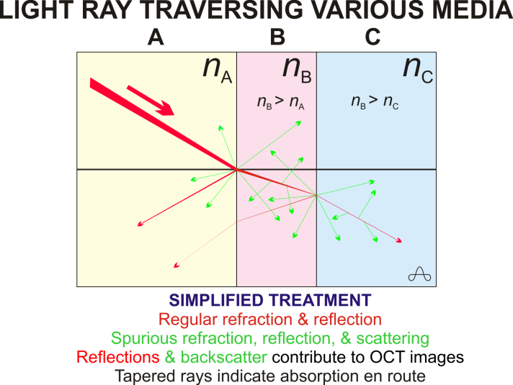
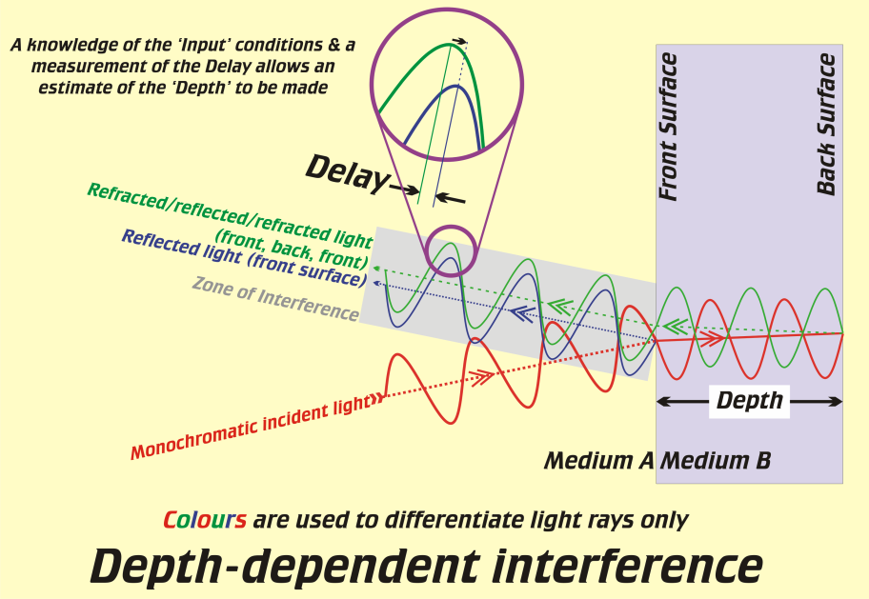
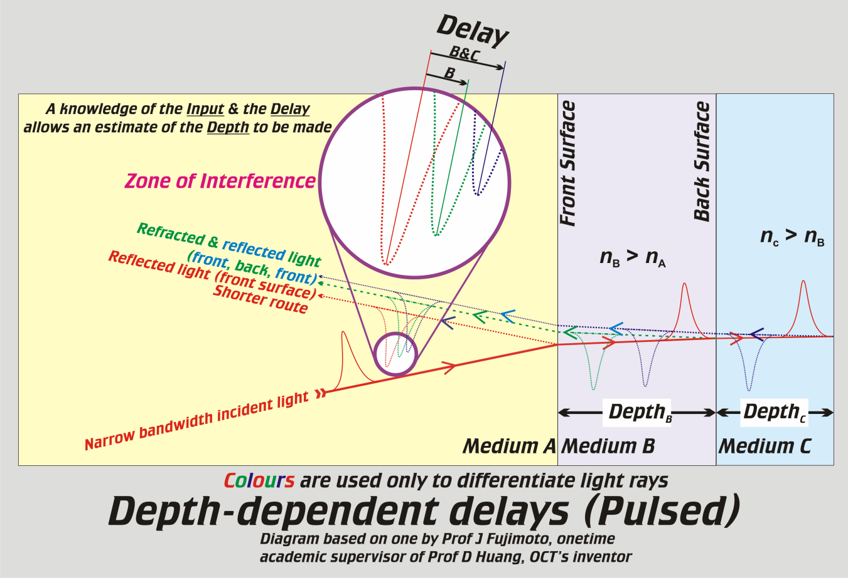
Optical Coherence Tomography (OCT): Technique cont’d
Notes:
RADAR = RAdio Detection And Ranging

Slide 15
The IACLE Contact Lens Course (ICLC) is NOT…
A collection of ready-to-use lectures
A collection of just-adequate, cut-down presentations
A recipe book of how & what should be taught
The final word on each of the subjects presented
An office decoration or bookcase filler
  rather it is intended to be used on a regular basis
Notes:
12
12

Slide 16

The ICLC (Version 1 & 2) is Intended for the World
Globes by Rocka Graphics
Selected lectures have been translated into non-core languages by IACLE members
Notes:
12
12

Slide 17
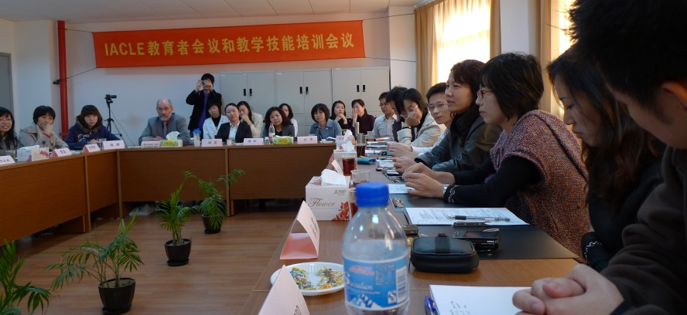
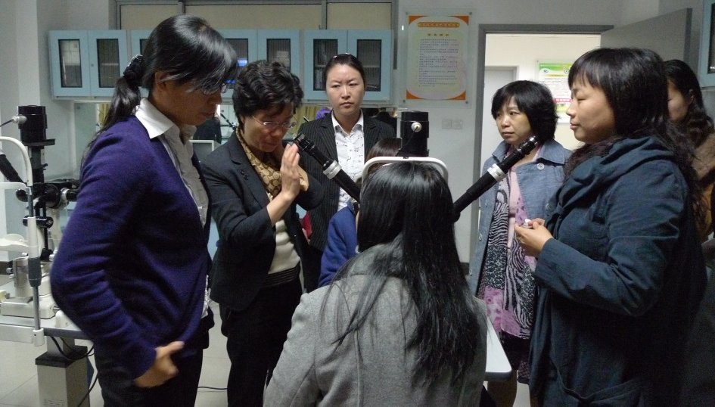
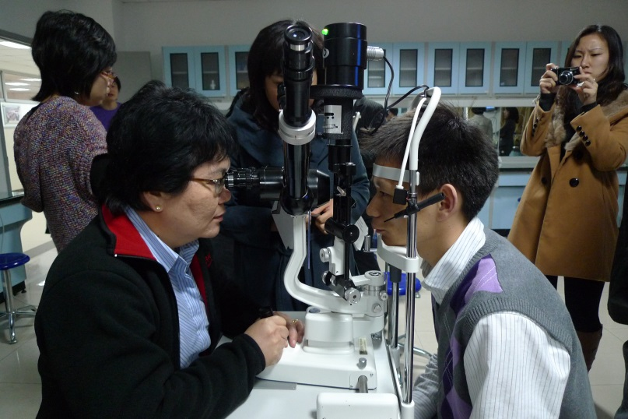
IACLE’s Educator Meetings & Train-the-Trainer Events
Where possible, topics are chosen to address the regional ‘needs’ identified through the Fellowship Exam & the STE
Local industry support – trial CLs & CL care product samples
Industry Professional Services Staff attend (to teach & learn)
Shanghai, China
Notes:
12
12

Slide 18
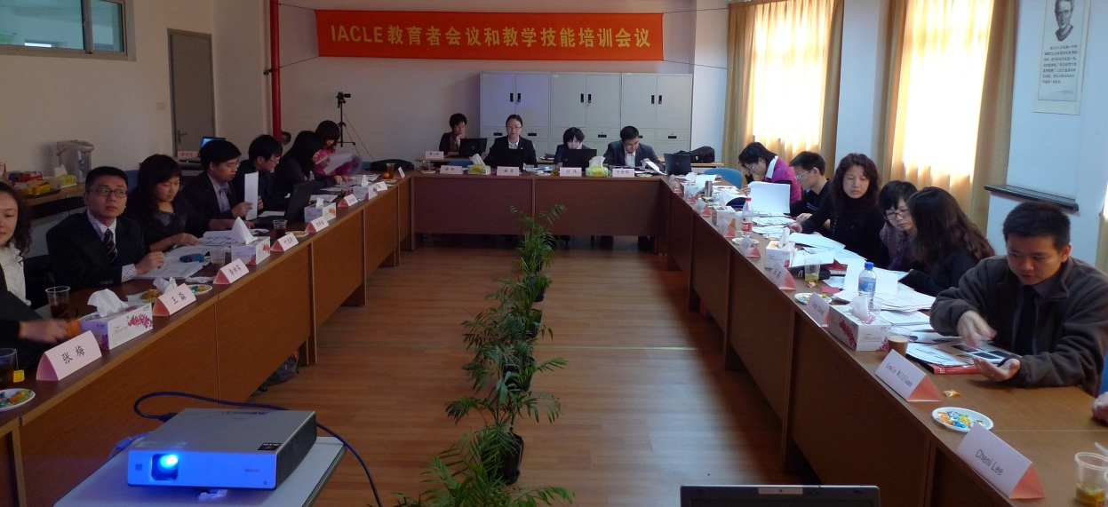
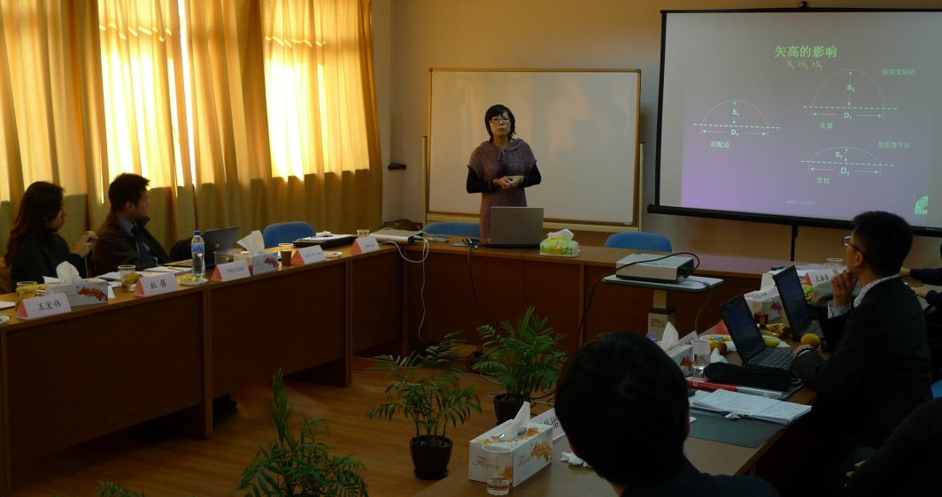
IACLE’s Educator Meetings & Train-the-Trainer Events
ATTEND
Participate as ‘faculty’ if you can contribute
Acquire new knowledge, &...
Use it to improve/evolve your
own CL course
Meet new colleagues
Notes:
12
12

Slide 19



The IACLE STE
Suggested for final year/senior students, shortly before their final CL examination
Available in 6 languages → English, Chinese, Bahasa, Korean (some), French, Spanish, & German
Candidates each receive a confidential performance report, indicating their scores for each sub-section of the exam
Educator receives a Results Summary & an indication of their student group’s Strengths & Weaknesses
Notes:
12
12

Slide 20
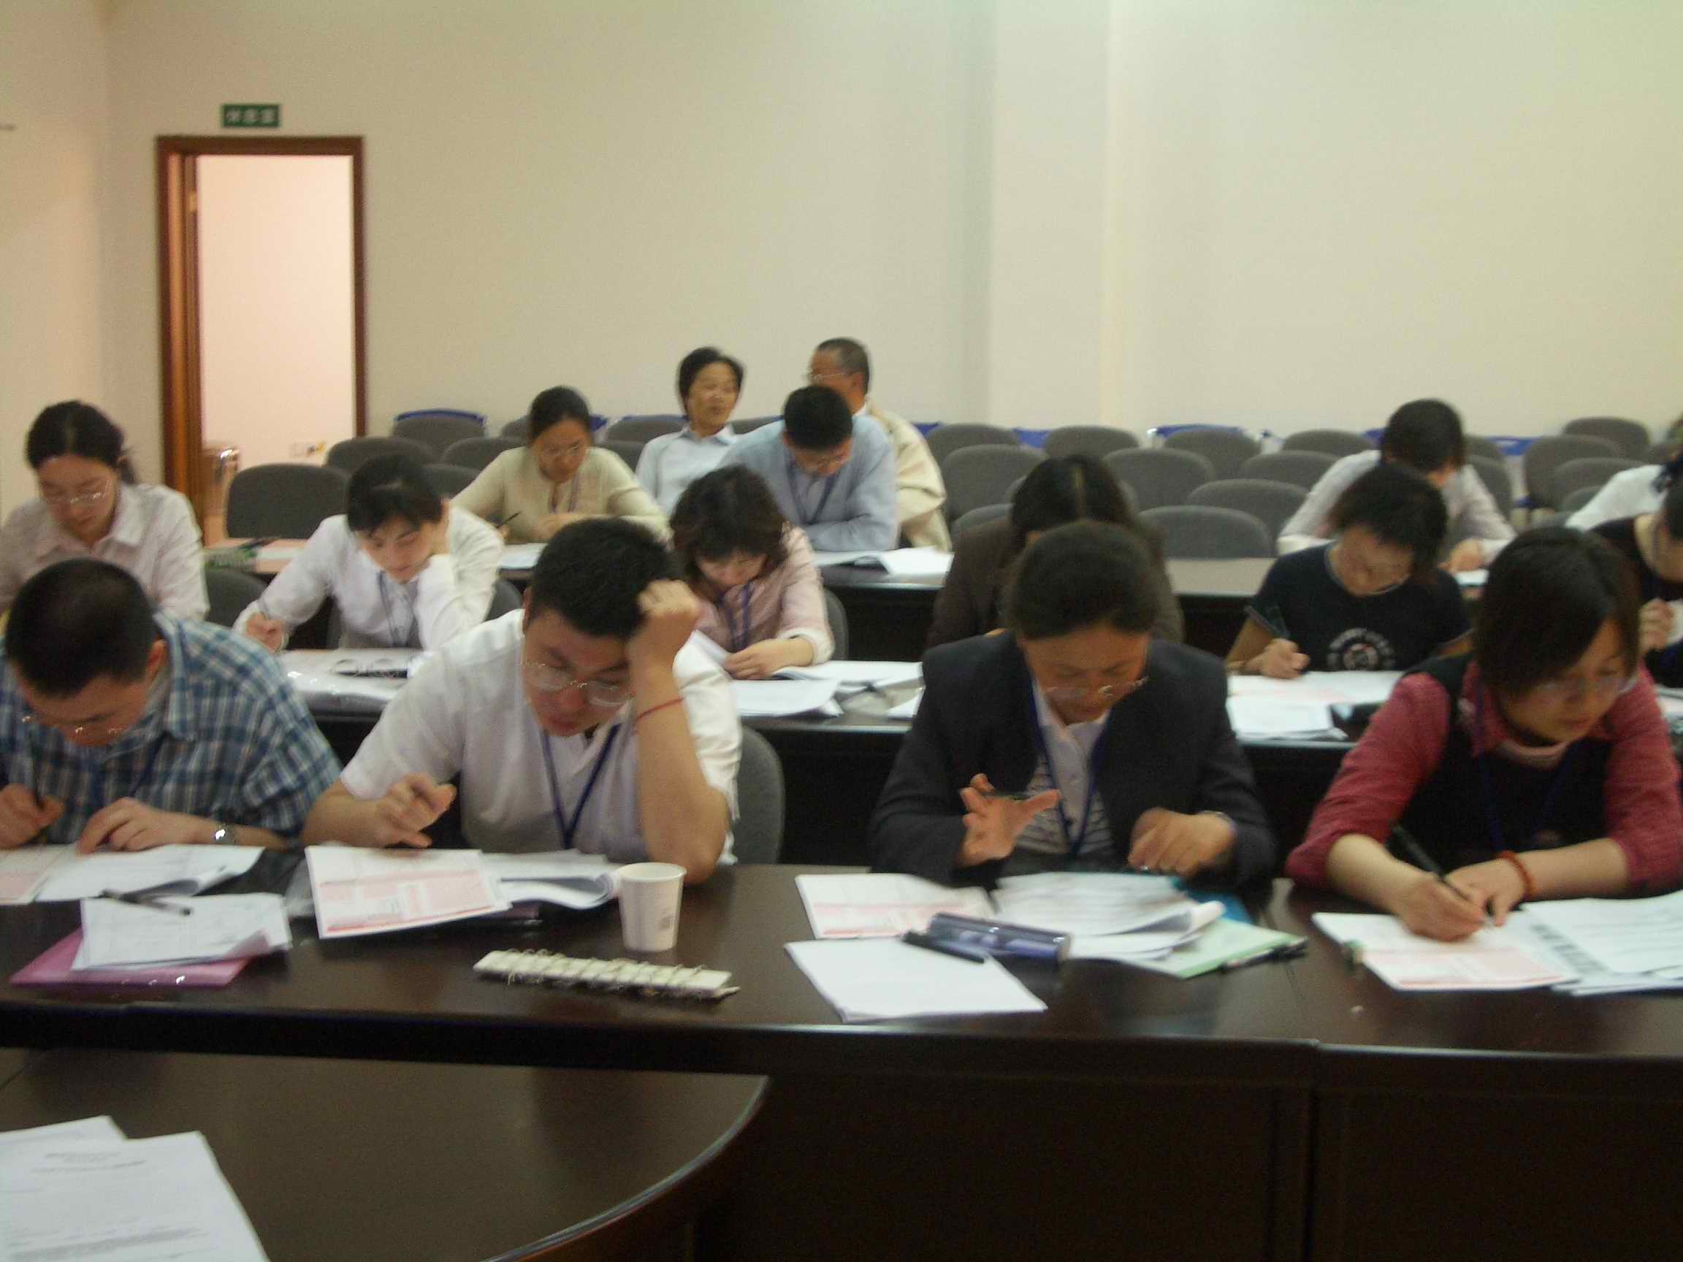
The IACLE Fellowship Exam
An instrument for assessing members’ knowledge
Consists of 153 MCQs including visual recognition and case-based questions
Studying the ICLC (versions 1 & 2) is recommended
Success in the exam determines eligibility for Fellow of IACLE (FIACLE) status
Since 1996, more than 1,300 candidates have taken the Accreditation Exam
Next administration: 2017
Notes:
12
12

Slide 21
Achieving FIACLE Status
Once successful in the Fellowship Exam, members can apply for Fellow of IACLE (FIACLE) status
Valid for a 3 year period
  renewed by active involvement in furthering contact lens education, i.e. reinvesting their knowledge
FIACLEs are encouraged to work with the local CL industry to deliver continuing practitioner education
Currently, around 35% of IACLE’s membership hold FIACLE status – this will rise, join them
Notes:
12
12

Slide 22
Achieving FIACLE Status
FIACLE status confirms that the IACLE member has demonstrated & proved they have an international standard of CL knowledge
Achieving FIACLE status is NOT easy & never will be
  the standard has already been set (since 1996)
Notes:
12
12

Slide 23
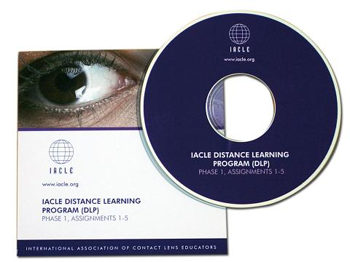
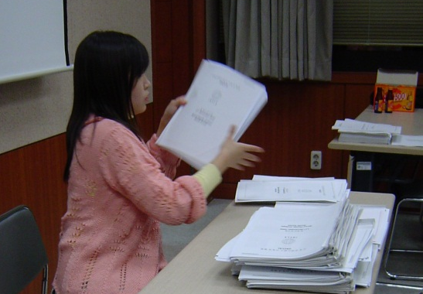
IACLE’s Distance Learning Program (DLP)
Members can expand their knowledge base from a ‘distance’ – the DLP, now in MCQ format
Based on the ICLC – assists educators to study each ICLC module systematically
Good preparation for the IACLE Fellowship Exam
Participants work independently & at their own pace
Notes:
12
12

Slide 24
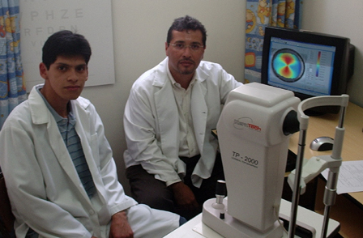
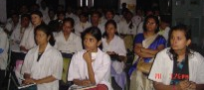
Industry Seminars
Through IACLE Industry Seminars, students gain:
Knowledge of the CL market
Practical experience through hands-on workshops
Increased confidence in fitting and recommending CLs
  students are more likely to continue to use familiar/successful products once in practice
The institution gains:
Support for its CL clinics (e.g. trial lenses, LCPs, etc.)
Better relationship with students and the CL industry locally
Students confident fitting CLs → CL market growth
(a win-win situation)
Notes:
12
12

Slide 25
The IACLE Image Collections
Image Collections

Slide 26
THE IACLE IMAGE COLLECTION
More than 115 images

Slide 27
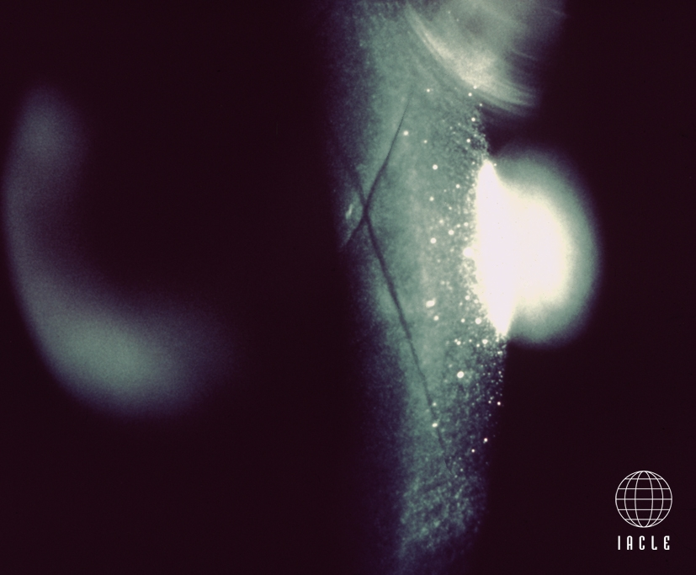
CORNEAL CONDITIONS 1E.12
Oedema-induced folds (stroma/Descemet’s): 20% swelling [Holden/Zantos]

Slide 28
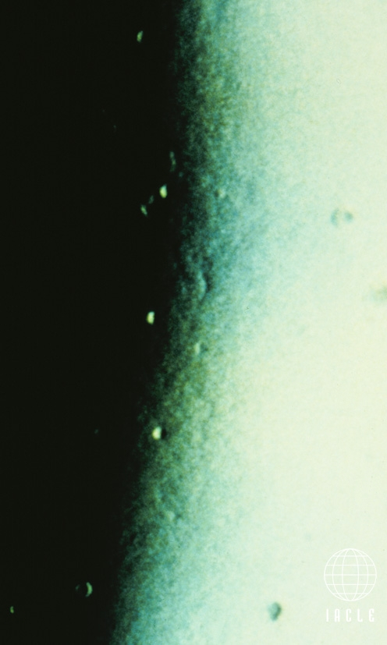
CORNEAL CONDITIONS 1H.4
Epithelial microcysts: Marginal retro-illumin, rev illumin [Holden]

Slide 29

The AOCLE Image Collection
Images contributed to IACLE by the
Association of Optometric Contact Lens Educators (AOCLE)
More than 75 images

Slide 30


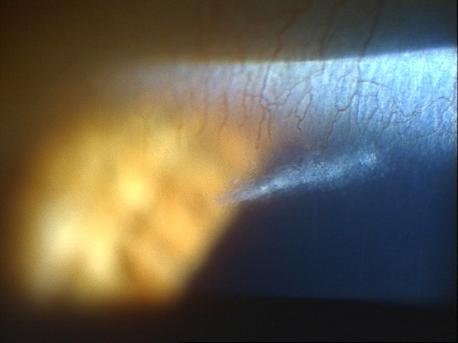
MCO
epithelial split.jpg

Slide 31
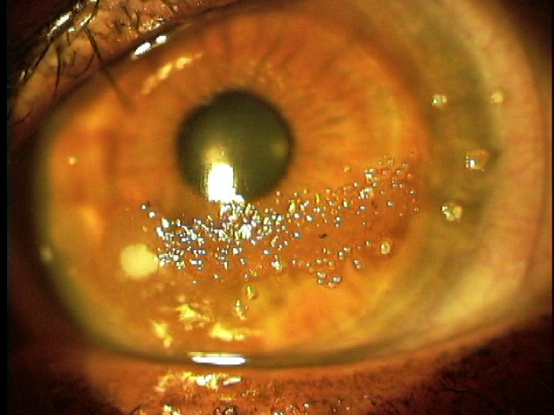
NSUOklahoma
custom toric worn over 2 yrs.jpg

Slide 32
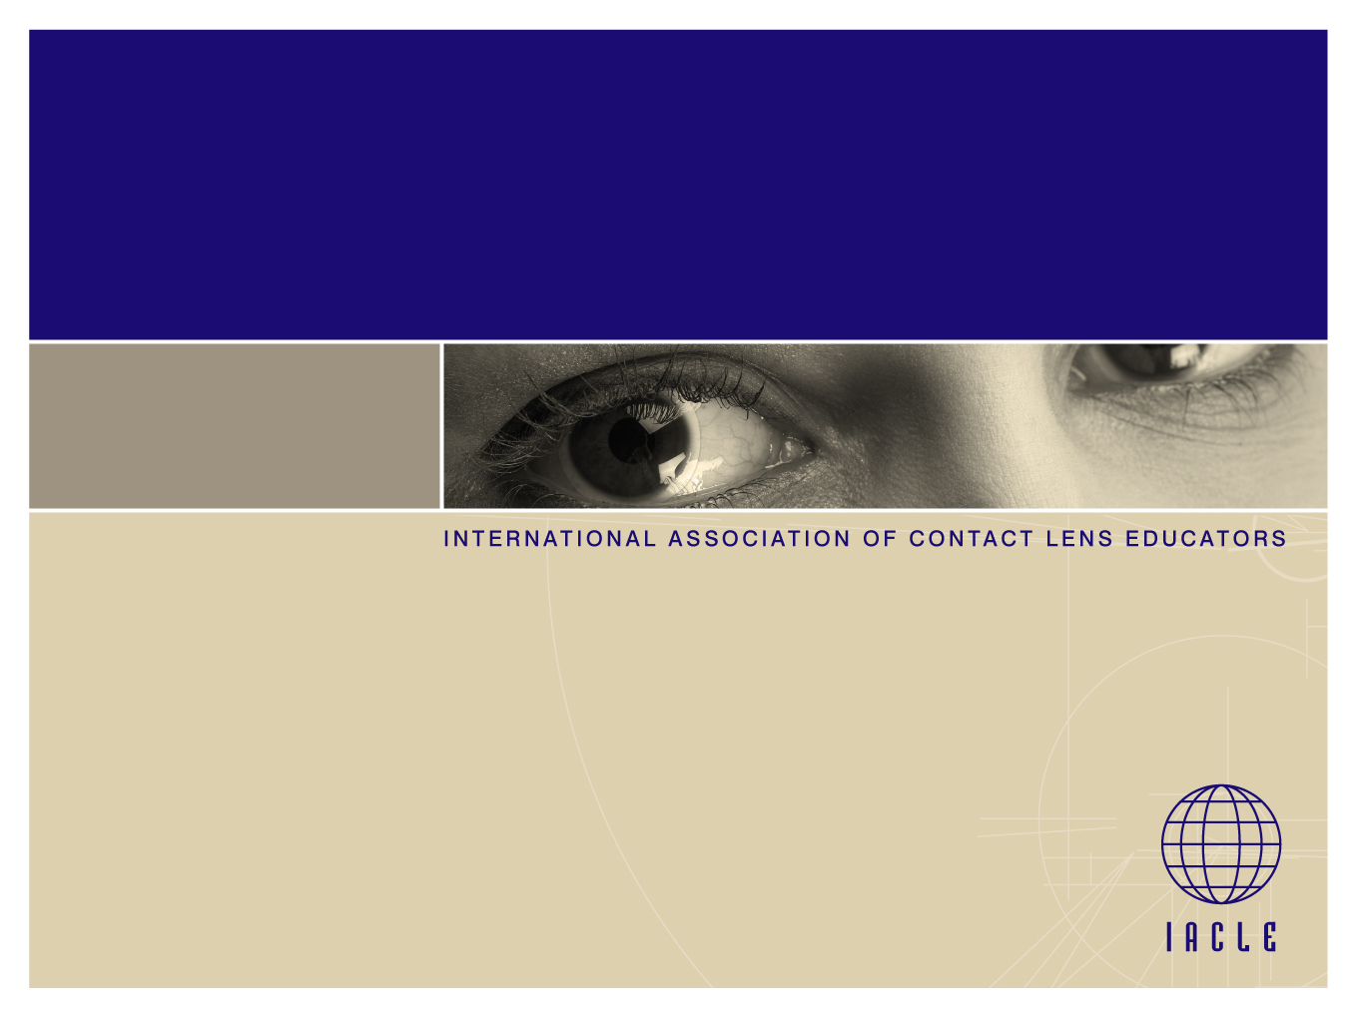
IACLE:
The SALAZAR
IMAGE Collection
More than 137 images

Slide 33
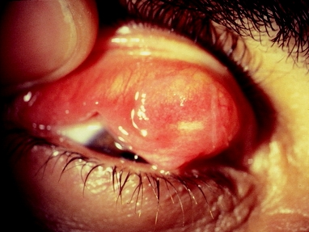
‘LOST’ RIGID CL:
EMBEDDED IN PALPEBRAL CONJUNCTIVA

Slide 34
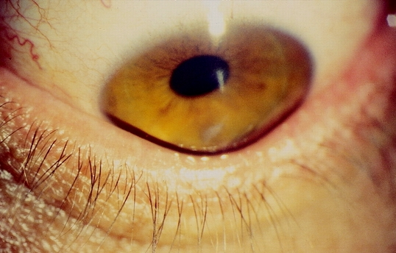
KERATOCONUS:
MUNSON’S SIGN & SCARRING

Slide 35
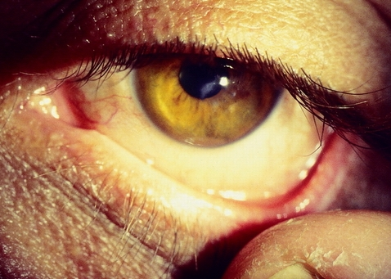
KERATOCONUS:
CHARLEUX SIGN (OIL DROPLET)

Slide 36
Other IACLE Resources
Video Resources
IACLE Video Library (a DVD)
IACLE’s YouTube Channel (up to you to subscribe)
CooperVision’s Video Animations (SCLs, spherical & toric)
CooperVision’s Slit-Lamp Examination video (in English & Cantonese)
IACLE’s World Congress #3 (Lectures given in Manchester in 2015)
Other Resources
Educational lectures
Member-Contributed Resource Library
Industry-Contributed Resource Library
Alcon Image Library (FIACLEs-only – access is controlled centrally)
IACLE CL Fitting Sheets, Record Forms, etc. (see next)

Slide 37
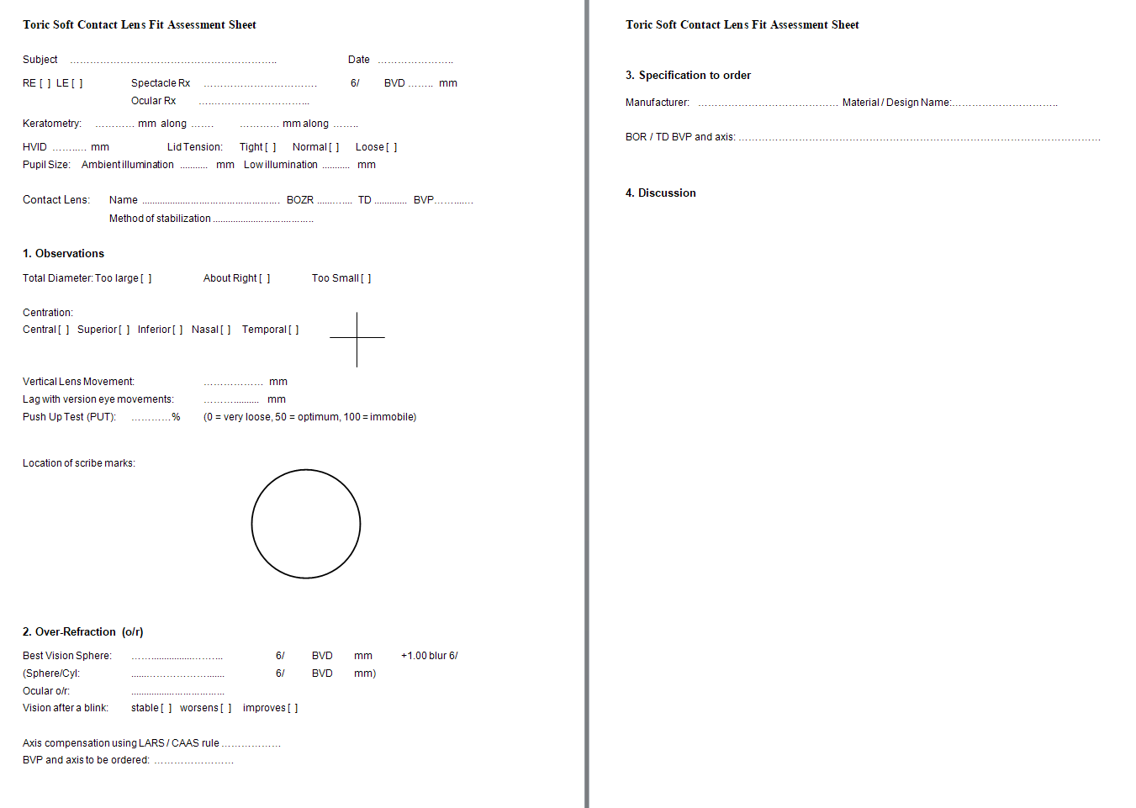
IACLE Fitting Sheets (an Example)
These can be used ‘as is’ or as the inspiration for a more suitable localized version

Slide 38
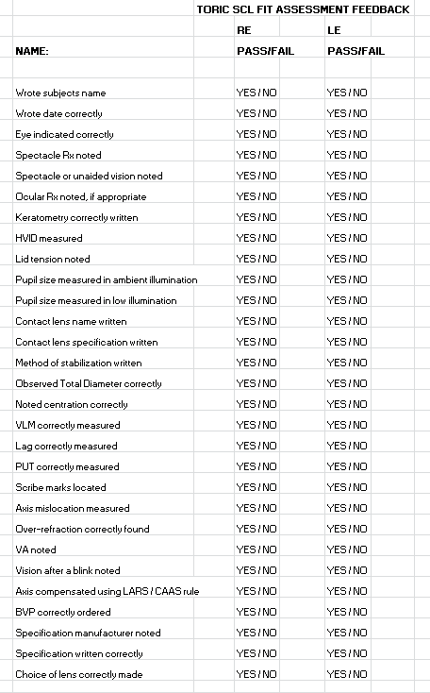
IACLE Student Assessment Sheets (an Example)
These can be used ‘as is’ or as the inspiration for a more suitable localized version

Slide 39
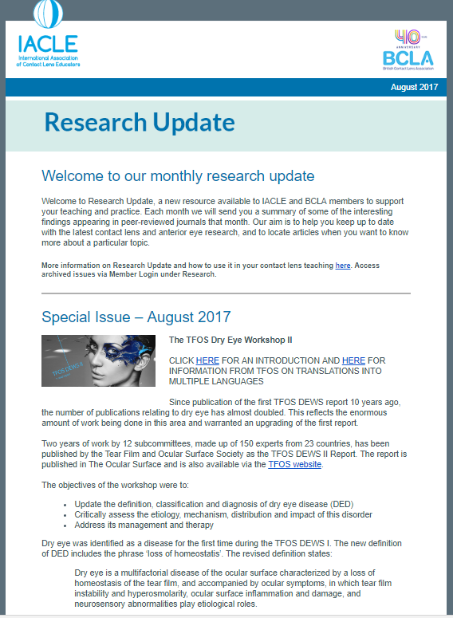
IACLE Research Update (a Monthly E-Zine)
New for 2017
Notes:
12
12
Static Fitting Assessment: Periphery (CL Edges)
The 2nd component of the peripheral fitting assessment involves the depth or clearance between the CL back surface & the cornea.
As the CL periphery lifts further away from the cornea, the fluorescein will be brighter. This variation allows the practitioner to estimate the axial edge clearance (AEC). It is possible for the clearance to be excessive while the width of the peripheral zone is minimal.
Another useful guide to the degree of AEC is the formation of a meniscus at the CL periphery. Due to surface tension effects, the tear film forms a meniscus as long as the AEC is not too great. The absence of a meniscus is indicative of excessive clearance.

Slide 40
Non-IACLE Resources Worth Pursuing
AOCLE ( http://www.aocle.org/ )
BCLA (https://www.bcla.org.uk/ )
GPLI ( http://www.gpli.info/ custom CL ed.)
AOA (https://www.aoa.org/ )
TFOS (http://www.tearfilm.org/ all DEWS II reports are open access – free registration required)

Slide 41
Our BEST IACLE Resource is YOU
You are creating teaching resources all the time – share them with your international colleagues through IACLE
You are taking images & might be making videos – share them
You are creating CL MCQs regularly – share them
New for 2018
Images for our 2018 IACLE Image Collection are now being sought. For outstanding images, we are awarding Image of the Month &, eventually, Image of the Year

Slide 42
The IACLE Case Report Series
Case Reports
(Demonstrated & Detailed Separately)

Slide 43





IACLE would like to thank our Industry Partners for their ongoing support of the development and delivery of educational resources and programs
Platinum Sponsor
Silver Sponsors
Bronze Sponsor
Donor Sponsor

Slide 44
Please visit us online at
www.iacle.org

