Slide 1
FITTING SILICONE HYDROGEL CONTACT LENSES
Lecture 3L9
2012-Aug-27
Notes:
12
12

Slide 2
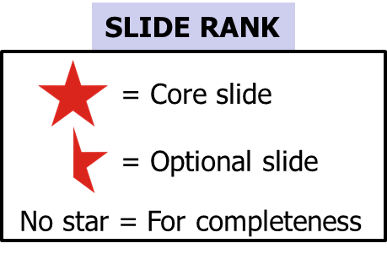
Published in Australia by The International Association of Contact Lens Educators First Edition 2012 The International Association of Contact Lens Educators 2000-2012 All rights reserved. No part of this publication may be reproduced, stored in a retrieval system, or transmitted, in any form or by any means, without the prior permission, in writing, of: The International Association of Contact Lens Educators IACLE Secretariat, PO Box 656 KENSINGTON NSW 2033 Australia Email: iacle@iacle.org
IACLE CONTACT LENS COURSE

Slide 3
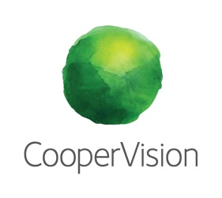
SPONSORS
Development and delivery of contact lens education by IACLE is supported through educational grants and in-kind contributions
Industry Supporters
Major In-Kind
Supporters

Slide 4
Copyright Notice
The IACLE Contact Lens Course (all formats) is the sole property of the International Association of Contact Lens Educators (IACLE) and is protected, without limitations, by copyright. By accessing this material, you agree to the following terms and conditions:
You may only access and use the IACLE Contact Lens Course for personal or educational purposes. Any dissemination or sale of the IACLE Contact Lens Course, either in whole or in part, or use of the materials for other than educational and personal purposes, is strictly prohibited without the express written consent of IACLE. Except as declared below, you may not reproduce, republish, post, transmit, or distribute any material included in the IACLE Contact Lens Course.
You may print materials for personal or educational purposes only. All copyright information, including the IACLE logo, must remain on the material. Appropriate reference must be provided to any use of the content of the IACLE Contact Lens Course, including text, images, &/or illustrations.

Slide 5
CONTRIBUTORS
Contributors: Lewis Williams AQIT(Optom), MOptom, PhD Dir: Educational Development IACLE International Secretariat (AUSTRALIA) Nilesh Thite MOptom, FIACLE Dir: Educational Programs IACLE International Secretariat (INDIA) | 3L9: Fitting Silicone Hydrogel Contact Lenses

Slide 6
SILICONE HYDROGELS WHY?
O₂ permeability (Dk) was prime motivation for developing silicone-based CL materials (GP & Soft). ↑ CL transmissibility (Dk/t) → ↑ corneal oxygenation, a ‘holy grail’ for materials developers, CL manufacturers, CL researchers, & CL practitioners alike.
Holden & Mertz (1984) paper et seq. set O₂ goalposts high, later revisions even higher
Hoped that ↑ physiological performance would ↓ or eliminate adverse outcomes of CL wear, especially infections (e.g. MK) & inflammatory events
Notes:
Holden BA, Mertz GW, 1984. Critical oxygen levels to avoid corneal edema for daily and extended wear contact lenses. Invest Ophthalmol Vis Sci. 25: 1161 – 1167
et seq.:
Brennan NA, 2005. Corneal oxygenation during contact lens wear: comparison of diffusion and EOP-based models. Eye Contact Lens 31: 103 - 108.
Brennan NA, 2005. Beyond flux: total corneal oxygen consumption as an index of corneal oxygenation during contact lens wear. Optom Vis Sci. 82: 467 - 472.
Efron N, Brennan NA, 1987. How much oxygen? In search of the critical oxygen requirement of the cornea. Contax July: 5 - 18.
Fonn D, Bruce AS, 2005. A Review of the Holden-Mertz Criteria for Critical Oxygen Transmission. Eye & CL. 31(6): 247 – 251.
Harvitt DM, Bonanno JA, 1999. Re-evaluation of the oxygen diffusion model for predicting minimum contact lens Dk/t values needed to avoid corneal anoxia. Optom Vis Sci. 76: 712 - 719.
Holden BA et al., 1984. The minimum precorneal oxygen tension to avoid corneal oedema. Invest Ophthalmol Vis Sci. 25: 476 – 480.

Slide 7
CL HISTORY HYDROGELS
Hydrogel CLs dominated SCL category from inception (researched: early 1950s, limited availability Czechoslovakia early 1960s, released Western world by B&L 1971) until late 1990s
1998: Silicone hydrogel (SiHy) CLs introduced
Hydrogel Dks inadequate for safe FW or EW & borderline for DW
Pervaporation staining thwarted use of obvious combination, i.e. high water (↑ Dk) & low t_{C} (↑ Dk/t)
Once hypothetical 100% water CL (an impossibility) shown to be inadequate for EW (e.g. Holden-Mertz criteria [1984] & sequels), industry pursued alternatives
Notes:
Despite some high water conventional hydrogel CLs being marketed as having ‘high’ oxygen transmissibility, the description has to be viewed in the context of the relevant era (1970s-1980s). SiHy CLs with Dk/t s some 6-10X those of conventional hydrogels changed the SCL scene greatly. The path to marketable SiHy CLs was long and winding (& costly).
Holden BA, Mertz GW (1984). Critical oxygen levels to avoid corneal edema for daily and extended wear contact lenses. IOVS. 25: 1161 – 1167.

Slide 8
CL HISTORY SILICONE HYDROGELS
Si elastomer (flexible) & silicone acrylate (GP) CLs demonstrated possible rôles for Si-containing materials
1979-Jan-1: Mueller & Kleiner (Ciba-Geigy Corp.) patented polysiloxane hydrogels (CLs were included as a possible application)
1979-Feb -1: SiHy CL patent issued to Tanaka et al. of Toyo Contact Lens Company (Menicon, Japan) – no commercial product resulted
1979: Deichert et al., B&L
1980: Chang, an independent researcher
1981: LeBoeuf, American Optical
1994 & 1995: Künzler & Ozark, B&L – still no commercial products (Künzler was part of original 1979 Deichert B&L filing)

Slide 9
SILICONE HYDROGELS
Most significant patents were granted to:
Greisser et al., 1996 (CSIRO, AUSTRALIA)
Nicolson et al., 1998 (CIBA Vision, USA)
both teams were part of the See3* project
first product: 1998 CIBA’s Night & Day SiHy CL made from lotrafilcon A
The SiHy race had begun
Later (also in 1998), B&L released PureVision (balafilcon A - based on Tanaka’s and Künzler & Ozark’s earlier work)
2003: J&J Vistakon with a Tanaka patent-based lens, Acuvue Advance (galyfilcon A)
2005: J&J Acuvue Oasys (senofilcon A - Dk >> galyfilcon A but a derivative of it)
Notes:
*See3: (CIBA Vision, CSIRO, CRCERT) :
CRCERT:
Cooperative Research Centre for Eye Research and Technology, UNSW, Sydney, AUSTRALIA
CSIRO: Commonwealth Scientific and Industrial Research Organisation of Australia, Melbourne, AUSTRALIA
CIBA Vision: Atlanta, GA, USA
Information based on the work of Prof Brian Tighe, Aston University in Contact Lenses 5th ed., 2007 (Phillips AJ, Speedwell L, Morris J. Butterworth Heinemann, Edinburgh) and Silicone Hydrogels the rebirth of continuous wear contact lenses 1st ed., 2000 (Sweeney DF. Butterworth Heinemann, Oxford)

Slide 10
SILICONE HYDROGELS GENERATIONS
First generation SiHy CLs:
Focus Night & Day (CIBA Vision, 1998, lotrafilcon A)
PureVision (B&L, 1998, balafilcon A)
Second generation:
Acuvue Advance (J&J, 2003, galyfilcon A)
PureVision 2 HD (B&L, 2010, balafilcon A)
Acuvue Oasys (J&J, 2005, senofilcon A)
O₂Optix/AirOptix (CIBA Vision, 2004, lotrafilcon B)
Third generation:
Biofinity (CooperVision, 2007, comfilcon A)
PremiO (Menicon, 2007, asmofilcon A)
Avaira (CooperVision, 2008, enfilcon A)
Notes:
Largely for marketing/competitive reasons, when releasing new products, SiHy CL companies have attempted to categorize existing CLs already on the market as being from an ‘earlier’ generation. The implication being that their ‘new’ product would surpass the existing products in all or most ways. The basic chronology of the products released are reflected in the generational categories presented above.

Slide 11
SILICONE HYDROGELS
Suppliers of SiHy CLs and/or SiHy lens materials:
Alcon (CLs)
Bausch & Lomb (CLs)
J&J Vistakon (CLs)
CooperVision (CLs)
Ultravision (CLs)
Menicon (CLs)
Sauflon (CLs)
Procornea (CLs)
mark'ennovy (CLs [custom])
Contamac (buttons)
Lagado (buttons)
Other: ?
Notes:
Relatively few SiHy lens button manufacturers are active currently. Interestingly, all custom materials tend to have inferior physiological performance when compared with stock SiHy CLs. Apart from chemical and/or button manufacturing differences it is conceivable that materials that can be lathed need different formulations (e.g. more rigid to resist flexing under the tool tip) to be practical as well as wettable, especially if complex and expensive secondary manufacture is to be avoided, e.g. surface treatment. In some cases the oxygen performance difference can be more than 40% lower.

Slide 12
SILICONE HYDROGELS CURRENT MARKET SITUATION
Currently, market dominated by large, multinational, stock lens manufacturers/suppliers
Relatively few custom lens labs exist. Almost by definition they are minority players
operate on the ‘periphery’ of normal distribution curve of lens parameters & Rxs
SiHy materials supplier numbers are very small
material Dks < or << materials deployed in stock CLs rendering them < suitable (but still >hydrogels) for high Rxs (excessive regional lens thicknesses)
materials more difficult to work with in the laboratory than conventional hydrogels
latheable SiHy (e.g. efrofilcon A from Contamac) becoming more common in custom CL market
Notes:
With the success of stock SiHy CLs, custom labs turned their attention to materials manufacturers seeking SiHy buttons that allowed them to supply CLs in Rxs outside the normal range covered by the stock lens companies. Some materials suppliers have delivered suitable products but their numbers still remain small.

Slide 13
SILICONE HYDROGELS SIMILARITIES TO HYDROGELS
Flexibility
CLs fitted larger & flatter than cornea
On-eye CLs movement with lid/blink influences
Similar t_{C}s
Lens profiles similar for reasons of comfort, movement, tear exchange, Dk/t
Refractive indices similar
Most water contents similar to low water hydrogels
Many polymer (hydrogel & SiHy) components have long history in silicone elastomer, siloxane acrylates (SA), and fluorosiloxane acrylate (FSA) CLs

Slide 14
SILICONE HYDROGELS SIMILARITIES TO HYDROGELS contd...
They deposit in use
protein & lipids are the most prevalent but their propensities for either deposit type is ≠ overall, ↓ deposits cf. hydrogel CLs
In most but not all cases, same LCPs can be employed
Infection & adverse response rates for non-hypoxia-related conditions are ≈
Manufacturing, storage, & disinfection requirements similar to other SCLs
Little evidence that vision quality differs significantly between CL types

Slide 15
SILICONE HYDROGELS DIFFERENCES FROM HYDROGELS
Dks > or >> hydrogels
hypoxia-related conditions ↓ significantly
Water contents are only similar to low water hydrogels, ↑ oxygen transmission derived from silicone content instead
Generally, rigidity > hydrogels necessitating lens design modifications → ↓ likelihood of → SEALs (problem only with early SiHy CLs & only in some patients)
Many polymer components are novel
Deposits more likely to be lipid-based rather than protein

Slide 16
SILICONE HYDROGELS DIFFERENCES FROM HYDROGELS
More difficult to manufacture (costs may remain higher)
Cannot be tinted using current technology
this will probably change
Inherently, hydrogels have hydraulic permeability. SiHy CLs do not. Polymer must be formulated to provide hydraulic permeability
hydraulic permeability relates to ability of water to move through CL material - required for on-eye lens movement & ocular health
SiHy lenses inherently < wettable due to hydrophobic lens surface, necessitating incorporation of wetting components, a surface coating, or both

Slide 17
SILICONE HYDROGELS DIFFERENCES FROM HYDROGELS
Some adverse interactions have been reported between some LCP formulations and some SiHy CLs (see Epstein, Jones, Andrasko, and others circa 2005)
Latheable SiHy materials may have a lower Dk than stock lenses fabricated using molding (spin-casting not used with current SiHy CLs)
Notes:
Amos C (2004). Performance of a new multipurpose solution used with silicone hydrogels. Optician 227(5945): 18 – 22.
Carnt N et al. (2007). Solution toxicity in soft contact lens daily wear is associated with corneal inflammation. Optom Vis Sci. 84:309 - 315.
Dumbleton K (2003). Noninflammatory silicone hydrogel contact lens complications. Eye & Contact Lens 29(1)(Suppl.): S186 – S189.
Epstein A (2002). SPK with daily wear of silicone hydrogel lenses and MPS. CL Spectrum. 17(11): 30.
Jones L, Dumbleton K (2002). Introducing silicone hydrogel contact lenses. Part 2 – Fitting procedures and in-practice protocols. Optician 223(5840): 37 – 45.
Newman CD (2003). Silicone hydrogel daily wear and MPS. CL Spectrum. 18(3): 17-19.
Sentell KB et al. (2004). Comparison of preservative uptake and release profiles of PHMB from soft contact lens care products by silicone hydrogel contact lenses. Invest Ophth Vis Sci. ARVO Abstracts Vol. 1: 1573.
Sorbara L et al. (2009). Multipurpose disinfecting solutions and their interactions with a silicone hydrogel lens. Eye & CL. 35(2): 92 – 97.
Tonge S et al. (2001). Contact lens care: Part 5 – The design and development of wetting and multi-purpose solutions. Optician 222(5817): 27 – 33.
Willcox et al. (2007). Protein and lipid deposits on lenses are affected by lens material and solutions, and associated with clinical performance. 5th International Conference on the Tear Film & Ocular Surface, Sicily, September 2007.
Andrasko: http://www.staininggrid.com/grid.aspx

Slide 18
SILICONE HYDROGELS DIFFERENCES FROM HYDROGELS
All other factors being equal, it is likely that the comfort of hydrogel CLs is marginally better
Dryness sensation is less of a problem with SiHy CLs
Pervaporation/pervaporation staining does not arise normally with SiHy CLs
SiHy CLs are more durable in the average wearer’s hands

Slide 19
SILICONE HYDROGELS DIFFERENCES FROM HYDROGELS
Due to their relative rigidity SiHy CLs:
are easier to handle than hydrogel CLs
may be somewhat more difficult to remove
small Rx changes may result from induced corneal alterations
it is prudent to perform an over-Rx over a well-settled SiHy trial lens before ordering the final BVP (BVP of trial & final Rxs assumed to be ‘similar’)
this is especially true when converting a hydrogel lens wearer to a SiHy lens for the first time
Notes:
Rx changes are covered in more detail later in this presentation.

Slide 20
SILICONE HYDROGELS MANUFACTURING
SiHy CLs cannot be made by cast-molding because:
some materials exist as a biphasic polymer (e.g. lotrafilcon A)
many require surface treatment, a secondary manufacturing step (e.g. lotrafilcon A, B, balafilcon A, asmofilcon A, silfilcon A)
few companies are familiar with spin-casting despite it being the oldest SCL fabrication technique (Wichterle late 1950s)

Slide 21
SILICONE HYDROGELS WEAR REGIMEN
SiHy CLs are suited to ALL modes of wear
DD
DW
FW
EW
CW
despite their high O₂ performance, SiHy CLs should not be thought of as simply an EW/CW product
high O₂ performance is desirable REGARDLESS of the wearing regimen
Notes:
DD Daily Disposable
DW Daily Wear
FW Flexible Wear
EW Extended Wear
CW Continuous Wear

Slide 22
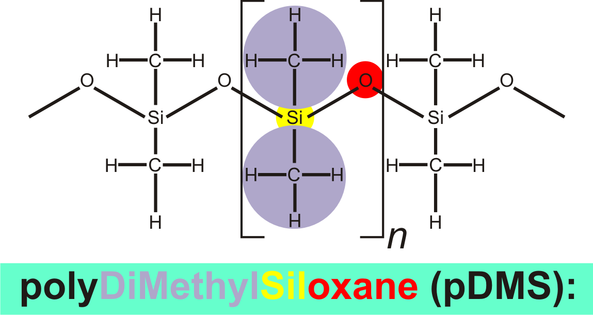
SILICONE HYDROGELS CHEMISTRY OF SiHy CLs
Notes:
pDMS is the chemical basis of all siloxane CLs be they rigid or soft. It is also the basis of silicone adhesives, breast implants, sealing gaskets, silicone elastomer kitchen tools, smartphone protective cases, etc..
pDMS has been known to be a solvent for lipids for a long time. This means that tear film lipids such as cholesterol and cholesterol esters can be absorbed INTO silicone-containing contact lenses (after Refojo, 1983).
Refojo M (1983). In: Lens Deposits – Adapted from the October 1982 meeting of CLAO. CLAO J. 9(2): 172.

Slide 23
SILICONE HYDROGELS CHEMISTRY OF SiHy CLs contd...
lotrafilcon A & B macromers
Propenyl group
Fluoroethylene oxide
Simplified version highlighting the hydrophobic centres
Notes:
lotrafilcon A contains not only pDMS but also poly(fluoroethylene oxide) (fluoroalkyl groups + oxygen) and propenyl groups as ‘bookends’ (after Nicolson, 2003).
Nicolson PC (2003). Continuous wear contact lens surface chemistry and wearability. Eye & CL.: Science & Clinical Practice 29(1): S30 – S32.

Slide 24
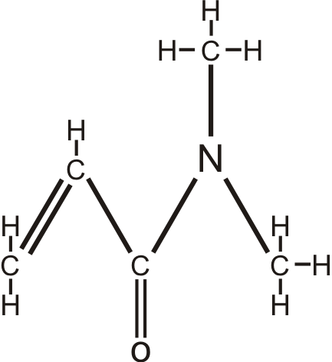
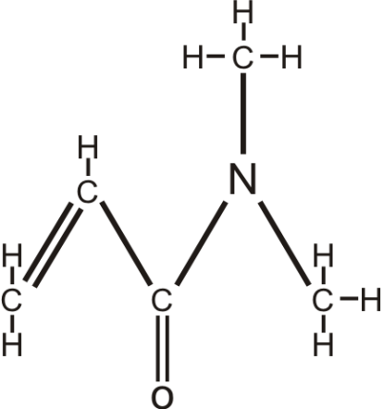
SILICONE HYDROGELS CHEMISTRY OF SiHy CLs contd...
+
–
Hydrophilic
locus
DMAA
DiMethylAcrylAmide
Notes:
DMAA is used in several SiHy CLs from at least two manufacturers (CIBA Vision & J&J Vistakon) (see Subbaraman et al., 2006).
DMAA is a hydrophilic monomer (see Karlgard et al., 2004).
Karlgard CCS et al. (2004). Drying methods for XPS analysis of PureVision ™, Focus® Night & Day™ and conventional hydrogel contact lenses. App Surf Sci. 230: 106 – 114.
Subbaraman LN et al. (2006). Kinetics of in vitro lysozyme deposition on silicone hydrogel, PMMA, and FDA Groups I,II, and IV contact lens materials. Curr Eye Res. 31: 787 – 796.

Slide 25
SILICONE HYDROGELS CHEMISTRY OF SiHy CLs
balafilcon A macromers
Vinyl
Carbonate ester
Butyl
Methyl
Silicon
Oxygen
Notes:
The balafilcon A macromer (macromonomer) has a pDMS repeating unit with symmetric terminating groups including n-butyl, a carbonate ester, & vinyl (the ‘bookends’) groups.

Slide 26
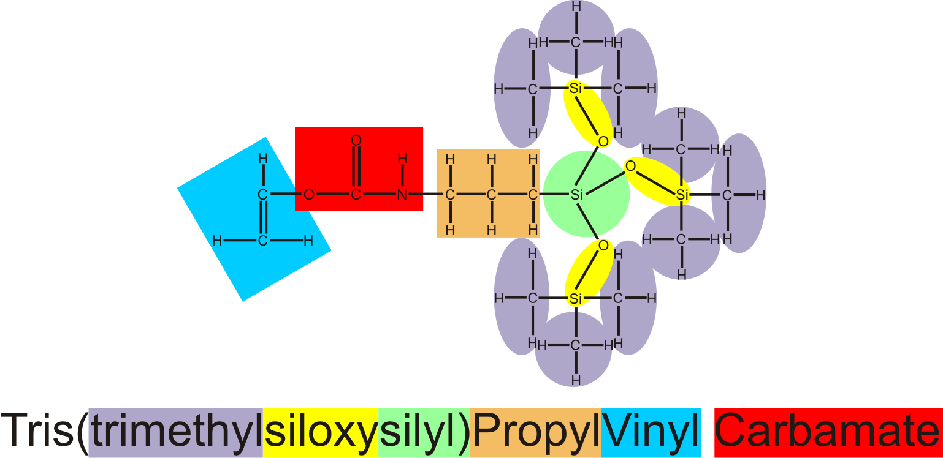
SILICONE HYDROGELS CHEMISTRY OF SiHy CLs
TPVC (in balafilcon A)
Notes:
TPVC is hydrophobic in nature (for further details see Karlgard et al., 2004 and Subbaraman et al., 2006)
Karlgard CCS et al. (2004). Drying methods for XPS analysis of PureVision ™, Focus® Night & Day™ and conventional hydrogel contact lenses. App Surf Sci. 230: 106 – 114.
Subbaraman LN et al. (2006). Kinetics of in vitro lysozyme deposition on silicone hydrogel, PMMA, and FDA Groups I,II, and IV contact lens materials. Curr Eye Res. 31: 787 – 796.

Slide 27
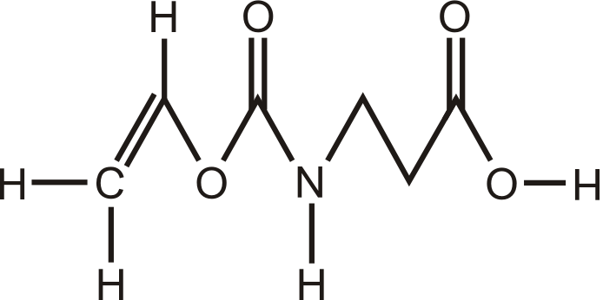
SILICONE HYDROGELS CHEMISTRY OF SiHy CLs
NCVE (in balafilcon A)
Carboxy group
Vinyl group
N-CarboxyVinyl Ester
Notes:
NCVE is a component of balafilcon A (for details see Karlgard et al., 2004 and Subbaraman et al., 2006).
Karlgard CCS et al. (2004). Drying methods for XPS analysis of PureVision ™, Focus® Night & Day™ and conventional hydrogel contact lenses. App Surf Sci. 230: 106 – 114.
Subbaraman LN et al. (2006). Kinetics of in vitro lysozyme deposition on silicone hydrogel, PMMA, and FDA Groups I,II, and IV contact lens materials. Curr Eye Res. 31: 787 – 796.

Slide 28
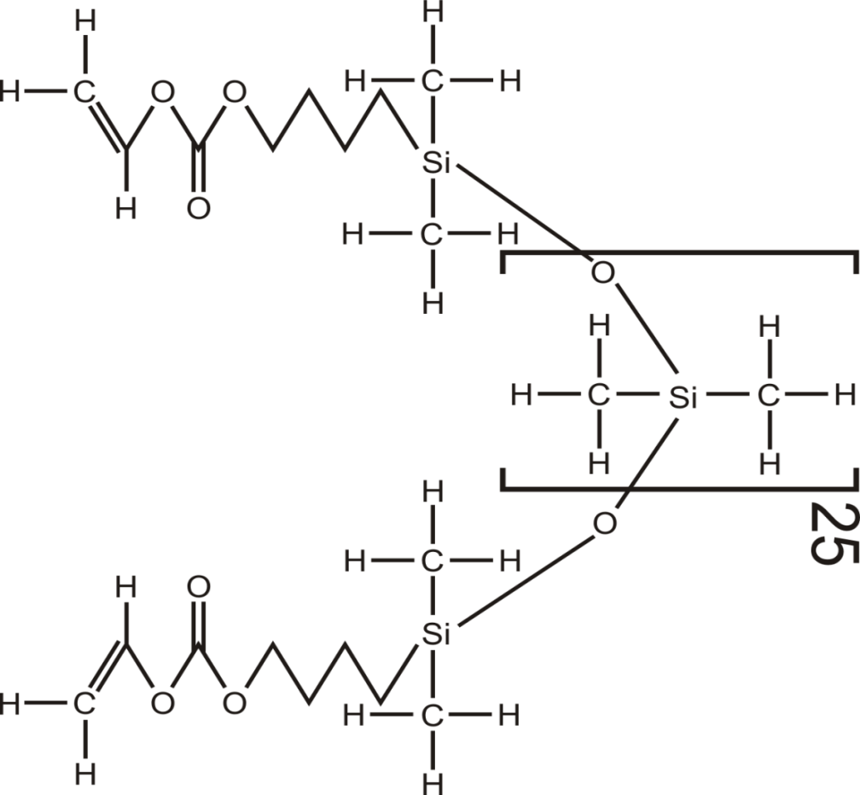
SILICONE HYDROGELS CHEMISTRY OF SiHy CLs
PBVC (in balafilcon A)
silylbutanol group
Carbamate group
dimethylsiloxy repeating unit (pDMS)
Vinyl group
Poly(dimethylsiloxy) di(silylbutanol) Bis (Vinyl Carbamate) (PBVC)
Notes:
PBVC is a component of balafilcon A (for further details see Karlgard et al., 2004 and Subbaraman et al., 2006).
Karlgard CCS et al. (2004). Drying methods for XPS analysis of PureVision ™, Focus® Night & Day™ and conventional hydrogel contact lenses. App Surf Sci. 230: 106 – 114.
Subbaraman LN et al. (2006). Kinetics of in vitro lysozyme deposition on silicone hydrogel, PMMA, and FDA Groups I,II, and IV contact lens materials. Curr Eye Res. 31: 787 – 796.

Slide 29
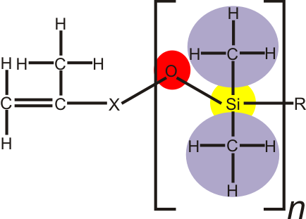
SILICONE HYDROGELS CHEMISTRY OF SiHy CLs
galyfilcon A & senofilcon A MACROMERS
Propenyl group
Notes:
Both galyfilcon A & senofilcon A have components in common with other SiHy lens materials, particularly pDMS. These lens materials are not surface treated when used in CLs.

Slide 30
SILICONE HYDROGELS MATERIAL IONICITY
Most SiHys: little or no surface charge, e.g. lotrafilcon A & B, galyfilcon A, senofilcon A, comfilcon A, narafilcon A, enfilcon A, asmofilcon A, silfilcon A
lotrafilcon A & B have a slight surface charge but are still considered non-ionic
plasma surface treatment
Notable exception:
balafilcon A material: charged surface by virtue of its surface treatment (plasma oxidation → a matrix of isolated (but close), hydrophilic, silicate, glassy ‘islands’ on CL surface
–ve surface charge < conventional hydrogels, e.g. etafilcon A

Slide 31
SILICONE HYDROGELS FDA GROUPS
The FDA materials grouping system is used widely (High water = ≥50% water):
Group 1: Low water, Non-ionic
Group 2: High water, Non-ionic
Group 3: Low water, Ionic
Group 4: High water, Ionic
Most SiHy CLs belong to Group 1 (Low water, Non-ionic)
at least one custom CL SiHy material is Group 2 (efrofilcon A)
at least one stock CL SiHy material is Group 3 (balafilcon A)
Notes:
Moves are again afoot (2012) to reclassify SiHy CLs into a separate group but the complexity of the issues involved and materials having little in common is proving to be a challenge.

Slide 32
SILICONE HYDROGELS & THE ISO 11539 STANDARD
This standard incorporates elements of the USAN naming conventions used by the US FDA applied in a systematic way
at the heart of the system are 2 stems – filcon for soft CLs materials (hydrogels having at least 10% water by mass ∴ includes SiHys) & focon for rigid CL materials
system’s PREFIX is derived from the USAN name, e.g. etafilcon (NB: the USAN name is in all lower case letters)
system’s SUFFIX is also USAN derived, e.g. etafilcon A. Suffix relates to the variant of the material, A = the first version (formulation) released, B = next version, etc.
as non-FDA-approved materials lack USAN prefixes & suffixes just the filcon stem is used
Notes:
USAN = A naming system managed by the US Adopted Names Council (USANC).

Slide 33
SILICONE HYDROGELS & THE ISO 11539 STANDARD
Also included in ISO 11539 naming is a SUFFIX (Roman numeral) defining water content & ionicity (based on FDA groupings) and ... (see next slide)
Group (ISO 11539) | FDA Group | Definition
I | 1 | <50% water,<1% ionic monomer
II | 2 | >50% water, <1% ionic monomer
III | 3 | <50% water,>1% ionic monomer
IV | 4 | >50% water, >1% ionic monomer
SUFFIX 1
etafilcon A IV 2
Notes:
USAN = A naming system managed by the US Adopted Names Council (USANC).

Slide 34
SILICONE HYDROGELS & THE ISO 11539 STANDARD
...a further SUFFIX (Arabic numerals) defining material Dk
Dk (ISO 11539) | Definition
0 | <1 Dk ISO unit
1 | 1 – 15 Dk ISO units
2 | 16 – 30 Dk ISO units
3 | 31 – 60 Dk ISO units
4 | 61 – 100 Dk ISO units
5 | 101 – 150 Dk ISO units
6 | 151 – 200 Dk ISO units
7 | 201 – 250 Dk ISO units
SUFFIX 2
FDA:
etafilcon A Gp. IV
ISO:
etafilcon A IV 2
Commercial Name:
Acuvue
FDA:
None
ISO:
filcon II 3
Commercial Name:
Sauflon Clarity
etafilcon A IV 2
NB: This system is extendable in 50 Dk unit steps
Notes:
USAN = A naming system managed by the US Adopted Names Council (USANC).
A conversion table for ‘traditional’ Dk to ISO Dk units (from Hough T in Phillips & Speedwell [2007]. Contact Lenses 5th ed., Butterworth Heinemann, Endinburgh):
Material Dk ISO Dk
38% hydrogel 9.5 7.13
55% hydrogel 20 15
70% hydrogel 35 26.25
SiHy 100 75
GP materials 60 45

Slide 35
SILICONE HYDROGELS PHYSICAL PROPERTIES
Tensile strength
Modulus of Elasticity (Young’s Modulus)
Elongation to break
Wettability
Ionicity
Transparency
Refractive index
Surface hardness (scratch resistance)
Water content
Hydration expansion coefficients (swell factor)
Thermal conductivity
Other
For explanation of Young’s Modulus

Slide 36
SILICONE HYDROGEL CLs RANGE OF PHYSICAL PROPERTIES
Water content: 24 – 75%
Dk: 55 – 140 barrer
Young’s Modulus: 0.27 – 1.5 MPa
FDA Groups: 1 (mostly), 2, & 3
Wetting Angle:
sessile drop: 60 – 101°
captive bubble: 27 – 45°
Refractive Index: 1.373 – 1.426
Current SiHy CL Market

Slide 37
SILICONE HYDROGELS AS PROBLEM SOLVER
Early to mild keratoconus
Orthokeratology (under investigation currently )
Dry eye (low water, little pervaporation, ∴ little pervaporation staining)
Post-refractive surgery correction:
post-RK
post LASIK & derivatives
mild post-LASIK ectasia
Patients with CL handling difficulties
Clumsy/careless wearers needing ↑ durability

Slide 38
SILICONE HYDROGELS FITTING: GENERAL
Suited to virtually ALL CL wearers
Ideal fit criteria include:
comfort (CL acceptance)
vision
movement (tear exchange)
stability of over-Rx (vision)
re-do over-Rx strongly recommended to eliminate unexpected refractive outcomes
Essentially, these are normal SCL fitting criteria except for the ‘Over-Rx’ recommendation
Assessment with a slit-lamp
Assess lens movement
Effect of a blink
Effect of gaze direction
Lower lid push-up test
Notes:
The possible effects of SiHy lens rigidity (movement, comfort, refractive changes) need to be considered. In most other aspects the criteria sought are the same or similar to those of conventional hydrogel CLs. So too are the assessment methods.

Slide 39
SILICONE HYDROGELS SOFT CL FITTING PHILOSOPHY
TANGENTIAL CONJUNCTIVAL BEARING
LIMBAL BRIDGING
BLINK-INDUCED LENS MOVEMENT
CORNEAL ALIGNMENT
NO CORNEAL PRESSURE POINTS
NO CONJUNCTIVAL INDENTATION
Notes:
Ideally no conjunctival indentation should result. Conjunctival indentation can result from a CL that is fitted too steeply (sagittal height of the CL > sagittal height of anterior eye for the same chord diameter). The terms steep & tight and loose & flat tend to be used interchangeably in writing and conversation. This is not always prudent because one pair (steep & flat) describes the physical relationship between CL and anterior eye whereas the other pair (tight & loose) actually describe on-eye lens behaviour. Both pairs have rôles to play in describing clinical situations or findings, e.g. “The right lens fits tightly. To resolve this problem I will select a flatter-fitting lens” (stating that a looser-fitting lens should be fitted does not really solve the problem, rather it states a goal. The solution is the selection of a suitable lens that has a flatter fit [>BOZR, <TD, or a combination of both these changes]).

Slide 40
SILICONE HYDROGELS SiHy CL PARAMETERS (ISO)

Slide 41
SILICONE HYDROGELS SiHy CL PARAMETERS (ISO)
BACK SURFACE
FRONT SURFACE
Notes:
The ISO parameters appear in more detail in Module 2, Lectures 2L4, 2L5

Slide 42
SILICONE HYDROGELS SiHy CL PARAMETERS (ISO)

Slide 43
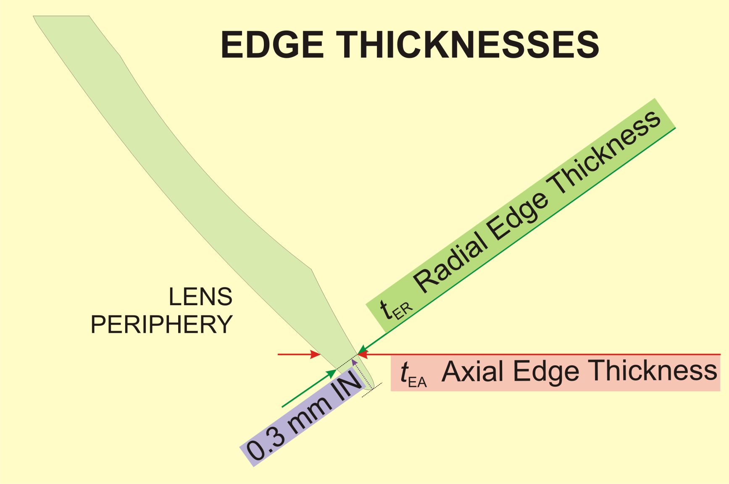
SILICONE HYDROGELS SiHy CL PARAMETERS (ISO)

Slide 44
SILICONE HYDROGELS FITTING CRITERIA
Essentially, fitting criteria same as for conventional hydrogel CLs
good & reliable centration & corneal coverage in primary & lateral gaze
some movement in the primary gaze position with the blink (0.2 – 0.5 mm)
some lag in up-gaze with corneal coverage maintained in all ‘normal’ positions
‘normal’ SCL lower-lid push-up test results
CL readily displaced (no undue force required)
CL recentres smoothly, promptly, & reliably
no conjunctival indentation
good & stable vision

Slide 45
SILICONE HYDROGELS BOZR SELECTION
As for hydrogel CLs, SiHy CLs are fitted flatter than K (central [≈3 mm] measure of corneal curvature)
accounts for flattening peripheral corneal profile, limbal bridging, & perilimbal conjunctival/scleral curvature (TD > HVID)
SiHy CLs are more rigid than hydrogel CLs - no need to fit them as flat (Hy CLs: 0.7 – 1.0 mm flatter, SiHy CLs: 0.4 – 0.8)
Any edge buckling is unacceptable
Notes:
Edge buckling or fluting is more likely in wearers with steep corneas (assumption: steep cornea indicates a steep anterior eye topography, an assumption that is not true universally) and higher Rxs. The latter in combination with lens rigidity means the lens centre (plus powers) or the edge of the optical zone (minus powers) is the most rigid zone and the thinner CL periphery is more likely to attempt to conform. Buckling is the result of a difference between the edge circumference of the CL unflexed (greater) and the CL circumference when/if conforming to the eye (smaller). If conformance cannot be achieved, the excessive circumference appears as convolutions or folds in the lens edge to accommodate the difference. More flexible materials are more likely to compress and conform as a result of lid pressures and hydrostatic forces meaning there is no practical difference in circumferences, hence no buckling/convolutions are required.
Generally, if any apparent buckling has not subsided within 10-15 minutes success in the longer term is unlikely.

Slide 46
SILICONE HYDROGELS BOZR SELECTION
Most SiHy CLs use ‘universal fit’ approach – one BOZR only (one size fits all)
If two BOZRs are available, trial the steepest first unless K readings are < 44 D
too much emphasis on Ks being representative of anterior eye’s topography is unwise
flatten only if lens movement inadequate
steepen to ↑ centration
If custom SiHy CLs being fitted, follow manufacturer’s guidelines as water contents vary greatly & on-eye behaviour also likely to vary

Slide 47
SILICONE HYDROGELS TD SELECTION
Like hydrogel CLs, SiHy CLs fitted > HVID
usually at least 2 mm > HVID (e.g. HVID: 11.5 mm → TD: 13.5)
Most SiHy CLs only available in one TD
Minimum of 0.5 mm coverage beyond limbus recommended
Custom SiHy CLs offer almost unlimited choices
useful for unusual or difficult cases
Important to recognize CLs that are too small & centre poorly, or too large & restrict tear exchange

Slide 48
SILICONE HYDROGELS TD
SiHy CLs dehydrate in situ significantly less than hydrogels, especially high water lenses Therefore:
Important to realize they maintain their TD on-eye
They appear larger than equivalent hydrogels even after settling
A SiHy CL that is too large at insertion is likely to remain too large subsequently

Slide 49
SILICONE HYDROGELS FITTING: EFFECT OF TD CHANGES
LOOSER
IDEAL FIT
TIGHTER
Too SMALL
CORRECT
Too LARGE

Slide 50
SILICONE HYDROGELS FIT: EFFECT OF ΔTD, ΔBOZR, ΔSAG
Notes:
Fit of SiHy and hydrogel CLs is related largely to the sagittal height (sag) of the lens. Any combination that ↑ the sag of a CL will tighten the lens fit. Likewise, a ↓ in sag will loosen the fit. Combinations that maintain the lens sag height should result in similar fitting behaviour.

Slide 51
SILICONE HYDROGELS SAME PARAMETERS = SAME FIT?
Same BOZR *
Same TD *
Same t _{C}
Same Rx *
but...
Different surface designs
Different Sag
Different material *
= Expect DIFFERENT performance!
* = Usual label data
Notes:
The naïve and the not so naïve default to the concept that if the ‘numbers’ are the same then CL interchangeability ensues. This is suggestive of a lack of understanding of all the factors involved in defining the fitting behaviour of a CL, any CL. Even if CLs are identical except for the material, the on-eye behaviour can still be quite different.

Slide 52
SILICONE HYDROGELS t_{C} SELECTION
As most SiHy CLs are stock CLs, no choice is offered (range 0.07 mm to 0.1 mm in spheres, thicker in torics)
If custom SiHy CLs contemplated, similar t_{C} range recommended
In small number of wearers who are well adapted to thin hydrogel CLs, it is conceivable that they may have difficulty adjusting to thicker & more rigid SiHy CLs

Slide 53
SILICONE HYDROGELS EDGE DESIGN
SiHy CL design based largely on conventional hydrogel CLs
Consideration required for material properties, especially Young’s modulus of elasticity
Rounded edge with apex slightly towards posterior surface (GP-like) probably best
Avoid excessively thick edges (more a problem of custom, lathed SiHy CLs

Slide 54
SILICONE HYDROGELS SURFACE FINISH
In rare cases some wearers with overly sensitive lids may be intolerant of some SiHy CL surface finishes
not likely in SiHy CLs that are not surface treated

Slide 55
SILICONE HYDROGELS FITTING: ASSESSING
Again, hydrogel criteria apply
white light (diffuse usually adequate)
little or no magnification
naked eye adequate for initial assessment
with slit-lamp, low - medium magnification (5X-15X), assess:
the conjunctiva at & beyond lens edge, including during lens movement (manipulate lens if necessary)
speed of lens movement
reliability & accuracy of lens recentration
after blink or push-up test or deliberate decentration
confirm no edge fluting (check @ 6 o’clock), indentation, or inadequate coverage

Slide 56
SILICONE HYDROGELS FITTING ASSESSING contd...
Fluting or edge lift-off unlikely to settle or disappear without changing lens type or lens parameters
usually accompanied by discomfort
Assessment valid after 5-10 min unless obvious tearing induced by lens insertion
actual time depends on water content (higher requires longer)
Although used infrequently outside research clinics, high-molecular weight fluorescein may reveal heavy corneal bearing areas, e.g. @ transitions on back surface
SEALs may result (↓↓ with newer SiHy CLs)
Notes:
An occasional problem seen with the first generation of SiHy CLs was the return of Superior Epithelial Arcuate Lesions (SEALs). This was probably a result of lens back-surface design combined with their material’s relatively high elastic modulus (Young’s modulus). A lens redesign resolved most of the previous problem cases and the lower moduli of subsequent SiHy CLs has seen the problem almost disappear from clinical practice once again (for more details and a history of SEALs see 7L2, Module 7, Slide 267 onwards). See the next slide for a diagrammatic explanation of the widely-accepted hypothesis of Dr Graeme Young of the UK.
Young G, Mirejovsky D, 1990. A hypothesis for the aetiology of soft contact lens induced superior arcuate keratopathy. ICLC. 20: 177 – 182.

Slide 57
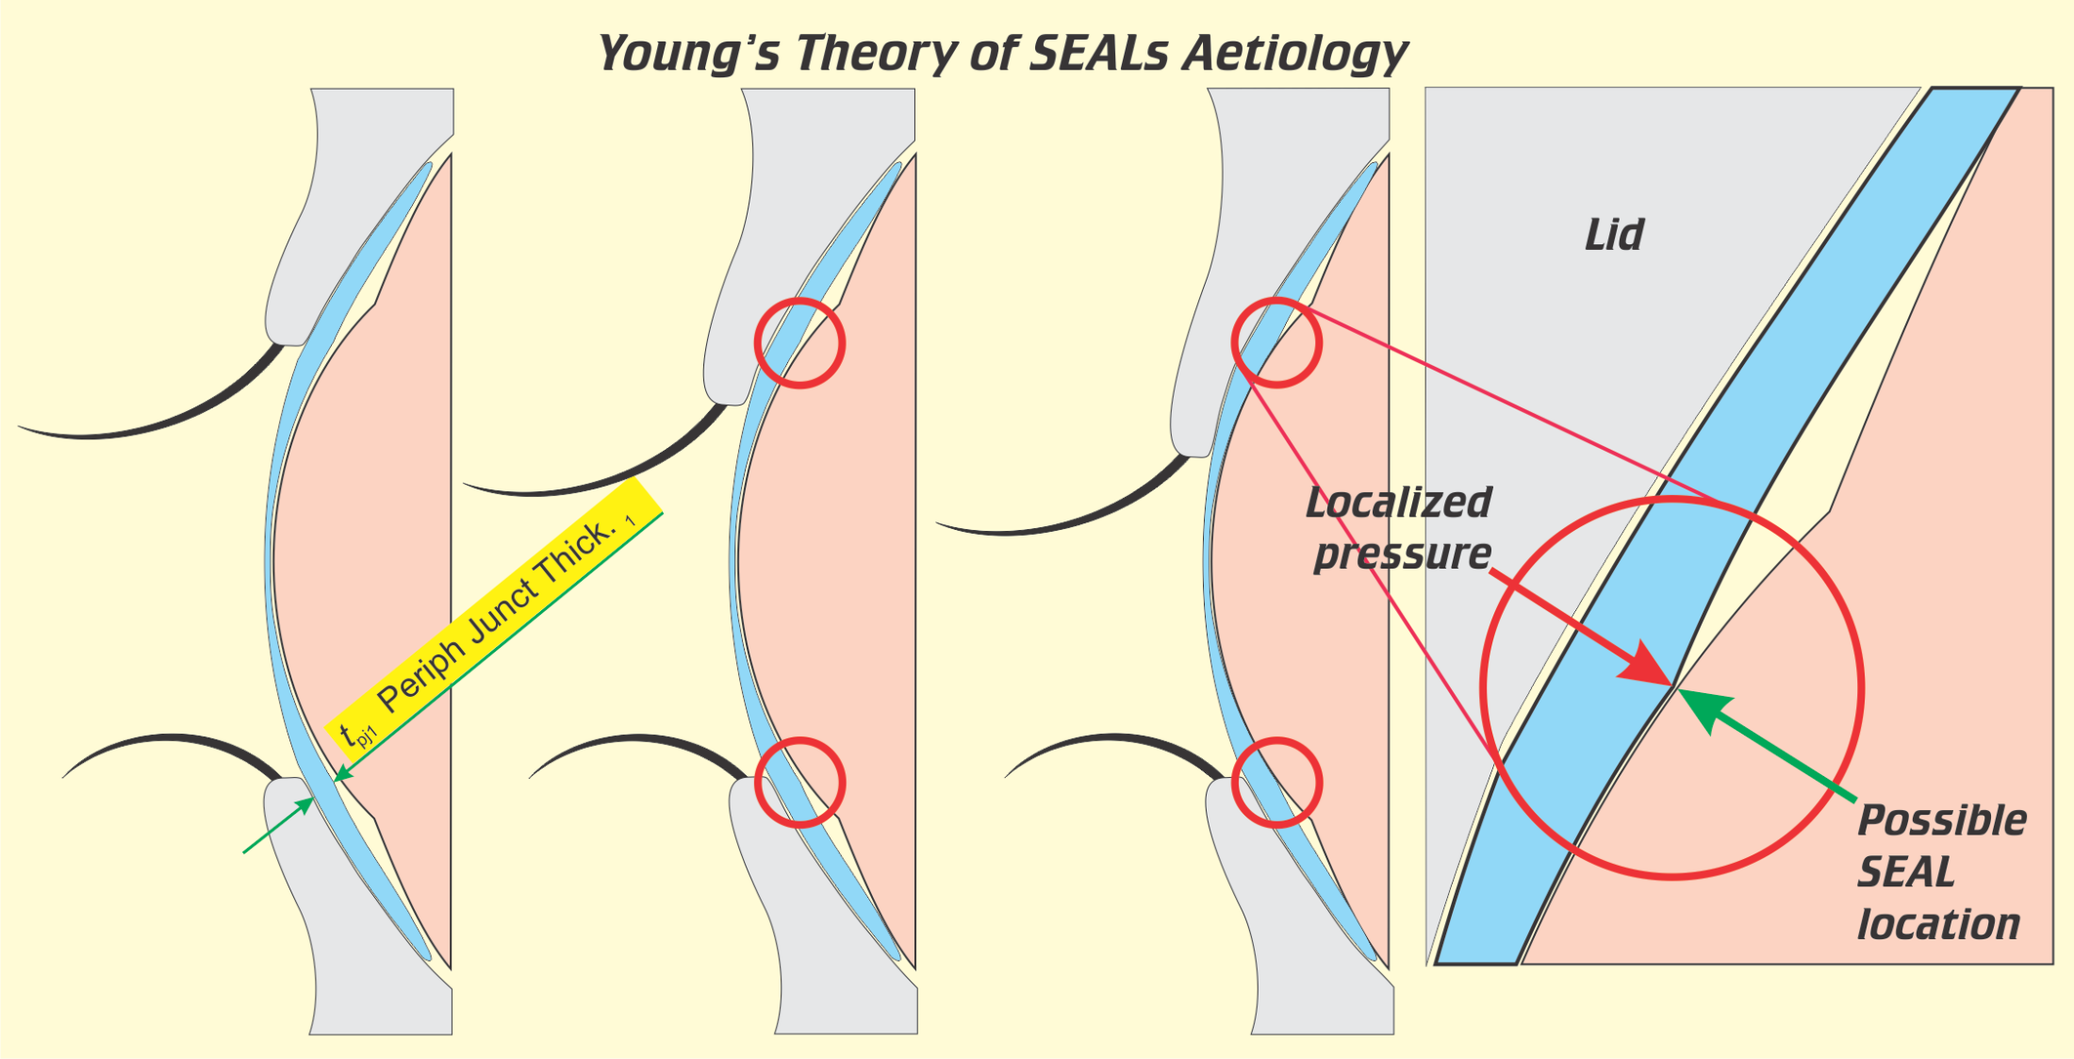
SILICONE HYDROGELS SEALs: YOUNG’S THEORY
Stages of a blink
Enlarged view
Notes:
These diagrams show a possible scenario for the aetiology of SEALs according to Young’s hypothesis. The lens junctions are exaggerated in these diagrams and manufacturers collectively do an excellent job in blending intersecting curves or in many cases create continuously varying surfaces or aspheric surfaces that do not incorporate detectable ‘junctions’. Some of the pressure applied to the cornea is lid pressure transmitted by/through the CL. Junction thickness variations can act as load points or load zones at which location epithelial disturbances can lead to SEALs in its many manifestations (see 7L2, Module 7, Slides 267 onwards for more details).
Young G, Mirejovsky D, 1990. A hypothesis for the aetiology of soft contact lens induced superior arcuate keratopathy. ICLC. 20: 177 – 182.

Slide 58
SILICONE HYDROGELS FITTING ASSESSMENT contd...
If EW/CW contemplated, enhanced lens movement should be sought provided comfort not compromised
lens tightness usually rated on 0% (CL slides from cornea on lid retraction) to 100% (CL appears bound to the eye) or some other suitable & validated rating system with clear end points and a desired ‘tightness’ somewhere mid-range. In 0-100% scheme, 50% considered optimum
EW/CW requires <50%, i.e. tending looser, but coverage in all reasonable eye positions still required

Slide 59
SILICONE HYDROGELS DISPENSING
Similar to other soft (hydrogel) CLs
Special instructions:
do not change prescribed LCPs without seeking professional advice
return in 1 day/1 week/1 month, or as appropriate (practice’s policy)
confirm refractive status on each possible occasion
follow the prescribed wear regimen
vary only after seeking advice
use a rubbing care regimen

Slide 60
SILICONE HYDROGELS FITTING, DISPENSING, AFTER-CARE
Fitting, dispensing, & after-care considerations relate mainly to their ↑ modulus of elasticity (especially the earlier materials), their ↓ on-eye dehydration, & their ↑↑ O₂ permeability (∴ transmissibility)
It is essential that the practitioner recognize a CL that → unsatisfactory performance & to know when to discontinue with a particular CL type, especially in EW applications
Notes:
With a relatively wide range of suitable products now available (aided by the wider availability of custom SiHy CLs as well) there are now viable alternatives to most CL-fitting situations. Should a particular SiHy CL series fail to provide a satisfactory solution to a particular problem it is probably better to switch to an alternative sooner rather than later, i.e. do not persist with a CL that seems to be suboptimal early in the fitting process.

Slide 61
SILICONE HYDROGELS LENS ADHERENCE
CL adherence during over-night wear not limited to GP CLs only
conventional hydrogel CLs can adhere
mobility restored 5-10 min after eye opening
SiHy CLs can also adhere during over-night wear
like hydrogel CLs, mobility restored 5-10 min after eye opening
SiHy adherence in DW virtually unknown
Sweeney (2nd edition) recommends 2-3 drops of sterile, unpreserved saline in each eye BEFORE & AFTER each sleep period
flushes debris & facilitates lens movement
Notes:
Sweeney DF (Ed.) (2004). Silicone Hydrogels (2nd ed.). Butterworth-Heinemann, Oxford.

Slide 62
SILICONE HYDROGELS FITTING IN EW/CW
Before EW/CW undertaken:
CLs must be comfortable
try DW for 1 week first
0.2-0.3 mm primary-gaze CL movement
complete corneal coverage in all directions of gaze
45-50% tightness with push-up test
any edge lift/fluting/buckling is unacceptable
lens fit is unlikely to alter significantly over time
what is observed initially is the actual situation
if poor initially, do not proceed
lens adaptation does not occur

Slide 63
SILICONE HYDROGELS VISION
As it’s the normal reason for CL wear, vision quality is of paramount importance
For satisfaction, vision must:
be good or better with no significant blur
quality sustained over whole wearing period
be stable (fluctuation-free in most situations)
not exhibit haloes
be flare-free
Failure to deliver good vision is likely to be the result of lens deposits and/or poor pre-lens tear film quality or ...
unstable or suboptimal lens fitting
edge buckling/fluting/lift-off

Slide 64
SILICONE HYDROGELS Rx
Largely because of rigidity, power of SiHy CLs sometimes difficult to correlate with previous standard or thin hydrogel CLs. This is particularly true with plus/high plus Rxs
Trial SiHy CLs must be allowed to settle fully before finalizing the Rx if an optimum result is to be achieved
Trial lens should be of similar power to the expected final Rx, especially in plus/high plus Rxs

Slide 65
SILICONE HYDROGELS HYPEROPIC SHIFTS
Early experience with 1st generation SiHy CLs showed occasional Rx changes (Dumbleton et al., 1999, Dumbleton, 2003, Mountford, 2003)
hydrogel CLs → small ↑ myopia
hypoxia-related, reversible
SiHy CLs → ↑ hyperopia/↓ myopia (albeit less frequently)
can be significant (up to 2.00 D reported)
worse in high Rxs & EW (Tehhan, 2004)
← corneal curvature changes
↓ by changing to DW & lower modulus materials
effect likened to unintended orthokeratology
Notes:
The physical properties of SiHy CL materials have clinical ramifications that cannot be ignored.
Terry et al., 1993 postulated that CL-induced Rx changes should be limited to <±0.50 DSph & ±0.75 DCyl. SiHy CLs, particularly the early generations were known to exceed these limits occasionally.
In addition to any early comfort issues with SiHy CLs, an additional motivation for the development of less rigid SiHy polymers was the corneal curvature alterations seen in up to 12% of hyperopic SiHy CL wearers. What remains unexplained is the failure of these reported Rx changes to manifest themselves immediately after commencement of lens wear rather than the weeks or months later reported (e.g. Mountford, 2003). For this reason alone the allusion to ortho-K is not particularly accurate because ortho-k effects usually occur from the outset and the greatest change usually occurs during the first overnight wear (usually with a rigid lens however). Regardless, all the evidence points to corneal curvature changes as the dominant cause of the refractive changes. Later generation SiHy materials exhibit such changes infrequently and corneal physical properties are more likely to be a factor in any changes seen with these more recent generation CLs.
Dumbleton K et al., 1999. Changes in myopic refractive error in nine months extended wear of hydrogel lenses with high and low oxygen permeability. Optom Vis Sci. 76: 845 – 849.
Dumbleton K, 2003 (June Editorial). Refractive error and corneal curvature issues with silicone hydrogel lens wear. Silicone Hydrogels website archive accessible through: www.contactlensupdate.com.
Mountford J, 2003 (August Articles). Unintended orthokeratology effect of silicone hydrogels on hypermetropic patients. Silicone Hydrogels website archive accessible through: www.contactlensupdate.com.
Tahhan N , 2004 (April Editorial). Vision and silicone hydrogels. Silicone Hydrogels website archive accessible through: www.contactlensupdate.com.
Terry R et al., 1993. CCLRU standards for success of daily and extended wear contact lenses. Optom Vis Sci. 70: 234 – 243.

Slide 66
SILICONE HYDROGELS PRACTICAL FITTING ADVICE
At insertion, minimize contact between fingers & CL → ↓ surface greasing &, in long-term, ↓ lipid deposits
If CL placed on sclera initially, manipulate into place by finger pressure through the lids or ask the patient to look towards the lens – avoid direct finger contact
Most wearers comfortable ≤ 3 days
if not adapted by 7 days, refit with a different SiHy CL
try one with a lower modulus
refit with hydrogel CL as last resort

Slide 67
SILICONE HYDROGELS MUCIN BALLS
In post-lens tear film (PLTF)
Initially described in association with hydrogel & GPs CLs (Fleming et al.,1994)
Much more common in SiHy CL wear
Can be:
small (10-20 μm), round, transparent (typically)
larger (20-50 μm), round, opalescent (typically)
seen within minutes of insertion
↑ size & ↑ number during initial lens wear
usually in upper quadrant, beneath resting lid
appear trapped against cornea (does not move with CL)
mucin balls indent the intact epithelium & CL
Notes:
Fleming C et al., 1994. Pre-corneal deposits during soft contact lens wear. Optom Vis Sci. 71(suppl): 152 – 153.

Slide 68
SILICONE HYDROGELS MUCIN BALLS contd....
Confocal microscopy shows indentation depth to be lower than surrounding Bowman’s layer (Jalbert et al.,2003)
Seen in adapted & unadapted wearers
Tend to be patient-specific
Wearer is totally asymptomatic
No association shown with adverse events or outcomes
EW schedule has little effect on numbers, e.g. 6 or 30 days
Notes:
Jalbert, I et al., 2003. In vivo confocal microscopy of the human cornea. Brit J Ophthalmol. 87: 225 – 236.

Slide 69
SILICONE HYDROGELS MUCIN BALLS contd....
Corneal indentations show fluorescein pooling but not true staining
Absorb sodium fluorescein but not Rose Bengal
Assays show them to be: mucin, tear proteins, little lipid
More likely with steep corneas (Dumbleton et al., 2000)
suggests CL rigidity & a mismatch between cornea & lens back surface implicated in aetiology
altering CL surfaces affects mucin ball numbers
∴ material modulus alone cannot be the cause
Notes:
Dumbleton K et al., 2000. Clinical characterization of spherical post-lens debris associated with lotrafilcon high-Dk silicone lenses. CLAO J. 26: 186 - 192.

Slide 70
SILICONE HYDROGELS EFFECT OF DEPOSITS
CL deposits can affect the fitting behaviour of a lens by increasing the interaction between lids and lens
may →↑ lens movement with a blink
may →↓ wearer comfort
may →↓ vision
↓ lens transparency
↑ lens instability (spherical & toric CLs)
↑ lens rotation in toric CLs
For more on SiHy deposits

Slide 71
SILICONE HYDROGELS SiHy CL COMPLICATIONS contd...
Refitting problem cases
Altering BVP to account for hyperopic shifts
reassess Rx at each after-care visit
investigate any changes (changes now rare)
SEALs – now of historic significance only
lens redesign focusing on thickness profile in the mid-periphery & periphery resolved most cases (see earlier)

Slide 72
SILICONE HYDROGELS SiHy CL COMPLICATIONS contd...
What if a SiHy wearer still has problems after all avenues are explored? Other than spectacles, refitting with non-SiHy CLs is the only option:
conventional hydrogel
GPs
conventional diameters (up to 9.8 mm TD)
large diameter, TD: 9.8 – 12.5 mm
scleral/haptics
mini-sclerals or pre-form sclerals
from impression molding

Slide 73
SILICONE HYDROGELS SiHy CL COMPLICATIONS contd...
Despite high hopes, SiHy CLs have only resolved CL wear complications related to hypoxia
Microbial keratitis and other anterior eye infections occur at a rate similar to that for hydrogel CLs
Inflammatory events also occur at a rate similar to that for hydrogel CLs
Alternative methods, alternative lens materials, or modifications to existing technologies will be required to solve the remaining issues
Notes:
All interested parties (from manufacturers to the end wearers and everyone else in the supply chain) had high hopes that highly oxygen permeable CL materials would result in problem-free CL wear. This has proved not to be the case except for the hypoxia issue. It seems that other effects such as surface deposition, the CL as a foreign body, effects on the pre-corneal tear film, effects on blink rate, retention of sloughed-off epithelial cells, and other effects not necessarily known or understood well, are still in play. The ultimate CL still does not exist - it may never be created because, regardless of the efforts of all involved, any contact lens may simply be regarded as a foreign body by the eye’s defence mechanisms and the latter will simply target the ‘interloper’ in the only ways it knows how. However, suppressing body defence systems is probably not the answer because to do so simply lowers the barrier to entry to other, possibly greater problems, e.g. MK.

Slide 74
SILICONE HYDROGELS SiHY CL LENS CARE
SiHy lens care may require special attention in some wearers
well-tolerated (previously) LCPs not guaranteed to be optimum when combined with SiHy CLs Solution incompatibilities
Special SiHy LCPs (reinforces association)
What about hydrogen peroxide (H₂O₂)
if they’re a problem solver, why wait for a problem to arise?

Slide 75
SILICONE HYDROGELS SiHy CL LENS CARE contd...
Lipid removal usually by alcohol-based cleaner
now more difficult following the discontinuation of CIBA Vision’s Miraflow, an isopropyl alcohol-based cleaner
some local manufacturers offer clone products or other alcohol-based products
Walgreen's Extra Strength Daily Cleaner
Crystal Cleaner from EYEYE
Contopharma I-clean
Optikem Sereine Extra Strength Daily Cleaner

Slide 76
FITTING SILICONE HYDROGELS SUMMARY
Fitted similar to hydrogel CLs
adequate lens movement
unconditional corneal coverage
seek good & stable vision
confirm over-Rx over a SiHy trial lens
prescribe suitable LCPs & emphasize ‘don’t change’ without advice
recommend rubbing during lens care
be clear on intended wear regimen

Slide 77
IACLE INDUSTRY SPONSORS

Slide 78
RESTART

Slide 79
ALL REFERENCES USED
(In alphabetical order)

Slide 80
Abry F et al. (2010) reported in Sivak A (2010), ARVO 2010 Part 2 available at: http://www.siliconehydrogels.org/meeting_synopsis/index.asp (accessed on 2010-Dec-22)
Amos C, 2004. Performance of a new multipurpose solution used with silicone hydrogels. Optician 227(5945): 18 – 22.
Bontempo AR, Rapp J, 1997. Protein-Lipid Interaction on the Surface of a Hydrophilic Contact Lens In Vitro. Curr Eye Res. 16: 776 - 781.
Brennan NA, 2005. Beyond flux: total corneal oxygen consumption as an index of corneal oxygenation during contact lens wear. Optom Vis Sci. 82: 467 - 472.
Brennan NA, 2005. Corneal oxygenation during contact lens wear: comparison of diffusion and EOP-based models. Eye Contact Lens 31: 103 - 108.
Butovich IA et al., 2009. Human tear film and meibum. I. Very long chain wax esters and (O-acyl)-omega-hydroxy fatty acids of meibum. J Lipid Res. 50: 2471 – 2485.
Carnt N et al., 2007. Solution toxicity in soft contact lens daily wear is associated with corneal inflammation. Optom Vis Sci. 84:309 - 315.
Dumbleton K et al., 1999. Changes in myopic refractive error in nine months extended wear of hydrogel lenses with high and low oxygen permeability. Optom Vis Sci. 76: 845 – 849.
Dumbleton K et al., 2000. Clinical characterization of spherical post-lens debris associated with lotrafilcon high-Dk silicone lenses. CLAO J. 26: 186 - 192.
Dumbleton K, 2003 (June Editorial). Refractive error and corneal curvature issues with silicone hydrogel lens wear. Silicone Hydrogels website archive accessible through: www.contactlensupdate.com.
Dumbleton K, 2003. Noninflammatory silicone hydrogel contact lens complications. Eye & Contact Lens 29(1)(Suppl.): S186 – S189.
Efron N, Brennan NA, 1987. How much oxygen? In search of the critical oxygen requirement of the cornea. Contax July: 5 - 18.
Epstein A, 2002. SPK with daily wear of silicone hydrogel lenses and MPS. CL Spectrum. 17(11): 30.
Fleming C et al., 1994. Pre-corneal deposits during soft contact lens wear. Optom Vis Sci. 71(suppl): 152 – 153.
Fonn D, Bruce AS, 2005. A Review of the Holden-Mertz Criteria for Critical Oxygen Transmission. Eye & CL. 31(6): 247 – 251.

Slide 81
Franklin V et al., 2001. Contact lens care: Part 4 – Contact lens deposition, discoloration and spoilation mechanisms. Optician 222(5808): 16 – 20.
Green-Church KB, Nichols JJ, 2008. Mass spectrometry-based proteomic analysis of contact lens deposition. Molec Vis. 14: 291 – 297.
Hall B et al., 2000. Clinical performance of biomimetic soft lenses. Optician 219(5753): 20 – 26.
Harvitt DM, Bonanno JA, 1999. Re-evaluation of the oxygen diffusion model for predicting minimum contact lens Dk/t values needed to avoid corneal anoxia. Optom Vis Sci. 76: 712 - 719.
Holden BA et al., 1984. The minimum precorneal oxygen tension to avoid corneal oedema. Invest Ophthalmol Vis Sci. 25: 476 – 480.
Holden BA, Mertz GW, 1984. Critical oxygen levels to avoid corneal edema for daily and extended wear contact lenses. Invest Ophth Vis Sci. 25: 1161 – 1167.
Hough T, 2007. Contact lens standards Chap 31. In: Phillips AJ & Speedwell L Contact Lenses 5th ed., Butterworth Heinemann, Endinburgh.
Jalbert, I et al., 2003. In vivo confocal microscopy of the human cornea. Brit J Ophthalmol. 87: 225 – 236.
Jones L et al., 2003. Lysozyme and lipid deposition of silicone hydrogel contact lens materials. Eye & Contact Lens 29(1)(Suppl.): S75 – S79.
Jones L, Dumbleton K, 2002. Introducing silicone hydrogel contact lenses. Part 2 – Fitting procedures and in-practice protocols. Optician 223(5840): 37 – 45.
Jones LWJ , 1992. Contact Lens Deposits: Their causes and control. The CL J. 20(1): 6 – 13.
Karlgard CCS et al., 2004. Drying methods for XPS analysis of PureVision ™, Focus® Night & Day™ and conventional hydrogel contact lenses. App Surf Sci. 230: 106 – 114.
Lewis KO, 2009. COMPARATIVE LIPIDOMICS OF HYDROGEL CONTACT LENSES IN VITRO AND IN VIVO. An MS Thesis submitted to the Graduate School of The Ohio State University.
Maïssa C et al., 1998. Influence of contact lens material surface characteristics and replacement frequency on protein and lipid deposition. Optom Vis Sci. 75(9): 697 – 705.
Minarik L, Rapp J, 1989. Protein deposits on individual hydrophilic contact lenses: Effects of water and ionicity. CLAO J. 15(3): 185 – 188.

Slide 82
Minno GE et al., 1991. Quantitative analysis of protein deposits on hydrophilic soft contact lenses: I. Comparison to visual methods of analysis. II. Deposit variation among FDA lens material groups. Optom Vis Sci. 68(11): 865 – 872.
Mountford J, 2003 (August Articles). Unintended orthokeratology effect of silicone hydrogels on hypermetropic patients. Silicone Hydrogels website archive accessible through: www.contactlensupdate.com.
Newman CD, 2003. Silicone hydrogel daily wear and MPS. CL Spectrum. 18(3): 17-19.
Nicolaides N, Santos EC, 1985. The di- and triesters of the lipids of steer and human meibomian glands. Lipids 20: 454 – 467.
Nicolson PC, 2003. Continuous wear contact lens surface chemistry and wearability. Eye & CL.: Science & Clinical Practice 29(1): S30 – S32.
Refojo M (1983). In: Lens Deposits – Adapted from the October 1982 meeting of CLAO. CLAO J. 9(2): 172.
Sariri R, Sabbaghzadeh R, 2001. Competitive absorption of proteins on hydrogel contact lenses. CLAO J. 27(3): 159 – 162.
Sentell KB et al., 2004. Comparison of preservative uptake and release profiles of PHMB from soft contact lens care products by silicone hydrogel contact lenses. Invest Ophth Vis Sci. ARVO Abstracts Vol. 1: 1573.
Simmons PA et al., 1996. Effect of patient wear and extent of protein deposition on adsorption of Acanthamoeba to five types of hydrogel contact lenses. Optom Vis Sci. 73(6): 362 – 368.
Sorbara L et al., 2009. Multipurpose disinfecting solutions and their interactions with a silicone hydrogel lens. Eye & CL. 35(2): 92 – 97.
Subbaraman LN et al., 2006. Kinetics of in vitro lysozyme deposition on silicone hydrogel, PMMA, and FDA Groups I,II, and IV contact lens materials. Curr Eye Res. 31: 787 – 796.
Sweeney DF (Ed.), 2000. Silicone Hydrogels the rebirth of continuous wear contact lenses 1st ed. Butterworth Heinemann, Oxford.
Sweeney DF (Ed.), 2004. Silicone Hydrogels (2nd ed.). Butterworth-Heinemann, Oxford.
Tahhan N, 2004 (April Editorial). Vision and silicone hydrogels. Silicone Hydrogels website archive accessible through: www.contactlensupdate.com.
Terry R et al., 1993. CCLRU standards for success of daily and extended wear contact lenses. Optom Vis Sci. 70: 234 – 243.
T

Slide 83
Tighe B, 2007. In: Contact Lenses 5th ed., 2007 (Phillips AJ, Speedwell L, Morris J Eds.). Butterworth Heinemann, Edinburgh.
Tonge S et al., 2001. Contact lens care: Part 5 – The design and development of wetting and multi-purpose solutions. Optician 222(5817): 27 – 33.
Willcox et al., 2007. Protein and lipid deposits on lenses are affected by lens material and solutions, and associated with clinical performance. 5th International Conference on the Tear Film & Ocular Surface, Sicily, September 2007.
Young G, Mirejovsky D, 1990. A hypothesis for the aetiology of soft contact lens induced superior arcuate keratopathy. ICLC. 20: 177 – 182.
Zhao Z et al. , 2009. Care regimen and lens material characteristics on silicone hydrogel contact lens deposits. Optom Vis Sci. 86(3): 251 – 259.

Slide 85
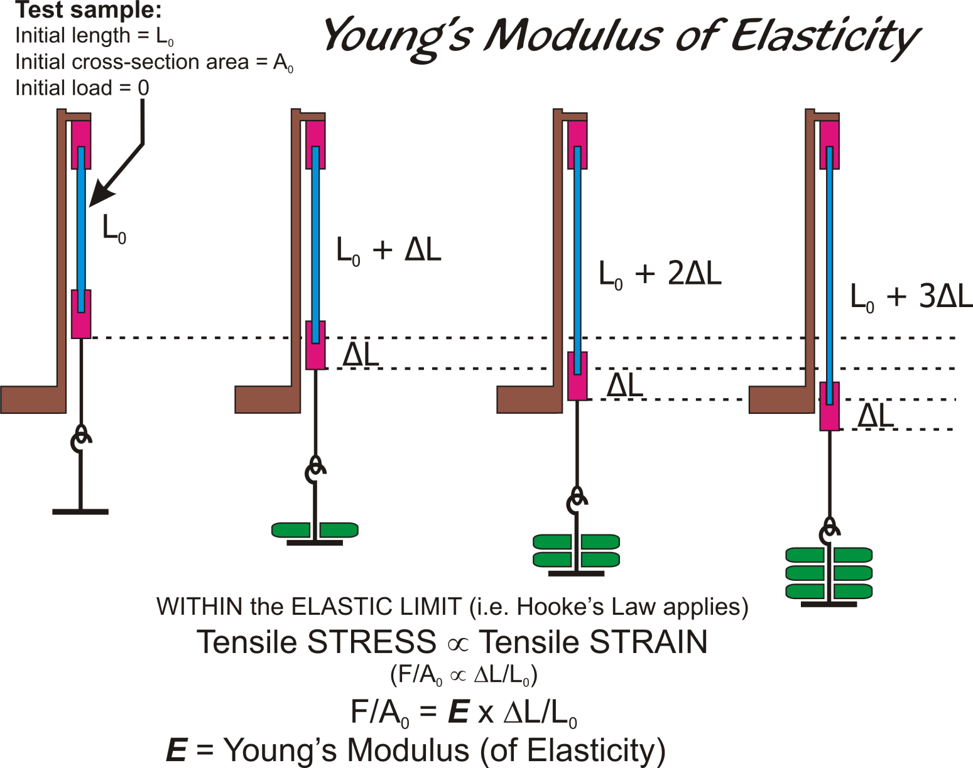
Young’s Modulus of Elasticity
Return
Notes:
These diagrams refer to a perfectly elastic sample (blue) which is stretched (strained) by a load (green) (stressed) such that the sample always returns to its original shape and size once the load is removed, i.e. it does not undergo any plastic deformation (a deformation from which the sample never recovers fully). Note that in the diagrams above, not only does the sample elongate but it also thins as it elongates (think of how a balloon wall gets thinner [and more translucent as a direct result] as the balloon inflates). A return to original dimensions confirms that the elastic limit has not been exceeded and therefore Hooke’s Law applies. Note that Stress has the units of pressure (i.e. force per unit area) while Strain is dimensionless (change in length / original length). While extension is depicted here, all this information applies equally to a sample in compression provided the elastic limit of the sample is again not exceeded.
Young’s Modulus of Elasticity (E) is the constant that completes the equation relating STRESS to STRAIN. Young’s Modulus is sometimes called Tensile Modulus because the sample is subjected to tension (a stretching load coaxial with the sample as in the above diagram) or the Elastic Modulus.
Other moduli exist, e.g. Bulk Modulus (resistance to uniform [all over the sample] compression) and Shear Modulus (or Modulus of Rigidity) (ratio of shearing stress to shearing strain).
If Young’s Modulus E is large then for a given load (stress) applied to a sample, the extension (strain) will be small. A large E is indicative of a relatively inextensible CL material and this means that the material’s suitability for use in CLs is questionable. Generally, materials with low moduli are desired as they conform more readily to the anterior eye and are less likely to cause SEALs. A possible downside is that low-modulus materials tend to be less durable although in normal, compliant CL use their limits are unlikely to be explored and certainly not exceeded.

Slide 86
SiHy CL MARKET
Material (USANC) | Contact Lens Series
asmofilcon A | PremiO (Menicon)
balafilcon A | PureVision(2) (B&L)
comfilcon A | Biofinity (CooperVision)
efrofilcon A | Definitive (Contamac)
enfilcon A | Avaira (CooperVision)
galyfilcon A | AcuVue Advance (J&J)
lotrafilcon A | Focus Night & Day (Alcon)
lotrafilcon B | O₂Optix or AirOptix (Alcon)
narafilcon A | 1-Day AcuVue TruEye (J&J)
senofilcon A | AcuVue Oasys (J&J)
silfilcon A | AirOptix Individual (Alcon)
(ISO) filcon II 3 | Clariti (Sauflon)
Various latheable | Many local custom labs
Return
@ 2012-Aug-27

Slide 87
SILICONE HYDROGELS CL DEPOSITS contd...
After tear film factors, it is probable that the lens material is the next most important consideration
Considerations are:
Chemistry (affects FDA grouping but group is not an exact indication of behaviour (Hall et al., 2000)
contains polydimethylsiloxane (pDMS), silyl groups, both
contains HEMA
contains methacrylic acid (MA)?
contains N-vinylpyrrolidone (NVP)?
ionic or non-ionic? (affects FDA grouping) (Minno et al., 1991)
water content? (affects FDA grouping) (Minarik & Rapp, 1989, Minno et al., 1991)
lens age & wearing schedule
surface treated? (e.g. balafilcon A)
method of manufacture (mold, lathe, combination)
Notes:
The key factors in lens material considerations are the incorporation of pDMS, NVP, and MA & whether the material is ionic & high water or not.
Franklin V et al. (2001). Contact lens care: Part 4 – Contact lens deposition, discoloration and spoilation mechanisms. Optician 222(5808): 16 – 20.
Hall B et al. (2000). Clinical performance of biomimetic soft lenses. Optician 219(5753): 20 – 26.
Jones LWJ (1992). Contact Lens Deposits: Their causes and control. The CL J. 20(1): 6 – 13.
Maïssa C et al. (1998). Influence of contact lens material surface characteristics and replacement frequency on protein and lipid deposition. Optom Vis Sci. 75(9): 697 – 705.
Minarik L, Rapp J (1989). Protein deposits on individual hydrophilic contact lenses: Effects of water and ionicity. CLAO J. 15(3): 185 – 188.
Minno GE et al. (1991). Quantitative analysis of protein deposits on hydrophilic soft contact lenses: I. Comparison to visual methods of analysis. II. Deposit variation among FDA lens material groups. Optom Vis Sci. 68(11): 865 – 872.
Hall B et al. (2000). Clinical performance of biomimetic soft lenses. Optician 219(5753): 20 – 26.
Minarik L, Rapp J (1989). Protein deposits on individual hydrophilic contact lenses: Effects of water and ionicity. CLAO J. 15(3): 185 – 188.
Minno GE et al. (1991). Quantitative analysis of protein deposits on hydrophilic soft contact lenses: I. Comparison to visual methods of analysis. II. Deposit variation among FDA lens material groups. Optom Vis Sci. 68(11): 865 – 872.

Slide 88
SILICONE HYDROGELS PROTEIN DEPOSITS
Total proteins identified: SiHys << conventional hydrogels. Types of proteins deposited: similar for all SiHy CLs. However, CL polymer characteristics may influence the variability observed in some less frequently identified proteins (Green-Church & Nichols, 2008)
Generally, lotrafilcon B, senofilcon A, & galyfilcon A accumulated relatively small amounts of proteins (Zhao et al., 2009), and...
SiHy CLs deposit ↓ protein with most of it being denatured, but ↑ lipids cf. conventional hydrogels (Jones et al., 2003, Lewis, 2009)
Notes:
Green-Church KB, Nichols JJ (2008). Mass spectrometry-based proteomic analysis of contact lens deposition. Molec Vis. 14: 291 – 297.
Jones L et al. (2003). Lysozyme and lipid deposition of silicone hydrogel contact lens materials. Eye & Contact Lens 29(1)(Suppl.): S75 – S79.
Lewis KO (2009). COMPARATIVE LIPIDOMICS OF HYDROGEL CONTACT LENSES IN VITRO AND IN VIVO. An MS Thesis submitted to the Graduate School of The Ohio State University.
Zhao Z et al. (2009). Care regimen and lens material characteristics on silicone hydrogel contact lens deposits. Optom Vis Sci. 86(3): 251 – 259.

Slide 89
SILICONE HYDROGELS: PROTEIN DEPOSITS: ADSORPTION
In vitro, competitive protein adsorption occurs if subsequent protein has more favourable electrostatic interactions with CL
if sequential adsorption occurs → almost total displacement of original adsorbed protein suggesting OR rather than an AND situation
surface charge reversal is possible (surface becomes +)
suggests layering observed in vivo is unlikely to be protein-on-protein
the relevance of in vitro to in vivo unknown
Notes:
Sariri and Sabbaghzadeh (2001) reported that when positively charged lysozyme is adsorbed onto the negatively charged surface of a group IV CL the charges neutralize and the lens attraction to lysozyme is thereby reduced. However, if sufficient lysozyme is already adsorbed, the lens surface charge can actually reverse (surface becomes +ve), i.e. the lysozyme charge dominates and the material becomes negatively charged. The authors noted that this point had been much earlier by Holly. Presumably, once the surface charge is reduced no further lysozyme deposition by electrostatic attraction occurs and this is at least a partial explanation of the plateauing of protein deposition reported by several workers. If other, more electrostatically attractive proteins are introduced subsequently, significant or even almost total displacement/replacement of the previously adsorbed species can occur. Fortunately, most SiHy CLs have little surface charge so they should , theoretically at least, have less of a problem with protein deposits. This is also borne out in practice and there is no report of surface charge reversal to date.
For more information on CL deposits in general & SiHy CL deposits in particular see Lecture 5L2 in Module 5.
Franklin V et al. (2001). Contact lens care: Part 4 – Contact lens deposition, discoloration and spoilation mechanisms. Optician 222 (5808): 16 – 20.
Sariri R, Sabbaghzadeh R (2001). Competitive absorption of proteins on hydrogel contact lenses. CLAO J. 27(3): 159 – 162.
Simmons PA et al. (1996). Effect of patient wear and extent of protein deposition on adsorption of Acanthamoeba to five types of hydrogel contact lenses. Optom Vis Sci. 73(6): 362 – 368.

Slide 90
SILICONE HYDROGELS SiHy CL DEPOSITS contd...
Lipid deposits:
limited solubility in water but can have > solubility in CL materials (Franklin et al., 2001)
advent of SiHy CLs resurrected lipid deposits as an issue, especially if they also contain polyvinylpyrrolidone (pVP or NVP)
lipid mainly from Meibomian glands (secondarily from fingers)
oily tears, thick lipid tear layer & lens dry spots may → ↑ lipid
some conditions ↑ Meibomian gland lipid secretion
bacterial conjunctivitis, chronic blepharoconjunctivitis, meibomianitis
some tear debris has affinity for tear lipids
CL deposition may follow
Maïssa et al. (1998): Lipid deposits penetrate CLs by solubility in lens polymer, slower process than penetration of proteins (via the aqueous phase)
appear as greasy, shiny deposit
difficult to remove. Commonly, form complexes with mucins, proteins, or Ca
cosmetics may contribute to such deposits (Jones, 1992)
Notes:
Franklin V et al. (2001). Contact lens care: Part 4 – Contact lens deposition, discoloration and spoilation mechanisms. Optician 222(5808): 16 – 20.
Jones LWJ (1992). Contact Lens Deposits: Their causes and control. The CL J. 20(1): 6 – 13.
Maïssa C et al. (1998). Influence of contact lens material surface characteristics and replacement frequency on protein and lipid deposition. Optom Vis Sci. 75(9): 697 – 705.

Slide 91
SILICONE HYDROGELS SiHy CL DEPOSITS contd...
pDMS-CONTAINING CONTACT LENSES
Association between polydimethylsiloxane (pDMS) moiety & lipids/lipid deposits has been known since advent of siloxane acrylate (SA) GP CL materials & early silicone elastomer flexible CLs
pDMS is lipophilic & a lipid solvent (Refojo, 1983)
in hydrogels at least, surface lipid deposits ↓ lens wettability & inhibit protein deposition
+ve charged proteins can compete with & replace polar lipids attached to CLs (Bontempo & Rapp, 1997)
Fluorosiloxane acrylates (FSA) that appeared subsequently were <prone to lipid deposition
fluorine component ↓lens lipophilicity (in SiHy CLs as well?)
Material NVP content shown to be a significant factor in lipid deposition
Not all lipids deposit equally nor are they attracted equally to all materials
Notes:
Bontempo & Rapp (1997) showed in vitro that protein adsorption on FDA Group IV (high, ionic) materials decreased the lens’ hydrophilicity thereby making it more susceptible to lipid deposition. However, in turn, lipid deposition renders the surface more hydrophobic which then tends to limit further protein deposition. In Group II materials (low, ionic), +ve charged proteins compete with & replace some polar lipids attached to lenses. They concluded that the interaction between proteins & lipids on a lens surface means that if the surface was particularly attractive to protein, said protein is less likely to bind to the surface and vice versa.
Bontempo AR, Rapp J (1997). Protein-Lipid Interaction on the Surface of a Hydrophilic Contact Lens In Vitro. Curr Eye Res. 16: 776 - 781.
Refojo M (1983). In: Lens Deposits – Adapted from the October 1982 meeting of CLAO. CLAO J. 9(2): 172.

Slide 92
SILICONE HYDROGELS CL DEPOSITS contd...
Cholesterlyl Oleate
Simplified schematic
C₄₅H₇₉O₂
Early results suggest that cholesteryl oleate (cholesterol ester of oleic acid) is the dominant SiHy lens lipid deposit. A contributing factor may be that CHO is the smallest cholesterol ester found in the human tear film. The ‘swordfish’ form of this molecule is not the only form in nature and significant folding is possible
Notes:
As raised earlier, Lewis structural diagrams like this are misleading, albeit ‘convenient’. The aliphatic and cholesterol tails’ actual formations are variable, the rings in the sterol root less so.
Given that lens material components may be only somewhat ‘flexible’ or labile (e.g. GP lens materials) or very flexible and very labile, at the surface at least (e.g. SCL or SiHy materials), it may be some time before definitive pronouncements can be made as to what is actually occurring in CL deposit formation (any lens type) at the molecular or atomic level.
Earlier work (e.g. Hart et al., 1986, Bontempo & Rapp, 1994) raised the possibility that cholesteryl oleate may be a significant lipid lens deposit. More recent work by Wei (Vision CRC, Sydney, personal communication 2009) suggests that at least on SiHy CLs, cholesteryl oleate is a significant lipid deposit component.

Slide 93
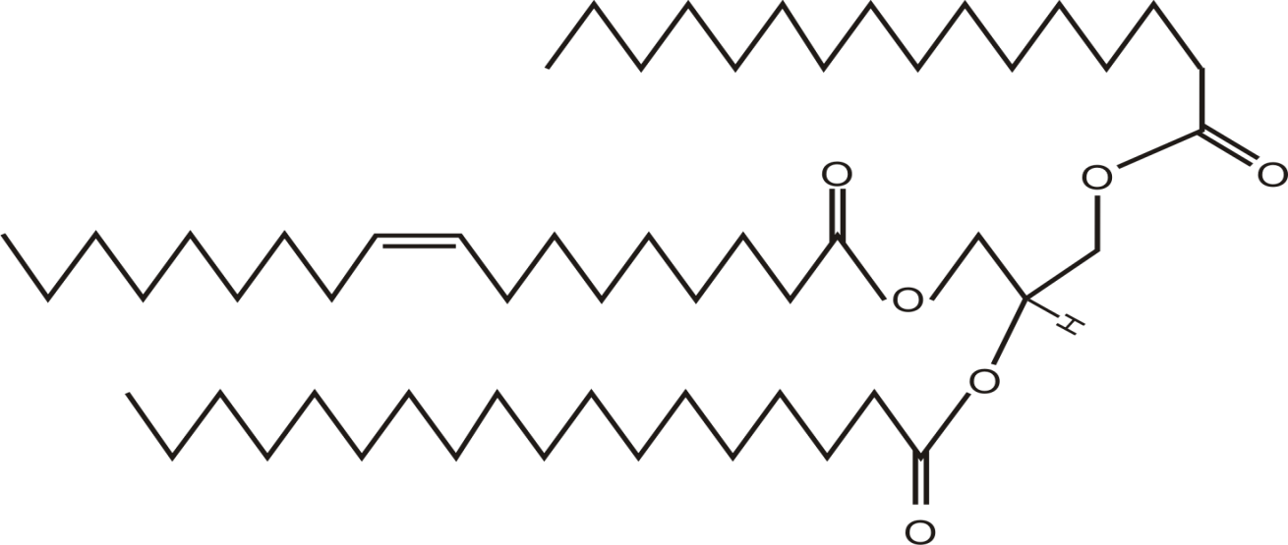
SILICONE HYDROGELS SiHy CL DEPOSITS contd...
Other lipids in meibum
C17
C16
Free fatty acid
Wax Ester (non-poloar lipid)
Simplified schematics
Triglyceride = Tri acyl glycerol = 1 molecule of glycerol & 3 fatty acids
Fatty acid
1
Fatty acid
2
A triglyceride
Glycerol
Fatty acid
3
Notes:
http://www.lipidlibrary.co.uk/Lipids/waxes/ (@ 2009-Sep-11)
http://www.cyberlipid.org/wax/wax0001.htm (@ 2009-Oct-12)
Butovich IA et al., (2009). Human tear film and meibum. I. Very long chain wax esters and (O-acyl)-omega-hydroxy fatty acids of meibum. J Lipid Res. (in Press Fall 2009).
Much of this work is very recent and should be regarded as a ‘work in progress’. As new information comes to light, some old ideas are being either revised or abandoned. In addition to wax esters, Butovich et al. (2009) also reported the presence (>20 observed) of O-acetylated ω-hydroxy fatty acids (OAHFA) (a poorly characterized group of very-long chain lipids whose existence was postulated almost 25 years ago by Nicolaides & Santos [1985] and which are wax ester-related – see next slide).
Nicolaides N, Santos EC (1985). The di- and triesters of the lipids of steer and human meibomian glands. Lipids 20: 454 – 467.
Butovich IA et al. (2009). Human tear film and meibum. Very long chain wax esters
and (o-acyl)-omega-hydroxy fatty acids of meibum. J Lipid Res. 50: 2471 – 2485.

Slide 94
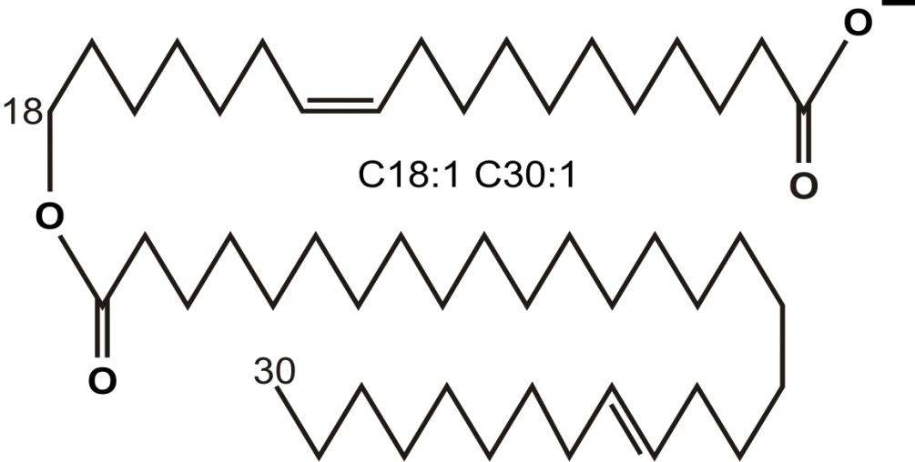
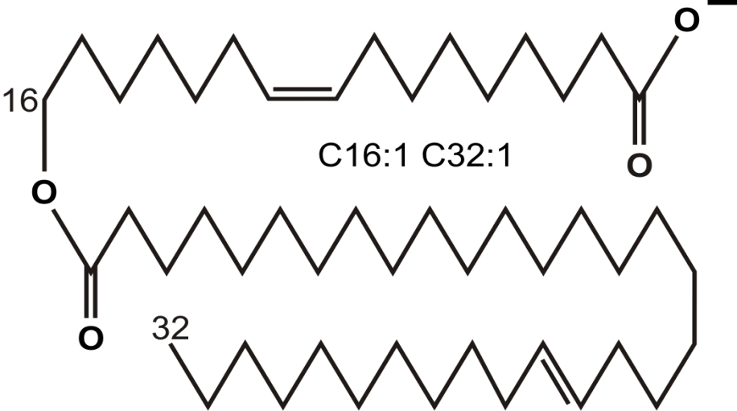
SILICONE HYDROGELS SiHy CL DEPOSITS contd...
Other lipids in meibum
Butovich et al., (2009)
5 OAHFAs identified in human meibum:
C18:1 – C30:1 C16:1 – C32:1 C18:1 – C32:1 C16:1 – C34:1 C18:1 – C34:1
Return
O-acetylated ω-hydroxy fatty acids (OAHFA)
Notes:
http://www.lipidlibrary.co.uk/Lipids/waxes/ (@ 2009-Sep-11)
http://www.cyberlipid.org/wax/wax0001.htm (@ 2009-Oct-12)
Importantly, OAHFAs carry an overall negative charge due to their free carboxyl groups while the other lipids are electroneutral and very hydrophobic. However, under physiological conditions (tear pH ~6.5 – 7.83 – see ICLC Slide 9, 7L4), a large part of this group is ionized thereby providing them with amphiphilic (possessing both hydrophilic & lipophilic properties) and surfactant properties. As there are few phospholipids, ceramides, monoacyl or diacylglycerols in meibum, OAHFAs are suitable candidates for fulfilling the rôle of the ‘bridging’ of the postulated thick, non-polar lipid sub-layer of wax esters, cholesterol esters, triacylglycerols, etc. and the deeper aqueous layer of the tear film. This ‘bridging’ rôle was attributed previously to phospholipids. Butovich et al. (2009) postulated that a finely tuned balance of OAHFAs and other, less polar, components of the tear film’s lipid layer could play a rôle in tear film stabilization (their work on this postulation is ongoing).
Omega-hydroxy fatty acids: formula R-OCH2 (CH2)n CH2 CH2 CH2 COOH (R is H or acyl [H-C-H], and n is an integer of 0 to 18)
Butovich IA et al. (2009). Human tear film and meibum. Very long chain wax esters
and (o-acyl)-omega-hydroxy fatty acids of meibum. J Lipid Res. 50: 2471 – 2485.

Slide 95
