Slide 1
接触镜发展史
A2
2015-May-19

Slide 2
编审者
撰稿人* | Robert Terry Ma. Meredith Reyes
编辑** | Tim Bowden
IACLE 责任编辑** | Janice Jurkus
IACLE 审稿人** | Nilesh Thite, Lewis Williams
更新时间 | 2015年5月19日
内容复审时间 | 2015年5月19日
* 原作者 | **2014 编辑和审稿人

Slide 3
通过教育基金和实物捐赠，IACLE开发和提供隐形眼镜教育
铂金赞助商
白银赞助商
捐赠资助
CIBA Vision Bausch & Lomb
Allergan
AMO
Ocular Sciences
Wesley Jessen
Menicon
Paragon
Pilkington Barnes-Hind
Aspect Vision Care

Slide 4
版权声明
国际接触镜教育者学会是IACLE接触镜镜课程（简称ICLC）所有格式和版本的唯一所有者，受版权保护。若要获得该接触镜材料，您需要同意以下条款：
IACLE接触镜课程只能用于个人或学习用途。未经IACLE书面同意，严禁传播或销售ICLC的全部或部分内容，或将本教材用于教育及个人以外的用途。除以下声明外，不得复制、重新发布、出版或分发ICLC中包含的任何材料。
你可以在个人或教育使用时打印课程材料。所有版权信息，包括IACLE徽标必须保留在材料上。使用ICLC的任何内容，包括文本，图片或注释等必须提供合适的引用标记。

Slide 5
出版 国际接触镜教育者学会(IACLE) 2016修订版 © 国际接触镜教育者学会2000-2015 版权所有。未经国际接触镜教育者学会事先书面许可，本出版物的任何部分不得复制、储存在检索系统中，或以任何形式或传播： 国际接触镜教育者学会 IACLE秘书处， PO Box 656 KENSINGTON NSW 2033 Australia 电子邮件：iacle@iacle.org

Slide 6
简介
截止2019年，全球隐形眼镜市场预计将达到134.7亿美元
2013年全球有超过1.25亿人使用

Slide 7
Introduction介绍
现在的市场包括
化妆美容用途-矫正视力
治疗用途-疾病、手术或创伤后
整形美容用途-改变外观面貌
它进一步分裂（改为分类）为球性，环曲面，透气性硬镜，软镜，多焦点镜片，定期更换，日抛型，可重复使用型，不定期更换型，和角膜塑形镜
在哪?如何使用?什么时候使用
Notes:
The history of CLs is a long & fascinating story but, out of necessity, this presentation can only be an abridged version.
The focus is on the major developments in CLs & lens care in general, & solutions in particular, are ignored. Further, little emphasis is placed on variations in CL types.
Apologies to all the hard-working CL pioneers who have not been mentioned, especially those in countries outside the main CL-pioneering countries whose work went, and continues to go, unreported.

Slide 8
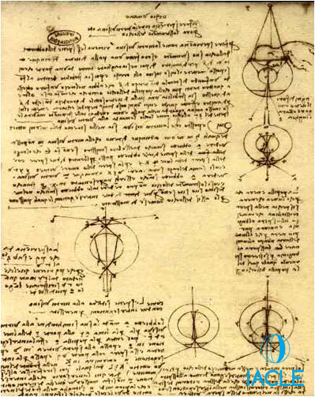
介绍
早期的理论研究者
在公元前25年到公元50年之间，翼状胬肉手术后会使用预防性的亚麻材质的盘子
年，《达芬奇:对开手稿》被认为是接触镜的“发明”。罗伯特·海茨驳斥了这个理论
1637年，勒内·笛卡尔:充满水的管子
1685年，Philip de la Hire:液体矫正近视?
以上研究其实都与真正的接触镜有一定距离
以下两段时期值得被关注
1801, Thomas Young 1801年,托马斯·杨时期
1827, Sir John Herschel 1827年,约翰赫歇时期
Notes:
Roman historian Celcus is reported the have used linen discs inserted into the eye between the eyelids following surgery for pterygium. It is not clear how that surgery was done or how the patient was kept still during surgery as the use of anaesthesia was the best part of a millenium away at that time.
Despite reports to the contrary, Da Vinci, Decartes, & de la Hire really have no relation to the true development of CLs.
However, Thomas Young & John Herschel deserve further discussion.

Slide 9
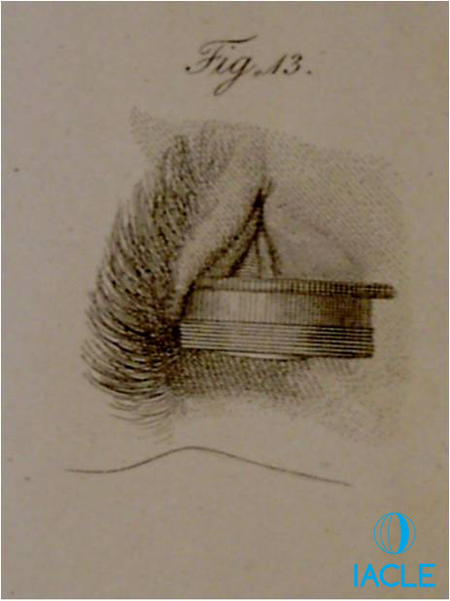
介绍
早期理论研究者
托马斯·杨爵士(1773-1829)是英国著名的内科医生和物理学家
1801年，他的一本书《眼睛的机制》写道：我从一个小的植物显微镜上取了一张照片半径为0.8英寸的双凸透镜，固定在五分之一英寸深的凹槽中。用蜡固定它的边缘，我把它滴入适量的冷水，直到它满了四分之三，然后把它敷在我的眼睛上，这样角膜就会投射到眼窝&与水接触的任何地方。
他展示了角膜的中和作用
没有实用性！
Notes:
There is no mention anywhere that Young ever took the idea any further.

Slide 10
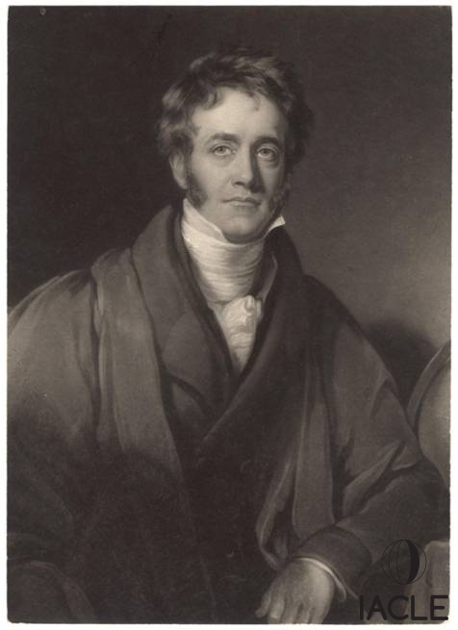
介绍
早期理论研究者
Sir John Hershel
他是威廉·赫歇尔爵士的儿子，他发现了天王星并绘制了北方的天空。约翰爵士绘制了南方的天空
定义了一些摄影术语：正，负，和投射
跟随 George Biddell Airy 做关于散光的研究
写的书：Wrote Treatise Light (1827) & Encyclopaedia Metropolitania
他在那份出版书上留下了批注
Notes:
William Henry Fox Talbot (1800 – 1877) was a pioneer of analogue (film) photography.
Sir George Biddell Airy, (1801 – 1892) was an English mathematician & the Astronomer Royal from 1835 to 1881, establishing Greenwich as the location of the prime meridian (Greenwich Mean Time [GMT] or more commonly now – Universal Time Co-ordinated [UTC] . As only the military can, GMT/UTC is called Zulu Time in military contexts – Zulu is the word in the phonetic alphabet for Z (zed or zee, country-dependent).

Slide 11
n介绍
Sir John Hershel留下的批注：
“如果发现任何非常严重的不规则角膜病例，值得考虑的是， 用一个球形玻璃胶囊中加上一些透明的动物胶，来获得暂时的视力提高;或者用角膜模子加入或嵌入一些透明物质来代替”。
手术当然应该是精细的，但肯定不如切开一只活的眼睛，取出里面的东西来得精细。
Notes:
The last sentence is thought to allude to the various methods available at the time to treat keratoconus. More later

Slide 12
接触镜的诞生

Slide 13
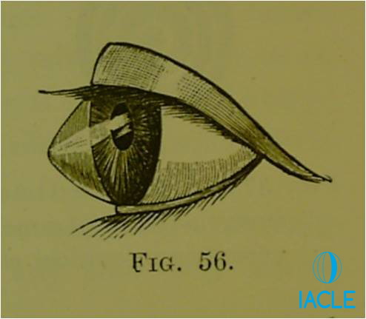
先驱
圆锥角膜
由Mauchart 1748, Taylor 1766和Nottingham 1854所著
治愈”尝试包括:
压迫
深度烧灼
纹身
诱导角膜溃疡
瞳孔重塑手术-水滴状或缝隙
Illustration of Conical Cornea from Conical Cornea Nottingham J, 1854
Notes:
Compression: Using small sacks of sand or similar resting on each closed eye to try to reduce the cone’s ectasia.
Deep cautrey: A hot cautery tool was applied to the apex of the cone (the contracting scar tissue flattens the cornea?). Still being advocated by Sir Stewart Duke-Elder (Ophthalmologist to HM The King of England) as recently as 1946.
Tattooing the apex of the cone to reduce distortions in vision.
Making a small incision in the apex of the cone to induce a corneal ulcer & ultimately, a corneal scar. A very brave option in the days before antibiotics.
Stenopaic slit: A small surgical hook was introduced through the perilimbal cornea, passed partially through the anterior chamber until the edge of the iris could be grasped/hooked. The hook was then retracted thus forming a slit-like pupil (a stenopaic slit). The excess iris was extracted via the incision & excised!

Slide 14
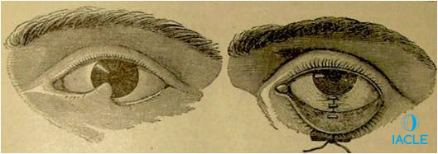
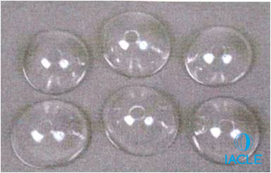
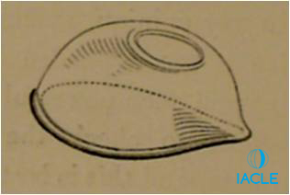
先驱
睑球粘连
眼睛的石灰烧伤导致眼睑附着在球结膜上
尝试结膜移植
铅、银、皮革和其他材料制成的面具或外壳试图分离眼睑和角膜
1859年，眼科医生威廉·怀特·库珀(William White Cooper)戴上了由伦敦戈斯韦尔道(Goswell Road)的格雷与哈尔福德(Gray & Halford)人工眼科医生制作的玻璃面具
这样的设备目前仍然可以使用
Cantor & Nissel 2009
Gray & Halford 1859
Notes:
Conjunctival transplants from mucous membrane from inside the mouth or vagina! No anaesthesia was used.
The motivation for better methods & better results is obvious.

Slide 15
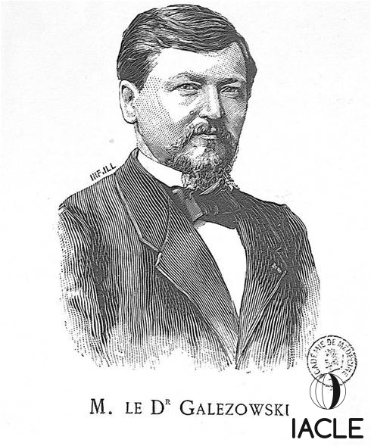
奠基者
Xavier Galezowski (1832 – 1907)
波兰眼科医生，1882年在巴黎工作
建议使用涂有药物的明胶壳治疗角膜脓肿
还建议注入可卡因和汞，以减轻白内障手术后的疼痛和消毒治疗。

Slide 16
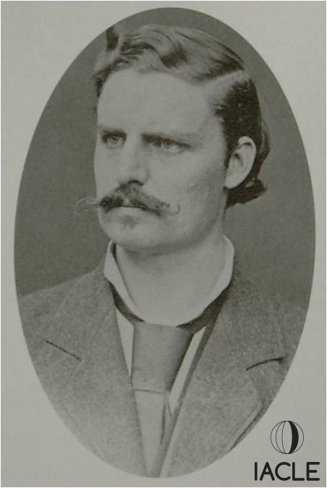
奠基者
Adolf Eugen Fick (1852 – 1937)
德国眼科医生,1888年在苏黎世工作
从事圆锥角膜
他取出兔子和尸体眼睛的模子，在瑞士巴塞尔找了蔡司的恩斯特·阿贝，用Strübin材料制作出了镜片。他尝试将镜片戴在兔子眼睛和自己的眼睛上
Fick’s 现象 = Sattler’s Veil
最终放弃了
Notes:
3 events occurred at around the same time.

Slide 17
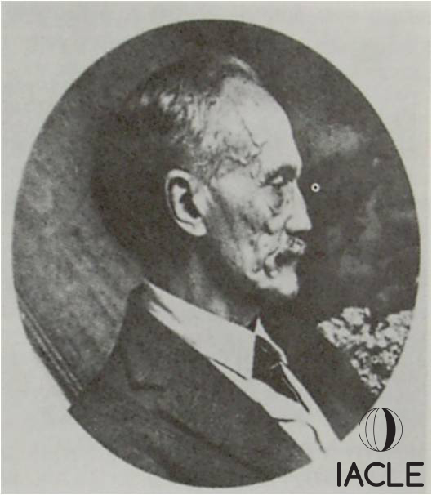
奠基者
Eugene Kalt (1861 – 1941)
法国眼科医生,1888年在巴黎工作
从事圆锥角膜
想要“类似于睑球粘连的镜片”
认为角膜形状可以被镜片改变
提到角膜塑形镜第一人吗?
结果失败
最终放弃了

Slide 18
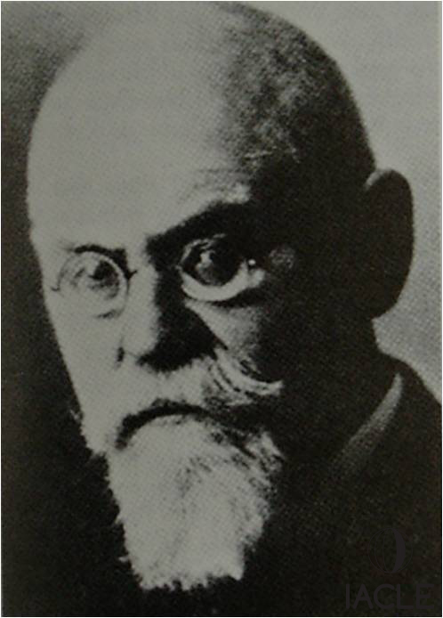
奠基者
August Müller (1864 – 1949)
医学生,1888年
第一个尝试用玻璃镜片矫正近视的人
他是-14.00 D的近视患者
镜片由奥托希姆莱(Otto Himmler)，柏林制作
配戴时间30分钟
用可卡因止痛
最终放弃了
Notes:
Further research on Otto Himmler & those CLs can be found in Pearson R M, 2007. Karl Otto Himmler, Manufacturer of the first contact lens. CL Ant Eye. 30(1): 11 - 16. ISSN 1367-0484. His 3 lenses remain in Munich.

Slide 19
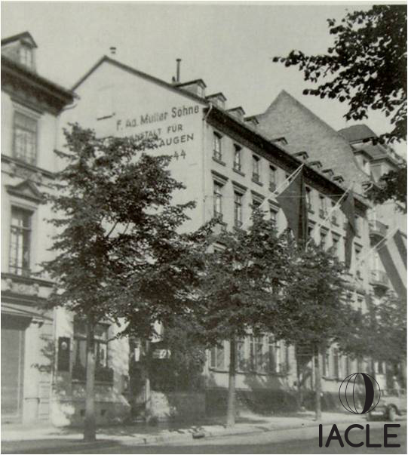
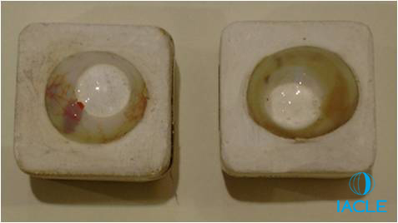
奠基者
F Ad Müller & Söhne, Wiesbaden
人工眼睛制造商
在1887年,制作出棕色玻璃镜片来保护眼睛
舒适度良好
镜片腐蚀很快，每6-9个月更换一次。6 – 10个镜片里才有一个合格的
Notes:
The shell was fitted to protect the eye from dehydration following the removal of the eye lids because of a tumour. The other eye was blind. The patient wore a shell in that eye ‘night & day’ for many years retaining useful vision.
The CLs shown are from a later date & have optical power. For many years CLs from this maker had opaque scleral parts showing their artificial eye ancestry. Generally these blown CLs were comfortable but vision was variable due to the method of manufacture.
The lab still exists today.

Slide 20
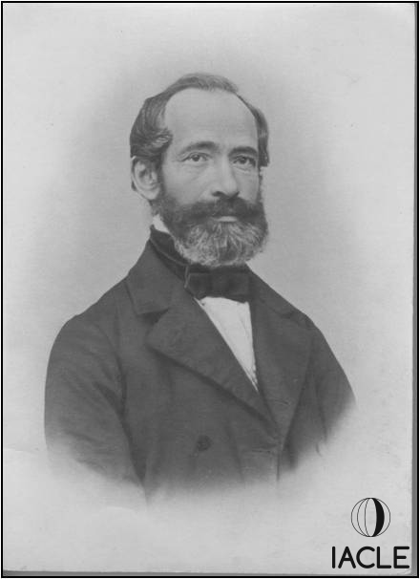
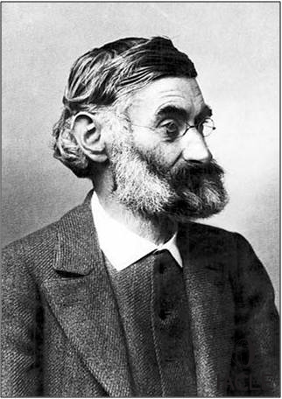
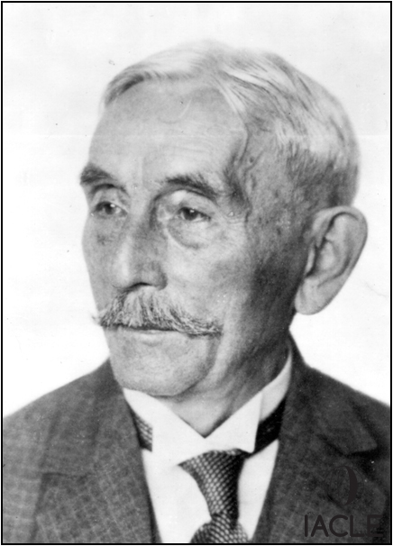
早期发展
Carl Zeiss (1816 – 1888)
Carl Zeiss (1816-1888)
Ernst Abbe (1840-1905)
Otto Schott (1851-1935)
Zeiss company founded 1864
Notes:
As the leading optical company at the time, it was no surprise that Fick contacted Carl Zeiss. He dealt with Abbe as it would have been just before the death of Carl Zeiss himself. That was to unlock a vast amount of work & development with Zeiss becoming the first real manufacturers of CLs, leading the world market until the late 1930s. Abbe was the physicist & Schott the glass expert (a German glass company still bears his name).

Slide 21
卡尔蔡司(1911)
通过塑模制作切削镜片
切削镜片的光学效果更好
第一个提供试戴片的公司
一组试戴片包含21片
镜片没有焦度
通过荧光素染色和白光评估配适
Notes:
12
12
Carl Zeiss of Jena (1911)
In 1920, Zeiss produced a fitting set used to correct keratoconus. That appears to be the 1st trial set of CLs ever produced.

Slide 22
卡尔蔡司(1911)
第一组试戴片的参数:
直径:20毫米
巩膜曲率半径:12毫米
角膜曲率半径:6.50,7.10,8.10和9.00毫米
全套试戴片的参数:
直径:20毫米
巩膜曲率半径:11.00, 12.00 & 13.00 mm
角膜曲率半径: 5.00, 6.00, 7.00, 8.00, 9.00, 10.00, & 11.00 mm
Notes:
12
12
The trial CLs were lathe-cut from molds & gave better optical performance. They were available in the following specifications:
Diameter: 20.00 mm.
Scleral radius: 12.00 mm.
Corneal radii: 6.50, 7.10, 8.10, & 9.00 mm.

Slide 23
卡尔蔡司(1911)
Notes:
12
12
In the 1930s, an expanded set of trial CLs was developed, consisting of 3 diameters & 7 corneal radii. Fitting assessment was done using fluorescein (also possibly a first) & observation of bubble formation.

Slide 24
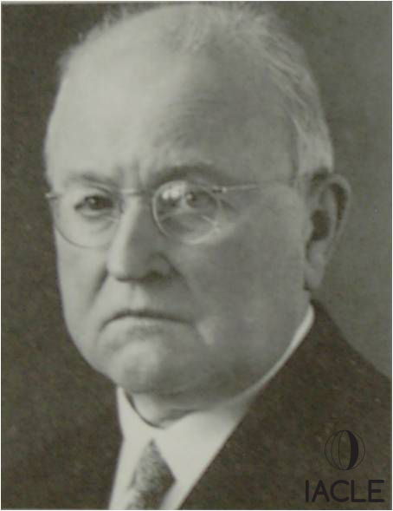
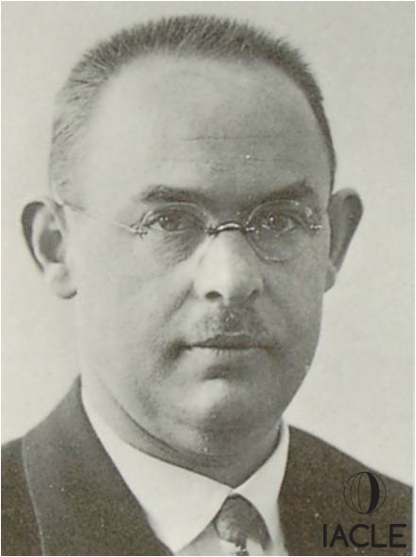
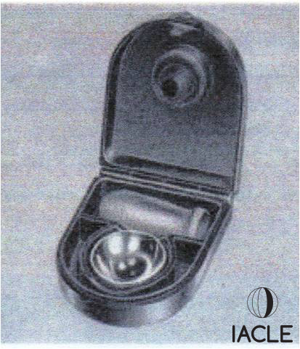
早期发展
Ground-glass fitting sets from 1911
Moritz von Rohr
(1868-1940)
Hans Hartinger
(1891-1960)
Notes:
von Rohr & Hartinger were the main exponents of CLs within the Zeiss company. The CLs were ground from glass & Zeiss were the first to produce fitting sets so ophthalmologists could order lenses from the set.

Slide 25
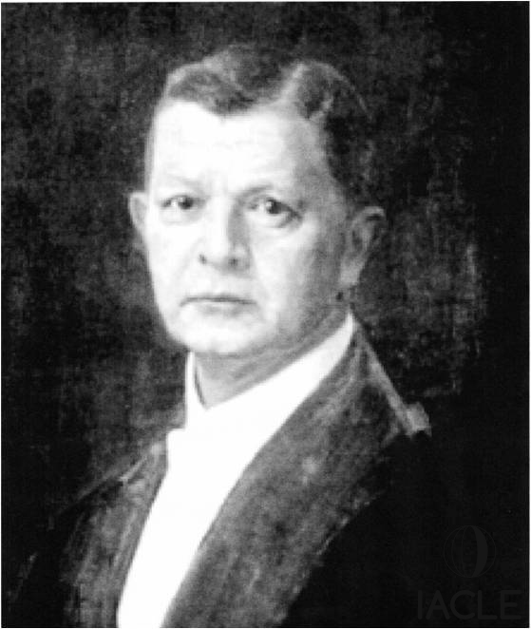
早期发展
Leopold Heine (1870 – 1940)
眼科医生
在1929年论证了无焦度接触镜的使用
为蔡司设计了39个镜片的实验
他是最早推荐接触镜用于美容而非医疗目的的人之一
Notes:
Around this time, CLs were ‘sealed’. There was little or no tear exchange. The afocal CLs were fitted with the intention of the liquid lens (tear lens) trapped under the CL correcting the vision. How it fitted the eye was of secondary importance. Later, the ‘stepping-up’ technique was used whereby a 1% solution of sodium bicarbonate ( Na HCO₃ ) was used to fill the CL prior to insertion. Once the onset of oedema was detected, the CL was removed & it was refilled with a 2% solution. Once the symptoms again returned, a 3% solution was used. That gave an apparently greater veil-free tolerance. Veiling also decreased with regular lens use but that finding is probably not true ‘adaptation’ as most corneal sign &/or symptoms do not adapt generally.

Slide 26
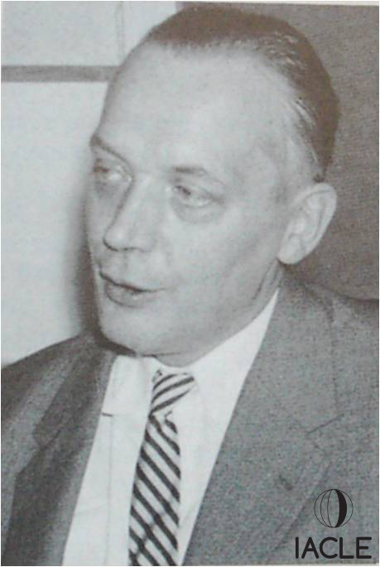
早期接触镜片
Adolph Müller-Welt (1904 – 1972)
人工眼睛制作者的儿子
1927年，非液体状的CLs是吹过出来的玻璃光学镜片。
泪液交换允许更长的配戴时间。
公司在加拿大多伦多成立，后来搬到了伊利诺斯州的芝加哥。
Notes:
As the son of an artificial eye maker,& having been trained in those arts, Müller-Welt made his CLs to follow the contour of the eye so there was an exchange of tears & hence longer wearing times. Based in Stuttgart, Germany he fitted CLs all over Germany during WWII while surviving many Allied bombing raids.
After the war, he re-fitted Joseph Breger, a US War Crimes investigator, which resulted in vastly improved wearing times. Breger encouraged the Müller-Welt family to move to first Canada & then Chicago setting up the Breger Müller-Welt company. Although very successful, personal dissatisfaction caused the partnership to break up & Müller-Welt returned to Stuttgart.
Note:- There is no known family relationship between the Müllers of Wiesbaden, August Müller, & Müller-Welt.

Slide 27
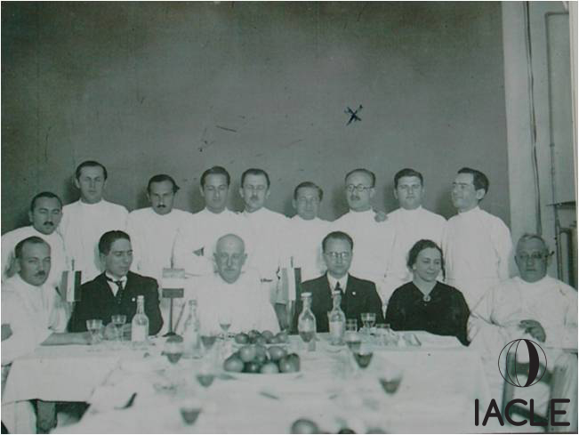
早期发展
Josef Dallos (1905 – 1979)
眼科医生,匈牙利布达佩斯
1930年提出了过渡曲线
1932年,透镜状切削降低蔡司接触镜的厚度
1933年开发了利用 Poller's Negocol的印模技术
由模子制作出的玻璃镜片
1937年来到英国。开了第一家隐形眼镜诊所
考虑角膜的生理学的第一人
Notes:
Initially, Dallos worked with Zeiss CLs suggesting they use a transitions curve between the optic & scleral curves plus lenticulation on the front surface to reduce weight & thickness. Those changes were patented jointly. He was the first to consider the physiology of the eye & moved to develop an impression technique. A cast was made from the mold & that was thrust through a softened glass sheet to form the scleral CL.
He was head-hunted by 3 British ophthalmologists & came to London in 1937 to evade the Nazi occupation on Hungary.

Slide 28
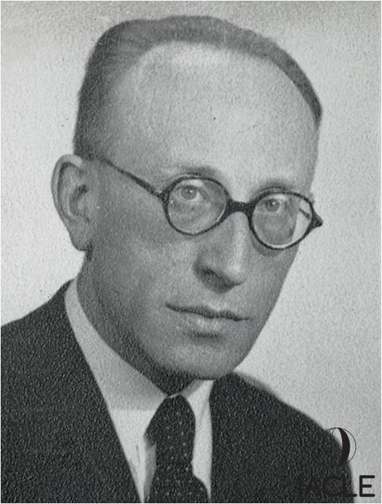
早期发展
Josef Dallos (1905 – 1979)
伦敦穆尔菲尔德医院的眼科医生
和伊达曼夫人一起工作
第二次世界大战造成的芥子气角膜炎需要角膜接触镜来中和角膜变形
在1939年意外发现了接触镜的开窗技术
最终倾向于选择软镜和热杀菌方法。
Notes:
With ophthalmologist Ida Mann, he was involved in the setting-up of the first CL department at Moorfields Eye Hospital where they fitted many patients with mustard gas keratitis from WWI. Over 85 RAF & other allied personnel were fitted with CLs during WW II.
He felt glass was best. When PMMA was made thin enough to be comfortable it was not rigid enough to correct vision. Once SCLs became available, he switched his preference to them. He went on to do much work on the heat sterilization of SCLs.
Dallos & Mann also laid down various CL fitting rules in the UK whereby non-medical people, i.e. opticians & optometrists, could fit CLs.
Fenestration – a small hole drilled through the lens to provide enhanced tear exchange was an accidental development attributed to Dallos.

Slide 29
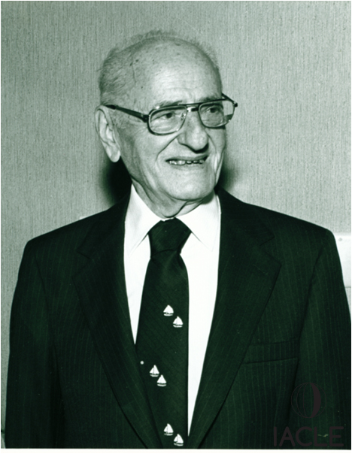
早期发展
William Feinbloom (1903 – 1985)
视光师博士,纽约
1936年，接触镜片采用玻璃角膜切片和塑料巩膜切片
同样在1936年，巩膜双焦点接触镜申请了专利
1937年与B&L公司共同开发了塑料玻璃U系列
主要为圆锥角膜
1940年B&L公司开发了T系列
所有博士伦接触镜退出时，美国进入二战(期间B&L有一个光学弹药焦点)
1946年,他引入所有树脂型接触镜
Feincone
Notes:
Just before the US entered WWII, B&L were ready to launch their T series CLs. They never launched due to the war (WWII).
In 1946, Feinbloom introduced an all-plastic contact lens called the Feincone CL having a spherical corneal part, a flat cone shaped scleral part, & a spherical temporal flange. That CL type was developed later by many others.
In 1961, he devised a complete telescopic CL which he called the Miniscope. This was a Galilean telescopic system constructed as a molded doublet separated by a sealed air space. The total thickness was 4.4 mm.

Slide 30
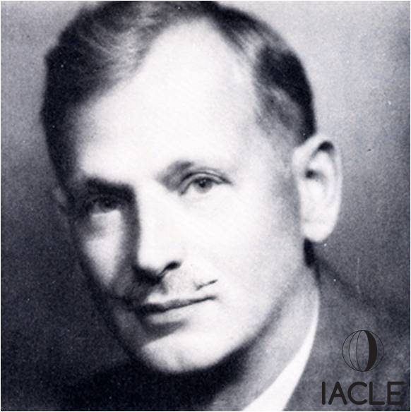
早期发展
Theodore Obrig (1896 – 1967)
1914年加入纽约Gall & Lemke光学公司
发明了双焦框架眼镜镜片
1930年开始对接触镜感兴趣
1936 年发现钴蓝光和荧光素的使用
1940年在纽约成立Obrig 实验室
1942年，出版了第一本关于接触镜配戴的书
Notes:
With Zeiss impression CLs, the practitioner took the mold & sent a cast to Jena in Germany. The finished CLs would arrive after about 3 months. Many had to be returned for modification so CL fitting could take over a year.

Slide 31
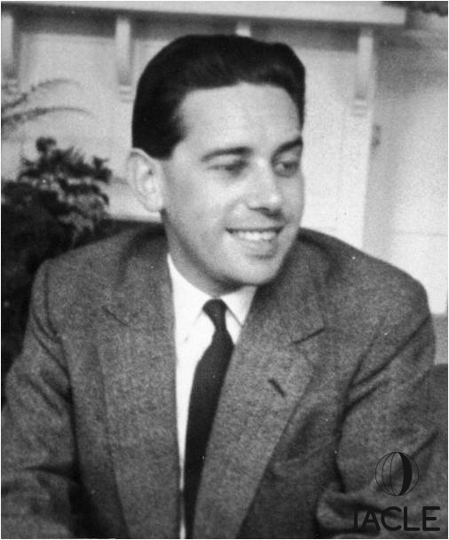
早期发展者
Norman Bier (1921 – 2009)
1943年，伦敦眼科医生，他设计了接触镜的弧。
开窗技术, 1947 获得专利
1947年成立欧米茄隐形眼镜
开发预成型试戴镜片- FLOMs和Bier轮廓接触镜
1958年，发明曲率半径测量仪
1953年写了课本《隐形眼镜常规与实践》
1965年首次提出单眼视的概念
Notes:
FLOM (Fenestrated Lens for Optical Measurement). Bier used the pre-formed CLs to fit the sclera & the FLOM set to fit the optic zone. The 2 separate instructions were then sent to the lab for fabrication.
Invented the radiuscope in 1958 (based on Drysdale’s method). Before then, radii were measured by test spheres, a technique that was not capable of ‘continuous’ measurements (i.e. steps only) & not especially accurate.
He made telescopic LVAs by combining a spectacle lens & a CL.

Slide 32
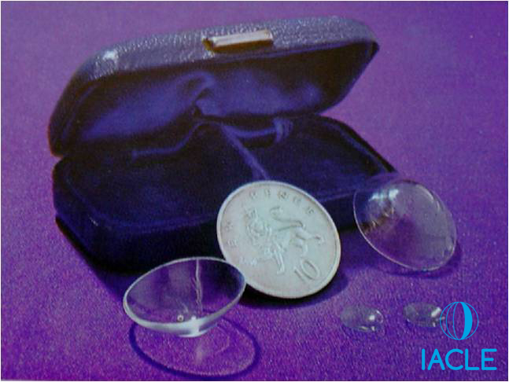
第一批塑料接触镜
PMMA
20世纪20年代末开发，30年代初推出
Röhm of Röhm & Haas, 1933
Hill & Crawford, _{ICI}, granted patent 1934
du Pont, 1937
接触镜的应用:
1937, Teissler (Czech.) CAB 的巩膜镜
1938, Ernest Mullen & Obrig, US
1938, Istvan Györffy, Hungary
1940, Harry Birchall, UK
因二次世界大战被延期
但是，二次世界大战证实了其安全性和加速了材料的更新迭代，广泛应用于飞机的窗户玻璃上
1943, Eugene Hirst (NZ)
1946, Penrhyn Thomas, Australia Corneal Lens Corporation (by Sept., 1949)
What’s in a name?
ICI (UK): Perspex (& later Perspex CQ (clinical quality), also Transpex
Röhm & Haas (Germany): Plexiglas
du Pont (USA): Lucite
Others:
Acrylite, Oroglas
Notes:
Celluloid was used in 1884 for artificial eyes but tended to react with the tears emitting a fetid camphor smell. It was also highly inflammable. As well as optical quality, deposits from the tears were also a problem for Teissler’s CAB scleral CLs.
There are unreleased British Pathé films available from 1938, 1946, 1948, & 1958. The 1938 (country unknown, scleral, possibly Josef Dallos [would have been 33 at that time??]) & 1946 (French, scleral) practitioners & circumstances are unknown but the 1948 clip shows a 30 year old Pen Thomas (Sydney, 1918-2010 [aged 91]) fitting molded scleral CLs: http://www.britishpathe.com/video/contact-lenses (all clips are at the same URL). The 1958 clip shows Wilhelm Söhnges (1905-1985) in action fitting corneal CLs.
It is not clear who was the first to use PMMA however it tended to develop more in the US as Europe was engulfed in ‘other’ matters, like WWII.

Slide 33
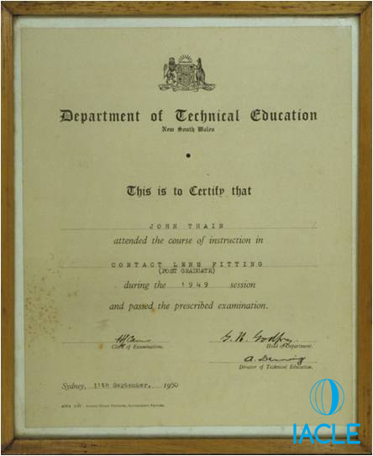
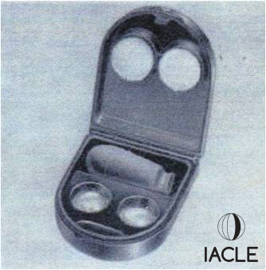
Corneal CLs角膜接触镜
谁是真正角膜接触镜发明人其实并不明确：
F Müller’s 1889 doctoral thesis refers to corneal lenses actually, 15-16 mm in diameter
1912, 1923, 1932, 1965 Zeiss glass CLs
1928, Arthur Osbourne of Hamblin's, London. Experimental CLs for mice
1946, Heinrich Wöhlk, Parabolar, Germany
1946, Dennis England applies for corneal CL patent
1947, Erwin Voss, Argentina
1947, Kevin Tuohy, US – patent 1950
1948, Adolf Müller-Welt, Germany
1949, Penrhyn Thomas, Australia (Lecturer for )
1950, Kyoichi Tanaka, Japan
1950, Butterfield, US, 1951 patent for alignment CL
1957, Bier, UK, Contour PMMA corneal CLs
Notes:
Who was the first with corneal lenses? Take your pick but it was certainly NOT Tuohy. According to Tuohy he had been making a scleral lens & the optic section broke away. He edged this & fitted it to the eye & it worked. This is a familiar story from almost all the CL workers of the time.

Slide 34
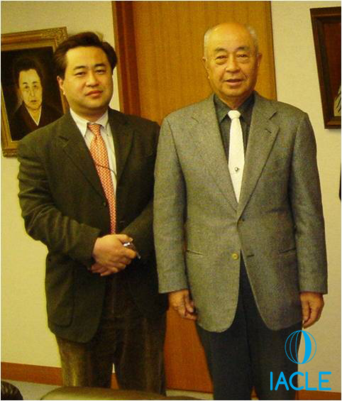
Corneal CLs角膜接触镜
Kyoichi Tanaka (1931 - )
1950, 第一批接触镜在他21岁的时候诞生于日本
用从三菱飞机的挡风玻璃来 雕刻自己的角膜接触镜验
第一批接触镜不能配戴,因为舒适问题
三个月后,接触镜开始配适舒服良好了,一次能制作30个。
成立了后来的东洋接触镜公司，后来的东洋Menicon，后来只是Menicon
Hidanari (President) & Kyoichi (Chairman) Tanaka
Notes:
In 1950, Tanaka was working at a spectacle store. A US officer’s wife asked him to make some spectacle frames but mentioned she usually wore CLs. She refused to show him what they were so he did some drawings of his own eyes & with no previous CL experience, used his father’s bamboo carving tools to carve a pair of CLs.
Menicon, the 5th largest company in the CL world, is the only one still in family control. CL production at Menicon has always been very mechanized.

Slide 35
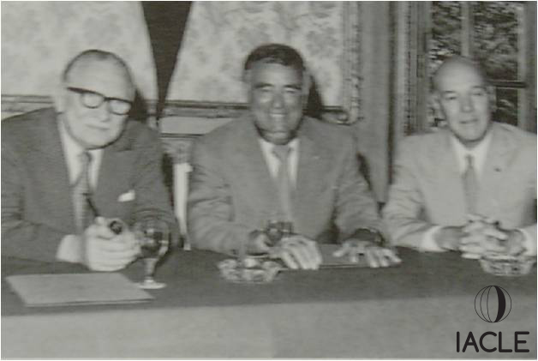
微角膜接触镜
Touhy’s CLs – 直径10-12 mm
Jack Neill (US), Wilhelm Söhnges (Germany), & Frank Dickinson (UK) 发明了微角膜接触镜8-9 mm 直径
1952年这三人共同创立了国际隐形眼镜专家协会(ISCLS)
1946年， Frank Dickinson & Keith Clifford Hall 出版了一本介绍隐形眼镜处方和配戴的书，这是英国第一本技术隐形眼镜教材
Neill (1902-1978), Söhnges (1905-1985) & Dickinson (1906-1978)
Notes:
The Tuohy CL tended to have a TD of 10-12 mm. The micro-corneal had a TD of 8-9 mm. The Clitan CL from Pen Thomas in Australia went down to a TD of 6.50 mm. With no oxygen transmission through the CL, smaller lenses allowed more oxygen to go around the CL.
ISCLS: International Society of Contact lens Specialists. An organization that is still going strong.
It was the advent of the micro-corneal lenses that really popularised CLs in the swinging 60s.

Slide 36
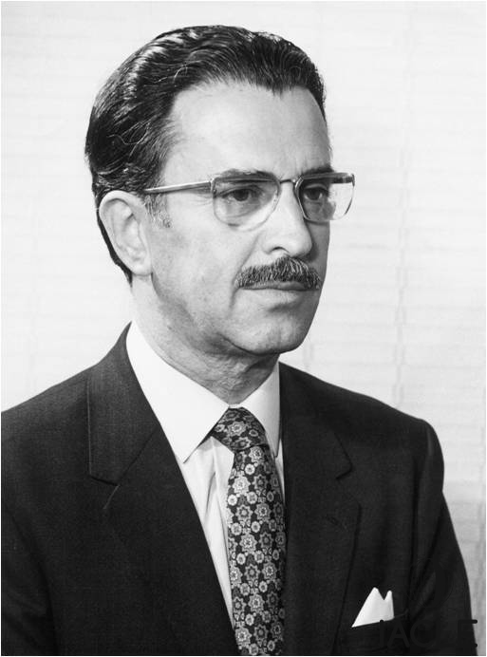
关键制造商
George Nissel (1913 – 1982) & Co.
1937年从特兰西瓦尼亚来到英国伦敦
1946年，成立第一个独立的英国接触镜实验室，Nissel & Co。
制造出生产接触镜的第一台机器
提供给世界上大部分的接触镜实验室
第一个使用电脑程序的进行接触镜设计
在威斯巴登有一个隐形眼镜实验室

Slide 37
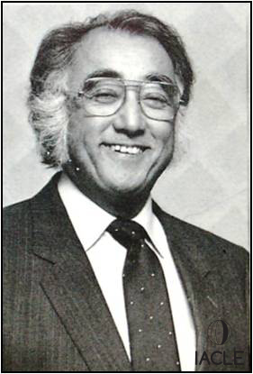
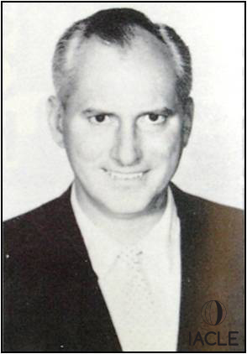
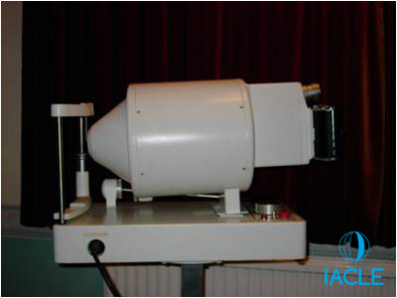
Key Manufacturers关键制造商
Plastic Contact Lens Co., Chicago, 1949
牛顿·K·韦斯利(Uyesugi)(1917 - 2011)，美国眼科医生
George Jessen (1916-1987)
为Wesley’s 圆锥角膜研制PMMA 接触镜镜片
1954年，成立国家眼科研究基金会(NERF)
1956年，Wesley-Jessen球形镜头设计
1959年，英国环球通信公司
1960年，矫形术论文现在被称为矫形学
1969年，光电角膜镜(PEK)，早期摄影地形学家
Wesley
Jessen
Notes:
Wesley was an optometry student of Japanese parentage when he was diagnosed with keratoconus. He worked many hours with George Jessen to find a way of fitting himself with CLs - eventually, successfully. No training courses on CLs were available in those days so Wesley flew himself to give lectures. Eventually set up the Wesley-Jessen company that at one time supplied 85% of all the CLs used around the world.
NERF: National Eye Research Foundation set up to help fund eye & CL research.
The trade marks of W-J included: Sphercon. Sphercon UK was set up with John deCarle & later became Contactalens.
Jessen delivered a paper on Ortho Focus, now known as Ortho K in 1960.
PEK was the Photo Electric Keratoscope developed by Townsly, Mandell, & Jessen. A Polaroid instant picture of a placido disc image was taken & from that a CL was designed using a digitizing technique limited only by the technology of the time. In effect, a very early topographer.

Slide 38
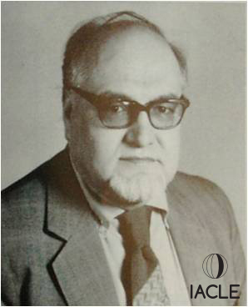
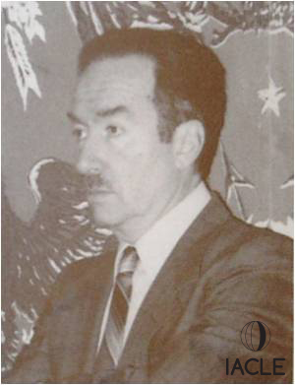
Gas Permeable CL Materials透气性硬性接触镜材料
1968年，唐纳德·科尔布(美国)发明了附盖技术
1970年，Norman Gaylord (1923-2007)， Joe & Lenny Seidner开发了硅氧烷-甲基丙烯酸酯材料
1972年，聚合物技术公司和Perry Rosenthal开发了波士顿材料
1972年，Irving Fatt建议使用醋酸丁酸纤维素(CAB)
1978 FDA approve CAB
1978年，Danker实验室首次在美国生产透气性硬性接触镜
1979年，Polycon首次获得商业成功的GP材料
后来被Syntex公司收购。
1982年,波士顿发展
1983, Don Ezekiel (Australia),巩膜硬性接触镜
1986, Paraperm 长戴型，DK 57
1997, Paragon HDS, Space Shuttle Endeavour, 10年计划
Norman Gaylord
Lenny Seidner
Notes:
This is a very brief timeline on the development of GP materials. Obviously lots more developments have occurred since then with a very wide range of oxygen transmissibilities & surface wetting characteristics.

Slide 39
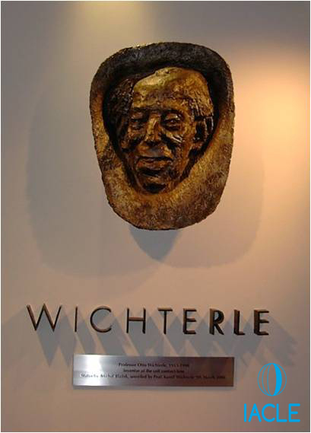
软性接触镜
1952年，Wichterle(1913-1998)和Lim(1925-2003)发明了第一个可膨胀的水凝胶HEMA。
最初打算作为通用的假体材料
1953年，Wichterle首次为软性接触镜申请专利。
1956, 硅树脂弹性体——沃尔特·贝克尔
1957年，Wichterle用封闭的聚苯乙烯模具制造软性接触镜,不成功,一年生产100台
1960年，生物用亲水性凝胶出版。自然185:117 - 118
Notes:
HEMA/pHEMA – poly Hydroxyl Ethyl MethAcrylate

Slide 40
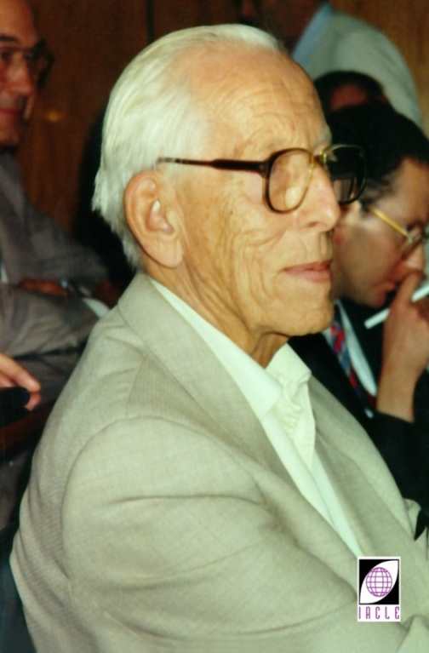
Wichterle & Lim
捷克斯洛伐克科学院大分子化学研究所，布拉格
Otto Wichterle
Dr Drashoslav Lim
Notes:
12
12
Otto Wichterle & Drashoslav Lim (1954)
In 1954, Professor Otto Wichterle & Dr Drashoslav Lim of the Institute of Macromolecular Chemistry of the Czechoslovak Academy of Sciences in Prague, suggested to experts in the medical plastics field that a plastic that more closely simulated living tissue, would be more suitable for orbital implants than the metals then being considered.

Slide 41
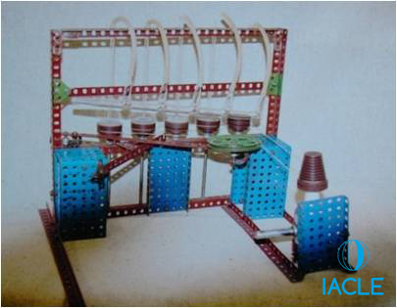
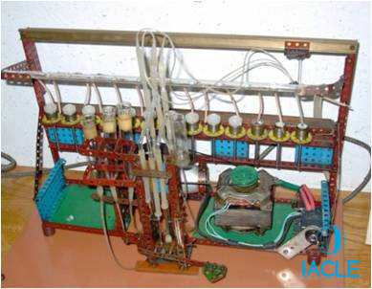
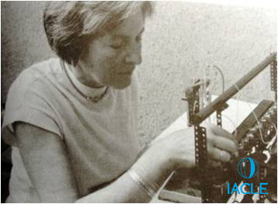
SCLs软性接触镜
Wichterle用他儿子Kamil的一套Merkur构造器(捷克类似于Meccano的构造器)造出了他的第一台自旋铸造机(左上)。ILAMO圣路易斯)
后来，一台更大的机器由留声机马达驱动(左下)。IMC,布拉格)
1961年圣诞节下午，在捷克斯洛伐克布拉格，他的餐桌上制作了第一批接触镜
用他自己的眼睛试了试，他们都成功了
到1961年元旦为止，已经有100多个镜片被生产出来，并为软性接触镜的旋转铸造申请了专利。许多其他专利遵循
在牙科医生琳达的帮助下，接触镜制作完成了
Notes:
The first 1000 CLs were produced from 80% HEMA & 20% diethyleneglycol-methacrylate (DEGMA). Wichterle thought those had diminished mechanical properties so later he made lenses of pure HEMA. Later still, he used cross-linking to make even stronger materials and that methodology survives to this day.

Slide 42
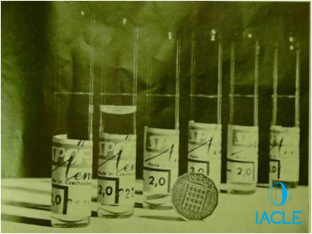
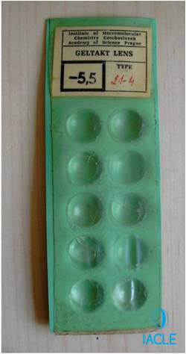
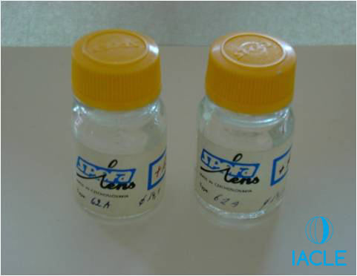
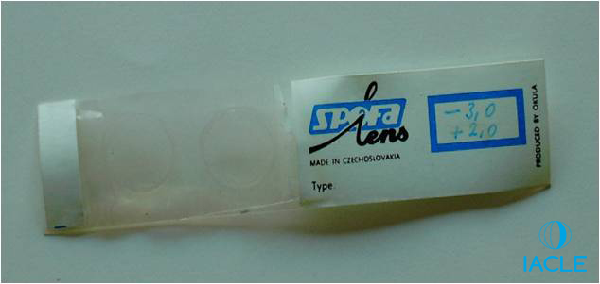
SCLs - Initial packaging ideas软性接触镜-原始的包装创意
Notes:
Top L: Test tube packaging. CLs in distilled water. The tube had to be broken along a pre-scored mark & the CL rinsed to ensure no glass shards were adherent. The CL was soaked for a time in normal saline. The coin in the photograph is a UK threepenny bit – no longer legal tender in the UK.
Bottom L: Later SPOFA (a Czech state enterprise) CLs in screw-top bottles.
Top R: Geltakt CLs stored dry in a molded green plastic tray. Geltakt were experimental CLs.
Bottom R: Two dehydrated SPOFA lenses sealed between two sheets of cellophane. It is not known when that packaging was in use or how it was used. The package example shown is the only one known to exist.

Slide 43
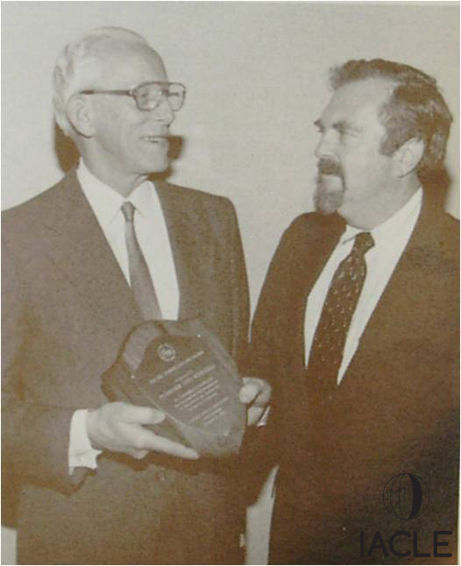
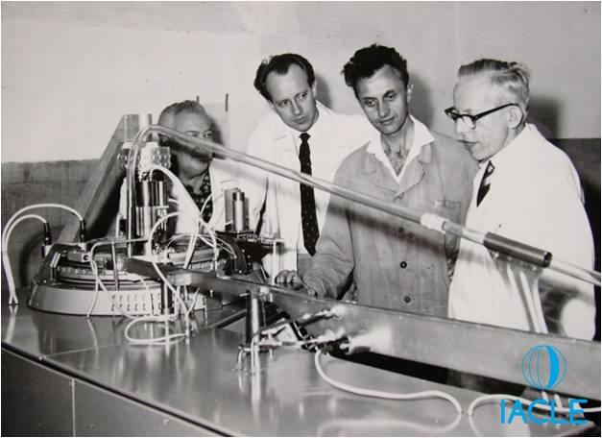
商业化
1965 meeting of Pollak (1927-2013)
& Wichterle
Notes:
In 1965, Martin Pollak of the National Patent Development Corporation (NPDC) came to visit Prague & acquired licenses for the development of the CLs. The photo on the R shows the first carousel manufacturing device. Several of these were made. Later, one was shipped to Bausch & Lomb in Rochester, up-state New York.

Slide 44
软性接触镜的发展
美国国家专利发展公司(NPDC)和罗伯特·莫里森博士购买了自旋铸造专利权- 1964年
博士伦(B&L)获得了制造自旋铸造软性接触镜- 1966的许可证
Notes:
12
12
SCL Development
Wichterle’s CL spin-casting production technology, materials, & design attracted the interest of the NPDC & Dr Robert Morrison of the US. In 1964, they bought the patent rights & decided to commercialize the CL (by that stage, NPDC had bought out Dr Morrison’s interests in the venture).

Slide 45
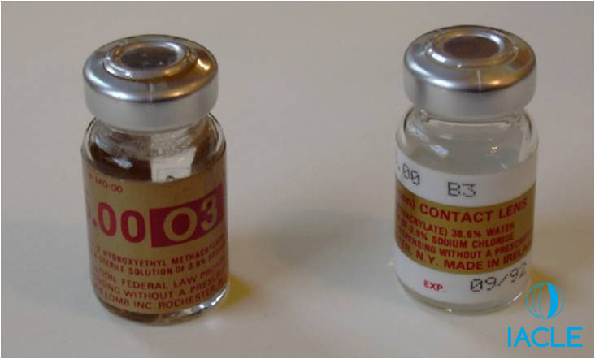
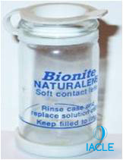
1966
NPDC与B&L签署协议
1968年，B&L公司的Dominic Ruscio选择血清瓶(一种行业标准瓶，在弹性体弹力桶上有一个20毫米的卷曲帽)作为新的包装
美国食品及药物管理局将软性接触镜列为“药物”——1968年
Griffin Bionite NATURALENS, 1969
55%离子HEMA-PVP共聚合物(演变为vifilcon A)
Notes:
The Czech CL product had been turned down by many CL manufacturers. B&L were about to get into CL production before WWII intervened & CL manufacture did not eventuate then. Financially, they were not in good shape at the time (1960s) so were willing to try something new having little to loose. The Canadian Griffin company created the Bionite NATURALENS product in the late 1960s. Today it would be classified as a Group IV CL material (high water [55%], ionic). After a series of ownership changes it found its way to the American Optical Company (Softcon) & from there to CIBA Vision where it became vifilcon A (Spectrum & NewVues products) after further evolution & with CL molding in mind as the preferred CL fabrication technique.

Slide 46
1970’s
Dr Gordon 博士发明了tetrafilcon材料
John deCarle 与Geoff Galley合作，开发出了第一个适用于长戴型的软镜
229,200 软镜在英国被验配
Titmus Eurocon 引进德国Weicon (HEMA)镜片
Obrig UK 在与NPDC的交易中被Smith & Nephew收购
博士伦公司B&L采用了旋转的机器，使用紫外线聚合而不是加热
聚氯乙烯(PVC)取代了以前使用的玻璃模具
博士伦公司为1300名CL患者提供了试验。80%达到≥6/6(20/20)
首次验配HEMA材料的软镜是在澳洲和新西兰 (1971) (Vic Lowe, Melbourne: Nissel [Australia], name used under licence from Nissel & Co. UK). Pen Thomas (Aust.Optical Co., later Intnl. Optical Corp.)followed almost immediately after with a 55% water, Griffin Bionite material SCL）
Notes:
Titmus Eurocon became CIBA Vision Germany in the late 1980s.

Slide 47
1970’s
全球视觉公司由deCarle & Galley.创立
后来被库珀实验室收购——库珀视觉的开始
Bob Morrison & Sam Kaplan 在干燥状态下制作HEMA(干燥凝胶)和车床切割它。
欧洲公司成立Hydron镜片有限公司，为客户提供车床切割软镜
球性,环形
由英国软镜制造公司开发的Sauflon SCLs(后来的Sauflon)
Notes:
Hydron is what the Czechs called their hydrated CL material.
Lathe cutting xerogels to make CLs raised many problems. Previous water-based polishing compounds could not be used & any humidity variation the lens buttons (blanks) were exposed to, changed the parameters of the finished CLs.

Slide 48
1970’s
博士伦B&L在1971年3月18日获得FDA批准上市软镜
6个月后，博士伦B&L宣布软镜的销售额为100万美元
在2013年大约5750000美元
10月1日出版的《华尔街日报》软性隐形眼镜遭遇了严重的困难，因为医生们正在为使用者讨论安全问题
第一批软性接触镜的恐怖故事?

Slide 49
By 1975
Tom Shepherd 获得国际镜片公司铸造成型专利
博士伦目前每天生产20,000台高质量的软镜
博士伦生产直径为13.50毫米的软镜称为F3, B3和J3
NPDC在美国法院发起的保护Wichterle专利的法律生效
在英国发布新产品
Permalens 71% (Global/CooperVision)
Scanlens75 (Scanlens, Sweden)
Snoflex 50 (Smith & Nephew, UK)
Notes:
Permalens: 71% water was the first lens designed for CW. DeCarle experimented on himself wearing for over 6 months at a time.
Scanlens 75: Scanlens of Gothenburg, Sweden, started by Klaus Nilsson, 75% water material, for 3 months EW.
Snoflex 50: A terpolymer of methyl methacrylate, vinyl pyrrolidone, & g-mema (3-methoxy-2-hydroxy-propyl methacrylate) giving a 52.5% water content - developed by Smith & Nephew, UK.

Slide 50
1977
四聚氰胺，第三种晶状体获得FDA批准
连续曲线隐形眼镜，由Donald Brucker在1960年，美国第一款超薄液晶软镜
博士伦镜片目前在73个国家销售
Penhryn Thomas(澳大利亚)申请了一个三角形(圆形)软镜
Don Korb 发现了巨大的乳头状结膜炎
接触镜相关的乳头状结膜炎有关
欧洲隐形眼镜行业联合会(EFCLIN)创建于1975年
Brien Holden
角膜和隐形眼镜研究组(CCLRU)，澳大利亚悉尼布莱恩·霍尔顿创立于1976年
Notes:
Tetrafilcon, a low water, non-ionic copolymer made up of HEMA, n-vinyl pyrrolidone (added to bring the water content up to 42%), & MMA was to be an important material in the CooperVision soft lens range.
Donald Brucker (1932-2005) Continuous Curve Contact Lens Co.

Slide 51
硅弹性体
1956 Walter Becker, 视光师，匹兹堡
1967 Breger Müller-Welt获得专利,芝加哥
1971, Dow Corning 获得 BMW 专利
1972, Dow Corning 生产硅胶镜片
1975, Pförtner Contact Lenses of Buenos Aires 获得在硅弹性接触镜方面的专利
他们开始生产硅水凝胶镜片，但是完全是不透明的！
1977 Wöhlk, Germany, 生产单体，疏水性表面在低压环境下被喷射上OH– 离子，产生亲水性
1979, B&L 博士伦公司专利的硅镜片有玻璃图层
1979,日本的 Toyo CL 公司被批准获得生产首批硅水凝胶镜片的原材料
1981, Silsoft (Silsight) 创立者为Dow Corning, 后被博士伦公司收购(as a service)
缺点:
difficulty fitting难配适
如果配适不佳，就会造成一定的负压，镜片会吸附在眼睛上
由于沉淀物多，所以导致镜片寿命短（脂质沉淀物？）
镜片表面的湿润性较差
相对来说比较贵
N目前已经被硅水凝胶镜片代 silicon hydrogels (SiHy)所取代

Slide 52
By 1980
Permalens, 第一个持续30天的软镜获得了FDA的批准
登山运动员乔·塔斯克(Joe Tasker)戴着(Permalens) CLs攀登康城章嘉山(Kangchenjunga)，海拔28200英尺(8600米)
Hydron Z6 lathe-cut SCLs, t_{C} = 0.06mm
American Hydron 获得FDA的批准为他们的第一个铸型软镜
Michael Bay, 丹麦人，开始使用新的稳定软成型系统的

Slide 53
By 1982
强生公司通过收购佛罗里达州Frontier隐形眼镜公司和Vistakon公司进入接触镜生产
考虑到对新接触镜的许多反应，丹麦眼科专家迈克尔·贝创建了MIA-lens公司来生产一次性接触镜。扔掉的问题!一周或两周的长戴型的。
Bay 还开发了吸塑包装、三个月的复检和直接付款。
CSI SCLs 由Syntex 创立
Michael Bay (1939-2007)
Notes:
At that time, EW CLs tended to be worn for months on end. Professionally, Bay had seen many cases of keratitis & unhappy eyes due to the deposits. He visited Scanlens in Sweden to see how they were made. On the flight back home he decided there must be a better way of making the CLs to allow them to be made cheaper & therefore thrown away more regularly.
The MIA lens Company was named after the Bay family members - Michael, wife Inger (a dentist), & daughter Annette.

Slide 54
1983
J&J Vistakon (Hank Green) 收购 Michael Bay
强生公司运用其丰富的医药包装知识，改进了吸塑包装，改进了Michael Bay的稳定软模成型技术，使CLs在潮湿状态下成型，以减少参数变化。
他们新生产了材料etafilcon A，这是他们从Frontier隐形眼镜公司衍生出来的材料，比Bay的材料更稳定。
他们利用自己在医药存储和计算机方面的丰富知识，开发了一个新的以计算机为主导的制造程序和分销系统。
戴6个晚上,有一晚可以不戴,第二天早上戴一个新的

Slide 55
1984
Holden & Mertz 发布了临界氧气水平，以避免日常佩戴和延长佩戴隐形眼镜时出现水肿。提示角膜对O2的需求量在夜间防止角膜肿胀率超过4%，相当于70-75毫米汞柱，这在当时的软镜材料中是无法实现的。
Foundation of Natratec by Prof Dennis Chapman. 纳特拉特克基金会，丹尼斯·查普曼教授。磷酰胆碱，第一个仿生接触镜材料，生产于1994年

Slide 56
1987
随着强生公司的Acuvue一次性接触镜的推出，CLs的世界永远改变了。美国:1987年，英国和澳大利亚:1988年
Notes:
Original style packaging for J&J Acuvue. That is a later model as the extended range of powers was not launched immediately. Each box contained 6 blisters each containing one CL. J&J supplied R & L stickers for attachment to the appropriate boxes in the square space provided at the L side of the front face.

Slide 57
1989
NewVues CIBA Vision – weekly EW
SeeQuence B&L- weekly EW or 2/52 DW
Medallist 1st monthly disposable from B&L
Spectrum Visitint CIBA Vision - 1, 2 or 3/12 DW
Cooperthin-molded non-disposable CLs
1994年， Ron Hamilton和Bill Seden发布了一种新的成型技术，使用这种模具作为最后的吸塑包装的一部分，让日抛型镜片成为可行
Ron Hamilton
Award Contact Lenses
Notes:
The Bausch & Lomb Medallist lens was made from HEMA (polymacon) using the Reverse Process 3 (RPIII) method. That was essentially their tried & tested spin-cast method but the CLs were made thicker so that a lathe could be used to form a spherical back surface.

Slide 58
1990
《泰晤士报》2月1日的一篇文章引起了人们对英国自来水中普遍存在的棘阿米巴原虫的关注
强生安视优成为世界第一个并获得FDA批准，每2周抛的日戴镜片 ,也有正镜镜片，增加负镜屈光力的变化范围
生产the Hydron Echelon 衍射软双焦接触镜
生产性SV38，第一颗像差控制的软性接触镜
1991
眼科医生John Dart博士在9月24日的《柳叶刀》杂志上发表了一篇文章，介绍了微生物角膜炎(MK)的研究进展

Slide 59
1992 1993
CIBA Vision 成产的镜片包括:
Focus Visitint, vifilcon A 材料
Focus Torics, 环曲面镜片焦点,月抛
Pilkington Barnes-Hind 生产的 Softperm, a hybrid CL
由Wesley-Jessen公司推出的第一种抛弃型有颜色的接触镜, Freshlook Lite Tint
The 1-Day Acuvue test marketed in the US

Slide 60
1996
CIBA Vision宣布了使用nelfilcon A材料，这是一种专门为日戴型而开发的材料
CCLRU 推出了全球首个光变色分级标准
博士伦B&L推出了 Occassions ，第一个多焦点的镜片
B&L 收购了The Premier Lens Company & 更名了镜片，之后称为Soflens One Day&L公司
Lightstream Technology by Peter Höfer for CIBA Vision’s Focus Dailies
Notes:
nelfilcon A, named after CIBA Vision’s NELTEG team (New Lens Technology Group), is a non-ionic, FDA Group II (low water, non-ionic) hydrogel incorporating a modified form of polyvinyl alcohol (PVA) giving it a water content of 69%. Light polymerization was used to for the CL edge in situ. Unpolymerized lens material could be simply washed off.

Slide 61
1997
Sven Erik Nilsson publishes Ten Years of Disposable Contact Lenses – A review of Benefits and Risks in CL Ant Eye. 20(4): 119 - 128
他的结论: 制造工艺具有高复制率通常能够提供优良的光学质量和视觉性能
↓ 镜片沉淀物
↓主观症状
↓ 角膜点染
↓ 隐形眼镜相关的巨乳头性结膜炎
↓ 急性红眼& 微生物性角膜炎
据报道成功率在70-90%
仍需对患者适宜性、专业适配性及后续护理进行适当评估的医疗器械。

Slide 62
1998
来自CIBA的非环状、环曲面软镜的专利 (filed, 1997) (Payor, Zhang, Williams, & Lafferty) from CIBA Vision, Atlanta.
环曲面软镜的旋转稳定技术，(，1997年)来自亚特兰大CIBA Vision的一个团队(Payor, Zhang, Williams， & Lafferty)。
临床试验可接受
无棱镜
设计复杂是个缺点
二次制造的成本降低了成本的竞争力
非环状

Slide 63
1999
前两种硅水凝胶接触镜在几个月内相继推出，都是每月长戴型
Night & Day from CIBA Vision
Purevision from B&L
J&J在Acuvue 2和Acuvue双焦接触镜上添加了一个UV防护和123标记

Slide 64
2000 2002
Ron Hamilton 推出日戴软镜®紫外线、第一日戴接触镜与紫外线防护
CIBA Vision推出了日戴型渐变多焦点镜片
CIBA和博士伦公司就硅水凝胶方面的专利展开了诉讼
CIBA Vision 1st DD toric CL, Focus Dailies Toric
全球大约300000人在40个国家可提供配戴Night & Day 镜片。
由Gelflex Australia的Don Ezekiel翻译的Triton soft bifocal CL得到了FDA的批准
Notes:
Patent litigation has been a feature of the development of CLs in general & is not a ‘recent’ phenomenon in the CL field. Now because of the vast costs of research & development of new materials & CLs, manufacturers are understandably keen to protect their intellectual property. Like those related to CLs, claims & counter claims regarding care solutions have at times taken on the appearance of the ‘cola wars’ – early it was peroxide vs. cold chemical systems vs. thermal disinfection, later it was polihexanides vs. polyquaternium compounds. Now the latter combatants are combined in more than one lens care product.
All the while, hydrogen peroxide lurks in the background still offering the advantages it has always offered.

Slide 65
2003 2004
J&J 强生在美国推出日戴型Acuvue Advance SiHy CL(2015年停产)
J&J强生发布了日抛型美瞳片
J&J launch发布了强身欧舒适1周弹性配戴和2周日戴型镜片
B&L 博士伦公司发布了散光纯视，第一款硅水凝胶散光镜片
Philip Morgan & Noel Brennan 建议用氧气流通率而不是氧气传导性能来用于评估硅水凝胶镜片材料的方法

Slide 66
2005 2006
The J&J Acuvue 强生推出了散光新定向方法的进展被宣传为“60秒零稳定”
J&J added wetting agent Lacreon to 1-Day Acuvue to create 1 Day Acuvue Moist 强生公司在1天针刺液中添加润湿剂Lacreon，使1天针刺液润湿
World’s first wavefront-corrected disposable CLs, Definitions Everyday & Definitions Monthly世界上第一个波前校正的一次性使用CLs，定义每天和定义每月
CooperVision 公司获得了FDA对日戴型生物质的批准
Bath University 研究的接触镜用于监测糖尿病患者的血糖水平
CIBA Vision l发布的产品包括:
Freshlook 日抛型彩色镜片
Air Optix Toric ，材料为lotrafilcon B, Night & Day的lotrafilcon A的衍生产品
B&L 博士伦发布纯视多焦点 PureVision Multifocal,世界上第一种多焦点硅水凝胶镜片
由英国Cantor & Nissel公司生产的第一次使用激光切割的硅水凝胶镜片
J&J 发布日抛散光型镜片
Clear Lab 发布 首次biomimetic 日抛型镜片
澳大利亚的Bignal & the Institute for Eye Research 批准了首款人用的抗菌型长戴型镜片

Slide 67
2007 2008
B&L 推出新的“更软”的材料版本2与非球面后表面镜片
CIBA Vision以三重保湿技术推出全球首款日抛型镜片，Focus Dailies Aqua Comfort Plus
Ultravision 发布定制型硅水凝胶镜片包括圆锥角膜的Kerasoft, HydroWave, 绷带镜bandage, 儿童专用pediatric, 无晶体眼aphakic, & 高度近视myopic CL ranges
J&J 强生推出了第1款日抛型的硅水凝胶镜片, 1天的acvue TruEye
第一个SiHy假眼用的是由英国 Ultravision 公司研发的

Slide 68
2011
Magic by Menicon
英国Sauflon 发布了 the clariti 1 day 环曲面镜片, 第一款日抛型硅水凝胶环曲面镜片
日本Menicon 公司推出了Magic DD CL，使用了只有1毫米厚的新平板包装。晶状体是一种由中心旋铸成型的HEMA-GMA水凝胶。由澳大利亚人史蒂夫•纽曼(Steve Newman)在其新加坡分部发明的这款包装，厚度仅为普通DD的12.5%，体积为40%
Triggerfish 公司总部位于瑞士，生产了一种用于监测眼内压的镜片，在美国完成了它的第一次试验
Sauflon 发布了the clariti 日抛多焦点镜片,第一款日抛型硅水凝胶多焦点镜片
Triggerfish

Slide 69
2011
奢侈品类的接触镜加入了黄金和钻石装饰显示-实用性?——可戴吗?
利用周边焦点的调节来控制近视，使用角膜塑形术和多焦点接触镜来控制近视进展
Coopervision 推出了，主要用于亚洲地区的近视进展人群

Slide 70
2012
B+L 公司发布了 Biotrue ONEday CLs, 一种新型的水凝胶镜片hydrogel CL . 声称材料是超凝胶的 (78% 含水量，water, nesofilcon A, 多聚体 结合了HEMA & NVP), 公司发言人称：对于日戴型镜片而言，对于大多数配戴者而言，水凝胶镜片是优于硅水凝胶的，因为其润滑度对硅水凝胶镜片来说是个问题

Slide 71
2013
爱尔康公司(原爱尔康和 CIBA Vision两个公司合并的)在英国发行了 Dailies Total 1 ，这是第一款SiHy 日抛型 CL，含水量为30%，表面含水量为80%。
角膜的第六层是由英国诺丁汉大学的Harminder Dua教授和他的同事们争议性地宣布的。
它位于角膜基质和角膜 的Descemet’s 层之间，厚度6.5至14微米
在各种出版物上多次提到过

Slide 72
2013
CooperVision 发布 了他们的 MyDay DD SiHy CL 系列
SynergEyes 发布了软硬组合型镜片hybrid CLs:SynergEyes:
Duette
Duette Progressive
Duette MultiFocal
UltraHealth
ClearKone

Slide 73
2014
谷歌宣布计划生产其谷歌玻璃产品的CL镜片
谷歌也在研究CLs来监测糖尿病患者的血糖水平
爱尔康发布了Air Optix Colors，一系列彩色的接触镜
强生发布了他们的日抛型镜片，美瞳接触镜

Slide 74
参考资料
© 2009
Bower House Publications, Shorne, Kent
ISBN: 978-0-9558981-0-5
这本书可以在大多数视光院校的图书馆找到

Slide 75
通过教育基金和实物捐赠，IACLE开发和提供隐形眼镜教育
铂金赞助商
白银赞助商
捐赠资助
CIBA Vision Bausch & Lomb
Allergan
AMO
Ocular Sciences
Wesley Jessen
Menicon
Paragon
Pilkington Barnes-Hind
Aspect Vision Care

Slide 76
THANK YOU
www.iacle.org

