Slide 1
接触镜类型、配戴方式和更替周期的选择
B2
2016-Jun-17

Slide 2
Attributions
讲稿作者* | Ma. Meredith Reyes, OD, MA Robert Terry, BOptom, MSc Lewis Williams, AQIT(Optom), MOptom, PhD
讲稿编辑** | Katherine Clore, BA, BS, OD Etty Bitton BSc, OD, MSc, FAAO
IACLE 执行编辑** | Etty Bitton BSc, OD, MSc, FAAO
IACLE 审稿人** | Nilesh Thite, Lewis Williams
讲稿更新 | 2016-Jun-14
讲稿内容校对 | 2016-Jun-17
* Original author(s) of lecture(s) | **2015/2016 Editors & reviewers

Slide 3
编审者
撰稿人* | Ma. Meredith Reyes, OD, MA Robert Terry, BOptom, MSc Lewis Williams, AQIT(Optom), MOptom, PhD
编辑** | Katherine Clore, BA, BS, OD Etty Bitton BSc, OD, MSc, FAAO
IACLE 责任编辑** | Etty Bitton BSc, OD, MSc, FAAO
IACLE 审稿人** | Nilesh Thite, Lewis Williams
更新时间 | 2016-年6月14日
内容复审时间 | 2016年6月17日
* 原作者 | **2015&2016编辑和审稿人

Slide 4
通过教育基金和实物捐赠，IACLE开发和提供隐形眼镜教育
铂金赞助商
白银赞助商
捐赠资助
CIBA Vision
Bausch & Lomb
Allergan
AMO
Ocular Sciences
Wesley Jessen
Menicon
Paragon
Pilkington Barnes-Hind
Aspect Vision Care

Slide 5
版权声明
国际接触镜教育者学会是IACLE接触镜镜课程（简称ICLC）所有格式和版本的唯一所有者，受版权保护。若要获得该接触镜材料，您需要同意以下条款：
IACLE接触镜课程只能用于个人或学习用途。未经IACLE书面同意，严禁传播或销售ICLC的全部或部分内容，或将本教材用于教育及个人以外的用途。除以下声明外，不得复制、重新发布、出版或分发ICLC中包含的任何材料。
你可以在个人或教育使用时打印课程材料。所有版权信息，包括IACLE徽标必须保留在材料上。使用ICLC的任何内容，包括文本，图片或注释等必须提供合适的引用标记。

Slide 6
出版
国际接触镜教育者学会(IACLE)
2016修订版
© 国际接触镜教育者学会2000-2015
版权所有。未经国际接触镜教育者学会事先书面许可，本出版物的任何部分不得复制、储存在检索系统中，或以任何形式或传播：
国际接触镜教育者学会
IACLE秘书处，
PO Box 656 KENSINGTON
NSW 2033
Australia
电子邮件：iacle@iacle.org

Slide 7
接触镜配适: 步骤
患者筛选
初步检查 & 相关检测
试戴片试戴
最终镜片选定
患者教导
镜片配发
后期护理
Notes:
12
12
CL Fitting: Steps in the CL Prescribing Protocol
A systematic procedure is essential to ensure thorough & efficient management of the CL patient. Such a procedure involves the following steps:
Patient screening - Screening is usually the first contact that the patient will have with a practitioner. If a practitioner is to obtain the necessary information from a prospective CL patient, steps should be taken to establish good rapport. It is during this time that an initial determination of the suitability of the patient for CLs is made. It is also an opportunity to discuss the benefits of CLs.
Preliminary examination & measurements - Following a decision to try CLs, an examination is conducted, & relevant measurements made, preparatory to trialing suitable CLs.
Trial lens fitting - Trial CL parameters as close to the final CL order as possible should be chosen. The trial fitting routine is aimed at determining the final CL specifications. These specifications will be central to patient satisfaction with the CLs.
CL dispensing - The CLs are dispensed after appropriate verification. Once the CLs are confirmed as being acceptable, the patient is instructed about CLs generally, the modes of CL wear being recommended & proper CL care.
After-care - After-care visits are necessary to monitor the patient’s adaptation to the CLs. The visits are scheduled at regular intervals after dispensing. After-care visits are usually the practitioner’s only opportunity to assess the eye’s response to CLs. Of special interest are objective signs which are not reflected in the patient’s subjective response to CL wear, e.g. superficial corneal staining, corneal oedema, etc.

Slide 8
患者筛选: 目的
询问患者为何需要配戴接触镜
患者是否适合配戴接触镜
获取各方面基础信息
给患者提供选择建议
Notes:
12
12
Patient Screening: Aims
Patients who indicate a desire to be fitted with CLs are usually well motivated. The reasons for wanting CLs range from recommendations from friends or relatives to specific work needs, sport, or recreation needs.
After inquiring about the patient’s interest in CLs, investigate their criteria for success relative to the types of CLs available, e.g. some CLs are made in a limited range of lens parameters. A local quick reference guide is useful for reviewing the range of CLs available. More comprehensive lists are published internationally, e.g. Tyler’s Quarterly Soft Contact Lens Parameter Guide, Contact Lens Data Book, AOCLE CL Pocket Guide, 5th ed (2014) (found at www.aocle.org) & supplements to CL journals.
At the preliminary examination, baseline information on ocular variables should be collected. Such data is useful for future reference & for comparison with post-fitting information.
Screening may indicate that the patient would be better served by spectacles rather than CLs. The options (if any) should be presented to the patient.

Slide 9
配戴接触镜的理由 (降序排列)
带框架镜不方便
美观
提高视觉质量
体育/娱乐
职业需要
视觉治疗
色觉缺陷
Notes:
Reasons for CL Wear
Establish the reasons for CL wear to get a better understanding of motivation & compliance.
Source: Clinical Manual of Contact Contact Lenses (4th ed) by Bennett & Henry 2014

Slide 10
患者筛选: 注意事项
解剖生理学
心理学
病理学
个人 & 职业需要
屈光状况
双眼视觉状况
动机
操作灵活性
Notes:
12
12
Patient Screening: Factors to Consider
Factors to consider are:
Anatomical & physiological. Examination of the structure, shape, & clarity of the anterior segment may reveal whether the eye is ‘normal’. The measured features of the eye will suggest the type & design of CL to be trialed.
Psychological. Motivation, intelligence, & personality influence the likely success rate of CL wear. A patient who expresses extreme sensitivity, may be suggestive of a potentially unsuccessful CL wearer. A comprehensive explanation of the advantages that can be derived from CL wear may dispel some of the fallacies of CL wear. Monitoring the compliance of such patients to the prescribed care regimen is necessary.
Pathological. A thorough history & subsequent eye examination may provide indications for, or contra-indications to, CL wear.

Slide 11
询问病史
一般健康状况 (包括是否吸烟)
家族病史
眼部健康状况
用药史，过敏史
眼部病史 (手术,感染,创伤或其他)
接触镜配戴史 (如有)
职业、娱乐和环境因素
Notes:
12
12
History
The important aspects of history taking are:
General health
Ocular health
Medication
Ocular history including vision corrections
Special occupational, recreational, & environmental factors.
Ocular abnormalities such as senile ectropion, Sjögren’s Syndrome, etc. may contra-indicate CL wear or help identify the type &/or design which may be more suitable.
Personal & occupational needs. Consideration of age, gender, cosmetic, occupational, recreational, environmental, & other factors may help the choice of type & design of CLs to be prescribed.
Refractive. Previous & current records of the patient’s refractive status should always be referred to, especially where binocular functions need to be considered. Referral letters & record cards are good sources of such information. Once fitted, CLs might perform differently from the patient’s expectations. It is the responsibility of the practitioner to explain the benefits & limitations of the CLs being prescribed. Problems arising are much easier to deal with if their possibility was raised beforehand. However, some problems can be ‘induced’ by their mere suggestion by the practitioner (In effect the practitioner has given the patient a ‘shopping list’ of potential problems). Clinical judgment based on sound experience is essential.
NOTE: Patient selection is discussed in further detail in Unit 4.1 of the original version of the ICLC.

Slide 12
接触镜配戴史
接触镜类型 (软性或硬性)
目前配戴的接触镜 (品牌，如果是软镜: HEMA、其他水凝胶或硅水凝胶?)
佩戴方式&更替周期 (建议 & 实际)
是否有症状? 是否满意?
镜片护理产品的使用(即使正在使用日抛型镜片)
停戴原因(如有)
接触镜相关病史
依从性 (卫生, 镜片盒, 护理方法, 按医嘱更替镜片等)
Notes:
CL History
If the patient is still wearing CLs at the time of the appointment, it is important to obtain as much information about the CLs & any associated problems they may have. If the patient discontinued CL wear, it is of great interest to understand why. For example, if dryness & discomfort were an issue, then specific CL materials can be chosen to limit these undesirable effects. If they discontinued because of the limited range of parameters available preveiously, it is possible that other CLs now are available in expanded parameter ranges.
A history of compiance issues, may require more strict education with the patient if they would like to return to CL wear.
Even if DD CLs are in use, a question about CL care products may elicit information suggesting non-compliant reuse, use of tap water on a CL dropped during insertion, or other risky behaviours.

Slide 13

病史
Notes:
12
12
History
A surfer requiring a distance correction may benefit from DD CLs with UV protection. CLs should be discarded after finishing the session.

Slide 14
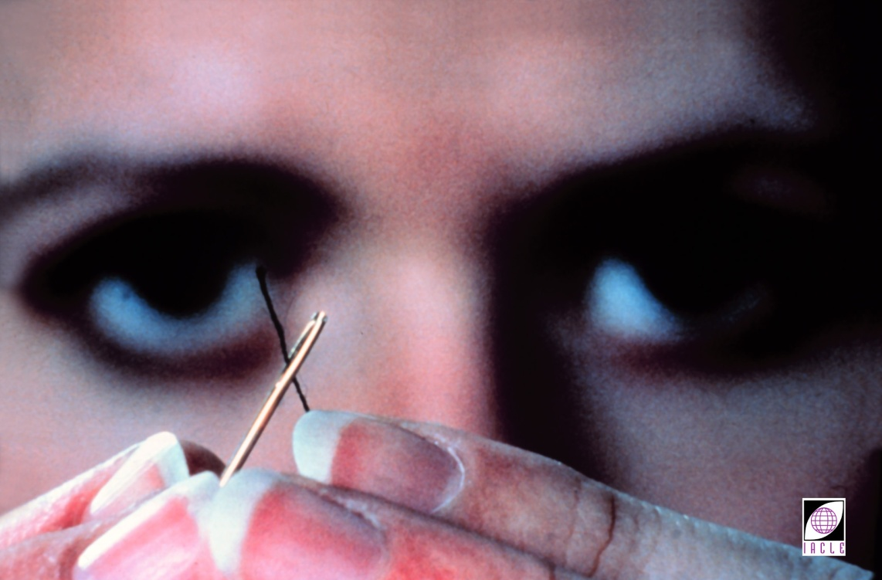
病史: 确定患者视觉需求:
远距离
中距离 (电脑、平板电脑、智能手机等)
近距离
其他职业方面的需求
Notes:
12
12
History
Where a patient is engaged in close work for many hours of the day, age & the requirement for near correction need to be considered. An overview of the benefits that a presbyope might derive from bifocal, monovision, or near spectacle corrections may need to be presented.

Slide 15
患者筛选 & 检查结果: 建议…
适用性
戴镜预期
  与个人情况相关的任何限制
配戴者义务
  卫生, 依从性, 后期护理及随访预约等
Notes:
12
12
Patient Screening & Examination Results
The patient should be informed that their suitability for CLs depends on the results of the screening, preliminary, & trial CL fitting examinations.
Patient selection & the appropriateness of the CLs prescribed, are crucial to ensuring successful CL wear. An inquiring & conservative practitioner attitude is required.

Slide 16
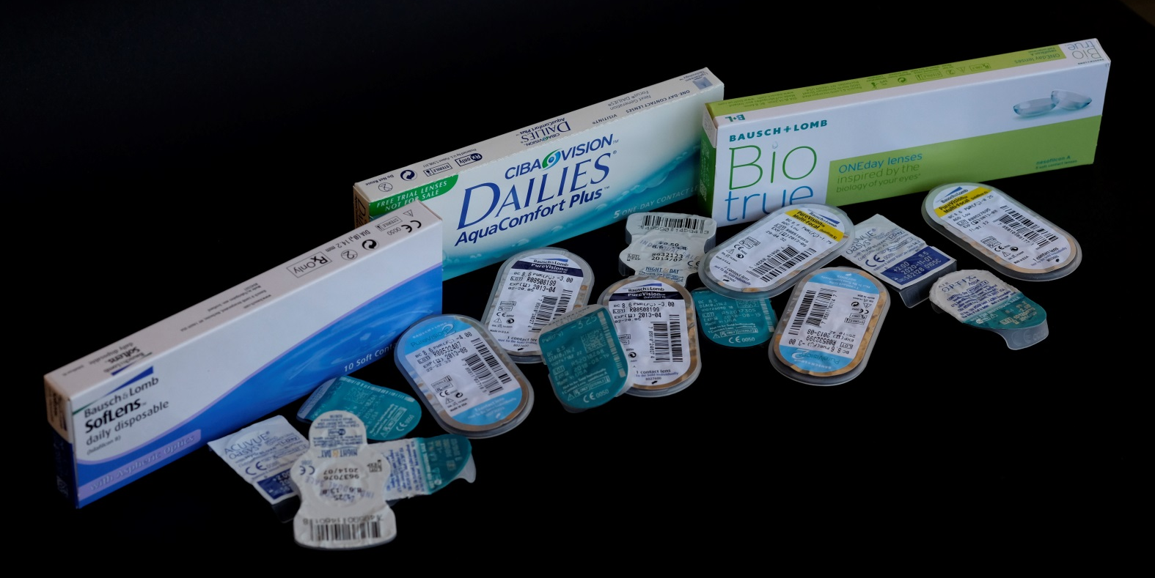
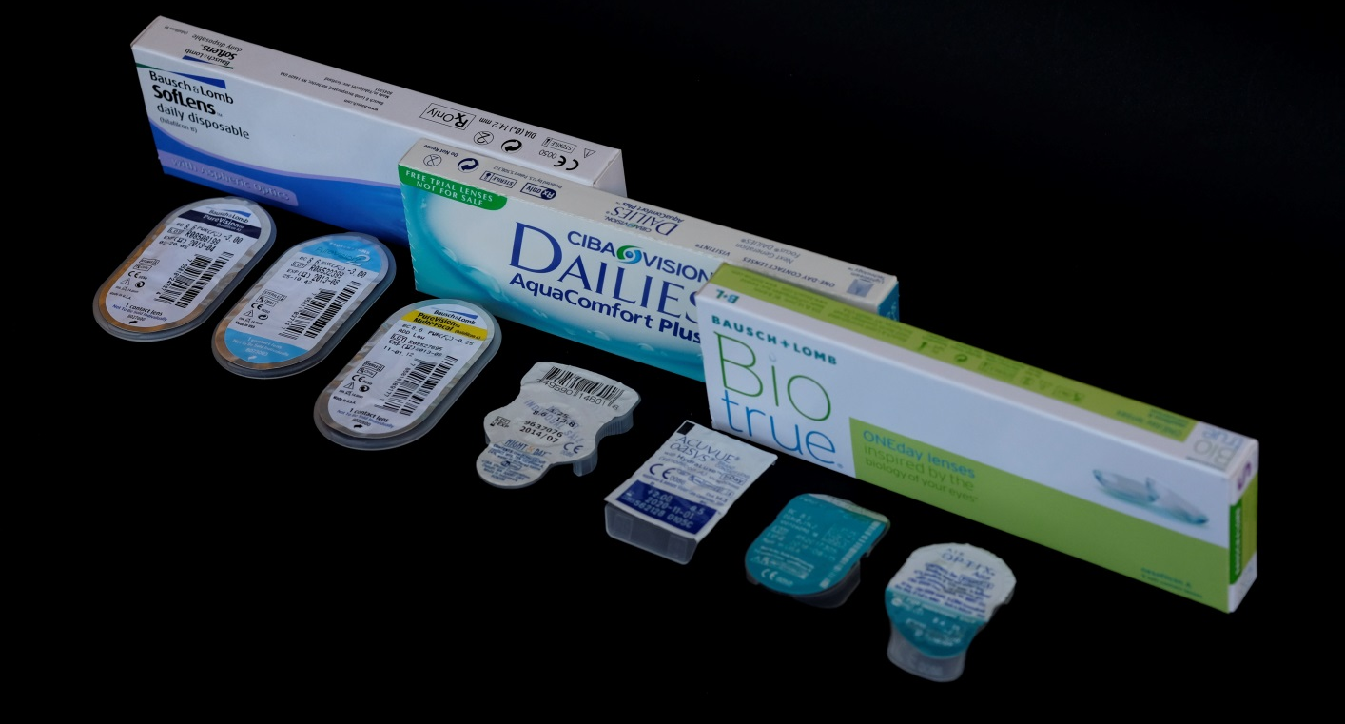
患者筛选 & 检查结果: 镜片选择
Notes:
12
12
Patient Screening: CL Options
Where screening suggests the patient is a good candidate for CLs, the benefits & limitations of each of the CL types suitable, should be explained. Trial fitting should begin with the CLs chosen by the practitioner, bearing in mind the needs of the patient & the findings of the preliminary examination.

Slide 17
初步检查&测量
眼前段裂隙灯检查
眼部参数测量
眼表、泪液以及泪膜的评估
精确的框架眼镜验光
Notes:
12
12
Preliminary Examination & Measurement
A comprehensive preliminary examination of the eye (see Units 1.2, 1.3, 1.4, & 4.1 of the original ICLC) provides the basis for determining whether CLs are a viable alternative, & if so, what trial CLs would be appropriate.
A preliminary examination should include:
A slit-lamp examination of the anterior segment
Keratometry
Corneal & pupil size measurements
Assessment of lid characteristics
A tear assessment
A spectacle refraction & calculation of the ocular Rx (corneal-plane refraction). Without a sound & reliable baseline Rx, it will always be difficult to assess ∆s/progress subsequently. Its importance to the records of each case cannot be overemphasized.
NOTE: A separate & detailed discussion of this sub-section is found in Unit 4.1.

Slide 18
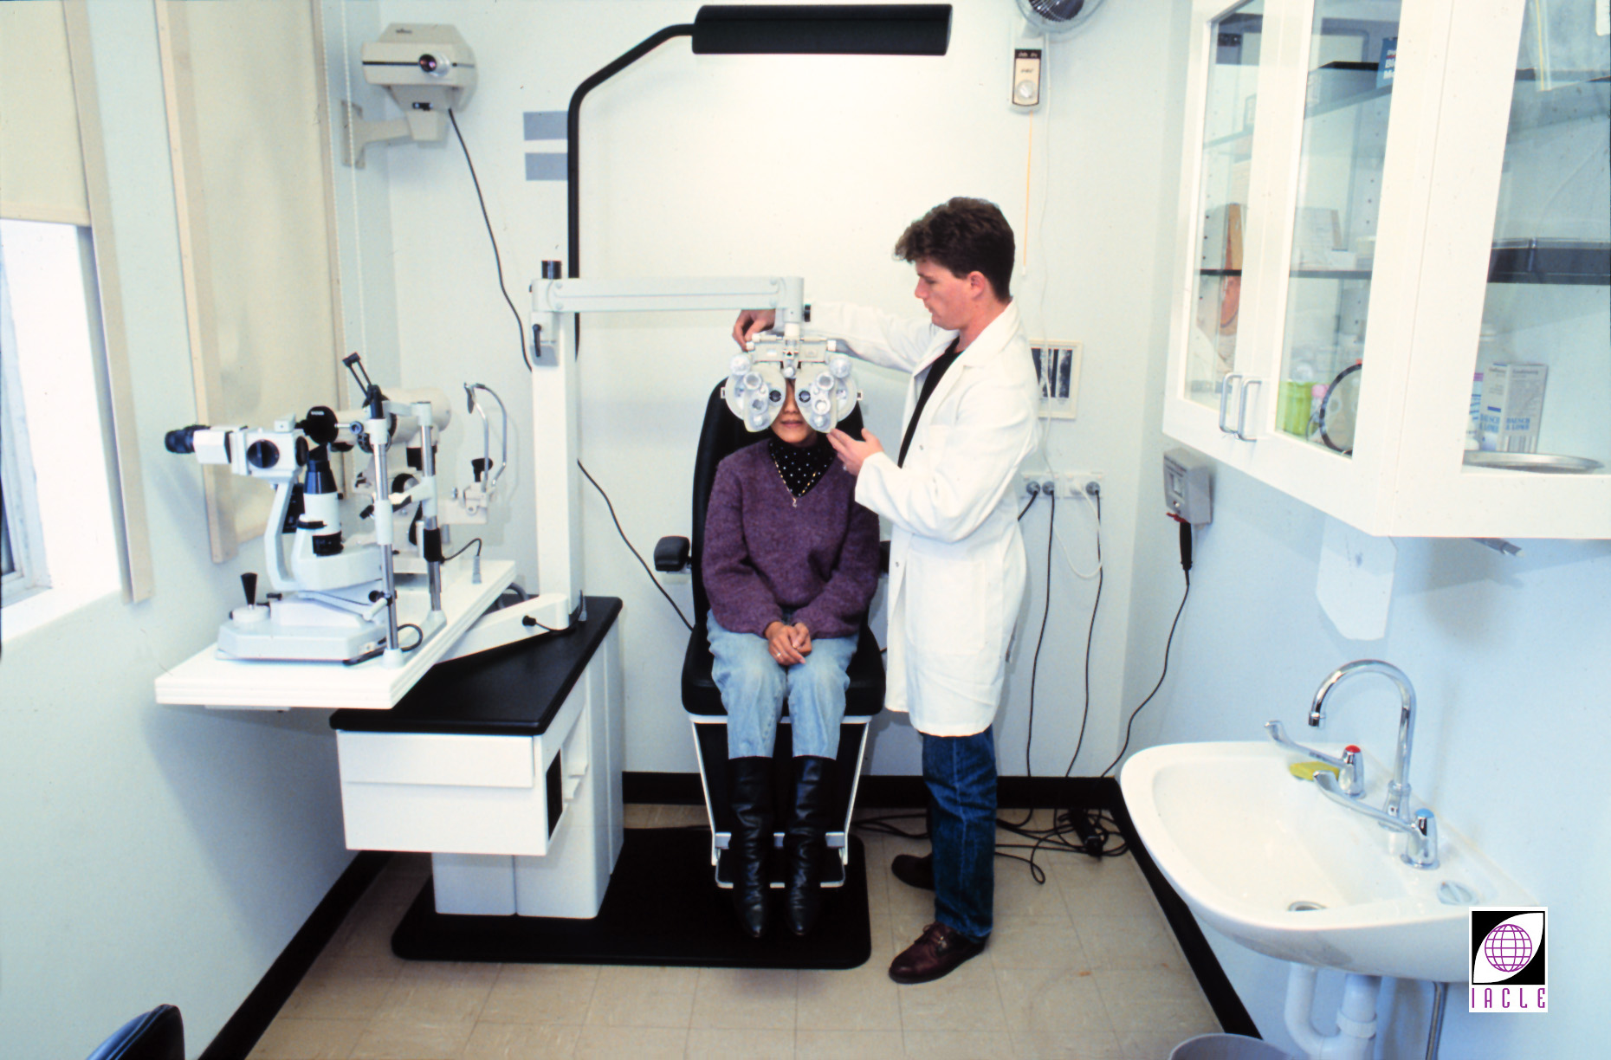
初步检测
Notes:
12
12
Preliminary Assessments: Baseline Rx
Ensure there is an updated refraction before any CL fitting is undertaken.

Slide 19
解剖学测量
水平可见虹膜直径（ HVID ）
瞳孔直径
睑裂高度/睑裂大小(PAS)
眼睑位置
眼睑张力
瞬目频率及完整性
Notes:
Anatomical Measurements
Anatomical measurements that are required for CL fitting include HIVD, pupil diameter (especially for bifocal CLs), palpebral aperture height (for proper GP CL fitting), lid position & lid tension, & blink rate/completeness.
Incomplete blinking may render GP CL fitting challenging if the CLs are not able to achieve adequate superior lid attachment
Source: Clinical Manual of Contact Lenses (4th ed) by Bennett & Henry 2014

Slide 20
试戴: 程序
诊断性试戴评估
最终订片
Notes:
12
12
Trial Fitting: Routine
The trial fitting routine involves the following steps:
Diagnostic fitting - A diagnostic or trial CL fitting uses a series of CLs, chosen on the basis of the findings of the preliminary examination. CLs are assessed sequentially until a desirable fit is obtained. The aim of the trial fit is ensure a good CL-cornea relationship with the design chosen & to confirm the final Rx required. The practitioner must recognize that each CL type has its own set of fitting criteria & the ‘optimum’ fit for each CL type should be their goal.
Final CL order - The specifications of the prescription CL to be ordered are firmly based on the outcome of the trial CL fit & the ocular Rx. The CL should interfere minimally with corneal metabolism & provide crisp, clear stable vision while being comfortable at all times.

Slide 21
试戴: 需求
接触镜试戴套装
接触镜护理液
裂隙灯
眼部染色 (荧光素钠, 钴蓝光激发滤光片, 黄光吸收滤光片)
病例文件 (记录形式: 印刷, 电子)
  照相文件系统?
Notes:
12
12
Trial Fitting: Requirements
Trial sets - A comprehensive range of both rigid & soft trial CLs should be held by the practitioner. The range should include the designs & products of several companies & only CLs which are readily available (locally available) should be used routinely. CLs that are difficult to procure may be justifiable in special cases. CL series may be stock items or custom products. A wide range of GP trial CLs is useful for an expeditious & accurate trial fitting.
Contact CL solutions - The use of appropriate lens care solutions (if any) preparatory to CL insertion is desirable for initial comfort & vision. Their use also presents an opportunity to explain the rôle of such solutions to the patient. This will save time at the dispensing visit.
Slit-lamp or illuminated magnifier (Burton Lamp) - Competency in the use of a slit-lamp is essential for assessing CL fit. In the absence of a slit-lamp, a Burton lamp or other illuminated magnifier, while more limited than a slit-lamp, may be used to examine CL movement, centration, & fluorescein patterns (with near-UV illumination) of rigid CLs.
Fluorescein dye - Sodium fluorescein dye instillation is an indispensable step in the trial fitting of rigid CLs. Fluorescein is also useful following removal of the CL, to ensure that the trial CLs have not had an adverse effect on the anterior eye. Its routine use at every after-care visit is also considered essential. To maximize the visualization of fluorescein staining, the cobalt blue filter (inherent to the slit lamp) is used & a yellow barrier filter is added (can be hand-held or inherent to modern slit lamps
Documentation - Complete & systematic documentation of the trial CL fitting (see the pro formas in the practical sessions for guidance) is necessary & enables a decision to be made at the end of the trial, as to which CL(s) was/were the most suitable.

Slide 22
试戴: 镜片选项
后表面光学区曲率 (BOZR)
总直径 (TD)
中心厚度 (t_{C})
含水量
氧传导率 (Dk/t)
镜片设计
镜片种类
镜片材料
后表面顶焦度 (BVPs)
镜片表面属性
Notes:
12
12
Trial Fitting: CL Selection
Trial CL selection includes a tentative determination of appropriate CL parameters/features. These might include:
Back optic zone radius (BOZR) - Corneal curvature measurements (in millimetres NOT dioptres) can be used as a starting point for choosing the initial BOZR. Remember, a keratometer only measures the central 3 mm (approximately).
Total diameter (TD) - The trial CL TD is generally found by measuring the Horizontal Visible Iris Diameter (HVID) & adding or subtracting 2 mm for soft & GP CLs, respectively.
Centre thickness (t_{c}) - This is a function of the BVP of the CL. Logically, plus CLs have a greater centre thickness than most minus CLs.
Water content (for soft CLs).
The CL BVP & the wearing modality desired will influence how the eye’s O₂ requirements will be met or approximated. Water content is an essential factor in such deliberations in earlier soft CL (hydrogels, mostly HEMA-based), however with silicone hydrogel (SiHy) CLs, the water content is not related directly to the O₂ transmission properties of the CL.
CL design (lenticular, multicurve, surface shape, etc.) - The desired CL fit can be better achieved by trialing various CL designs, e.g. using lenticulation to improve CL centration in a highly myopic patient or using a back surface multicurve design to improve the CL-cornea relationship.
CL type (spherical, toric, multifocal, etc.) - This choice is dependent on the refractive & curvature measurements of the eye. Providing the best spherical refraction may not always give satisfactory VA & toric CLs may be needed.
CL material – O₂ transmissibility, Dk/t, is a most important material property of the CLs to be prescribed. Ideally, trial CLs should be of the same material as the CLs to be ordered because material choice can significantly affect their fitting behaviour.
Back vertex powers (BVP) - near & distance - Select the trial CL that is closest to the patient’s Rx, particularly for high Rxs. Over time, & the occasional failure, a practitioner will build a collection of CLs, including special CLs such as bifocal & toric CLs, to complement their standard CL trial sets.
CL surface properties - CL surface properties such as surface hardness & surface coatings may be considered when choosing a CL to ↓ discomfort & ↑ the relationship with adjacent ocular tissues.

Slide 23
试戴: 步骤
初始镜片选择
试戴 & 视觉评估
戴镜验光, 如果需要
如初步选择的镜片不合适还需进行后续选择试戴
Notes:
12
12
Trial Fitting: Procedure
Initial CL selection. After baseline measurements have been recorded, the first trial CLs are selected & inserted.
Trial CL fitting & vision assessment. After the CLs have settled, their fit & → vision are assessed. Assessment should be both quantitative & qualitative (see record forms in the practicals of Units 3.2 & 3.3 of the original ICLC for guidance). Once a satisfactory fit is achieved, the prescription can be finalized & the CLs ordered.
Subsequent trial CL selection. If the initial CLs prove to be unsatisfactory, further trials are required.
When the trial CLs required are not available, the practitioner will have to either order them in or resort to empirical prescribing. Empirical prescribing involves no trial CLs. Rather, the final CL order is based on the results of the preliminary examination & the ocular Rx as calculated from the spectacle Rx.

Slide 24
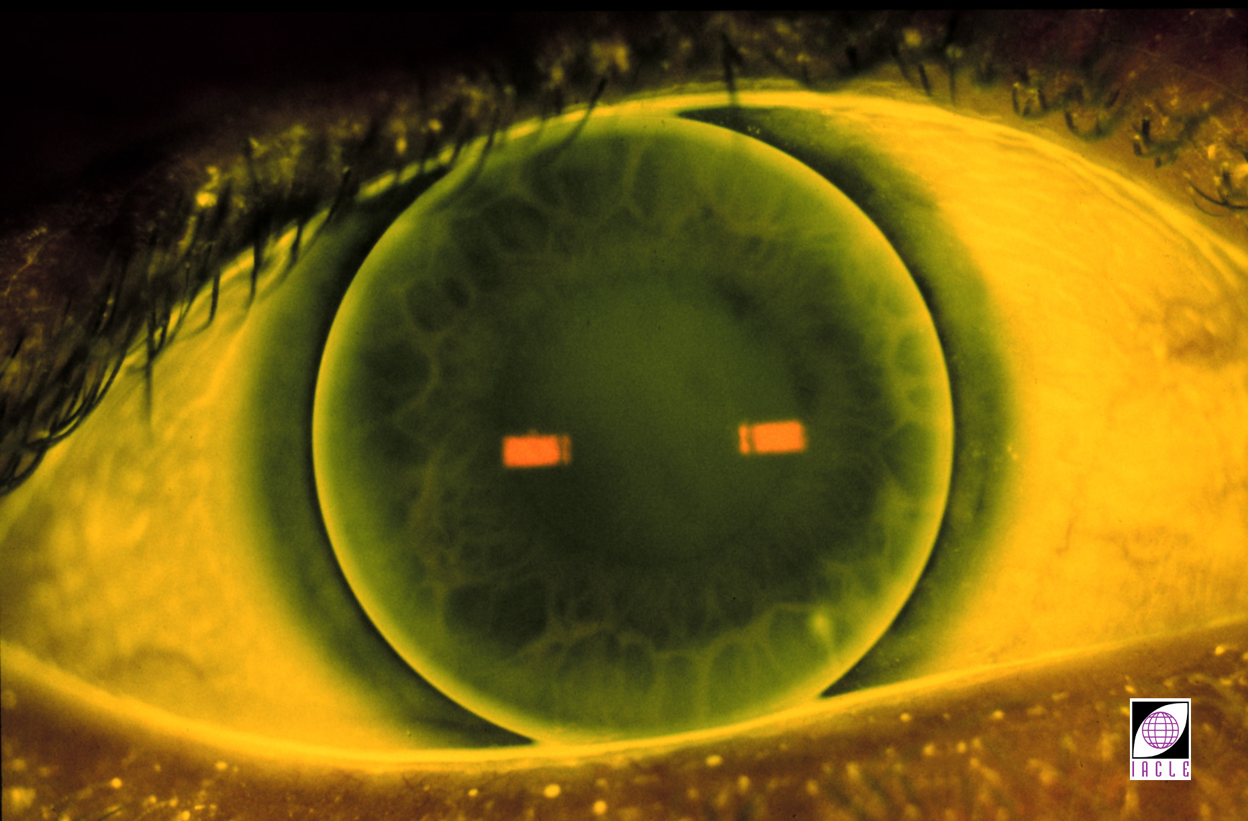
试戴: 硬镜理想配适
Notes:
12
12
Trial Fitting: Desired GP CL Fit
Central alignment - This example shows no fluorescein under the central portion of the CL. This suggests that the BOZR of the CL closely matches the central corneal curvature.
Moderate edge clearance - This manifests itself as a bright band of fluorescein at the periphery of the CL.
Good centration - CL positioned so that it is concentric with the limbus in the rest position & its BOZD covers the pupil adequately. While CL movement is essential, rapid recentration after a blink is highly desirable.
Adequate size (TD) - The CL diameter in this example should allow the possibility of top lid attachment in normal gaze without excessive CL movement. Viewed dynamically, it would probably be a stable fit.
Vision - With an accurate over-Rx, the vision should be clear & stable.

Slide 25
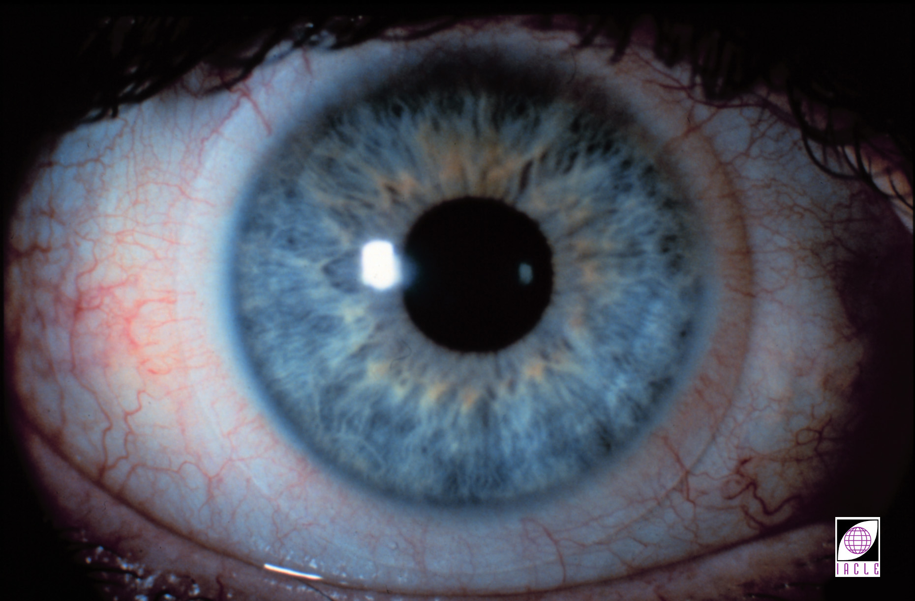
试戴: 软镜理想配适
Notes:
12
12
Trial Fitting: Desired SCL Fit
CL centration - Good SCL centration is characterized by a uniform amount of CL overlap of the sclera beyond the limbus. Blink-induced CL movement should be followed by rapid recentration.
Complete corneal coverage - Although some CL decentration may be unavoidable, the practitioner has to ensure the CL covers the cornea under all reasonable circumstances.
Adequate movement - While some minimum movement is required for all CLs, the actual amount depends on the CL type. Generally, the amount will be between 0.2 & 1 mm. The prime reason for CL movement being required is the dispersal of metabolic waste from the post-CL space. Tear exchange has been demonstrated to be minimal under SCLs largely because of the thinness of the post-CL tear film.
Comfort - SCLs are usually very comfortable initially. Any fitting factor that can compromise ocular health may → some wearer discomfort some time after insertion (usually 20 - 120 minutes after insertion).
Good & stable vision - With an accurate over-Rx, the result should be clear & stable vision.

Slide 26
试戴: 最终订片-规格
镜片参数
镜片材料和种类
特殊需求
要求交货日期
Notes:
12
12
Trial Fitting: Final CL Order - Specifications
The final CL order includes:
CL parameters - Generally, as a minimum: BOZR, TD, BVP, & t_{c} are the CL parameters that should be recorded on an order form.
CL material & type - In addition to the material & type of CL, it is customary to write the brand/trade name of the CLs if they are stock items.
Special requirements:
Requests for a specific centre thickness, tint, blending requirement, lenticulation, type of bifocal/multifocal, etc. are included as a separate part of a CL order is custom requests can be accommodated.
Delivery date required - Nominating an expected CL delivery date assists the supplier in determining the priority of the order. Establishing credibility with a supplier is essential if true urgencies are to be attended to appropriately. If all orders are claimed to be urgent then eventually, all orders will be treated with disdain.

Slide 27
患者教导: 提供背景资料
告知患者所选的镜片种类及原因
告知患者镜片护理方法
给患者提供厂家的说明书或者内部自编的指导材料或两者都提供——最好是图文并茂的
提供患者可靠的在线资源，包括自身官网
在配发镜片时，给患者做进一步的教学指导
Notes:
12
12

Slide 28
取片
→ 接触镜护理知识
练习戴摘技巧
→ 关于镜片适应的信息
→ 关于并发症的体征信息
与接触镜配戴日程相关的卫生及依从性教育
复查随访建议
在离开诊所前进行总结
Notes:
12
12
CL Dispensing
Verification of CL parameters should be performed prior to the dispensing visit to ensure their suitability. Patient education is crucial to ensuring compliance with the necessary care & maintenance regimen. Arguably, compliance with CL care instructions forms the basis of successful CL wear.
The procedures recommended for the dispensing visit follow:
Verbal & written instructions including symptoms (adaptive & non-adaptive), periods of adaptation, as well as the dos & don’ts of CL wear, should be provided.
Insertion & removal of CLs should be practiced until the patient is proficient enough to be able to do both without coaching or assistance. The ability to remove CLs is possibly the more important (if the wearer is unable to insert CLs, the potential for harm is non-existent unless an incompetent insertion process itself poses a threat to the eyes).
The practitioner should ensure the patient understands the likely signs of possible complications & the appropriate action to take (if in doubt, take them out!).
The schedule of after-care visits should be presented in written form to serve as a firm reminder. A database (computer or record card based) system should be created to assist practice staff to manage patients who fail to comply with their after-care schedule.

Slide 29
后期护理
投诉调查
进行综合的眼部检查:
  戴镜验光
  裂隙灯显微镜检查
  部分特殊患者的相关检查
配适评估
卫生检查 (手, 镜片盒, 戴镜环境等)
依从性检查 (护理, 是否按医嘱配戴, 是否如期更换)
确定下次复查日期
Notes:
12
12
After-Care
CL wearers should be scheduled for regular after-care visits. The frequency of visits depends on their ocular & refractive conditions, CL type, & patient-specific needs.
A case history is a vital component of the regular after-care visit & should include provision for a progress report on events since the last consultation. If the patient visit is unscheduled, information should be sought as to why & what has transpired since the complaint or problem arose. Unless the person taking the initial call or inquiry has considerable experience & is aware of their limitations, preliminary advice should probably be sought from the practitioner, since the potential for professional misadventure in any intervening period is considerable.
A decline in VA may be indicative of some ocular or fitting complication (i.e. oedema, ghosting, diplopia, excessive CL movement, etc.), or inaccurate BVP.
An examination should include:
Over-Rx
Slit-lamp biomicroscopy
Other tests particular to the case (referral may be necessary for complications requiring treatment by other professions, e.g. ophthalmology).
With time & experience, patients can become quite complacent about their CL care regimen (familiarity breeds contempt?). A review provided in the form of printed material, videos (waiting room, consulting room or taken home), or a personal presentation will raise the wearer’s awareness of the issues presented previously.
A schedule of the next after-care visit should be presented before the end of the consultation. This is also an opportunity for the practitioner to stress the need for ongoing care of both eyes & CLs.
NOTE: Modules 4 & 5 of the original ICLC provide more in-depth discussions of CL dispensing, care & maintenance, & after-care.

Slide 30
接触镜配戴类型: 种类
日戴型 (DW)
弹性配戴型 (FW)
长戴型 (EW)
持续配戴型 (CW)
Notes:
12
12
CL Wear Modalities: Classification
Various programmes of CL wear may be recommended by practitioners:
Daily wear (DW) - Daily wear is defined as the wearing of CLs while the eyes are open. The CLs are inserted some time after awakening from sleep & are removed some time before the next sleep period.
Flexible wear (FW) - Flexible wear is daily wear interspersed with occasional overnight wear. Traditionally, FW refers to a maximum of 2 or 3 nights of wear (during sleep) per week, not necessarily consecutively.
Extended wear (EW) - Extended wear refers to uninterrupted wear of CLs throughout the day & night, usually extending to 1 week. After the 7th day the CLs are removed for cleaning & disinfection, then reinserted the next morning for a further week of EW. If disposable CLs are used, no cleaning or disinfection is required at the end of the one week wearing cycle, as new CLs are inserted each week.
Continuous wear (CW) - Continuous wear refers to the use of CLs throughout the day & night for an extended period, usually of between 1 week & 1 month. CL removal, cleaning & overnight disinfection are performed at the end of the period of continuous wear. If disposable CLs are used, no disinfection or cleaning is required at the end of the 1 month period.
The length of time that CLs can be worn is individually variable & depends on the interaction of many factors not all of which are well understood.

Slide 31
接触镜更替周期: 种类
透气硬镜: 按需更替
频繁更换型
软镜: 传统型
频繁更换型 (FRP)
抛弃型
日抛型 (DD)
Notes:
12
12
CL Replacement Schedules: Classifications
CLs are generally replaced on the basis of 2 conditions. These are:
CL age & degree of contamination &/or damage.
As a preventive measure against ocular complications.
A GP CL can be used for up to 2-3 years providing hard deposits, warpage, crazing, permanent scratches, & cracks do not develop or large Rx changes do not become necessary. Because of their longer life span, GP CLs are more economical than SCLs in the long term.
The high O₂ permeability of most GP materials make them more suitable for EW than SCLs & similar to SiHy CLs. GPs used for EW should be replaced more frequently than those used for FW or DW.
Due to their hydrophilic nature, SCLs are more susceptible to deposit formation & microbial contamination than GP CLs. CL replacement schedules may vary from one individual to the next. SCL replacement schedule classifications are:
Conventional - Conventional CLs are CLs which are not replaced until either their expected longer life-span has been reached or their usefulness is terminated prematurely by damage or deposits. CL replacement usually occurs at about 12 months providing a complete care regimen, including enzymatic cleaning, has been used.
Frequent replacement - Frequent replacement (planned replacement, programmed replacement) refers to a 1-3 month schedule of CL replacement using a complete care regimen including enzymatic cleaning.
Disposable - Disposable CL wear refers to a schedule of weekly or fortnightly CL replacement while using a care regimen which does not usually include enzymatic cleaning.
Daily disposable - Daily disposable CLs are CLs discarded after each period of wear (usually a day). A new pair is inserted for the following period of wear (usually beginning the next morning). No CL care is required. These are true disposable CLs because they are true ‘single-use’ products.
Frequent replacement & disposable CLs can be categorized as frequent or planned replacement with the schedule varying according to patient requirements & characteristics as well as success of CL wear.

Slide 32
日戴 vs 长戴: 注意事项
角膜状况
风险因素
处方
泪膜
眼睑完整性
环境因素
个体特征
Notes:
12
12
DW versus EW: Ocular Considerations
The soft & rigid CLs available currently differ significantly in their material properties, designs, on-eye dynamics, & fitting requirements. Along with individual ocular differences, e.g. metabolic requirements & corneal health, CL characteristics help determine whether CLs may be worn on a daily (DW) or extended wear (EW) basis. Important considerations in prescribing DW or EW CLs are listed opposite.
For simplicity, CL wear modalities will be categorized generally as DW or EW (including FW & CW) in the following discussion unless otherwise stated.

Slide 33
日戴 vs 长戴: 角膜状况
如果正常:
      日戴
      长戴
如果有不良迹象:
      只选日戴
Notes:
12
12
DW versus EW: Corneal Status
Contact CLs induce metabolic ∆s that may affect the anterior eye in various ways. The ability of the eye in general, & the cornea in particular, to sustain such changes must be ascertained before CL wear proper commences.
If, after a comprehensive examination, the cornea is clear & apparently normal, prima facie the eye is suitable for either DW or EW CLs.
If the cornea exhibits any signs of compromise (past or present), EW should be excluded from the list of options considered or offered.
Signs may include corneal distortion, scars or opacities, infiltrates, epithelial microcysts, vacuoles, polymegethism, vascularization (corneal or limbal), keratic precipitates, etc.
In most cases in which signs of compromise are detected, DW, rather than EW or FW should be the wear modality of choice.

Slide 34
日戴 vs 长戴: 风险因素
角膜水肿
角膜敏感度下降
镜片粘附
炎症&感染
Notes:
12
12
DW versus EW: Risk Factors
Many controlled & post hoc studies of the risks of DW & EW have been conducted. However the different methodologies, populations, & CLs deployed make comparisons extremely difficult or even impossible. The majority of studies have focused on SCL EW.
There is general agreement that, compared with DW, EW increases the risk of CL complications by between 2X & 6X (Weissman et al., 1987, Schein et al., 1989, Benjamin, 1991, MacRae et al., 1991, Brennan & Coles, 1997).
Further, the risks involved in EW ↑ with each additional consecutive night of wear (Schein et al., 1989).
It is probable that both practitioners & patients must accept that not all those seeking EW are or will be successful in EW (Benjamin, 1991).
Complications arising from CL use are partially attributable to the physiological limitations of CLs currently available. Other factors such as CL contamination, poor CL care compliance, microbial agents, & tear stagnation may also have a rôle in risk determination.
Originally, it was hoped that disposable CLs would address the bulk of problems that were not O₂ transmissibility-dependent. Unfortunately, this has not proved to be the case (Poggio & Abelson, 1993, Guillon et al., 1994). This suggests that replacement scheme per se is not a major factor in their aetiology. However, Holden et al. (1987) showed fewer CL-induced effects overall in CLs which are more frequently removed & replaced.
EW: SCL & GP
Useful studies comparing problem rates with SCL & GP CL EW are rare, largely because GP EW is uncommon & rigorous studies are difficult & expensive to undertake.
One of the attractions of GP CLs is their greater O₂ transmissibility. However, while many studies suggest that corneal hypoxia in EW is associated with infectious keratitis, absolute proof is still lacking (Brennan & Coles, 1997).
Some studies have shown that GP CL EW is safer than SCL EW (e.g. Benjamin, 1991, Maehara & Kastl, 1994). By analysing the limited data available, Benjamin (1991) concluded that:
GP CL EW is ‘twice as safe’ as SCL EW (0.42% versus 0.88% ulcer rate, per patient, per year.
GP CL EW is ‘half as safe’ as SCL DW.
Not all data published supports the assertion that the incidence of adverse responses in GP CL EW is lower than SCL EW, e.g. MacRae et al., 1991, Brennan & Coles, 1997. Further, few attempt to rate the severity of the final outcome of adverse responses by either CL type or wear modality, making comparisons, beyond mere incidence rates, difficult.
GP CL adherence, which occurs in 95% of wearers at least occasionally (Swarbrick, 1991), should probably not be considered an adverse response in most instances.

Slide 35
日戴 vs 长戴: 感染性角膜炎&非感染性浸润性角膜炎
相同发病率:
抛弃型和传统性接触镜
更高发病率:
长戴型 (尤其是软镜)
Notes:
12
12
DW versus EW: Infectious Keratitis & Sterile Infiltrative Keratitis
Overnight wear ↑ the likelihood of corneal infection, regardless of CL type. A study of patients wearing SiHy CLs EW for 30 days concluded that the overall rate of microbial keratitis was similar to that of conventional EW SCLs (Schein, et al. 1994). A study of patients wearing SiHy CLs showed they developed sterile inflammatory peripheral corneal infiltrates within a year of use (Nilsson, et al., 2001).

Slide 36
日戴 vs 长戴: 处方因素
正负镜片的平均厚度
特殊条件下的氧需求
长戴型镜片诱导的角膜变化
视力的改变
Notes:
12
12
DW versus EW: Rx Factors
When deliberating on the DW versus EW issue, a number of additional factors need to be considered:
Average thickness of plus or minus CLs.
↑ centre & mid-peripheral thicknesses with high plus & minus power, respectively, cause ↑ corneal swelling. However, in assessing the swelling response, the average CL thickness was recommended as the basis for determining the O₂ transmission across the CL surface (Holden et al., 1983; Wechsler, 1985). The greater average thicknesses of the CLs required to correct the higher ametropias (+ or –) necessitate materials with ↑ O₂ permeabilities to attain the required CL O₂ transmission. SiHy CL material should be considered to → the necessary CL O₂ transmission.

Slide 37
最小 Dk/t_{av} 需求量
日戴: 24.1 x 10⁻⁹ (cm x mL/O₂)/(s x mL x mm_{Hg})
长戴: 87.0 x 10⁻⁹ (cm x mL/O₂)/(s x mL x mm_{Hg})
——正常的过夜角膜水肿率（4%）
34.3 x 10⁻⁹ (cm x mL/O₂)/(s x mL x mm_{Hg})
——极限的过夜角膜水肿率（8%）
Holden & Mertz, 1984
Notes:
12
12
Minimum Dk/t_{AV} Requirements
O₂ demands under specific conditions.
Based on a normal population of subjects, the minimum Dk/t_{av} requirement for SCL DW is 24.1 x 10⁻⁹ units & 87.0 x 10⁻⁹ units for EW (Holden & Mertz, 1984) which limits the overnight corneal swelling to 4% & does not include any DW swelling. However, a compromise Dk/t_{av} of 34.3 x 10⁻⁹ units is recommended to limit overnight swelling to 8%.
Other figures have been suggested over the years, e.g. 125 & 35 units (assuming no stromal hypoxia - Harvitt & Bonnano, 1999), 125 units (assuming 3.2% oedema - Sweeney, 2003), 125 units (assuming no limbal hyperaemia - Papas, 1998)

Slide 38
日戴 vs 长戴: 泪膜
干眼症迹象
泪液碎片（在泪膜表面及内部）
脂质过剩
Notes:
12
12
DW versus EW: Tear Film
The quality of the tears/tear film is an important consideration when selecting CL type & wear schedule.
Dry eye & marginal dry eye patients have a thinner tear film &/or ↓ tear volume which contra-indicate EW.
The choice of SCL water content is a controversial subject. While many suggest that, based on experience, conventional high water materials are contra-indicated in dry eye, others, equally experienced, suggest the opposite. It would seem therefore that CLs at either end of the water-content scale could be trialed and, in the event of problems being encountered, CLs at the other end of the scale evaluated.
Recently, several manufacturers have released high water materials or complete CLs which it is claimed, demonstrate an ↑ resistance to the bulk flow of water. SiHy CLs are often now preferred in patients with dry or marginally dry eyes.
In some cases, GP CLs may be the preferred option.

Slide 39
日戴 vs 长戴: 眼睑完整性
明显的乳头和/或滤泡
红眼 (充血)
Notes:
12
12
DW versus EW: Lid Integrity
A thorough lid evaluation is central to selecting both the type of CL & the most suitable CL wearing schedule. Signs of redness & roughness of the tarsal conjunctiva in a non-wearer should alert the practitioner to possible problems associated with CL wear (GP or SCL).
CL-induced lid changes have been reported in both DW & EW. CL-related Papillary Conjunctivitis (CLPC) is occasionally observed on the palpebral conjunctiva of the upper lid & is characterized by redness & an ↑ in number, or ∆ in size, of papillae. The incidence of CLPC is greater in EW & higher for SCL wearers than GP wearers.
In studying the incidence & onset of Giant Papillary Conjunctivitis (GPC), the frequency of SCL replacement rather than wear modality seems to be an aetiological factor (Spring, 1974; Allansmith et al., 1977, Kotow et al., 1987). This means that frequent replacement SCLs & GP CLs are more likely to prevent the development of lid ∆s or resolve existing conditions (Grant, 1991).

Slide 40
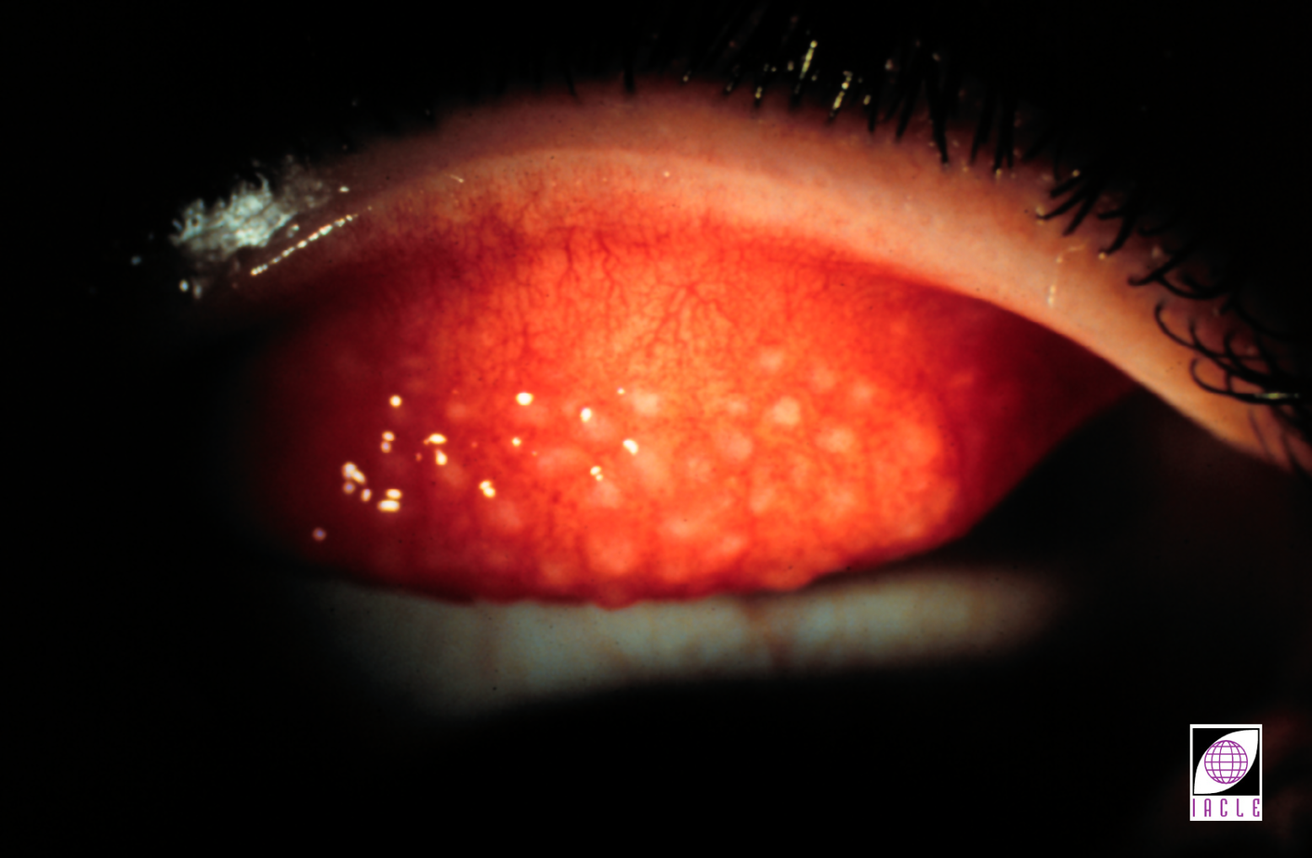
日戴 vs 长戴: 眼睑完整性
Notes:
12
12
DW versus EW: Lid Integrity
This slide shows palpebral redness & enlarged papillae characteristic of advanced GPC which developed after several years of SCL wear.

Slide 41
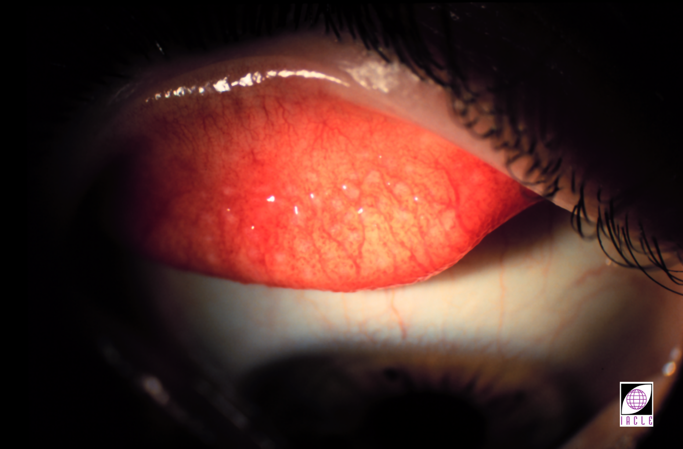
日戴 vs 长戴: 眼睑完整性
Notes:
12
12
DW versus EW: Lid Integrity
This slide shows significant resolution of the condition 6 months after commencing GP CL wear.

Slide 42
日戴 vs 长戴: 环境及职业因素
暴露于毒气、烟尘、化学物质以及污染物
工作性质
不常戴镜者
视觉需求
Notes:
12
12
DW versus EW: Environmental & Occupational Factors
The decision to choose DW or EW.
Environmental factors can be as important as the related physiological factors discussed already.
Nature of work - The demand on CLs varies greatly from one working environment to another. It is important to evaluate carefully the suitability of DW or EW CLs on a case-by-case basis.
Exposure to gas, fumes, chemicals & pollutants - As an example, a microbiologist may benefit more from EW SCL or DD CLs for which there is lesser risk of transferring micro-organisms from cultures to CLs, solutions, & CL cases. An industrial chemist, on the other hand, may be safer with DW GP CLs which will not absorb chemical fumes in the laboratory. Particulate pollutants in the air can be a source of frequent foreign body irritation to rigid CL wearers (& non-wearers). These employees may benefit from SCLs.
Infrequent user - A target shooter, who may need clear & crisp VA only during practice or competitions, may find DD CLs more convenient.
Visual demands - If the demands on the visual system are high, toric SCLs, toric/bitoric, or spherical GP CLs may be necessary to → optimum VA.

Slide 43
日戴 vs 长戴: 个体特征的考虑
操作灵活度
个人偏好
接触镜配戴史
眼部差异
Notes:
12
12
DW versus EW: Consideration of Individual Characteristics
DW patients handle their CLs more than EW patients. In either modality, the amount of mechanical pressure applied to the CLs during handling, as well as the dexterity & level of caution shown by the individual, may determine the risk of CL damage. It is important to assess these factors in prospective CL wearers.
Patients who lack patience & tolerance may find the repetitive processes associated with adaptation to GP CLs too tedious. In such cases disposable SCLs may be more convenient.
It is important to be aware of any previous CL wear experience when determining the suitability of a DW or EW schedule. Any unsatisfactory CL wear should be evaluated & factored into the selection of the most suitable CL type & wear schedule.
Even though most people show only negligible difference between the eyes, it is important to consider each eye independently & to select the CL type & wear modality best suited to the patient. A mix of wear modes is not usually suggested for an individual wearer.

Slide 44
接触镜: 患者预期的用途–戴镜频率
全时配戴 (每周6-7天)
部分时间配戴 (每周2-3天)
仅用于社交场合
运动
仅工作中使用
仅居家使用
Notes:
12
12
CLs: Intended Usage – Frequency of Wear
In consultation with the patient, the intended usage of the CLs needs to be ascertained. Many possibilities exist & most have a bearing on the:
Type of CL selected
Maximum wearing time advisable (as opposed to that desired by the patient)
CL replacement rate
Level of CL care required
Level of professional care required
Overall cost of CL wear to the patient
Intermittent, part-time or casual wear requires special attention to the CL replacement rate & CL storage requirements.

Slide 45
处方问题
近视
远视
散光 (逆规, 顺规, 斜轴?)
无晶体眼
屈光参差
圆锥角膜
Notes:
12
12
Rx Issues
The ametropia to be corrected influences the choice of CL type since not all Rxs are available in, nor are all suited to, all materials, all replacement schemes, or all modes of CL wear. In the interests of enabling manufacturers to stock & offer a finite number of individual products, CL designers & clinical researchers offer a relatively small number of clinical ‘fits’ in a rational range of BVPs. The latter commonly covers the range +8.00D to –12.00D, frequently only offering ±0.50D steps in the higher BVPs.
Similarly, the extent to which astigmats are catered to with stock CLs is expanding as several manufacturers have disposable or planned replacement programs, although the toric Rx options are more limited than the spherical CLs available in stock CLs. Once the number of different products that need to be manufactured & stocked is estimated (thousands), the magnitude of the manufacturers’ problems with stock torics can be appreciated. While it is feasible to stock spherical GP CLs, the problem with toric GPs is almost insurmountable because of the large number of base curves required to satisfy a practical proportion of the potential market, which is much smaller than the SCL market.
SCLs which lie outside the ‘normal’ clinical range of BVP are usually supplied as ‘conventional’ CLs & are discarded quarterly or annually. More recently, expanded parameters have become available in ‘custom’ CLs in SiHy CL materials & may be available as monthly replacement.

Slide 46
角膜地形
曲率:
  陡峭
  平坦
  偏心率
散光:
  逆规
  顺规
  不规则
圆锥角膜
Notes:
12
12
Corneal Topography
Like the limited range of BVPs available in stock CLs, the range of fits is also limited to allow for a rational stock situation. This translates to 2 or 3 base curves in 1 , & sometimes 2, CL diameters.
This restricted number of ‘fits’ means that corneas with abnormally flat or steep curvatures cannot be fitted satisfactorily, let alone optimally, with stock CLs. This also rules out disposable &/or planned replacement programmes for less common curvatures, since such schemes represent the ultimate form of ‘stocked’ CLs catering for the middle of the normal distribution curve. While the eccentricity of the cornea is less relevant to SCLs, it is an additional factor to be accounted for when considering the possibility of stocking spherical GP CLs.
The presence & type of astigmatism affects CL choice & availability of stock CLs. If the level of corneal astigmatism is low to moderate & it accounts for all or most of the manifest ocular astigmatism, it follows that the ability of a spherical GP CL/tear fluid combination to neutralize most (90%) of the corneal astigmatism, may provide the answer. This is also true for cases of corneal irregularity.
When choosing between rigid & SCLs, the orientation of astigmatism warrants consideration. WTR astigmatism, especially with little or no spherical component, often proves to be unsuitable for toric soft CLs due to orientational instability. Conversely, ATR cases may be more suited to soft CLs than GP CLs.
Some manufacturers of stock CL offer CLs ‘around the clock’ thereby including the oblique axes, while others ignore oblique axes altogether in anticipation of those CLs having a lower success rate. Their offerings relate to the frequency of the axes in the wearer population, possibly coloured by their perceptions of the likely limitations of their designs in the axes not offered.
Keratoconus, like other curvatures that fall outside the ‘core’ of the normal distribution curve, cannot reasonably & rationally be catered for by stock CL companies. It is probable that it never will. All such cases require ‘conventional’ CLs made on a custom basis.

Slide 47
泪液/泪膜问题
正常
干眼症
瞬目异常
Notes:
12
12
Tear/Tear Film Issues
The patient’s tear film quality requires assessment so that any existing condition which precludes the use of a particular CL material or CL design can be addressed, e.g. somebody with a marginal dry eye should not be fitted with a thin high water CL. A case of true dry eye may be unsuitable for any CL, rigid or soft.
Blink abnormalities may preclude the use of rigid CLs because the wearer may blink excessively, or infrequently, in response to the presence of a GP CL.

Slide 48
眼球尺寸
水平可见虹膜直径:
  偏小
  正常
  偏大
睑裂:
  狭窄
  正常
  宽
瞳孔大小 (取决于光照度):
  偏小
  正常
  偏大
Notes:
12
12
Ocular Dimensions
HVID is an important determinant of a CL’ total diameter (TD). As with other ocular parameters, dimensions falling outside the ‘normal’ range are seldom catered for by stock CLs & a conventional custom CL will usually be required.
Palpebral aperture size (PAS) is of greater importance when GP CLs are being fitted.
While pupil size is relevant to all CL types, it is probably of greater import when fitting GP CLs with relatively small TDs. This is due to the limitations placed on the BOZD or FOZD by relating these parameters to the TD as part of the overall CL design. Visual disturbances can be expected when small OZDs are used in wearers with relatively large pupils, especially in low light levels.
The next few slides provide data of the ‘average’ eye & the parameters of initial SCL & GP trial CLs for such an eye.
In cases of medium to high Rxs, high Dk/t high water CLs or SiHy CLs should be used to ↑ the O₂ transmission. Materials or CLs claiming to resist dehydration &/or bulk flow of water through themselves may prove helpful for high water SCLs.

Slide 49
适用于普通眼的镜片参数: 透气硬镜
后表面光学区曲率半径BOZR 7.8 mm (r_{o} ± 0.1 mm)
后表面光学区直径BOZD ≥8 mm
总直径TD 9.5 mm (HVID – 2.5)
中央厚度t_{c}
中 Dk: 0.12 mm
高 Dk: 0.15 mm
Notes:
12
12

Slide 50
眼球平均参数 (范围)
角膜:
水平可见虹膜直径HVID: 12 mm (11 - 12.5 mm)
曲率半径r_{o}: 7.8 mm (7 - 9.5 mm)
偏心率e: 0.47 (0.4 - 0.6 mm)
瞳孔: 直径: 7–8 mm
眼睑: 睑裂高度: 9.5 mm
(取决于人种)
Notes:
12
12

Slide 51
适用于普通眼的镜片参数: 软性接触镜
后表面光学区曲率半径BOZR: 8.5 mm (r_{o} + 0.7)
后/前表面光学区直径BOZD/FOZD: ≥8 mm
总直径TD: 14 mm (HVID + 2)
中央厚度t_{c}:
低含水: 0.035 mm
高含水: 0.06 - 0.10 mm
Notes:
12
12

Slide 52
动机
眼部健康
减少镜片护理
单位成本
长戴
惰性
Notes:
12
12
Motivation
Motivational issues go beyond merely choosing CLs over alternative forms of vision correction.
Patients who are primarily motivated by the ‘desirability’ of a particular type of CL are rarely encountered. However, some may express an interest in how a particular type rates ‘physiologically’ relative to the alternatives, or may enter discussions on the subject.
More commonly, prospective patients are motivated by the expectation of lowered requirements for CL handling & CL care, initial cost of the CLs, & overall CL ‘ownership’ costs.
As is demonstrated repeatedly in market surveys of CL wearers, the concept of EW or CW has great appeal. Desire for EW &/or CW is expressed frequently in consulting rooms.
The suitability of the patient, their Rx, etc. to the eye physiology accommodated by the current generation of CL materials & designs needs to be ascertained. Should these desires arise from a wearer’s laziness, a prudent practitioner will try to determine whether any CLs should be fitted at all, or whether the patient might be susceptible to a little ‘re-education’.

Slide 53
镜片选择
镜片设计
镜片材料
镜片可选参数
镜片更换周期
戴镜方式
Notes:
12
12
CL Options
CL options available to a particular patient must take the foregoing issues into consideration. Providing the requirements are sufficiently common, most options are available, albeit with some ↓ in choice. If a particular mode of wear or a type of planned replacement is contemplated, the choice may narrow somewhat. However, in most cases this is not a major hurdle to selecting a suitable CL because the industry provides efficacious combinations of CL design, material, & replacement programmes. While stock CLs may represent something of a compromise, usually they are able to meet most needs.

Slide 54
镜片种类
软镜 (球面/环曲面/渐进镜/多焦点)
透气硬镜 (球面/环曲面/渐进镜/多焦点)
彩色片
双光, 多焦点, 渐进镜
特殊 (混合型, 巩膜镜, 假体隐斜眼镜)
Notes:
12
12
CL Types
In addition to the common types of CLs available, there are occasional needs for special CLs. These include hybrid CLs (e.g. SynergEyes™) & scleral/miniscleral GP CLs for keratoconus or some other type of corneal irregularity, special tints for the purpose of aiding defective colour vision (e.g. X-Chrom or similar), theatrical CLs, prosthetic opaques to mask disfigured eyes, etc. Generally, keratoconic CLs fall into one of the more common classifications, e.g. spherical GP.

Slide 55
镜片种类的选择
低度框架散光 球面软镜
框架散光＝角膜散光 球面RGP或环曲面软镜
角膜曲率不规则 球面RGP
中高度屈光不正 球面RGP
高度屈光不正 球面软镜
眼内散光 环曲面软镜
高度角膜散光 双复曲面RGP
高视敏度/高透氧 RGP
Notes:
12
12
Choice of CL Type
Ultimately, the practitioner must settle on a type of CL which best suits the patient’s needs after consideration of all relevant aspects.
This table suggests the CL type theoretically most suitable for each refractive circumstance. While these suggestions may not be the CLs chosen finally, for various reasons including patients’ responses, it does provide an appropriate starting point to the process of prescribing CLs.
As with most aspects of CL practice, an application of clinical ‘art’ is often required. The application of clinical ‘science’ cannot guarantee clinical success while humans are involved in either aspect (i.e. practitioner or patient) of a CL consultation.
The recommendations in this list are based largely on optical/physical considerations. Usually, the determination of the apparent O₂ demands of the cornea/anterior eye is determined indirectly using ‘secondary’ clues such as visible signs of oedema, e.g. striae, folds, limbal vascular engorgement, or neovascularization.

Slide 56
软镜: 建议 – 含水量及中心厚度
高度屈光不正 高含水
干眼症 低含水/厚
干眼症+高度屈光不正 低含水/薄
瞬目不完全 低含水/中等厚度
环曲面+高度屈光不正 高含水
低度屈光不正 低含水/薄
*See notes to consider SiHy CLs
Notes:
12
12
SCLs: Suggestions - Water Content & t_{c}
The choice of CL material & centre thickness is usually based on physiological considerations.
Where Rxs are high, the resultant regional CL thicknesses, & their effects on CL O₂ transmissibility (locally & overall), warrant consideration.
In cases of dry eye or those reporting dryness symptoms without CLs, steps are required to prevent the bulk flow of water from the anterior cornea via the CL to the atmosphere (pervaporation). The option of a thick t_{c} should only be exercised if the cornea’s physiology will not be compromised excessively. The choice of water content has been addressed previously. Pervaporation is less of a problem in thicker hydrogel designs, e.g. most torics. Considering the ↓ likelihood of pervaporation & the need for ↑ transmissibility with such CLs, the material of choice is high water hydrogel CLs. Several studies have shown that SiHy CL wearers reported ↓ dryness & end-of-day discomfort compared to hydrogel CL wearers (Chalmers et al. 2009; Brennan et al. 2006; Chalmers et al. 2005)
Regular replacement of CLs has also been shown to be beneficial in limiting dry eye symptoms (Guillon, 1997).

Slide 57
软镜: 离子性
高度屈光不正 非离子型
干眼症 非离子型
过敏 非离子型
瞬目不完全 非离子型
环曲面+高度屈光不正 离子型或非离子型
低度屈光不正 离子型或非离子型
Notes:
12
12
SCLs: Ionicity
This question is not straightforward because our current knowledge of the issues involved is incomplete. While it is agreed that ionic materials attract more deposits (Minno et al., 1991 & Myers et al., 1991), a material’s water content is also a factor. Further, ionicity also influences the type of deposit attracted to the CL surface (ionic materials attract hydrophilic lysozyme whereas non-ionic materials attract hydrophobic albumin & lactoferrin (Tighe in Guillon et al., 1997)). These in turn affect CL wettability. This area has been investigated in the context of DD SCLs & no clinical differences were found between high water ionic & non-ionic materials (Guillon et al., 1997).

Slide 58
RGP: 建议
高度屈光不正 高DK
高角膜散光 高Dk/中等厚度
低度屈光不正 中-高 Dk
巨乳头性结膜炎 中-高 Dk
干眼症 中 DK
干眼症+高度屈光不正 高 Dk
低度顺规散光 高 Dk/平均中央厚度
Notes:
12
12
GP CL: Suggestions
The factors influencing the choice of GP CL material & CL thickness are essentially similar to those affecting SCL selection. One difference is the need to consider CL flexure in situ & its effect on the correction of corneal astigmatism. Thin flexible GP CLs will result in CL flexure on toric corneas. An incomplete, or even variable, correction results.
To address this problem, either a more rigid CL material is required, or the CL thickness needs to be increased. Both factors can be altered, but any changes should not be detrimental to the final Dk/t.

Slide 59
软镜: 配戴时长
日戴:
  低含水
  薄
  硅水凝胶
长戴:
  高含水/厚
  低含水/薄
  硅水凝胶
Notes:
12
12
SCLs: Wearing Time
In the interest of minimum acceptable CL transmissibility, DW CLs should be thin (range: 0.035 – 0.06 mm) if low water materials are used (37 - 40%). The use of higher water materials will usually ↑ the transmissibility & are as suitable, or more suitable, for DW. To prevent pervaporation problems, thin high water materials of current technology should not be used. Most but not all SiHy materials with a high Dk have a relatively low water content, resulting in the pervaporation issue being rendered irrelevant - mostly. Therefore, SiHy CLs are quickly replacing hydrogel soft in stock & custom CLs.

Slide 60
配戴时长: 日戴 或 长戴?
配戴: DW – 验配: EW
高度屈光不正: 验配EW但配戴DW
寻找不良反应的迹象
配戴: EW – 验配: EW
必要的
仅戴一晚 (FW)
必须没有不良反应
Notes:
12
12
Wearing Time: DW or EW?
The issues of DW versus EW have been already been covered in this Unit (Section II).
Even if DW is contemplated, the physiological conditions under the CL need consideration. If the Rx is high (↓ transmissibility), CLs offering ↑ physiology are required. CLs nominally intended for use in EW are suitable candidates. When CLs of lower transmissibility are used, the practitioner should be alert to the ↑ possibility of an adverse corneal response to the resultant hypoxia.
The high physiological demands of the anterior eye under closed-eye conditions can only be met by CLs intended for the purpose. The ↑ risk of ulcerative keratitis (9X) from using DW CLs in EW has already been demonstrated (Schein et al., 1989). Practitioners should counsel patients on the relative merits & risks of DW versus EW.
The adage ‘If in doubt, take them out’ should be reinforced at every opportunity.

Slide 61
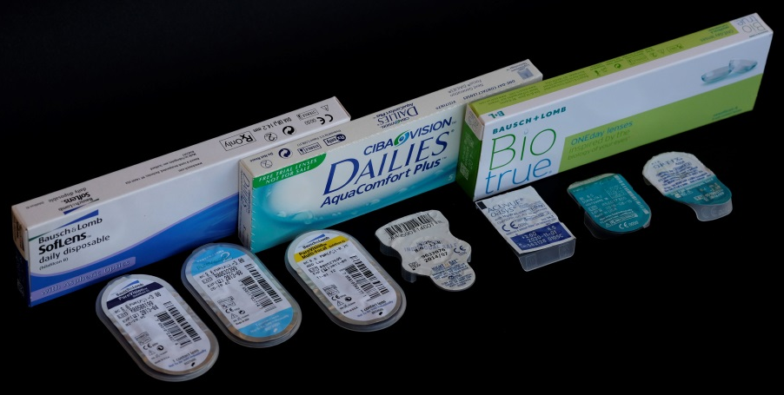
更替周期
传统型
2 - 4周抛弃型
部分时间配戴
特殊参数
透气材料
特殊染色片
全时或部分时间配戴
干眼症
依从性差
3 - 6月频繁更换型
日抛型
部分时间配戴
依从性良好
全时或部分时间配戴
无需依从性
无需护理
干眼症
Notes:
12
12
Replacement Schedules
Common schedules of replacement vary somewhat from country to country, even for identical products. These differences reflect the differences in local perception of the potential problems, cultural issues, economic issues and, sometimes, the level of education & knowledge of the local practitioner population. With the ‘globalization’ of information & the dominance of the CL industry by the large multi-national companies, regional differences can be expected to ↓ over time.
This slide shows the most common general schemes in operation world-wide. Many practitioners will customize schemes to suit their practice style or individual patient needs. The suitability of the various schemes to particular wearing pattern, compliance levels, & ocular conditions is presented.
A study to address the pertinent question ‘How often should CLs be replaced?’ using comfort, vision, & CL wettability criteria provided the answer ‘1 week to 3 months,’ subject to individual variation (Guillon et al., 1992). While this is suggestive of the need for a range of replacement rates, the difficulty of assessing the patient to decide which one is appropriate & the administrative overheads likely to follow such a decision is difficult to justify. Most choose to adhere to one of the common schemes.
It has been claimed that wearers find the ‘Rule of Ones’ easier to follow, i.e. one day, one month, 1 quarter, or one year. The popularity, & apparent success, of 2-week replacement schemes raises questions about the ‘Rule of Ones’.
Conventional CLs are seen by some as meaning 1-2 years of often 6-7 days a week wear. This is imprudent & as a maximum, ‘conventional’ should be synonymous with annual replacement. Gellatly et al. (1988) showed that for daily wear HEMA CLs (low water, non-ionic), ↑ vision & ↑ deposits resulted in an unsatisfactory clinical situation after 12 months or 4,000 hr of wear. High water & ionic high water CLs can be expected to deliver shorter or much shorter total wearing times.

Slide 62
配戴形式的选择: 患者需求
方便
安全
舒适
知识/受教育程度
Notes:
12
12
Choosing Wear Modality: Patient Requirements
When choosing a wear modality, a key issue in the minds of new CL wearers is convenience. Overnight wear of CLs → the greatest convenience but also carries the greatest risk. The latter factor is usually not apparent to the novice CL wearer.
When establishing a wearing schedule, the practitioner must weigh the desires of the patient against the need to consider the long-term ramifications of CL utilization. Safety & comfort are probably the most important considerations in determining the optimum CL wear modality.
It is important that the reasons for selecting a particular wearing schedule are explained clearly to the patient. This should be regarded as part of their CL education.

Slide 63
配戴形式的选择: 镜片选项
材料性质
配适特征
参数范围
Notes:
12
12
Choosing Wear Modality: CL Selection
The optimum wearing schedule for each patient is dictated by many different factors. Even though a wide range of CLs is available to the practitioner, it is possible that an optimal CL fitting is not achieved. In such cases the CL wearing schedule should be based on the quality of the CL fitting that is achieved.

Slide 64
配戴形式的选择: 用途、诉求、需求
接触镜配戴时间越长 =所需镜片Dk/t越高
Notes:
12
12
Choosing Wear Modality: Purpose, Demands, & Needs
The individual visual needs of patients vary. Occupational & recreational activities also have varying visual demands. The total wearing time is not as important a consideration as the duration of each wear period, & the environment the patient & CLs are exposed to during use. The longer the wearing time needed, the higher the O₂ transmissibility required, especially if EW (or FW) is contemplated.

Slide 65
镜片更换周期: 因素
成本
方便和实用性
患者管理/咨询
治疗目的
库存保有量
Notes:
12
12
CL Replacement Schedule: Factors
The CL replacement schedule is dictated by a number of factors which must be considered on a case-by-case basis. Considerations include the requirements for work & recreation, convenience, the likely compliance level, & even local availability of such schemes.

Slide 66
镜片更换周期: 成本
RGP更物有所值
镜片成本VS护理成本
Notes:
12
12
CL Replacement Schedule: Cost
Of major concern to patients is the cost of CLs & their maintenance. GP CLs have the longest life span & can usually be polished to remove scratches, deposits, & surface films They can be modified for small power or parameter changes, which eliminates the need to order new CLs whenever a change becomes necessary. These features make them the most cost-effective CL type.
Current market trends & significantly improved manufacturing technology have made DD & frequent replacement of CLs affordable. Because solutions are not required with DD CLs, the higher cost of such CLs can be partially offset by the savings on the CL care products required with other replacement schedules.
Warranties, life expectancie,s & replacement costs for different CL types may differ & should be explained clearly to the patient from the outset.

Slide 67
镜片更换周期: 方便和实用性
频繁操作
丢失镜片的倾向
频繁旅行
Notes:
12
12
CL Replacement Schedule: Convenience & Practicality
The convenience aspect should embrace broadly all aspects of CL wear from the care regimen to the ease & practicality of CL replacement.
Frequent CL handling associated with DW may be a source of contamination & CL damage for geriatric & paediatric patients or people engaged in manual labour. In such cases, DW conventional CLs are not as convenient or practical as EW or, possibly, DD CLs.
Some patients may exhibit a propensity to lose their CLs more frequently than others. Because disposable CLs are dispensed in multiple packs, spare CLs will be always on hand. This ↓ the inconvenience associated with not being able to obtain a replacement CL quickly.
People who are frequent travellers, or who wear their CLs occasionally, have special needs. Storage of CLs for longer than normal periods is an issue all too often ignored but which is fraught with potential dangers. These dangers are greater if the care products have relatively low antimicrobial powers.

Slide 68
镜片更替周期: 患者管理
频繁更换:
减少并发症
减少就诊时间
防止沉淀物堆积
Notes:
12
12
CL Replacement Schedule: Patient Management
Overall ocular health is usually better with frequent replacement & disposable CLs because, physiologically, corneal homeostasis is better maintained with such CLs. GP CLs offer the same advantage possibly because of their higher O₂ transmissibility. However, as discussed previously, the incidence of infectious keratitis & sterile infiltrative keratitis seem not to be ↓ significantly by the use of disposable CLs.
As well as the ocular health aspects, ↓ the onset of complications means ↓ chairtime. Frequent replacement & disposable CLs prevent deposit build-up, so that deposit-related complications can be prevented. GP CLs may develop scratches, & often a protein film forms on the CL surface using scratches to establish a foothold on the CL. However, surface scratches & deposit can be readily polished off prior to any significant build-up forming on the CL surface.
Wearer success is frequently dependent on the quality of the counselling provided at the commencement of CL use. A clear understanding of the reasons for selecting the CL replacement schedule & the need for wearer compliance are fundamental to achieving optimal wear as well as wearer safety.

Slide 69
镜片更换周期: 患者管理
保持镜片配戴日程
依从性:
    护理液
    镜片
Notes:
12
12
CL Replacement Schedule: Patient Counselling
Wearer success is frequently dependent on the quality of the counselling provided at the commencement of CL use. A clear understanding of the reasons for selecting the CL replacement schedule & the need for wearer compliance are fundamental to achieving optimal wear as well as wearer safety.

Slide 70
镜片更换周期: 治疗目的
使用高透氧的硅水凝胶镜片
可以使用薄的、长戴型、高含水的水凝胶镜片
如果不考虑处方，选择平均厚度最低的镜片
Notes:
12
12
CL Replacement Schedule: Therapeutic Purposes
Some CLs have properties that permit their use as a therapeutic device. Such CLs aid the healing process by preventing mechanical exfoliation of the growing epithelial cells during a blink. They also allow instillation of medication with the CL in situ. Therapeutic CLs are now usually plano powered SiHy CLs (for vision quality reasons) with a high Dk, & are available as frequent replacement & two-weekly disposable CLs. In some lens series, plano CLs may not be as thin as CLs of around –0.50 D – if the CL’s surfaces are parallel, a MINUS BVP results because of the short radii of curvature.
If therapeutic CLs are not available & the Rx is irrelevant, the CL with the lowest average thickness should be chosen from a CL series of known high physiological performance.
CLs used for therapeutic purposes should be discarded after use.

Slide 71
镜片更换周期: 库存保有量
频繁更换/需要补货
保有大量库存→好处
需要有效的库存控制体系
  基于电脑?
  给单个工作人员分配责任
  —轮休保证任务完全覆盖
Notes:
12
12
CL Replacement Schedule: Maintaining Inventory
Frequent CL replacement necessitates a large CL inventory in a practice. Such inventories represent a significant investment by the practice. CL inventory levels should be maintained to allow immediate dispensing of CLs to the majority of patients (think ‘normal distribution curve’ of BVPs and ocular parameters).
Where possible, a planned replacement program should be made available to each patient where it might encourage compliance. Since patients like maximum convenience, CL dispensing & collection should ideally be scheduled during the after-care visits.
This will allow staff members to check the CL inventory prior to the after-care visit & order CLs if necessary.
Fitting frequent replacement or disposable CLs in a practice necessitates a large inventory which requires some form of stock control. Today, computerized stock & inventory control software is available to manage these issues & out-of-stock situations should be uncommon.

Slide 72
致谢
欢迎反馈关于错误、遗漏或改进的建议。请联系我们: iacle@iacle.org
请查阅以下幻灯片
IACLE接触镜课程中使用的符号、简称
和首字母缩略词
14

Slide 73
符号
↑ | 增加，提高 | { | 由…共同产生
↓ | 减少，降低 | } | 共同产生
→ | 生产，向着 | Σ | 总和
← | 从...产生，，由…引起 | ± | 加减
↔ | 没有变化，不明显 | + | 正号，加，包括，和
↑ ↑ | 明显增加 | - | 负号，减少
↓↓ | 明显减少 | ≈ | 约等于
% | 百分比 | = | 等于，与什么相同
＜ | 小于 | & | 和，以及
＞ | 大于 | x0 | 角度，例如45⁰
≥ | 大于等于 | ＠ | 在…子午线上
≤ | 小于等于 | D | 屈光度
？ | 不确定，有疑问的 | X | 例如-1.00X175 代表-1.00柱镜，轴向175⁰
n | 折射率 | △ | 棱镜度数

Slide 74
简称
μg | 微克（0.001毫克） | min | 分钟
μL | 微升（0.001毫升） | mL | 毫升（0.001升）
μm | 微米（0.001毫米） | mm | 毫米
μmol | 微摩尔 | mmol | 毫摩尔
cm | 厘米（0.01m） | mOsm | 毫渗透摩尔
d | 天，天数 | nm | 纳米（10⁻⁹m）
Endo | 内皮 | Px | 配戴者
Epi | 上皮 | Rx | 处方
h | 小时，小时数 | S | 秒，几秒
Inf. | 下面 | Sup | 上面
kg | 公斤 | t | 厚度
L | 升

Slide 75
首字母缩略词
ADP | 二磷酸腺苷 | L | 左
ATP | 三磷酸腺苷 | LE/OS | 左眼（拉丁文左眼）
ATR | 逆规 | LPS | 提上睑肌
BS | 最佳球镜 | NADPH | 还原型辅酶II
BUT | 破裂时间 | NIBUT | 非侵犯性破裂时间
CCC | 中央角膜云翳 | OO | 眼轮匝肌
CCD | 电荷耦合装置 | OU | 双眼(拉丁文）
Cf. | 与什么相比 | PD | 瞳距
CL | 接触镜 | PMMA | 聚甲基丙烯酸甲酯
Dk | 氧通透性 | R | 右眼

Slide 76
首字母缩略词
DW | 日戴 | R&L | 右&左
e.g. | 例如 | RE/OD | 右眼/右眼（拉丁文）
EW | 长戴 | RGP | 硬性透气性隐形眼镜
GAG | 黏多糖 | SCL | 软性角膜接触镜
GPC | 巨乳头性结膜炎 | TBUT | 泪膜破裂时间
HCL | 硬性隐形眼镜 | TCA | 三氯乙酸
HVID | 水平可见虹膜直径 | UV | 紫外线
i.e. | 也就是 | VVID | 垂直可见虹膜直径
K | 角膜曲率读数 | WTR | 顺规散光

Slide 77
Please visit us online at:
www.iacle.org

