Slide 1
配发及复查
B7
2016-Aug-24
Notes:
Symbology used in the Notes section of this lecture:
Symbols are used throughout this lecture in the interests of clarity & to make translations subsequently, a little easier. The most common ones are explained in the following:
↑ = increase(s), high(er), enhance(s), improve(s), raise(s), greater, larger, better, maximizes, gain(s), excessive [generally, a positive step]
↓ = decrease(s), low(er), reduce(s), detracts from, worse, worsens, smaller, lower(s), lesser, lessen(s), minimizes, affects adversely, loss(es), poorer, inadequate [generally, a negative step]
= produce(s), cause(s), give(s), results in, induce(s) [what follows this statement]
← = induced by, a result of, results from, produced by [what follows this statement]
∆ = change(s), difference(s), alteration(s)
↕ = varied, variations, changed, altered, alterations, fluctuating, fluctuations [to/of whatever follows this statement]
> = greater than, more than, better than [usually similar to its uses in mathematics]
< = smaller than, less than, lower than, worse than [usually similar to its uses in mathematics]
= Equal or greater than what follows the symbol
≤ = Equal or less than what follows the symbol
≈ = approximately equal to, almost equal to, very similar to, close enough to, near enough for practical purposes
O₂ = oxygen
H₂O = water

Slide 2
编审者
撰稿人* | Meredith Reyes, Robert Terry
编辑** | Fabrizio Zeri
IACLE 责任编辑** | Etty Bitton
IACLE 审稿人** | Nilesh Thite, Lewis Williams
更新时间 | 2015年10月10日
内容复审时间 | 2016年8月
* 原作者 | **2014 编辑和审稿人

Slide 3
通过教育基金和实物捐赠，IACLE开发和提供隐形眼镜教育
铂金赞助商
白银赞助商
捐赠资助
CIBA Vision Bausch & Lomb
Allergan
AMO
Ocular Sciences
Wesley Jessen
Menicon
Paragon
Pilkington Barnes-Hind
Aspect Vision Care

Slide 4
版权声明
国际接触镜教育者学会是IACLE接触镜镜课程（简称ICLC）所有格式和版本的唯一所有者，受版权保护。若要获得该接触镜材料，您需要同意以下条款：
IACLE接触镜课程只能用于个人或学习用途。未经IACLE书面同意，严禁传播或销售ICLC的全部或部分内容，或将本教材用于教育及个人以外的用途。除以下声明外，不得复制、重新发布、出版或分发ICLC中包含的任何材料。
你可以在个人或教育使用时打印课程材料。所有版权信息，包括IACLE徽标必须保留在材料上。使用ICLC的任何内容，包括文本，图片或注释等必须提供合适的引用标记。

Slide 5
出版 国际接触镜教育者学会(IACLE) 2016修订版 © 国际接触镜教育者学会2000-2015 版权所有。未经国际接触镜教育者学会事先书面许可，本出版物的任何部分不得复制、储存在检索系统中，或以任何形式或传播： 国际接触镜教育者学会 IACLE秘书处， PO Box 656 KENSINGTON NSW 2033 Australia 电子邮件：iacle@iacle.org

Slide 6
接触镜配发及患者教育

Slide 7
核实: 阶段
实验室
诊所
患者
Notes:
12
12
Verification
Verification of CLs involves 3 stages:
Laboratory
Laboratory verification is usually performed in conjunction with each phase of the manufacturing process. Verification of each parameter generated during manufacture is required. Automated manufacturing processes require ↓ verification steps. During the final phase of manufacture, an overall parameter check is performed to ensure the CLs do not differ significantly from the parameters ordered by the practitioner.
Clinic
It is the responsibility of the practitioner to verify that the CLs received have the correct parameters. Warranties for a limited time period are offered by most laboratories. Verification of CLs upon receipt, rather than during the dispensing visit, is advisable. This enables warranty claims to be made & assures the practitioner that the CLs are within tolerance.
Patient
Assuming the original practitioner’s order was appropriate for the patient, ‘on-eye’ fit is another indicator of whether a CL has been manufactured to specifications. A satisfactory CL-to-cornea relationship with adequate tear exchange should be the main objectives of the fitting assessment.

Slide 8
软镜: 水合允差
室温: 20 ± 0.5 °C 水合溶液: 0.9% 生理盐水
BOZR: ±0.20 mm (wet-cell)
±0.10 mm (dehydrated)
BOZD: ±0.20 mm
FOZD: ±0.20 mm
BPRs: ±0.20 mm
TD: ±0.20 mm
BVP: ±0.25 D (+10.00 to –10.00 D)
t_{c} & t_{EA}: ±0.03 mm
Notes:
12
12
Parameters to be Checked In-House:
In-practice, parameter verification should be performed to confirm that:
Parameters fall within acceptable tolerance limits (Pearson, 1979; Standards Association of Australia, now Standards Australia, 1976). These slides show the tolerances for soft & rigid CLs according to Australian Standard 1887 - 1976, the first comprehensive standard published in the world.
There are no manufacturing defects.
The correct tint, if any, is incorporated.

Slide 9
RGP: 允差
BOZR: ±0.02 mm
BOZD: ±0.05 mm (轻度混合)
±0.10 mm (中、重度混合)
FOZD: ±0.10 mm
BPRs: ±0.10 mm
BPZDs: ±0.05 mm
TD: ±0.05 mm
BVP: ±0.12 D (+10.00 to –10.00 D)
±0.25 D (>10.00 D)
t_{c} & t_{EA}: ±0.02 mm
Notes:
12
12
Key to the accompanying slides:
BCOD Back Central Optic Diameter
BOZR Back Optic Zone Radius
BPOR Back Peripheral Optic Radius
BVP Back Vertex Power
BPCD Back Peripheral Curve Diameter
BPR Back Peripheral Radius
FCOD Front Central Optic Diameter
TD Total Diameter
t_{C} Centre Thickness
t_{EA} Axial Edge Thickness

Slide 10
接触镜: 储存 & 标记
使用合适的镜片盒
在配发镜片之前标记所有的盒子
使用接触镜储存或消毒溶液，以保证镜片的正常水合 (PMMA, RGP, 水凝胶,硅水凝胶接触镜)
Notes:
12
12
Proper Storage & Labelling
CLs that arrive from laboratories are often stored in vials or cases that are inappropriate for patient use. CL cases should have the following characteristics:
Deep wells that submerge the CLs fully in the storage solution
Wells with a concave floor & ribbed walls to prevent CLs adherence & allow easy CL removal
CL baskets of a size & design to preclude puncturing the CL with the clasp when closing the basket
Made of materials that are heat-resistant to allow disinfection of the CL case by immersion in boiling H₂O
Clear markings of ‘R’ & ‘L’ with the letters (or some other means of identification such as dots) raised for tactile identification.

Slide 11
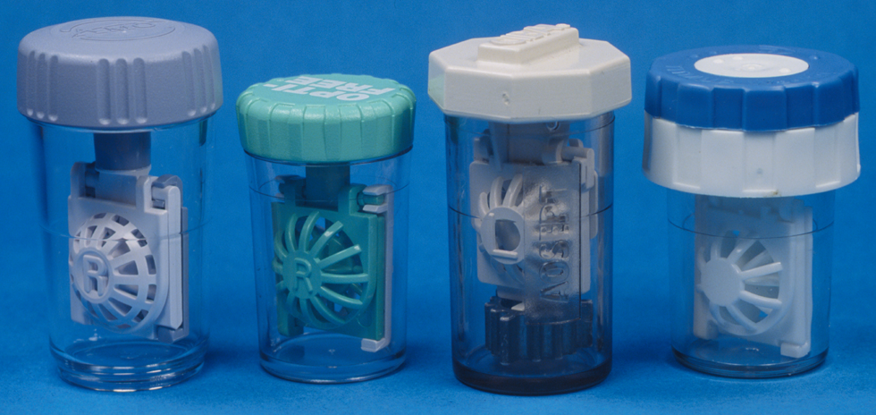
接触镜: 储存 & 标记
Notes:
12
12
Slide shows an assortment of cases for GP CLs & SCLs most of which meet the requirements presented above.

Slide 12
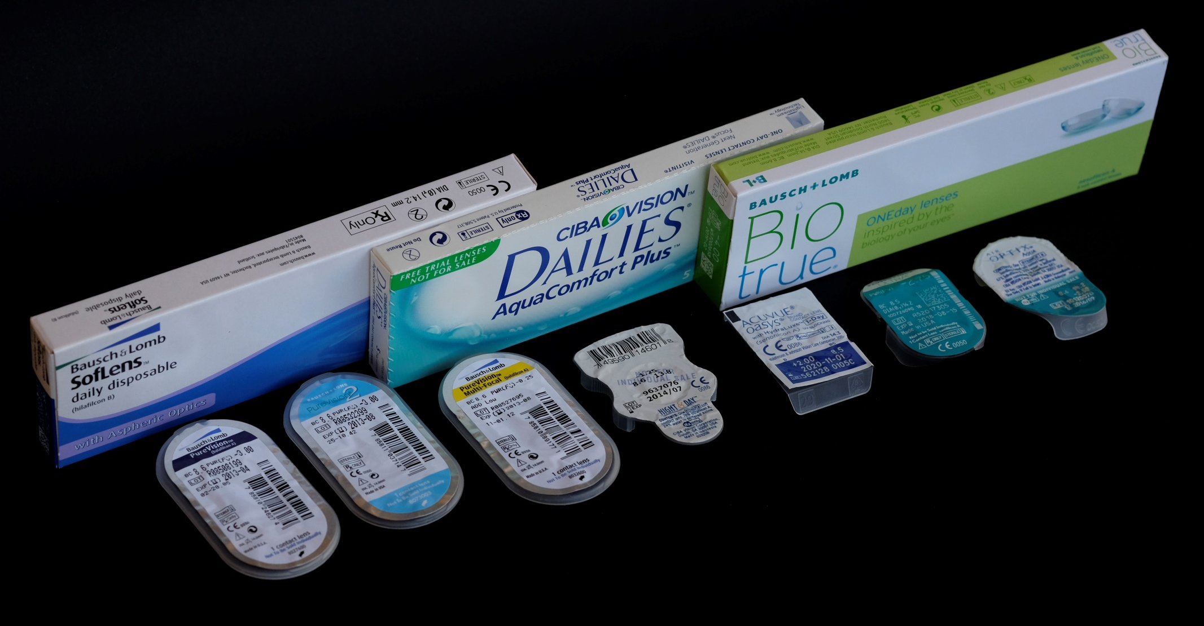
接触镜: 储存 & 标记
Notes:
12
12
Disposable CLs are usually supplied in boxes containing several individually blister-packed CLs.
Because blister packs cannot be resealed, disposable CLs are not verified routinely prior to dispensing. Manufacturers are aware of this & due consideration is given to this added responsibility in their manufacturing quality assurance programmes.
Preparation of GP CLs for dispensing should include a thorough cleaning & rinsing followed by disinfection/conditioning in an appropriate disinfecting/storage solution, preferably overnight.
Hydrating all types of CLs prior to dispensing eliminates the fitting problems caused by parametric variations & enhances their surface wettability.

Slide 13
接触镜: 水合效果
对于透气硬镜，水合作用会使后表面光学区变平
低含水的软镜，脱水-水合差异较小
高含水软镜，脱水-水合差异较大
对水凝胶镜片, 折射率(n_{CL})和含水量之间存在线性关系,即 n_{CL} ∞ %H₂O
对硅水凝胶镜片,折射率和含水量之间的关系更为复杂
Notes:
12
12
Effects of Hydration
Hydration or the degree of hydrophilicity (wetness) depends on the amount & method of binding of H₂O to the CL polymer. Alterations in hydration can result in parametric variations in CLs. These variations have implications for verification & fitting:
Sakata & Koide (1992) studied the effect of hydration on the BOZR of GP CLs. Their study shows minus CLs flatten with hydration. Higher power & thinner-centre minus CLs have ↑ degrees of flattening.
In order to negate the effect of hydration ∆s on the BOZR, Barr & Hettler (1984) recommend that GP CLs (Boston II was used in the study) be soaked for at least 4 hours prior to assessing the BOZR fit on the patient. It takes about 1 hour for a hydrated CL to revert to its dehydrated state.
The degree of dehydration-hydration ∆ is ↓ for lower water content SCLs (Dormon-Brailsford, 1974). This results in better stability than high water content CLs.
Other factors relating to hydration of SCLs are worthy of mention because of their influences on fitting:
The individual variation in tear pH, & the faster dilution by tears of care solutions that are more alkaline, have induced manufacturers to formulate solutions with a pH of 8 - 9. This suggests that a soaking solution that more closely matches the pH of tears should be used for trial CLs.
Most solutions have osmolalities that are the same as tears or close to normal saline (0.9%). This is necessary to avoid fitting ∆s ← osmotic forces ← ∆s between storage solution & tear tonicities. When using trial CLs, misleading fits can be avoided by soaking the CLs in solutions that have the same tonicity as tears & allowing a period of adaptation (around 15 min) prior to assessment.
The linear relationship between refractive index & H₂O content (Mousa et al., 1983; Fatt & Chaston, 1980), although small, makes high water content SCLs more prone to BVP ∆s (<0.25 D) during ↑ in temperature of 14°C. The ∆s in CL optics have been found to be closely related to the front & back surface curvature rather than to centre thickness or refractive index.

Slide 14
验配师职责: 配发阶段
镜片检查
视敏度良好
镜片配适
镜片护理及保养介绍
Notes:
12
12
Responsibilities of the Practitioner
Ensuring that CLs dispensed have the correct parameters, are sterile, & are in good condition.
Ensuring that optimum VA is achieved by the patient with the CLs.
Ensuring that the CLs fit satisfactorily.
Providing instruction on CL care & maintenance.
Personally supervising the practice of relevant procedures until the patient becomes confident & adept at CL insertion, removal ,& handling.
Ensuring that the patient understands the responsibilities involved in CL wear & the importance of after-care visits.
Describing the anticipated adaptive symptoms (however, avoid providing the new wearer with a ‘shopping list’ of potential problems).
Providing the patient with information on insurance, & warranties relevant to their CLs.
N B ./A

Slide 15
验配师职责: 配发时的视力
评估戴镜验光前后的视力
Notes:
12
12
Vision Assessment
At the time of the dispensing visit, the ideal corrected VA should ≥ the expected VA based on that obtained during the trial fitting visit.
The unaided VA should be measured prior to insertion of the CLs to be dispensed.
VA with CLs is taken after the Best Sphere (BS) & sphero-cylindrical over-Rx. Vision can be checked using high & low contrast VA charts. Distance & near VA should be tested.
If minor deficiencies in VA & Rx are found, do not ∆ the CL(s) at this stage but check again at the first after-care visit.

Slide 16
验配师职责: 镜片配适评估
镜片静态/动态评估
镜片表面湿润度及镜片质量
角膜完整性
Notes:
12
12
Fitting Assessment
Both static & dynamic fitting of the CLs should be checked. These should be checked with the slit-lamp using both white & cobalt blue light (for GP CLs).
CL surface wettability & overall CL quality should be observed with a slit-lamp while the CLs are in situ.
Check to ensure that no corneal insult is evident after fluorescein instillation following removal of the CLs.

Slide 17
对患者的教育指导是一个持续不断的过程
Notes:
12
12
Factors to Consider in Patient Instruction
Patient education & instruction is critically important in ensuring compliance with recommended care & maintenance procedures. It is important to note that patient instruction does not end with the completion of the dispensing visit. It is a continuous process that forms a part of each after-care visit.
It involves a variety of approaches depending on a number of factors…

Slide 18
患者指导: 注意事项
适合患者和镜片的护理方法
年龄和性别
患者的理解力和能力
配发的镜片类型
职业需求和视觉需求
环境暴露
临时情况注意事项
Notes:
12
12
Factors to be Considered
Care regimen
Care regimen suitable for the patient, especially if there is a known sensitivity.
CL solutions are available in a variety of formulations & have different applications for different CLs. There have been numerous reports of patients suffering from hypersensitivities & allergies to preservatives. Obviously, solutions that do not contain the chemical(s) known to disturb a particular patient should be selected, where this is possible.
Age & gender
Different instructional approaches are required for children & adults For children, simple vocabulary & demonstrations to aid understanding should be used. The element of play can be included without loss of emphasis on the importance of care in CL wear. Aged patients may require special aids such as a magnifying glass. Alternatively, family members can be taught to take care of the CLs as well as CL insertion & removal.
Gender difference usually becomes an important factor when considering the use of cosmetics & creams. Appropriate make-up types & their application should be stressed. Hair sprays have also been known to contaminate or even ‘etch’ CL surfaces. Do not assume that males are not users of cosmetics.
Intelligence of the patient
For some patients, verbal instruction is adequate while others require handouts (preferably with illustrations) detailing the steps & providing tips on CL care & handling. It is always best to provide adequate written guidelines for the patient. It is also common for patients to require additional visits to master CL insertion & removal.
Types of CLs dispensed
GP, disposable, & conventional SCLs all differ in their care regimens. The adaptation period for GP CLs requires a slower build-up of wearing time for new wearers or those who have discontinued CL wear for a long time. Disposable SCLs eliminate the need for protein cleaning. Conventional SCLs for DW & EW require ↑ compliance.
Occupational & visual demands
Frequency of CL wear should be determined so that appropriate instructions on the care, maintenance, & storage of unworn CLs can be provided. Units 9.2 & 9.3 provide in depth discussions of CLs in relation to sports & the working environment.
Environmental exposure
Risks of exposure to the environment should be stressed, especially if the patient is regularly exposed to less than ideal conditions. Frequent exposure to chemical vapours & gases can → discomfort & may limit the wear of SCLs due to absorption. A surfer needs to be instructed on the use of CLs at the beach & the cleaning necessary after swimming.
Temporary conditions
Other conditions may require modification to, or limits on, wearing time for the duration of the condition. For example, a patient undergoing medical treatment with eyedrops or ointments that can contaminate CLs should discontinue CL wear during treatment. Instruction on modifying wear modality & cleaning should be provided.

Slide 19
患者指导: 注意事项
Notes:
12
12

Slide 20
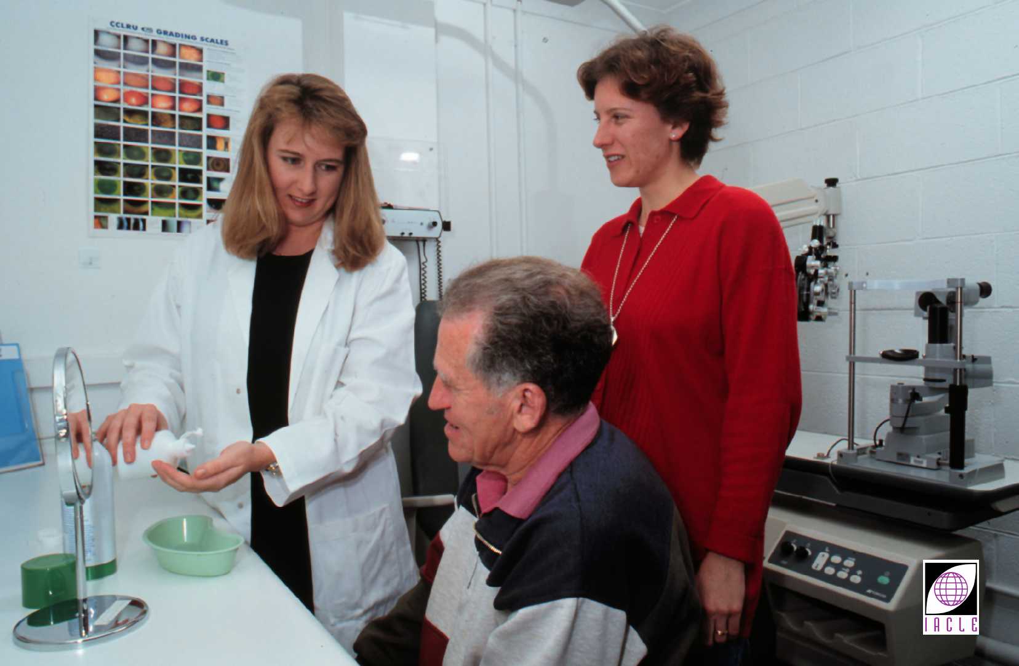
患者指导: 注意事项
Notes:
12
12

Slide 21
临床助理能够提供帮助
在接触镜操作过程中
是非常有价值的
Notes:
12
12
Educating/Training the Clinical Assistant
Because all of the factors in the foregoing require some level of familiarity with the patient, the practitioner is the best person to provide instruction to the patient. However, in a busy practice, practitioner time can be optimized by utilizing the skills of a suitably-trained clinical assistant & delegating some of the clinical tasks to them, e.g. history taking, keratometry, auto-refractometry, visual fields, & teaching CL care & maintenance.
The practitioner can also make the use of teaching videos such as videos of insertion & removal of CLs.

Slide 22
临床助理: 可委任的方面
病史采集
曲率仪/全自动曲率仪/角膜地形图仪
电脑验光仪
视野检查
镜片摘戴教导
试戴片维护
Notes:
12
12
Education & training of the assistant by the practitioner is a necessary prerequisite for such delegation. During such education & training, they learn specific skills & develop a better understanding of, & an appreciation for, what the patient experiences during an eye examination. In the case of CL instruction, the assistant will acquire an understanding of the process from the patient’s viewpoint.

Slide 23
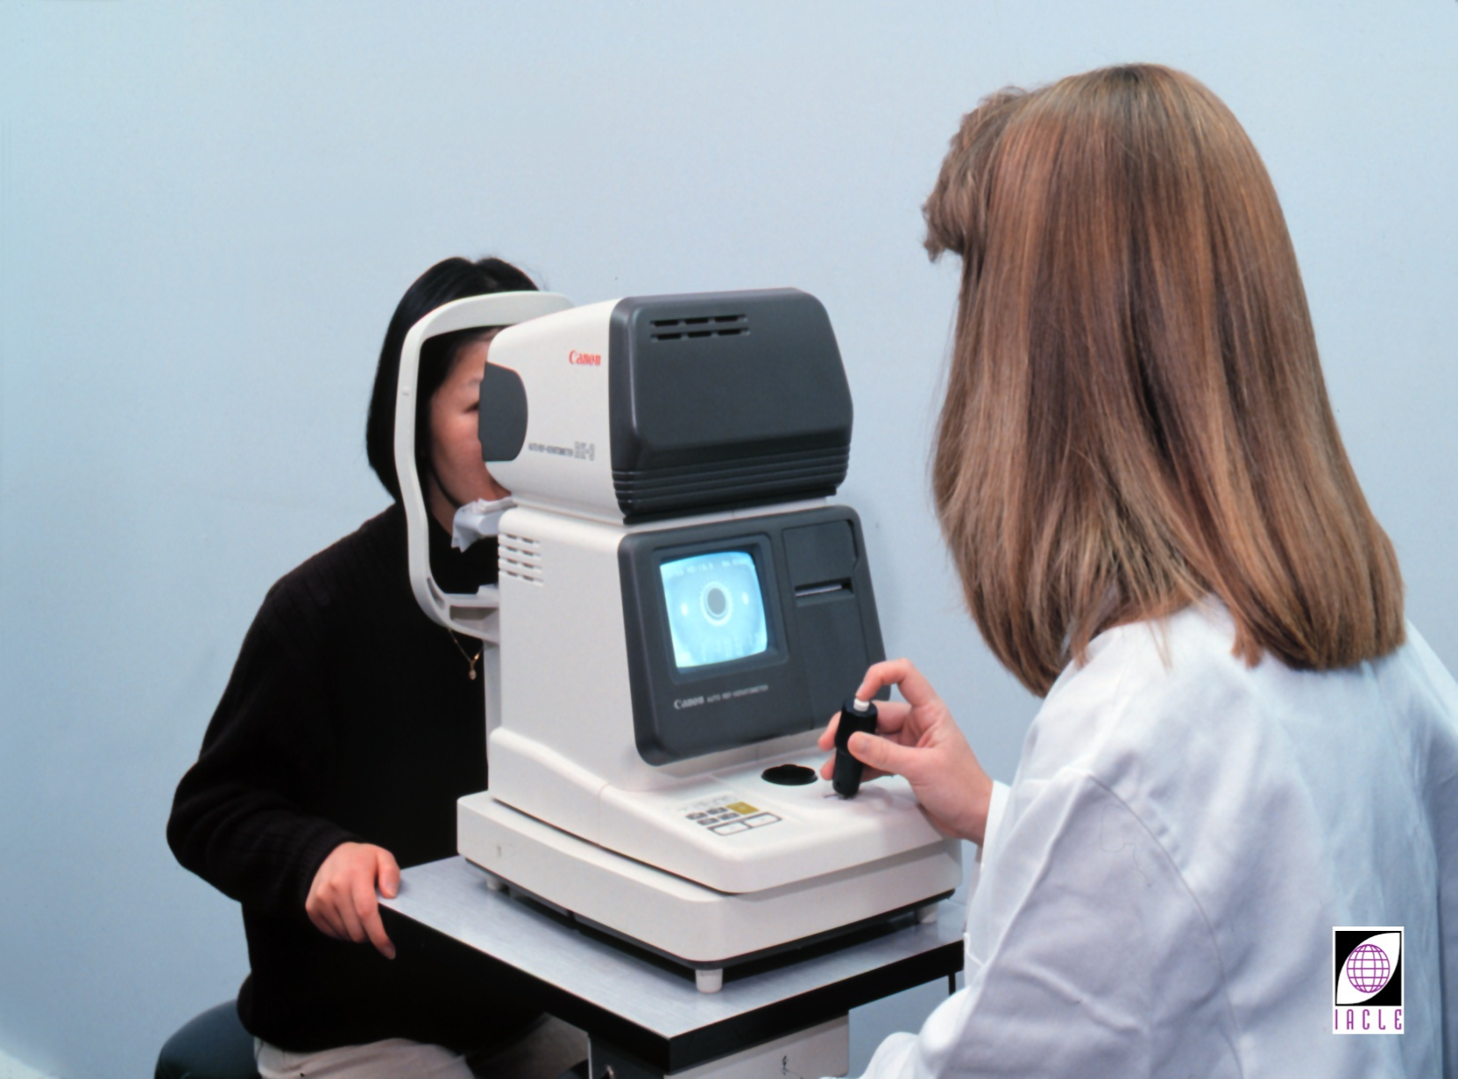
临床助理
Notes:
12
12
Resources for education & training of the clinical assistant include:
Videotapes that provide systematic & consistent instruction.
Written materials from journals & textbooks. The following are helpful references:
Home Study Course for Optometric Assisting (American Optometric Association - Paraoptometric Section, 1989)
Seven Steps to Better Patient Care: An Educational Resource for the Contact Lens Assistant (Contact Lens Spectrum, November 1994).
Industry representatives who have product-specific knowledge.
Seminars, workshops, & conferences.
Case study sessions led by the practitioner.

Slide 24
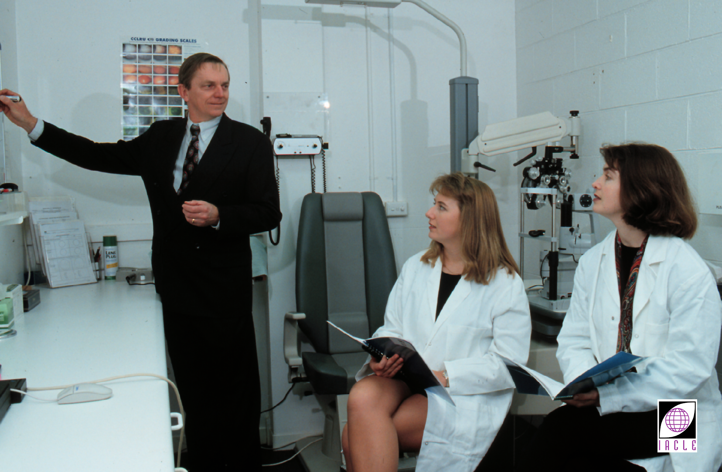
临床助理
Notes:
12
12

Slide 25
临床助理
Notes:
12
12

Slide 26
接触镜操作技巧的教授
配戴和摘除
在镜盒存放和拿取
揉搓和冲洗过程
接触镜意外掉落或偏位
紧急摘除
Notes:
12
12
Teaching the Patient CL Handling Techniques
Proper CL handling by the patient should be taught. It involves:
Insertion, removal & recentring of CLs
Teaching CL insertion & removal is greatly assisted by showing the patient a video demonstration of the techniques. This should then be followed by a step-by-step, supervised, hands-on session with the patient
Storage & removal from the CL case
A commonly encountered situation in a CL practice is a patient who has torn or damaged a CL while closing the lid or removing it from the CL case. Demonstrating the placement of a CL in a case prior to pouring the disinfecting or storage solution (to ensure full immersion) will help prevent the CL getting caught in the lid of the CL case.

Slide 27
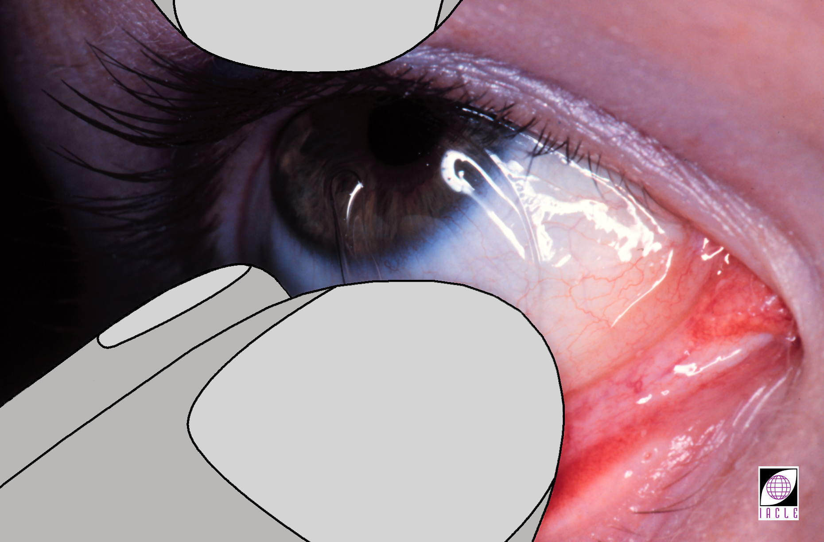
接触镜操作技巧的教授
Notes:
12
12
Removal of a CL from the eye is another problem that can damage a CL. Stressing the importance of short fingernails & careful CL extraction techniques will help prevent this type of CL damage.

Slide 28
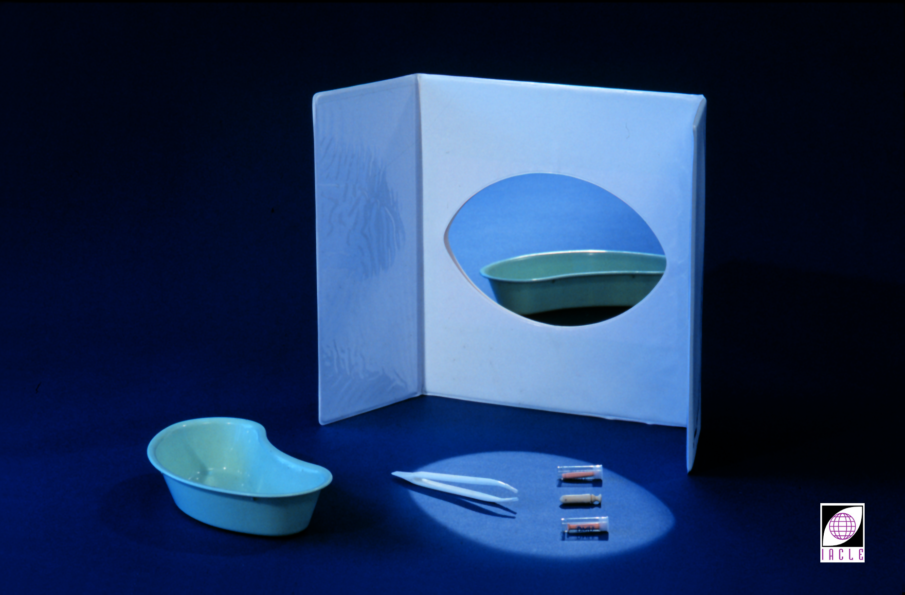
接触镜操作技巧的教授
Notes:
12
12
Rub & rinse process when cleaning
The importance of washing the hands prior to CL handling should be stressed. The contaminating effects of inks, cosmetics, & dirt should be explained. Providing a list of contaminants can be a useful precaution. The patient should be made aware of the dangers of long fingernails, leaving rings on fingers while cleaning, & aggressive handling of the CLs.

Slide 29
接触镜操作技巧的教授
Notes:
12
12
Accidental ejection from the eye
Procedures to be followed when CLs are accidentally ejected from the eye should be discussed. Patients should be advised to carry a CL case filled with fresh storage solution. Emergency procedures & substitute solutions (e.g. comfort drops approved for use with the type of CLs involved, SCL storage solutions even if the CLs are GPs but not the reverse &, as a last resort, drinkable H₂O provided a thorough & complete CL care cycle follows as soon as possible thereafter) should also be discussed. In the absence of a CL case, a drinking glass, tablet bottle, or other suitable small container may have to be employed.
The risk of the contents (and by implication the CL) being discarded by other people needs to be addressed.
CLs dislodged from the cornea can cause patient distress, especially if they are GPs. SCLs can become folded while in situ. Patients should be taught how to locate the dislodged CL in the eye & how to recentre it. Practicing the techniques avoids panic & dispels any fallacies of the CL getting lost ‘behind the eye’ (see Practical 4.3).
Emergency CL removal
Situations may arise where the CL has to be removed, due to embedded foreign bodies, onset of infection, etc. Often, a ‘scleral wash or massage’ may be all that is needed by the patient when discomfort is felt. The handling of CLs during an adverse response, when discomfort persists, or in emergency situations should be discussed. Contact phone numbers of the practitioner should also be given to the patient in case of an emergency.

Slide 30
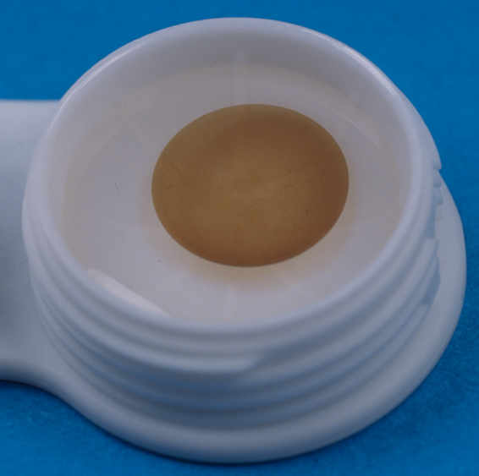
护理产品使用的教授
针对患者的个性化的镜片护理方案
简化教导
提供演示、图文并茂的详细说明，以及最简必需护理产品清单
如有需要，可以对一个负责人的家庭成员进行适当的指导
建议不要随意替换产品
Notes:
12
12
Teaching the Use of Solutions
In giving instruction on the use of solutions, it is important to stress to the patient that a specific care regimen has been recommended (and provided) to them. This means that they are to be discouraged from purchasing substitute solutions without discussing the matter with the practitioner. The following should be explained to the patient:
There are a large variety of solutions available in the market & differences in formulations prohibit the mixing & matching of non-recommended preparations. Some solutions are incompatible with each other.
People exhibit different individual sensitivities to preservatives in CL solutions.
The care regimen has been specifically recommended based on the patient’s specific CL type, wear modality, needs, & wearing schedule.
The image above is of a hydrogel CL that was exposed to pharmacy-grade 3% H₂O₂ possibly stabilized with phenacetin or some other CL-incompatible stabilizer.

Slide 31
护理产品的使用的教授
Notes:
12
12
Young & elderly patients should be given the simplest care regimen possible. Explanations should be simple & avoid the use of technical terminology as this will sound overwhelming & may be too complicated for the patient
The use of each solution is best explained by demonstration during the instruction session. Showing the patient the accompanying product literature also helps allay any concern about forgetting how to use them. Alternatively, providing the patient with a referral sheet/checklist with simplified instructions is often helpful.
For young & elderly patients, the same instructions for solution usage should be given to a member of the family who will supervise &/or perform the care & maintenance procedures.

Slide 32
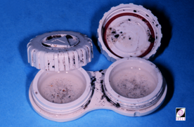
镜片盒护理的教授
提供不同种类型的镜片盒样品
镜盒更换周期以及清洁说明
注意提供镜盒护理标准中的视觉线索，尤其是对不充分者
用案例图片说明不遵医嘱的风险
Notes:
12
12
Teaching Care of the CL Case
Instruction on care of the CL case is often the most neglected or inadequately emphasized part of patient education.
Some CL wearers have been known to use the wrong type, e.g. using a vented case as a travelling case.
CL case replacement schedule & cleaning/sterilizing instructions should be written down as patients tend to observe these requirements irregularly.
Neglect of care for the CL case is common, especially amongst experienced CL wearers who have not encountered any problems. Characteristically, these patients will have old, scratched, cracked, dirty, & mouldy CL cases. These visual clues are strong indications of a need for patient re-education (or further consideration of DD CLs).
Showing photos of dirty cases & the associated complications can imprint on the mind of the patient the risks of non-compliance. However, excessive use of such materials can amount to negative ‘marketing’ of CLs & CL wear, & may adversely affect the wearer’s motivation.
Recommended CL case care can be found at:
http://www.aao.org/eye-health/glasses-contacts/contact-lens-care
http://www.contactlenssafety.org/lenscases.html

Slide 33
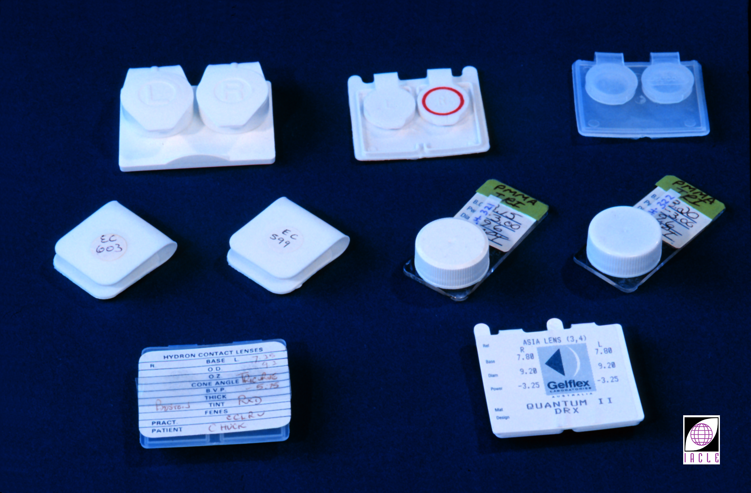
镜片盒护理的教授
Notes:
12
12

Slide 34
把患者遗忘镜片护理的风险最小化
辅助工具: - 视频 (CD, DVD, USB, 网站链接)
- 插图和印刷说明
- 清单
- 标签
- 计划表
不断重复
抓住每次机会对患者进行巩固(尤其是配后复查时)
Notes:
12
12
Minimizing the Risk of Forgetting Instructions
No matter how simple the care regimen, retention of the instructions is best accomplished by utilizing visual aids & demonstrations. In fact, one could argue that the simpler the care regimen, the more likely the patient will have a tendency to be lax about it.
Hearing & seeing results in about 60% information retention compared to hearing alone, which achieves only 40% retention. Coupling the instruction with a hands-on session ensures that it can be performed at home without supervision. Aids to instruction that ↓ the risk of the patient forgetting are:
Videos
Illustrations & printed notes
Checklists
Labels
Schedules (lens & case).
Asking the patient to repeat specific instructions builds their confidence & assures the clinical assistant or practitioner that the instructions have been understood. Take-home handouts & instructions organized as an information kit allow patients to review the instructions at home. Clarifications can then be made over the phone or during the next after-care visit.
Patient education should be reinforced during the after-care visits to ensure compliance to a strict care regimen & the ↓ deviations from the original instructions.

Slide 35
理解接触镜配戴模式
向患者说明，不同的人需要不同的配戴模式以及相应的护理产品
故不同的人需要不同的操作教程以及不同的护理产品
Notes:
12
12
Understanding Wear Modality
It is important for the patient to understand that patients have different recommended CL wear modalities. This serves as a precaution against ∆ wearing schedules as they see fit or because their friends follow schedules that appear more convenient. The different wear modalities should be defined in the handout & marked according to what is recommended for each patient. As the patient gains confidence, the desire to wear their CLs for extended periods of time ↑. Extensions or ↕ of the wearing schedule should be discussed so the problems resulting from over-wear can be avoided.

Slide 36
理解镜片的更换频率
遵守规定的更换频率
是配戴者眼睛健康的关键因素
Notes:
12
12
Understanding Frequency of Replacement Schedules
It is important for the patient to understand that CLs should be replace in accordance with the Rx recommended by their CL practitioner.
For SCLs, frequent replacement → ↓ deposits, ↓ complications, & ↑ clinical performance (e.g. Poggio & Abelson, 1993, Pritchard et al., 1996, Solomon et al., 1996, Sankaridurg et al., 2003; Radford et al., 2009).
However compliance with recommended replacement frequency is often poor: many CL wearers use their CLs for > advised (e.g. Smith 1996, Jones et al., 2002, Dumbleton et al., 2010)

Slide 37
适应过程
镜片配戴
视力和护理
镜片的日常维护
Notes:
12
12
Adaptation Period
The first few weeks or months of CL wear constitute an adaptation period. This includes adaptation to wear, vision, & care and maintenance routines. CLs entail a responsibility that demands ∆s to the day-to-day routine of the wearer.
During this period ‘questions may arise, so easy access to the support services of the clinic/practice should be available. This can be achieved by → any one or combination of the following:
Emergency phone numbers
Emergency names & addresses
Pager number
E-mail addresses
Voice messages with emergency instructions.
A list of adaptation symptoms should be provided in the handout. An explanation of how adaptive symptoms differ from the symptoms that may be precursors of a complication should also be discussed. Most importantly, risk factors, contamination sources, & first-aid measures should also be included in the handout.

Slide 38
随访和护理计划:对……很重要
眼部健康
患者管理
患者监护
Notes:
12
12
Follow-Up & After-Care Schedules
After ensuring the patient understands the instructions & is able to manage the care routine without supervision, a follow-up & after-care schedule relative to the CL wear modality should be given. An example of such a schedule is shown in next slide. After-care visits are steps in the continuous assessment of the wearer’s progress. They are intended to prevent, & in some cases correct, post-adaptation ∆s due to the CLs dispensed. Explaining the importance of these visits:
↓ the need for frequent follow-up reminders
→ an opportunity to discuss questions or problems that may arise during the course of CL wear
Develops rapport with the practitioner & staff & thereby develops communication channels between parties
↓ the risk of complications
Provides an avenue for continuous patient education & re-education
Ensures patient compliance
Reflects the service-oriented philosophy of the practice, which helps ↑ patient confidence in the practitioner & staff
Follow-up & after-care visits depend on the wear modality prescribed. For example:
SCL
DW:
1 week
1 month
3 months
Every 6 months.
EW:
After overnight wear
1 week
2 weeks
Monthly for the first 3 months
Every 3 months.
GP
DW:
1 week
1 month
3 months
6 months
Yearly.
EW:
After overnight wear
1 week
2 weeks
Monthly for the first 3 months
Every 3 months.
A 3 - 4 monthly follow-up for paediatric, elderly, & hyper-sensitive patients, & other SCL patients with progressive conditions & a history of complications, is recommended unless more frequent visits are required.

Slide 39
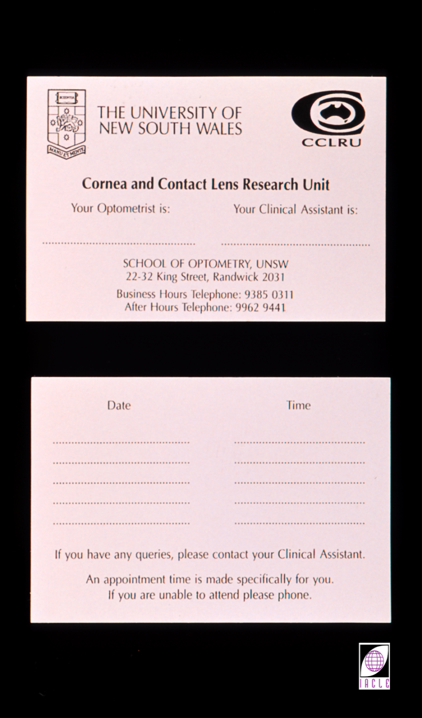
随访和护理计划
Notes:
12
12

Slide 40
适应期症状：出现
新手戴镜者最易发
流失的接触镜使用者一旦重新配镜后可能发生
偶尔戴镜者会发生
硬镜配戴者更易发生
据报道，往往是部分患者会有，而非全部
往往只发生于配戴早期
Notes:
12
12
Adaptive Symptoms
During the initial periods of CL wear, the neophyte CL patient will experience a range of symptoms, many of which will be novel to them.
Some of these symptoms are caused by the physical presence of the CL , others by the CL-induced perturbations of the normal physiology & functions of the anterior eye & lids. Additionally, others may be due to a retinal sensory reflex, i.e. effects of light on the retina/optic nerve (Bennett,1986). Psychological factors are probably also involved.
The duration of the ‘adaptation’ period varies according to CL type, fit, individual wearer characteristics, & possibly even seasonal & climatic factors (e.g. humidity, temperature). 1 month would normally cover most eventualities.
A major influence on the ‘severity’ or even the occurrence of the symptoms reported is the CL type. For example, it is uncommon for a SCL wearer to report photophobia whereas an GP CL wearer is more likely to report it.
In all cases, the possibility that the symptoms reported are not CL adaptation-related needs to be considered. Examples include damaged or defective CLs, solution sensitivity, eyelashes under CLs, airborne contaminants entering the eye &/or becoming trapped under CLs, & a range of common illnesses. The latter includes colds & influenza, viral infections, hay fever & related hypersensitivities & lid conditions such as hordeola & inward growing eyelashes (after Bennett, 1986).
Ruben (1975) suggests that physical adaptation is aided by the avoidance of physical & mental fatigue (because of their negative effects on motivation?) & that tolerance to CLs & general sensitivity are also age dependent.
If CL wear is discontinued for some time, at least some of the adaptive symptoms can be expected on resumption. If CL wear is occasional, some adaptive symptoms are possible on each occasion CLs are worn.
In a study by Pons et al., 1998, it appeared that, at least with disposable SCLs worn on a DW basis, vision quality (determined objectively & subjectively) did not exhibit ‘adaptation’. At the end of an 8-10 hour wearing period there was no ↓ in vision & no ∆ between habitual & non-habitual wearers.

Slide 41
适应期症状: 病因
镜片存在感（异物感）
眼前段及眼睑生理的扰乱
- 缺氧
低渗泪液
瞬目频繁
视网膜知觉反射
心理学? (伪盲??)
Notes:
12
12
Adaptive Symptoms: Aetiology
CL wear invokes 2 sensory reflexes:
The peripheral sensory reflex involving the cornea, conjunctiva, & lids.
The retinal sensory reflex involving the effects of light on the retina (optic nerve) & higher pathways (after Bennett, 1986).
Foreign body (FB) sensations are the result of the peripheral sensory reflex &, as can be readily demonstrated by the simple expedient of retracting both lids, involve the lids & not the cornea in most cases.
In a study of PMMA CL wearers, Lowther et al. (1970) showed that tear sodium levels (an analogue of tear fluid osmolality) varied in parallel with subjective symptoms & objective signs of adaptation. Low sodium levels were commonly associated with initial photophobia, irritation, excess tearing, & even central corneal clouding (very low physiological performance CLs). The return to prefitting levels accompanied the ↓ of adaptive symptoms.
The question of CL-induced hypoxia, which dominated CL research until recent times, will be covered in detail in A6 of this series & Module 6 of the original ICLC & will not be dealt with here. However, it should be noted that hypoxia is implicated in a number of symptoms which occur during adaptation & adapted CL wear, especially with CLs of low O₂ transmissibility.

Slide 42
适应期症状
流泪
眼睑刺激征
向上注视困难
间歇性视物模糊/视觉干扰
大幅度眼球运动倾向减少
头位异常
Notes:
12
12
Adaptive Symptoms
This list is adapted from Mandell (1988) & Fletcher et al. (1994).
Tearing
Excessive lacrimation is a common experience immediately following CL insertion. While this is particularly true of GP CLs, it also happens to a lesser extent with SCLs.
Lid irritation/itchiness/swelling
This is less common with SCLs except when FBs become trapped under the CL, the CL is a toric of medium to high BVP, or is an aphakic CL.
Difficulty looking up &/or to the side
Many GP CL wearers find that looking down → ↑ CL comfort. This is due largely to both lids resting on the CL & the elimination of the ‘lid margin - CL edge’ interactions. Looking up &/or to the side ↑ the wearer’s discomfort &/or ↑ their apprehension about CL ‘security’, see Abnormal head posture/lid aperture narrowing below.
Occasional blurring, haze, haloes
This is partially due to CL mobility (especially with GP CLs) made possible by excessive lacrimation & partially due to tear-induced disturbances of the pre-lens tear film (PLTF). Other tear-related problems include flare, which is usually worse at night due to ↑ pupil size, & tears ‘bridging’ the transition zone at the edge of the optic zone.
Eye redness
Bulbar & palpebral hyperaemia are the result of mechanical stimulation, sub-optimal CL physiological performance, & possibly a sensitivity to CL care product chemistry. While redness caused by the latter is more likely to ↑, the mechanically & physiologically caused hyperaemia is likely to ↓ with adaptation. However they usually do not return to baseline values as long as CL wear is continued.
Reduced inclination to make extreme eye movements
Some CL wearers fear an ↑ likelihood of CL loss on looking up. Further, as the CLs are likely to be mobile, they may interact with the lower lid margin excessively, or even rise with the globe & subsequently drop until stopped by the lower lid margin. As a result, patients think that if they do not look up, the discomfort will be ↓.
Abnormal head posture/lid aperture narrowing (‘squinting’)
To some extent, this is probably related to the previous point. Some wearers, fearing CL loss, believe that ↓ eye movement = ↓ minimal risk. Arguably, the financial disincentive to CL loss is less now than in previous times when individual CL costs were very significant, especially for rigid CLs.
Additionally, lack of confidence in their ability to recentre a displaced CL (rigid or soft) makes wearers fearful of the prospect of having to do so.

Slide 43
适应期症状
瞬目频繁
畏光
头疼
镜片遗失或移位
疲劳
Notes:
12
12
Excessive blinking
Frequently this is a response to the FB sensation experienced at CL insertion. The ↑ mobility of rigid CLs probably exacerbates the sensation, thereby further ↑ the blink rate.
Photophobia
Photophobia is not well understood. However, it has been demonstrated by Bailey (1958, in Mandell, 1988) that it is caused by CL irritation of the cornea, eyelids, or both. Bailey relieved photophobia by anaesthetizing the cornea (and lids?).
Headache
The intensity of the new experience, the concern for CL loss, & other difficulties, the possible irritation by CLs (especially rigid CLs) & the resultant blinking & the lack of initial confidence may all contribute to the onset of headaches.
CL loss or displacement
Mobile CLs, abnormal head posture & eye positions, excessive lacrimation & blinking, & possibly more eye rubbing all contribute to a significant possibility of CLs being lost or displaced from the eye. Adaptation results in a ↓ in abnormal lacrimation, blinking & head posture thereby ↓ the likelihood of CL loss or displacement.
Tiredness
A feeling of tiredness is frequently reported by inexperienced CL wearers. While reported by wearers of both types of CLs, the effect reported is greater for rigid CL users.
Eyes & CLs feel dry, especially towards the end of a wearing period
Tears act as a lubricating film for the lids passing over the cornea, conjunctiva, & CLs. The presence of a CL alters the behaviour (e.g. BUT), the physiology (e.g. osmolality), & distribution of the tear film (e.g. lipid layer of the pre-lens tear film is absent or very thin). Further, if the blink rate ↓ as a result of CL wear, the evaporation rate of the aqueous phase of the tears will ↑. All or some of these effects can → feelings of ‘dryness’ especially if the tear film’s lubricating properties are ↓.

Slide 44
适应期症状: 其他
长戴型镜片引起内皮空泡:
逐步减少
戴镜一周后变得几乎无法察觉
Notes:
12
12
Adaptation: Other
Some adaptation may be symptomless. It has been shown that the endothelial bleb response ↓ progressively to an almost imperceptible level over 1 week of EW (Williams & Holden, 1986). The significance of this result has yet to be determined.

Slide 45
适应期症状: 异常反应
持续性的:
疼痛
雾浊
光晕
显著充血
睡醒后超过1-2小时戴框架镜模糊
Notes:
12
12
Adaptive Symptoms: Abnormal
Under ‘normal’ circumstances, extreme or persistent manifestations of the symptoms presented in this section should not occur. Should such manifestations occur they are indicative of more serious problems (pain, hyperaemia, vascularization) be they physical (pain, hyperaemia, prolonged spectacle blur) or physiological (haze, haloes, vascularization, spectacle blur).
While most problems are less likely to occur in SCL wearers (except for vascularization), the potential effects of aphakic or low water toric SCLs should not be underestimated.
Vascularization (neovascularization) is an adverse adaptation by the cornea to hypoxic stress ← CLs, especially low O₂ transmissibility SCLs. The new blood vessels encroach onto the cornea as an alternative supply line for the O₂ needed by the cornea to maintain its function at some ↓, but minimally acceptable, level.
Normally, haloes, haze, vascularization, or even significant spectacle blur would not be expected with modern GP CLs.

Slide 46
配后复查的执行
Notes:
6
6
Conducting the After-Care Visit
After-care visits are consultations after CLs have been dispensed & CL wear has commenced. At such visits, progress is evaluated & the condition of the anterior eye & CLs are monitored. This is done to prevent complications arising & to treat any abnormality detected. After an initial settling & monitoring period, follow-up & after-care visit schedules are commonly 6-monthly to yearly with most cases. However, complicated or problem cases may require more frequent visits. CL fitting &/or Rx changes may be required in the longer term. Complications, which can arise from many causes, can be either symptomatic or asymptomatic.
An overview of the after-care visit follows.
The recommended sequence of after-care procedures follows (Fonn, 1992).

Slide 47
复查
病史
复查检查
镜片护理和保养回顾
解决镜片问题
讨论复查发现
Notes:
12
12
With CLs ON:
History
Posture & blinking
VA
Retinoscopy
Over-Rx
FSK (Front Surface Keratometry of the CL in situ).
Assessment of CL performance
Fluorescein pattern
Centration
Movement.
Assessment of CL surface
Wettability
Deposits.
With CLs OFF:
Slit-lamp biomicroscopy
Keratometry
Retinoscopy
Refraction
VA
Examination of CLs
Deposits
Surface & edge inspection
Parameter measurement/verification.
A flow chart of the sequence of an after-care visit for GP CLs with & without complications was presented by Fonn & Gauthier (1990). A similar flow chart for SCLs can be devised.

Slide 48
病史
镜片详情
复查历史
眼病史/用药史
症状/主诉
患者自我戴镜评估
戴镜时长
其他问题
Notes:
12
12
Case History
Primarily, a progress history is taken to communicate to the examiner the CL wearer’s impressions of the success or otherwise & experiences of CL wear in the period since the last consultation. Such impressions also provide guidance (albeit subjective) as to which additional procedures it may be prudent to perform. Progress history also ensures that specific concerns expressed by the wearer are addressed. Although a standard examination routine is recommended, information derived from the history may indicate the need for an investigation of a specific aspect of the eye or vision. The following information should be recorded prior to any examination:
CL details (e.g. key parameters, wear modality, etc.).
A history of visits (e.g. times, dates, visit number) is necessary to track progress & document the history of wear
An ocular history may reveal problems experienced by the wearer when using CLs
A medical history may reveal other treatments or physical or systemic conditions that may have some bearing on the findings during the after-care visit
Symptoms & other complaints. Unless specifically questioned, patients may forget minor, temporary, or transient symptoms or complaints. Prevalence, onset, duration & predisposing factors should be investigated
Subjective assessment of CL wear. Record quality of vision, comfort, ease of handling, & impressions of the care regimen
Wearing time in hours per day & days per week should be recorded as a gauge of progress. It is often an indication of the actual level of ‘success’ & if less than expected, the reason(s) needs to be explored. If greater than advised, does it constitute overwear? If limited wearing time is desired, e.g. social wear or sports, this should be noted
Note patient-specific conditions that may be relevant to the examination’s findings (e.g. the need for a shortened wearing time, special medications or applications, engagement in a specific activity, etc.).

Slide 49
接待: 针对不同病人的不同方法…
儿童
老年患者
忧郁症患者
语言障碍患者
听力障碍患者
其他特殊人群
Notes:
12
12
The Interview: Interviewer-Interviewee Process
While the interview process is aimed at soliciting information that can improve the level of patient care, the interviewer must always be receptive to unsolicited information which may prove to be of great value. The interview can be conducted over the telephone or face-to-face. It differs little from those conducted during earlier visits except for its aim of ascertaining what symptomatology (if any) may be CL-related. Aside from the various details mentioned above, family & personal information may provide further insight into the patient’s perspective & is also useful in that attempts to elicit it demonstrate concern for the total wellbeing of the patient. The information derived from patients can vary depending on the level of trust, confidence, & rapport that the practitioner &/or clinical staff have established. Ideally, the approach & attitude should be varied according to the needs & personality of the patient:
Children
Children often find it difficult to express what they feel. Simple language & examples help them communicate what they may be experiencing. It may also be easier for children to associate with mascots or characters in motion pictures or cartoons. Kindergarten, Illiterate E, & Landolt C VA charts are useful with young children, especially if there is a language or cultural barrier as well.
Elderly patients
Older patients like to talk about how they are feeling. A suitable level of concern on the part of the practitioner helps to build a good practitioner-patient relationship, & is probably one of the main aspects elderly patients look for in their health care providers.
Hypochondriacs
Overly sensitive patients are difficult to deal with because their complaints may be based on underlying fears & insecurities rather than clinical difficulties, or may be disproportionately related to the underlying cause (if any). Reassurance should be given during the interview & after the examination to allay any doubts that the patient may have. However, with such people excessive fuss over details may be unwise, as it may fuel their problem rather than help manage it.
Patients with verbal disability
When verbal communication is not possible, other means need to be employed to question patients about how they feel. Sign language, writing, hand gestures, & facial expressions are useful ways to facilitate communication. General body language should also be observed as it is frequently the most efficient & least fatiguing method of both gross & subtle communication. A family member is often useful as an intermediary between the practitioner & patient.
Patients with hearing disability
Any interview should maintain the privacy of patients, especially those with hearing disabilities. When conversation volume needs to be ↑, conducting the interview in another room away from the hearing of others (e.g. patients in the waiting room are often just a wall away) will help make the patient less inhibited & more open, & result in a better quality of communication.

Slide 50
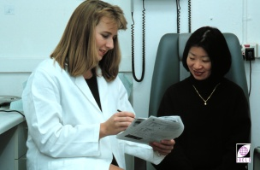
接待
Notes:
12
12

Slide 51
接待: 关键要素
积极倾听 (当回答时可重复回答)
给患者最真切的兴趣和关心
避免封闭式问题（即只回答是否）
例如，“你的镜片配戴得舒适吗？”
进行开放式的提问（需要更多细节反馈）
“可以描述一下你在工作日不同时间的戴镜感受吗？”
Notes:
12
12
The Interview - Developing the Skills
Good interviewing skills can be developed. Being a good listener & showing genuine interest & concern are the key elements of conducting a good interview. There are a number of ways in which a good interview can be conducted by the practitioner or clinical assistant:
Prepare a list of all the essential issues, questions, & other information which need to be raised with the patient
Ensure the record card’s design facilitates easy recording & has enough space for comments
To aid patient openness, the introduction should be casual, unhurried ,& aimed at putting the patient at ease prior to the interview proper commencing. Keen observation skills may provide clues to issues (e.g. the condition of the CL case) that should be raised subsequently
Adjust the terminology used to suit the patient
Photographs, illustrations, & diagrams (often available from optical/CL manufacturers) are useful in helping patients describe a transient symptom or observation they may have made.

Slide 52
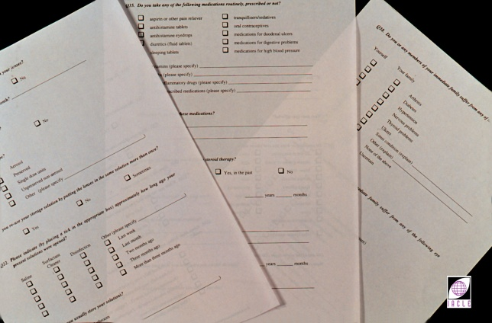
接待
Notes:
12
12
The Interview
The interview proper should encompass most or all of the following:
Wearing time on the day of consultation as well as the ‘usual’ wearing time
Patient’s impression of their:
CL comfort
vision quality
eye health
general health.
Medications, allergies, etc. which may be relevant
A discussion of expected & abnormal adaptive symptoms
CL care products used, the frequency of their use, & the apparent level of patient compliance with CL care instructions. Are the recommended CL care products being used? If protein remover has been prescribed, is it being used & in the manner recommended?
Age(s) of the CLs. How do the reported figures fit with the replacement schedule (if any)?
Competence at insertion & removal (claimed or demonstrated).

Slide 53
复查步骤
戴镜
如果镜片未被戴来复查，检测结果的意义不大，因为戴镜时间不足
未戴镜
Notes:
12
12
After-Care Examination Procedures
Where there is no apparent contra-indication, patients should be advised to wear their CLs when they attend after-care visits. This allows the practitioner to make an evaluation of the CLs in situ after several hours of CL wear. If patients are having difficulties wearing &/or adapting to their CLs they should not be coerced into wearing them to the after-care visit in case there is a serious underlying cause for the difficulty. Under such circumstances, the patient should present their CLs for inspection before insertion is attempted. It is useful to ascertain whether the problem is unilateral or bilateral.
Differences in fitting, vision, & comfort between the after-care & dispensing visits should be carefully noted. Any significant difference is reason to suspect the existence of a problem arising during the adaptation period, e.g. corneal curvature changes, alterations in CL fit (see Unit 5.4, & Dormon-Brailsford, 1974).
A standard protocol for an after-care examination might include all or most of the following. Where possible, findings should be recorded diagrammatically.

Slide 54
复查步骤: 戴镜
视力
视网膜检影 (视网膜反光的规律性及质量)
角膜前表面曲率计检查(FSK)
戴镜表现
裂隙灯显微镜检查
镜片完整性
荧光素染色配适 (RGP)
Notes:
12
12
With CLs ON
Visual acuity. Monocularly & binocularly.
Retinoscopy & over-refraction. The latter can be either a best-sphere result or a full sphero-cylindrical subjective. The result recorded should mirror a balanced binocular refraction.
Front Surface Keratometry (FSK or Over-keratometry). The flexure of an GP CL in situ can be ascertained by a keratometer (ophthalmometer) or a videokeratoscope/topographer. With SCLs, a qualitative assessment of their fitting behaviour can be also be made with a keratometer by noting the quality of the instrument mires reflected by the pre-lens tear film (PreLTF). Behavioural changes ← blinking are also important.
CL behaviour in situ, regardless of CL type should be assessed. Rest position, lag in straight ahead & up-gaze eye positions, & effects of a blink should all be observed & recorded (diagrammatically if possible).
Biomicroscopy (see Unit 4.5). With the CLs in place, the slit-lamp can be used to study any obvious effects the CLs have on:
Limbal vessels
The conjunctiva under the CLs, especially at their edges
The lids & the lid margins.
In the case of GPs, their physical relationship with the CL edges.
The PreLTF, its BUT & any distinguishing characteristics such as repeatable dry spots, mucoid floaters, & particulate matter
The PLTF.
Evaluation of the anterior eye proper is best performed with the CL off.
CL integrity. Seeking evidence of CL damage & assessing CL condition is a routine pursuit which ↑ in importance when discomfort or irritation is reported.
In the case of GP CLs, the fluorescein pattern could also be assessed & the findings recorded diagrammatically. Some practitioners prefer to use a Burton lamp to assess the fluorescein fitting pattern. However, the spectral transmission characteristics of some GP CL materials render the Burton lamp approach impossible.
Photograph appearances of interest. A file tracking system will be required if images are to be matched to the relevant patient file.

Slide 55
复查步骤: 不戴镜
裂隙灯显微镜检查
曲率计检测
视网膜检影 (视网膜反光的规律性 [眼屈光])
镜片核实
镜片离体检查
其他必要的检查
Notes:
12
12
With CLs OFF
Slit-lamp
Keratometry, videokeratoscopy/topography
Retinoscopy
Refraction, monocular & binocular
Lens verification. Confirm the CL to be what was originally delivered. With stock CLs, this is often a matter of simply inspecting & confirming the CL markings & measuring the BVP. Rigid CLs require considerable more effort because of the greater number of key parameters, e.g. BOZR, TD, BVP, BOZD, etc.
Inspection of the CLs in vitro. This step is more important when the symptomatology suggests CL condition as a possible cause of wearer discomfort.
Other tests as appropriate.

Slide 56
复查检测: 戴镜 - 视力
未报告问题
主诉有些模糊
模糊开始的时间的条件
频率
视觉质量
Notes:
12
12
With CLs ON: Visual Acuity
VA testing should be performed monocularly & binocularly, at both distance & near, regardless of the complaints (if any) presented by the patient. When complaints about vision are made, other issues which might be investigated include:
Onset of blur (time & condition)
Blur that occurs in the morning may be ← excessive lacrimation upon insertion, or in the case of EW patients, corneal swelling, mucus, etc. Blurring during the day may be due to dehydration (SCLs) especially when exposed to drying from wind, air conditioning, room heating, etc. Rigid CL wearers may experience blurring from excessive movement or decentration. Ghost images (flare) may be seen when excessive CL decentration causes the transition zones to encroach onto the pupil area
Frequency of blur (fluctuating, intermittent, consistent)
Quality of blur (haziness, distortion, etc.). Corneal oedema & incorrect BVP blur vision in characteristic ways. Similarly, toric CL axis mislocation will also affect vision quality adversely.

Slide 57
复查检测: 戴镜 – 片上验光
视网膜检影
主觉验光
电脑验光仪
考虑双眼视问题
Notes:
12
12
With CLs ON: Over-Refraction & Retinoscopy
Retinoscopy & refraction over CLs → measures of the accuracy of the BVP prescribed. When the subjective refraction is inconsistent or inconclusive, an autorefractor, or even a retinoscope, may provide additional information. Further, an autorefractor is invaluable when examining children, the elderly, & patients with speech or hearing impairments.
When a ∆ between the subjective & objective results is found, the possible involvement of binocular issues should be suspected. In this circumstance, the final Rx issued may require clinical judgement & a measure of experience.

Slide 58
复查检测: 戴镜
角膜前表面曲率计(FSK)
镜片弯曲
残余散光
更厚的镜片
GP (Dk/t)?
散光镜片
RGP & SCL
Notes:
12
12
With CLs ON: Front Surface Keratometry/Photokeratoscopy
Front surface keratometry (FSK, keratometry of the front surface of CLs or over-keratometry) is conducted to determine how much corneal astigmatism is translated to the front surface of an GP CL in situ. While CL flexure also occurs with SCLs, modern SCLs translate almost all corneal astigmatism to the front surface. Consequently, little useful information can be gleaned from FSK measurement.
GP CL flexure can be ↓ by ↑ CL thickness. However, this will also reduce O₂ transmissibility.
Other options are:
A more rigid CL material of the same thickness & Dk (or even higher).
A thicker CL with a higher Dk material to maintain CL transmissibility.

Slide 59
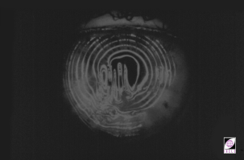
复查检测: 戴镜
FSK
Notes:
12
12
Surface contamination may also result in irregular surface keratometry (by rendering the reflecting surface irregular) & blurred vision. Similarly, wrinkling of SCLs can be seen as a distortion of mire images during keratometry & photokeratoscopy.

Slide 60
复查检测: 戴镜表现
镜片中心定位及角膜覆盖率
镜片活动度
角膜匹配 (RGP; 荧光素染色)
Notes:
12
12
Methods of assessment Rigid & SCLs are reported in lectures B3 & B4 respectively.
SCLs should be assessed in terms of:
Centration
Position & movement on blink with eye in:
primary position
lateral gaze
up-gaze
rapid & extreme lateral eye movements
Lower lid push-up test in primary gaze
Edge condition
Centration & Movement of SCLs can be assess according to (Wolffsohn JS, Hunt OA, Basra AK. Simplified recording of soft CL fit. CLAE 2009; 32: 37–42) on 3 parameters classified on a 3 step scale:
Movement on blink in up-gaze=B B⁺ = >0.5 mm, B⁰ = 0.25–0.50 mm, B– = <0.25 mm
Push Up=P P⁺ = >4 mm/s, P⁰ = 2–4 mm/s, P–= <2 mm/s
Lag on horizontal excursions (nasal & temporal)=L L⁺ = >1.0 mm, L⁰ = 0.5–1.0 mm, L– = <0.5 mm
GP should be assessed in terms of:
Dynamic fitting
position
movement
Static fitting
lens to cornea relationship

Slide 61
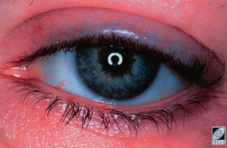
瞬目质量评价
复查检测: 戴镜
Notes:
12
12
With CLs ON: Blink Evaluation
Alterations to a wearer’s blink pattern & palpebral aperture are common, especially with GP CLs. GP CL wearers tend to ↑ blink frequency, an effect that is ↓ common with SCLs. Several investigators (Sheldon et al., 1979; Molinari, 1983. Fonn & Holden, 1986; Fonn & Holden, 1988) have also reported the development of a partial lid ptosis over time with rigid CL wearers (slide shows partial ptosis with some upper lid swelling).
Although excessive blinking does not have any serious adverse effects, it can → feelings of fatigue.
The completeness of a blink also needs to be assessed. It is of particular importance when band-like deposit patterns are observed on the front surface of CLs. Blink completeness is particularly important to wearers of toric SCLs. Toric SCLs worn by an incomplete blinker will eventually exhibit a band-shaped deposit which delineates the ‘gap’ between lids when the lids are ‘closed’ (incompletely) during a blink.

Slide 62
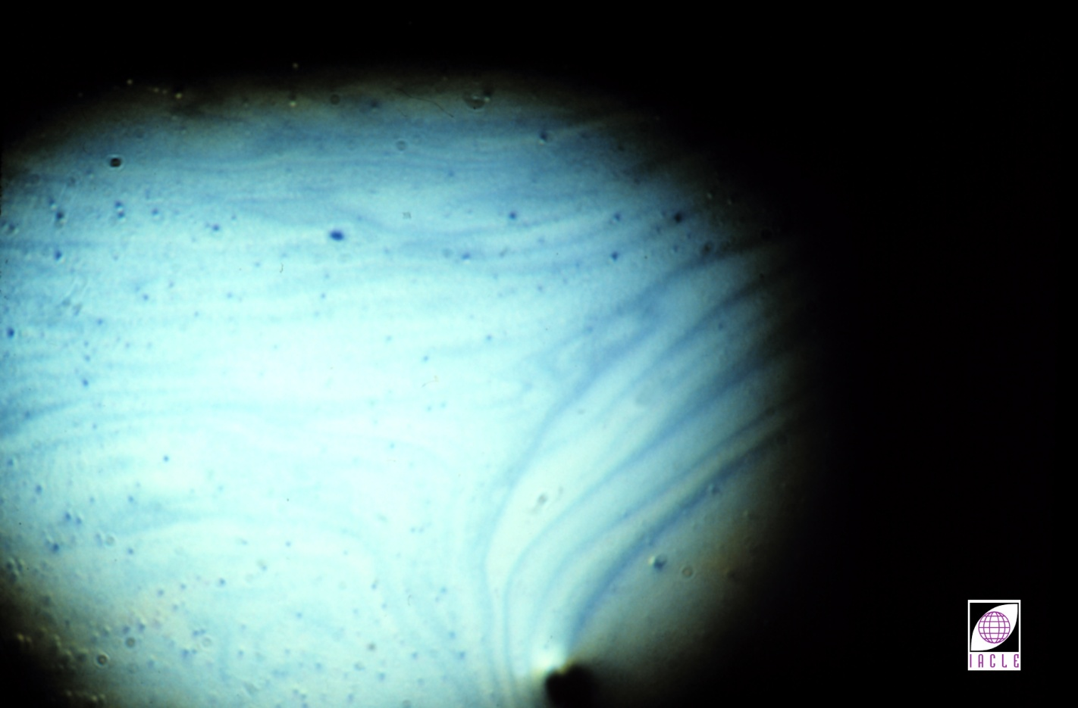
泪液质量评价
复查检测: 戴镜
Notes:
12
12
With CLs ON: Tear Evaluation
The tear film is examined to determine its stability, surface characteristics including flow, colour fringing & particulate matter, & overall appearance. If CL wear → tear film instability, the use of viscosity-enhancing eyedrops may help, at least temporarily. An examination of the tear film’s lipid layer during CL wear may show it has thinned & demonstrates a stable flow pattern…

Slide 63
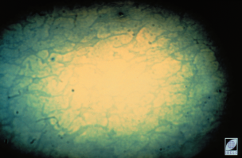
泪液质量评价
复查检测:戴镜
Notes:
12
12
or even a non-mixing & unstable open meshwork. This suggests ↑ evaporation as a possible cause of dryness symptoms.

Slide 64
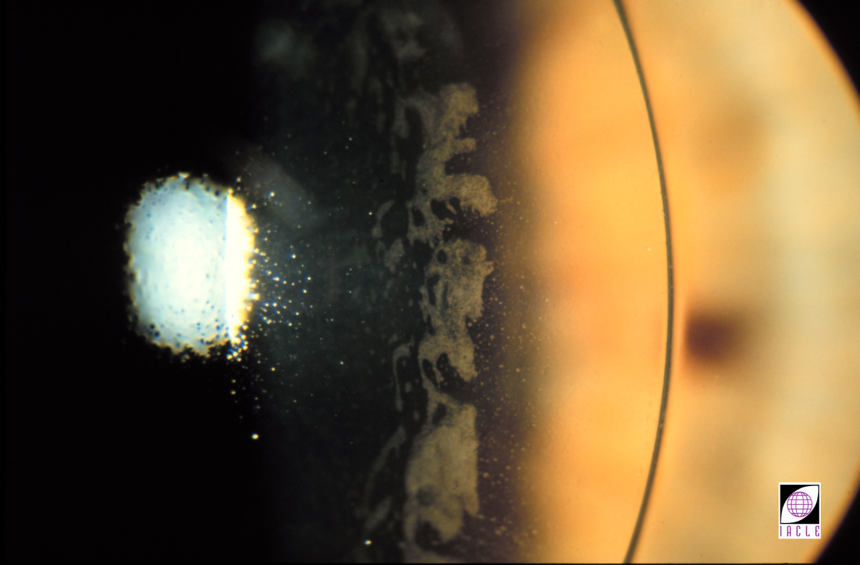
复查检测:戴镜
泪液质量评价
Notes:
12
12
With GP CLs, retention of fluorescein-stained post-lens tears for many minutes suggests a low tear exchange rate (or even stagnation). This indicates that the CL/cornea relationship needs to be ↕. Either the BOZR needs to be flattened or the back surface design ↕ (peripheral & edge curves made flatter) or both. Trapped PLTF debris is usually indicative of a tight fitting CL.

Slide 65
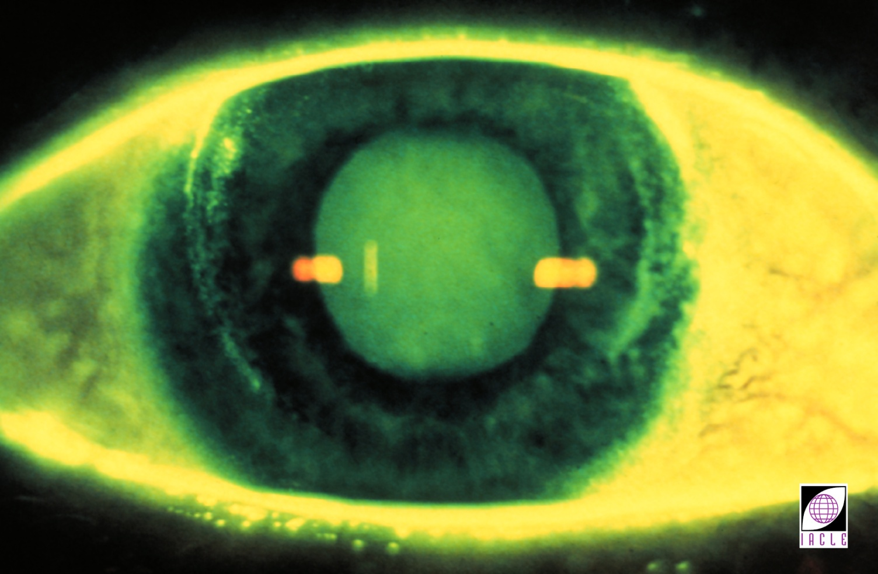
复查检测: 不戴镜
裂隙灯显微镜检查
Notes:
12
12
With CLs OFF: Slit-Lamp Biomicroscopy
Biomicroscopy is probably the most important part of an after-care visit because it facilitates an objective determination of any corneal insult resulting from CL wear.
Fluorescein is instilled into the anterior eye to disclose any tissue damage. Tissue damage is seen as yellow fluorescing areas which may vary in size from punctate (point-like) to significant areas of apparently sheet-like (continuous) staining. Generally, areas of damage, regardless of size, are referred to simply as ‘staining’ whether viewed in white or blue light. The type of staining is often characteristic of its aetiology, e.g. adherent GP CLs produce corneal indentations seen as ‘compression rings.’
NOTE: Fit assessment is covered in Module B (Lectures B1 to B9)

Slide 66
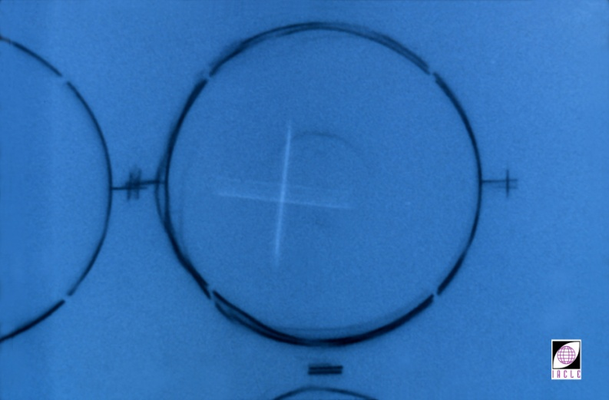
复查检测: 不戴镜
曲率检测
Notes:
12
12
With CLs OFF: Keratometry/Videokeratoscopy, Photokeratoscopy, Topography
Keratometry, videokeratoscopy, photokeratoscopy, topography should be performed routinely after CL removal. If significant ∆s in CL fit were evident from the fluorescein pattern, either the corneal curvature, CL shape, or both have changed. The cause(s) need to be determined. While corneal curvature ∆s are now uncommon, the practitioner needs to confirm any variations noted & try to determine whether they are CL-induced or not. Corneal mapping systems cover much more of the corneal area than keratometers (only approximately the central 3 mm) & may provide more useful information. The clarity of mire images should be noted. Where corneal distortion is apparent, some level of ‘spectacle blur’ or vision decrement can be expected, & this should be investigated during refraction. This slide shows mire image distortion indicative of CL effects on corneal surface shape.

Slide 67
复查检测: 不戴镜- 屈光检查
比较基础数据与复查数据
考虑: - 角膜前表面曲率测量结果 (镜片弯曲)
- 戴镜验光
- 曲率检测 (原始数据)
- 曲率检测 (不戴镜数据)
Notes:
12
12
With CLs OFF: Retinoscopy & Refraction
Retinoscopy, subjective refraction, &/or autorefraction without CLs may provide some insight into the effects of CL wear on the eye. Data acquired at the after-care visit is compared with the baseline results found during the preliminary examination. Over-Rx data, particularly any residual astigmatism, also needs to be considered when comparing baseline & without-CL results.
Especially in the case of GP CLs where astigmatism may be corneal & internal, the analysis of results can be complex & may require a good working knowledge of CL optics (A3). This is more so if FSK results also show in situ CL flexure. The cause of discrepancies needs to be ascertained.
If the best spectacle acuity after CL removal is ↓, i.e. ‘spectacle blur’, & corneal distortion or warpage is suggested by keratometry, it is likely that the CLs need to be altered to ↓ their untoward effect on the cornea.

Slide 68
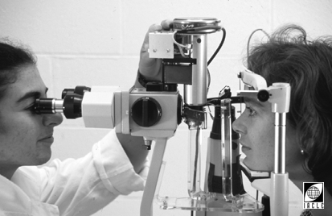
光学测厚仪
复查检测: 不戴镜– 其他检查
Notes:
12
12
With CLs OFF: Other Tests
The following additional tests may be useful (if the equipment necessary is available). As with the preceding tests, findings should be compared with the preliminary (baseline) data:
Pachometry

Slide 69
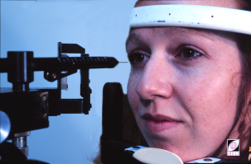
复查检测: 不戴镜– 其他检查
感觉测量仪 (Cochet-Bonnet)
Notes:
12
12
Corneal sensitivity (e.g. Cochet-Bonnet aesthesiometry)
Tear film assessment
CL parameter verification
CL inspection in vitro
Other tests may be required on an ‘as & when required’ basis. Selection may require clinical judgement & some experience.

Slide 70
镜片护理及保养回顾
镜片操作
护理液使用
卫生状况
补充指导
Notes:
12
12
Review of CL Care & Maintenance
While a comprehensive CL care review need not be conducted at every after-care visit, take the opportunity to review the issues & re-educate as necessary, regardless of the patient’s experience. Aspects of the care regimen that may need reinforcement can usually be determined easily during the interview. Obvious clues, e.g. a dirty CL case, should be noted & the matter pursued when appropriate.
Care & maintenance is discussed in Module C (Lectures C1 to C4).
In this section, care & maintenance will be reviewed:

Slide 71
镜片操作
保证安全以及熟练
保证正确的镜片清理及消毒
用适合患者的方式，鼓励其提高依从性
Notes:
12
12
CL Handling
By the time patients return to the clinic for their 1st after-care visit, they should be capable CL handlers. Individual techniques may have been developed & the practitioner should evaluate the safety of the methods employed. The need for additional aids, such as a CL applicator or mirror, is usually apparent quite early.
Initiate a conversation about proper cleaning & disinfection by asking, ‘What difficulties have you encountered with the cleaning procedure?’ Avoid questions requiring simple YES or NO answers (i.e. closed probing), e.g. ‘Do you have any difficulties cleaning your CLs?’. Patients will usually answer NO, just to avoid answering any further questions & to imply they have mastered the subject.
Alternatively, the patient may volunteer information to the practitioner or clinical assistant about which steps they are unsure of. Openness & frankness should be encouraged actively (by suggesting they be forthcoming) & passively (by the ‘style’ & friendliness of the practitioner & staff).
The approach taken, casual & relaxed or authoritarian, depends largely on an interpretation of the attitude of the patient. With careless, inattentive, reckless, or neglectful patients, a more authoritative stance may be more successful. With intelligent or professional patients, an explanation of the issues involved will probably be more successful.

Slide 72
护理液使用情况
考虑市面上其他（更新的）接触镜护理系统
将护理液考虑作引起并发症的可能原因
通过指定问题回顾接触镜的护理方法及依从性
Notes:
12
12
Solution Use & Patient Compliance
Frequently, CL wearers develop & maintain an interest in new developments in the CL field. Manufacturers of CL care products release new products regularly, & CL wearers are exposed to advertising claims of better, cheaper, & more convenient care systems. Although practitioners usually stress the importance of using the ‘prescribed’ care system, they should also be aware of new care systems being released. Their suitability for some or all CL wearers should be assessed regularly.
Unless questioned specifically, patients are usually reluctant to inform the practitioner of changes they have initiated. An investigation of the care system should be instigated if problems arise that are apparently not CL fit-related. Patients know little about the differences between CL care products & may have used/be using solutions other than those recommended.
If a decision to use a new solution is made, the procedures to be followed should be re-taught. If there is no difference from the current system, a brief review will help reinforce compliance generally.
When determining compliance with the recommended care regimen, the following questions are relevant:
How do you clean (rub & rinse) your CLs every time you take them out?
How often do you clean your CLs (even if they are worn for EW)?
How do you keep the CL case clean?
What solutions are you using for cleaning, disinfection, & rinsing?
If protein removal is needed, is it done as frequently as recommended?
For how long are the CLs disinfected for?

Slide 73
卫生状况
个人护理
镜盒及其它配件
护理液储存及使用
Notes:
12
12
Hygiene
Commencement of CL wear often requires the adoption of an ↑ level of personal hygiene. Over time, patients will tend to revert to their old habits & standards of hygiene. Practitioners should remember that compliance is usually the exception rather than the rule. For this reason, regular education & re-education, although time-consuming, is a necessary part of CL after-care.

Slide 74
卫生: 提醒戴镜者护理液的存放和使用方法
洗手
按照指示消毒镜盒及其他配件
即时盖上镜盒盖
盒盖合于桌面放置
擦掉容器边缘多余的液滴
防止瓶口接触到皮肤、物体表面或水
Notes:
12
12
Good hygienic practices involve:
Personal care - This is perhaps the best indicator of the probable level of personal hygiene. Usually, a clean & hygienic person also applies they has a high standard of CL care & maintenance. A less hygienic person will need their behaviour modified. Generally, it is easy to distinguish between patients with good & bad hygiene.
CL case & accessories hygiene - A wide range of CL cases & accessories, made from a variety of engineering plastics, is available. Knowing the appropriate cleaning/disinfection method for a particular case or accessory is necessary but not always easy to determine. Ideally, any material that comes in contact with CLs should be able to withstand boiling (many do not unfortunately). A soiled CL case, use of an inappropriate case, & infrequent cleaning can → complications & ocular infections.

Slide 75
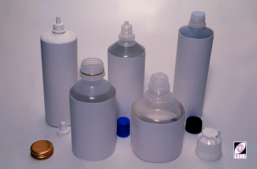
卫生状况
Notes:
12
12
Solution storage & use
In a study of microbial contamination of CL care systems (rigid & soft), Donzis et al. (1987) discovered that 50% were contaminated. Of commercial solutions, 13% were contaminated 21 days after opening & use by asymptomatic patients. Seven patient solutions were found to be contaminated by the pathogenic Bacillus sp. (Gram + bacteria) which can → endophthalmitis & corneal ulceration. Most of the micro-organisms isolated were aerobic & found to be part of the normal skin/ocular flora. These findings indicate the importance of good hygiene when using solutions. Reinforcing the advice given will help prevent microbial contamination. Two issues of importance are: Bottle caps, when unscrewed, should be placed open-face down on the table & …

Slide 76
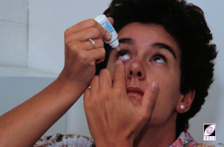
卫生状况
Notes:
12
12
Avoid letting bottle tips (dispensing nozzles, jets) touch the skin, other surfaces, or H₂O that may contain micro-organisms that can contaminate the solution ultimately .

Slide 77
补充说明
针对每位戴镜者的特殊需求
提供不同的补充说明
Notes:
12
12
Additional Instructions
Additional instructions on care & maintenance should be provided to patients in the following circumstances:
Travelling
Playing sport
Taking medication
Convalescing & having ceased CL wear
Engaged in any other activity that may necessitate a change in CL care.

Slide 78
接触镜配后护理症状学
配后护理是一个持续不断的过程
Notes:
12
12
Symptomatology in CL After-Care
Symptomatology is the study of symptoms, their development, & the indications they provide that are of assistance in identifying the disease or complication. In CL practice, symptomatology should not be limited to CL use, as conditions may arise that only become manifest as a result of CL wear, but which are not CL effects per se. The eyes are adapting continually to CLs because of minute time-dependent changes occurring in the CLs. This is why after-care is, and always will be, on-going care.

Slide 79
接触镜配后护理症状学
要问开放性问题
不要问只需回答是或否的问题
Notes:
12
12
Unscheduled visits are usually emergency cases. In such cases it may be necessary to determine priorities & the course of action(s) to be taken from the moment the patient first calls. If they have not already done so, it may be prudent for the patient to remove their CLs (if in doubt, take them out). Referral to another practitioner or an ophthalmologist may be necessary. A contingency plan for handling emergency cases should be in place in the practice for those occasions when the attending practitioner is absent or the practice is unmanned.
A systematic approach is necessary to identify correctly the cause of the symptoms so that appropriate remedial action can be taken.
The following are central to a reliable differential diagnosis:
Description of symptoms & complaints
Onset of problems
Patient compliance with recommended care regimen
Associated circumstances.

Slide 80
姓名：
日期 : / /
配后护理问诊
右 /左
频率
何时
程度
持续时长
CAUSALITY
正常情况
环境 (如空气)
异物
镜片相关
护理体系相关
其他（请解释）
仅一次
间歇发生
持续发生
镜片戴入时
戴镜期间
摘镜后
轻度
中度
中度
< 1 分钟
1-10 分钟
> 10 分钟
（请圈起来）
无
视力模糊
光晕 /闪光感
畏光
流泪
异物感
灼烧感 / 刺激
干眼
痒
红眼
异常的眼睛分泌物
镜片需要清洗
其他
Notes:
12
12
Questions that practitioners &/or clinical assistants ask the patient should be as specific as possible & should encourage descriptive responses. Patient responses can be recorded on a suitable pro forma.
Adaptive symptoms with GP CLs include:
Difficulty looking up &/or to the side
Abnormal head posture & interpalpebral aperture narrowing
Lid & eye itchiness
Photophobia & glare
Frequent blinking
Red eyes
Fluctuating vision
Haze & flare
Lid swelling
Spectacle blur (mild)
Discomfort &/or mild irritation
CLs & eyes feel dry especially towards the end of the wearing period.
Adaptive symptoms with SCLs include:
Little, if any, adaptation
↓ vision, ↕ or hazy vision
CLs & eyes feel dry, especially towards the end of the wearing period
Red eyes
CLs sting on insertion.
Non-adaptive symptoms include:
Significant discomfort
Dryness
Redness, especially if persistent
↓ vision.
In some extreme cases, CL wear may have been abandoned. The reasons for this need to be investigated thoroughly. Possible reasons include:
The need for replacement CLs
Care of CLs considered too much effort
CL insertion & removal considered too much effort
CLs &/or CL care products considered too expensive
Unwilling to tolerate adaptive symptoms
Unwilling to comply with issued instructions even minimally
Adaptive & non-adaptive symptoms after Mandell (1988). These are covered more fully in Unit 4.3.

Slide 81
症状 & 主诉
视力下降:
什么时候, 描述, 什么情况
不舒服:
什么部位, 什么时候, 描述, 什么情况
Notes:
12
12
Description of Symptoms & Complaints
Vision
Is vision blurred or distorted?
Is the visual complaint at distance or at near?
Is the visual compliant unilateral or bilateral?
Is the visual complaint intermittent, fluctuating or constant?
Were R & L CLs interchanged?
Discomfort
Is the discomfort a minor irritation, a dull ache, tenderness, or pain?
Is the discomfort described as gritty, dry, stinging, warm, or hot?
Is the pain felt in or on the eye, around ,or in the eyelids?
Is the discomfort intermittent, constant, or occasional, with & without CLs?
Is there an accompanying mucus discharge, tearing, or crust formation? Does this occur in the morning or during the day, sometimes, or all the time?
Does the discomfort occur on or soon after CL insertion, or after a number of hours of wear?
Does the discomfort ↑ over time, with CL wear, or without CL wear?

Slide 82
发病
一天的什么时候
发病的描述
是否戴镜
戴镜/摘镜的影响
Notes:
12
12
Onset of Problems
The practitioner’s task is to determine whether the cause of CL-related problems is due to:
Fitting
CL material
CL wearing time
CL wear modality
CL care system
CL parameters
A combination of the above.
The circumstances surrounding the onset of the problem may give an indication of the likely course of development:
Does it occur upon CL insertion, early in the day or later, in the afternoon or evening?
Is the onset sudden or gradual, & does it ↑ over time?
Is the discomfort felt with or without CLs, or both?

Slide 83
相关情况
环境变化
药物使用
日常作息的变化
压力
Notes:
12
12
Associated Circumstances
Are you aware of any ∆s in the environments you are exposed to (especially gas or chemical fumes) which occurred at about the time you began experiencing discomfort?
What drugs or medication have you taken lately?
What ∆s have there been to your everyday routine, habits, & lifestyle?
Can you describe any stress-related activities, if any, at work, home, or within your family?

Slide 84
依从性
不依从也许是接触镜相关问题的罪魁祸首
依从性水平分布:
0% (Yung et al., 2007)
to
60% (Chun & Weissman, 1987)
不考虑来源/作者，报道的依从性水平远远不到100%。 另外，不依从是导致微生物性角膜炎MK (e.g. Dart et al., 2008)及镜片感染 (e.g. Stapleton et al., 2007)
的风险因素
Notes:
12
12
Compliance
Non-compliance is probably the biggest single source of CL-related problems and the presence of ocular signs & symptoms during CL wear correlates with the level of compliance (e.g. Collins & Carney, 1986).
Despite the best efforts of practitioners, the compliance level (adherence to instructions issued) of many CL wearers leaves much to be desired. Many studies have shown compliance levels between 0% (all subjects showed degree of non-compliance - Yung et al., 2007), 26% (Collins & Carney, 1986A) & 60% (Chun & Weissman, 1987). The CL industry responds to needs & has → products that, when used correctly, can generally be expected to result in trouble-free CL wear. If products are misused, or not used at all, their performance can be expected to be suboptimal & the complication rate for CL wear will be higher. This has already been shown by Collins & Carney (1986B).

Slide 85
依从性
由不同无依从性行为导致的接触镜相关感染相对风险 (Morgan et al., 2011)
手未洗干净 1.5/4.5
超出处方范围的过夜戴镜 4.0
长戴型镜片配戴过久 6.7
镜片更换周期过长 4.8
镜盒未洗干净 4.0
未使用正确的消毒液 21.8/55.9
未揉搓并冲洗镜片 3.5
护理液瓶盖朝上或未盖 2.5
Notes:
85
Morgan P et al., 2011. An international analysis of CL compliance. CL & Ant Eye. 34: 223 – 228

Slide 86
成功配戴接触镜的条件
Notes:
12
12
Success Criteria for Soft & Rigid CL Wear
This section presents criteria for DW & EW CL success based largely on the standards of the CCLRU (Cornea & CL Research Unit, School of Optometry, The University of New South Wales [now disbanded]). These in turn are an update/revision of the success standards outlined by Sarver & Harris in 1971 (Terry et al., 1993).
Successful DW is a prerequisite of the commencement of an EW schedule.

Slide 87
成功配戴接触镜的条件: 戴镜时长
日戴DW
≥5 天/周，戴镜时间为12小时/天
长戴EW
≥ 6晚连续戴镜
Notes:
12
12

Slide 88
成功配戴接触镜的条件: 舒适度
软镜应该戴入之后即刻舒适，并在整个戴镜期间持续保持舒适
RGP配戴初期会有不适感，在戴镜一个月之后应感觉舒适
Notes:
12
12
Comfort
Wearer comfort is probably the most important criterion for success. CLs should not → irritation or discomfort & any discomfort should be alleviated promptly by simple measures.
SCL patients must report the CL being comfortable immediately after insertion. GP CLs, which usually offer less initial comfort, may require up to 1 month of adaptation before providing the same level of comfort as SCLs.
Convenience
The CL care & maintenance required by the patient should be minimized where possible.

Slide 89
成功配戴接触镜的条件: 视力/视觉质量
≥惯用框架眼镜的视力
Notes:
12
12
Vision/VA
VA with CLs should be = to, or >, the habitual spectacle VA on both low & high contrast acuity charts.
CLs should not → any significant blur, ↕ in vision, haloes, or flare.

Slide 90
成功配戴接触镜的条件: EW眼部组织变化
缺氧:
微囊: ≤ 10
微泡: ≤ 10
条纹: 1(<1 hour)
皱褶: None
Notes:
12
12
Ocular Tissue Changes
Hypoxia
Overnight corneal oedema, & the resultant corneal swelling, are the best indicators of EW hypoxic stress. Hypoxia is also implicated in the development of microcysts, vacuoles, striae, & black lines/folds. These signs should not normally be present in DW. Microcysts & vacuoles can occur over time with both wear modalities & should not exceed 10 for either mode.
Stromal striae indicate a corneal swelling of 5% or more, while folds indicate 8% or more. Overnight corneal oedema occurs with EW but should be followed by rapid deswelling (thinning). Striae seen 1 hour after eye opening is indicative of overnight corneal swelling of 5 to 6%.
When overnight corneal oedema is high or deswelling is slow, appropriate action should be taken to provide ↑ corneal oxygenation by ∆s to 1 or more of the following:
CL material
Cl design
CL wearing schedule.

Slide 91
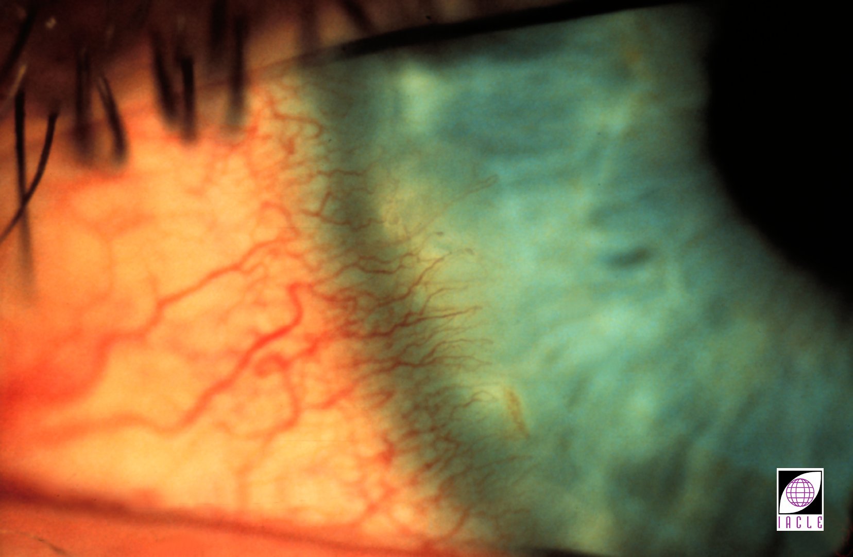
成功配戴接触镜的条件
Notes:
12
12
Ocular Tissue Changes
Corneal Vascularization
New vessel growth into the cornea is indicative of corneal stress & a shortage of metabolic nutrients, especially O₂ . Limbal vessel growth is observed more amongst wearers of thick, low water, hydrogel CLs than GP CLs or thin hydrogel CLs.
New vessel growth should not exceed 0.5 mm beyond the corneo-limbal transition zone in any part of the corneal circumference.

Slide 92
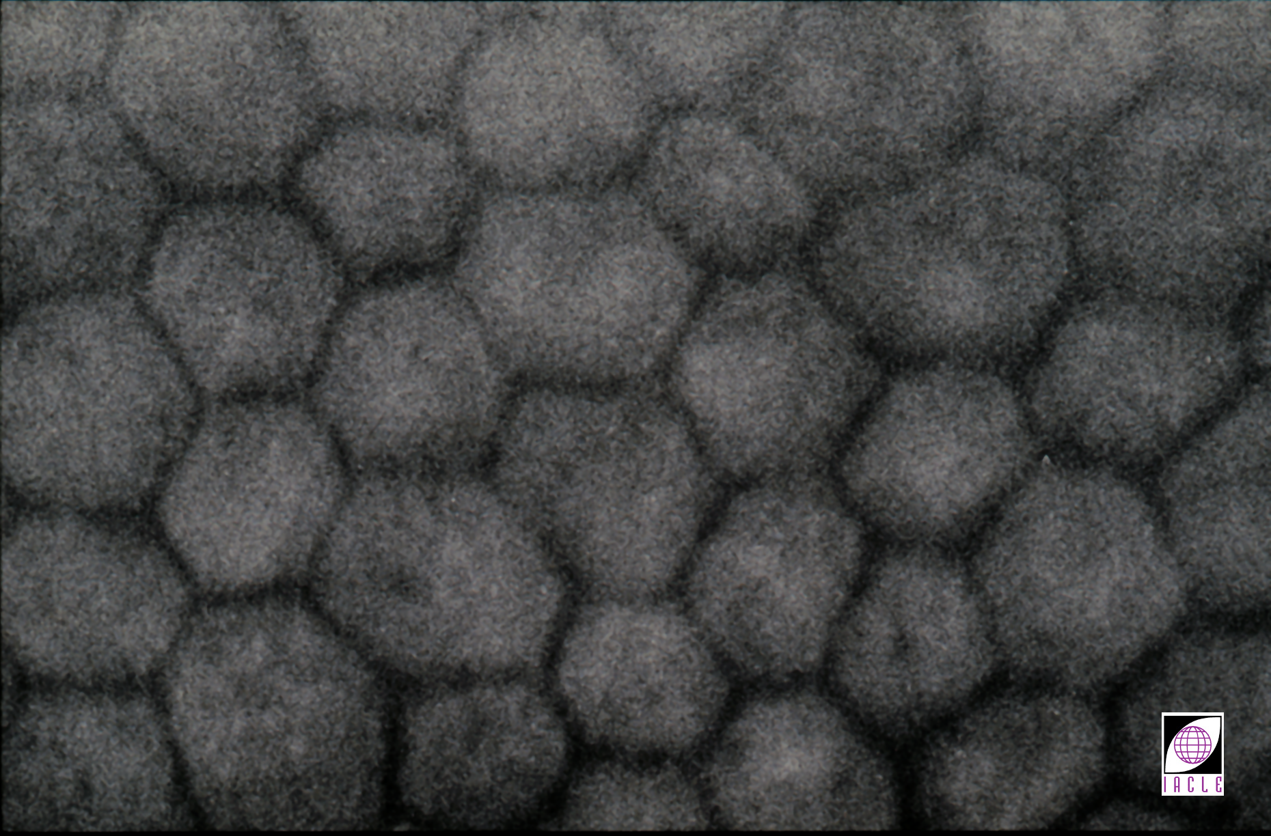
成功配戴接触镜的条件
Notes:
12
12
Ocular Tissue Changes
Endothelial Polymegethism
The degree of polymegethism can be graded with a slit-lamp & an ↑ due to CL wear of greater than 1 grade is unacceptable.

Slide 93
成功配戴接触镜的条件: 最小曲率变化
水平: ≤ 0.50 D
垂直: ≤ 0.75 D
Notes:
12
12
Corneal Curvature & Refractive Error Changes
Corneal curvature changes in the principal meridians should not exceed 0.50 D (horizontal) & 0.75 D (vertical). They may be ← mechanical molding or corneal oedema especially in the vertical meridian & can → ↓ corneal toricity.
Low Dk/t CLs can → corneal distortion & warpage which indicate the need to ↕ the CLs to ones of a more suitable material or design.

Slide 94
成功配戴接触镜的条件: 可接受的染色等级
种类: ≤ 2
深度: ≤ 1
程度: 少量角膜点染
Notes:
12
12
Corneal Staining with Fluorescein
Corneal staining occurs when there is epithelial cell damage or loss, allowing instilled fluorescein to penetrate the cells or the space that was occupied by lost cells. Cell loss or damage can → localized stromal oedema & ↑ risk of infection. If the damage is severe enough, sub-epithelial spreading of fluorescein can → a diffuse ‘halo’ as a backdrop to the better defined area of damage.
Using the following scale, persistent staining of the cornea should not be more than grade 2 for type & grade 1 for depth:
Grading of the Corneal staining:
The other 2 variables in the CCLRU system are depth & extent of staining.
If there is no staining, the depth is graded as 0
Superficial epithelial involvement is Grade 1
The presence of a stromal glow within 30 seconds is Grade 2
An immediate localized stromal glow is Grade 3
An immediate diffuse stromal glow is Grade 4.
If there is no staining, the extent is graded as 0
From 1 to 15% of surface involvement is Grade 1,
16 to 30% surface involvement is Grade 2
31 to 45% surface involvement is Grade 3
≥46% surface involvement is Grade 4.

Slide 95
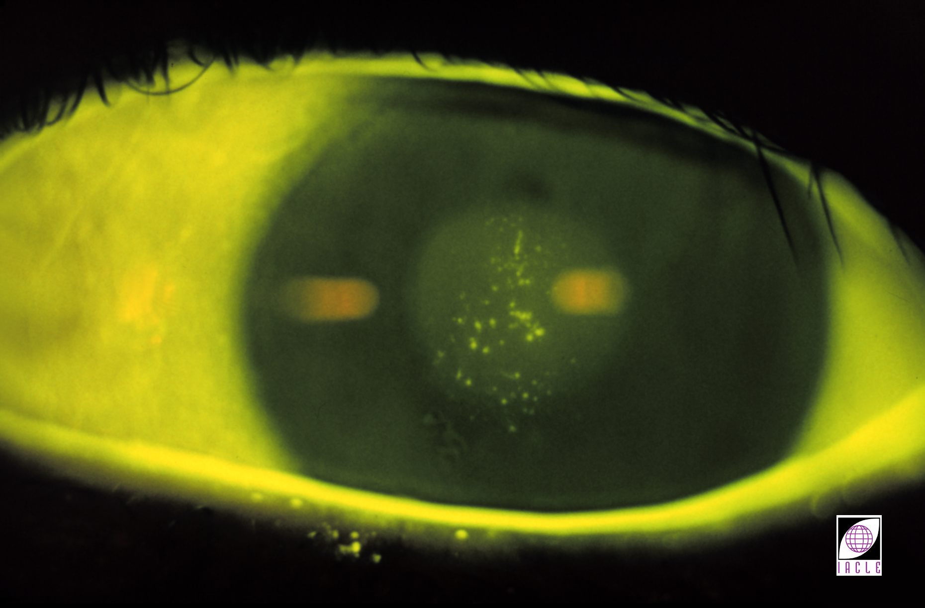
成功配戴接触镜的条件: 染色 - 种类
Notes:
12
12
Staining Type
0 Absent
1 Micropunctate
2 Macropunctate
3 Coalescent macropunctate
4 Patch

Slide 96
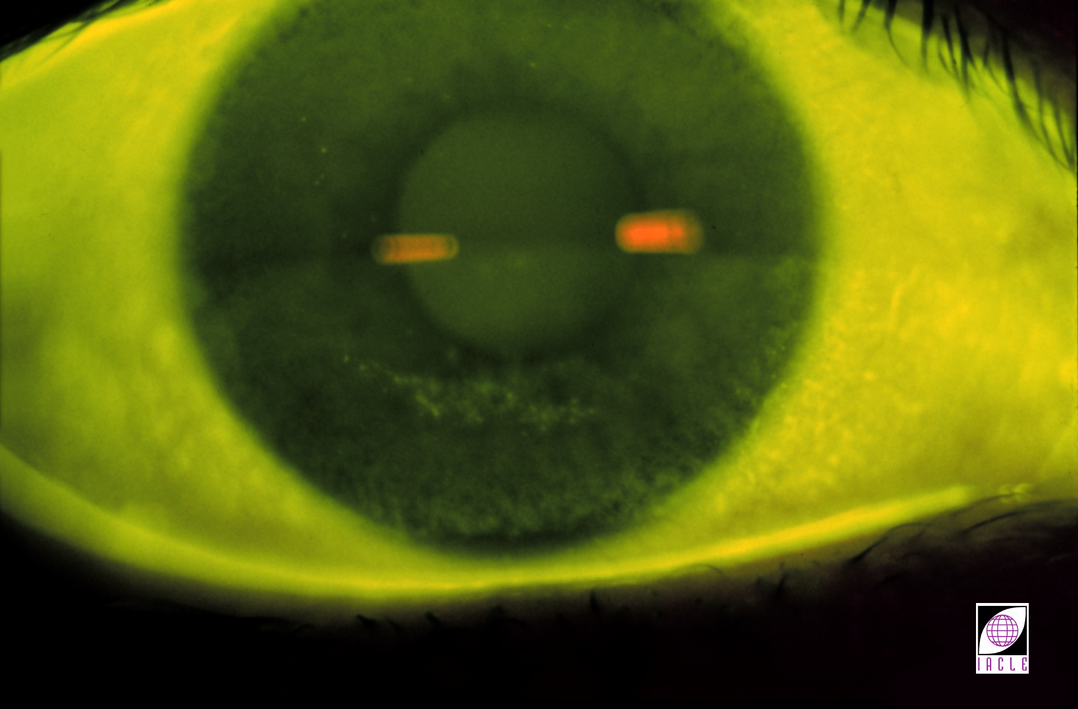
成功配戴接触镜的条件: 染色 - 深度
Notes:
12
12
Depth
0 Absent
1 Superficial epithelial involvement
2 Stromal glow present within 30 seconds
3 Immediate localized glow
4 Immediate diffuse stromal glow
Extent
It is difficult to estimate accurately the area of the cornea stained with fluorescein. Perhaps a Nil, Mild, Moderate & Severe grading system is appropriate. Even moderate involvement should be regarded as undesirable & steps taken immediately to prevent any continuation or reoccurrence of the staining.

Slide 97
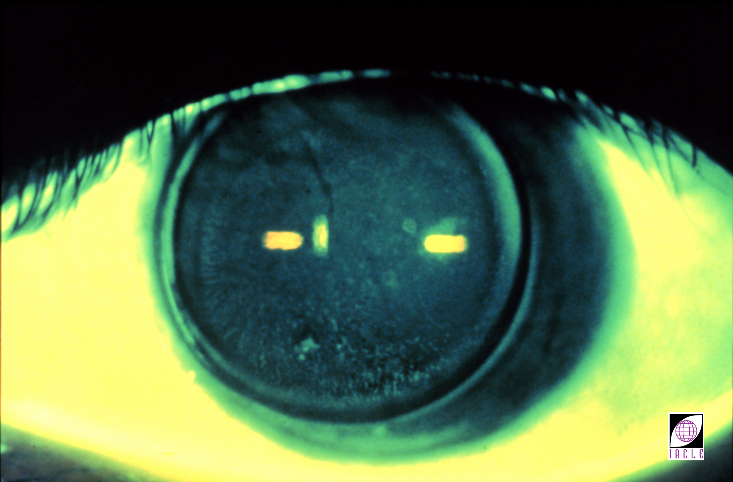
成功配戴接触镜的条件: 镜片粘附
Notes:
12
12
CL Adherence
As discussed previously, CL adherence is common among EW GP CL wearers. Persistent adherence can trap debris under the CL & provoke an inflammatory acute red eye reaction (CLARE).
This slide shows the characteristic pooling of fluorescein around the circumferential area of compression after removal of the GP CL.
CL adherence should not be observed among DW patients & should not occur persistently with EW.

Slide 98
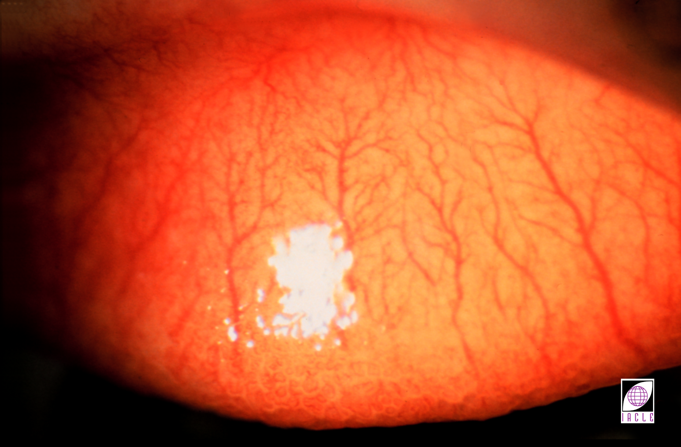
成功配戴接触镜的条件: 接触镜引起的乳头性结膜炎
Notes:
12
12
Contact Lens-induced Papillary Conjunctivitis
Persistent CLPC can develop into GPC & → significant patient discomfort resulting in discontinuation of CL wear. The upper & lower lids must be everted & examined for roughness & redness of the palpebral conjunctiva. Grading is based on a 0 (absent) to 4 (severe) scale.
There should not be more than a 1 grade ↑ in papillae.

Slide 99
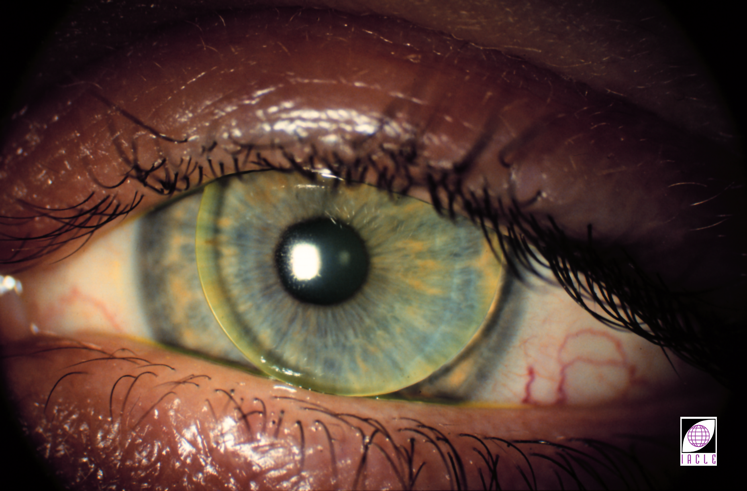
成功配戴接触镜的条件
Notes:
12
12
Patient Appearance
There should not be a significant ∆ in the overall appearance of the patient. ∆s resulting from CL wear such as excessive redness of the bulbar conjunctiva, limbus, lid margins, excessive mucus formation, ↑ blink rate, ptosis, or narrowing of the palpebral aperture should not be more than a 1 grade ↑. Blink rate & palpebral aperture are more likely to be ↕ in the case of GP CL wearers.

Slide 100
符号
↑ | 增加，提高 | { | 由…共同产生
↓ | 减少，降低 | } | 共同产生
→ | 生产，向着 | Σ | 总和
← | 从...产生，，由…引起 | ± | 加减
↔ | 没有变化，不明显 | + | 正号，加，包括，和
↑ ↑ | 明显增加 | - | 负号，减少
↓↓ | 明显减少 | ≈ | 约等于
% | 百分比 | = | 等于，与什么相同
＜ | 小于 | & | 和，以及
＞ | 大于 | x0 | 角度，例如45⁰
≥ | 大于等于 | ＠ | 在…子午线上
≤ | 小于等于 | D | 屈光度
？ | 不确定，有疑问的 | X | 例如-1.00X175 代表-1.00柱镜，轴向175⁰
n | 折射率 | △ | 棱镜度数

Slide 101
简称
μg | 微克（0.001毫克） | min | 分钟
μL | 微升（0.001毫升） | mL | 毫升（0.001升）
μm | 微米（0.001毫米） | mm | 毫米
μmol | 微摩尔 | mmol | 毫摩尔
cm | 厘米（0.01m） | mOsm | 毫渗透摩尔
d | 天，天数 | nm | 纳米（10⁻⁹m）
Endo | 内皮 | Px | 配戴者
Epi | 上皮 | Rx | 处方
h | 小时，小时数 | S | 秒，几秒
Inf. | 下面 | Sup | 上面
kg | 公斤 | t | 厚度
L | 升

Slide 102
首字母缩略词
ADP | 二磷酸腺苷 | L | 左
ATP | 三磷酸腺苷 | LE/OS | 左眼（拉丁文左眼）
ATR | 逆规 | LPS | 提上睑肌
BS | 最佳球镜 | NADPH | 还原型辅酶II
BUT | 破裂时间 | NIBUT | 非侵犯性破裂时间
CCC | 中央角膜云翳 | OO | 眼轮匝肌
CCD | 电荷耦合装置 | OU | 双眼(拉丁文）
Cf. | 与什么相比 | PD | 瞳距
CL | 接触镜 | PMMA | 聚甲基丙烯酸甲酯
Dk | 氧通透性 | R | 右眼

Slide 103
首字母缩略词
DW | 日戴 | R&L | 右&左
e.g. | 例如 | RE/OD | 右眼/右眼（拉丁文）
EW | 长戴 | RGP | 硬性透气性隐形眼镜
GAG | 黏多糖 | SCL | 软性角膜接触镜
GPC | 巨乳头性结膜炎 | TBUT | 泪膜破裂时间
HCL | 硬性隐形眼镜 | TCA | 三氯乙酸
HVID | 水平可见虹膜直径 | UV | 紫外线
i.e. | 也就是 | VVID | 垂直可见虹膜直径
K | 角膜曲率读数 | WTR | 顺规散光

Slide 104
THANK YOU
www.iacle.org

